Slide 1
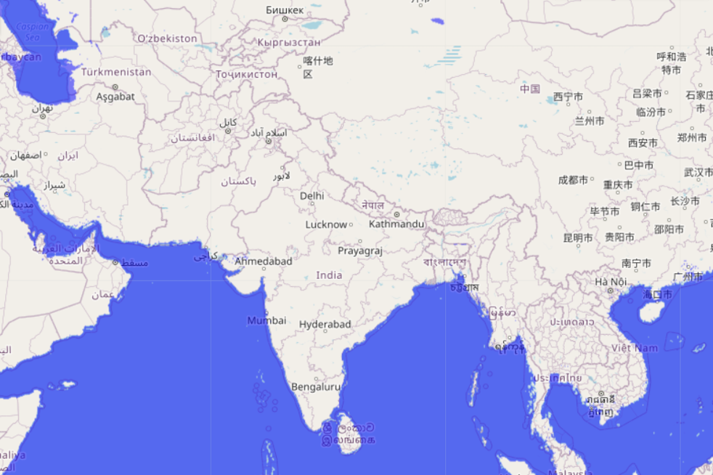
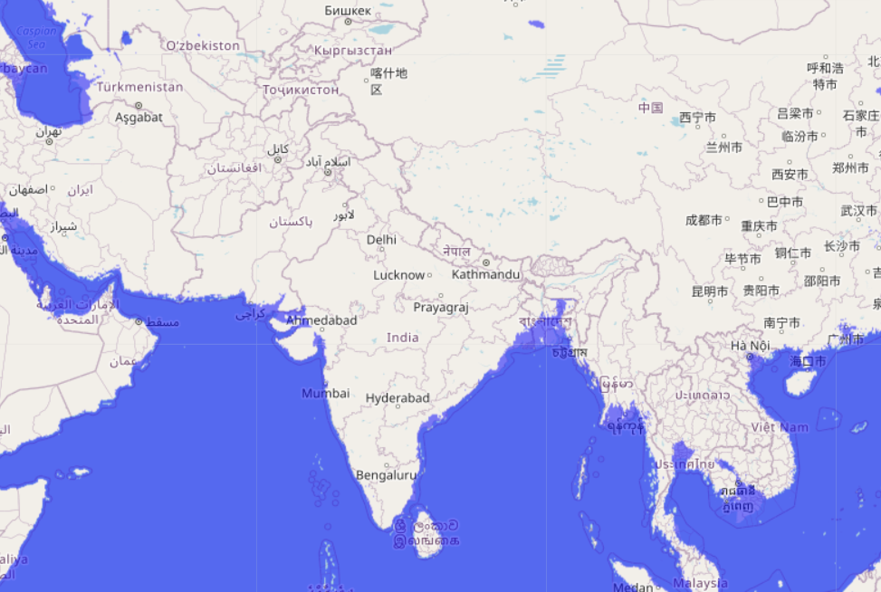
BANGLADESH

Slide 2
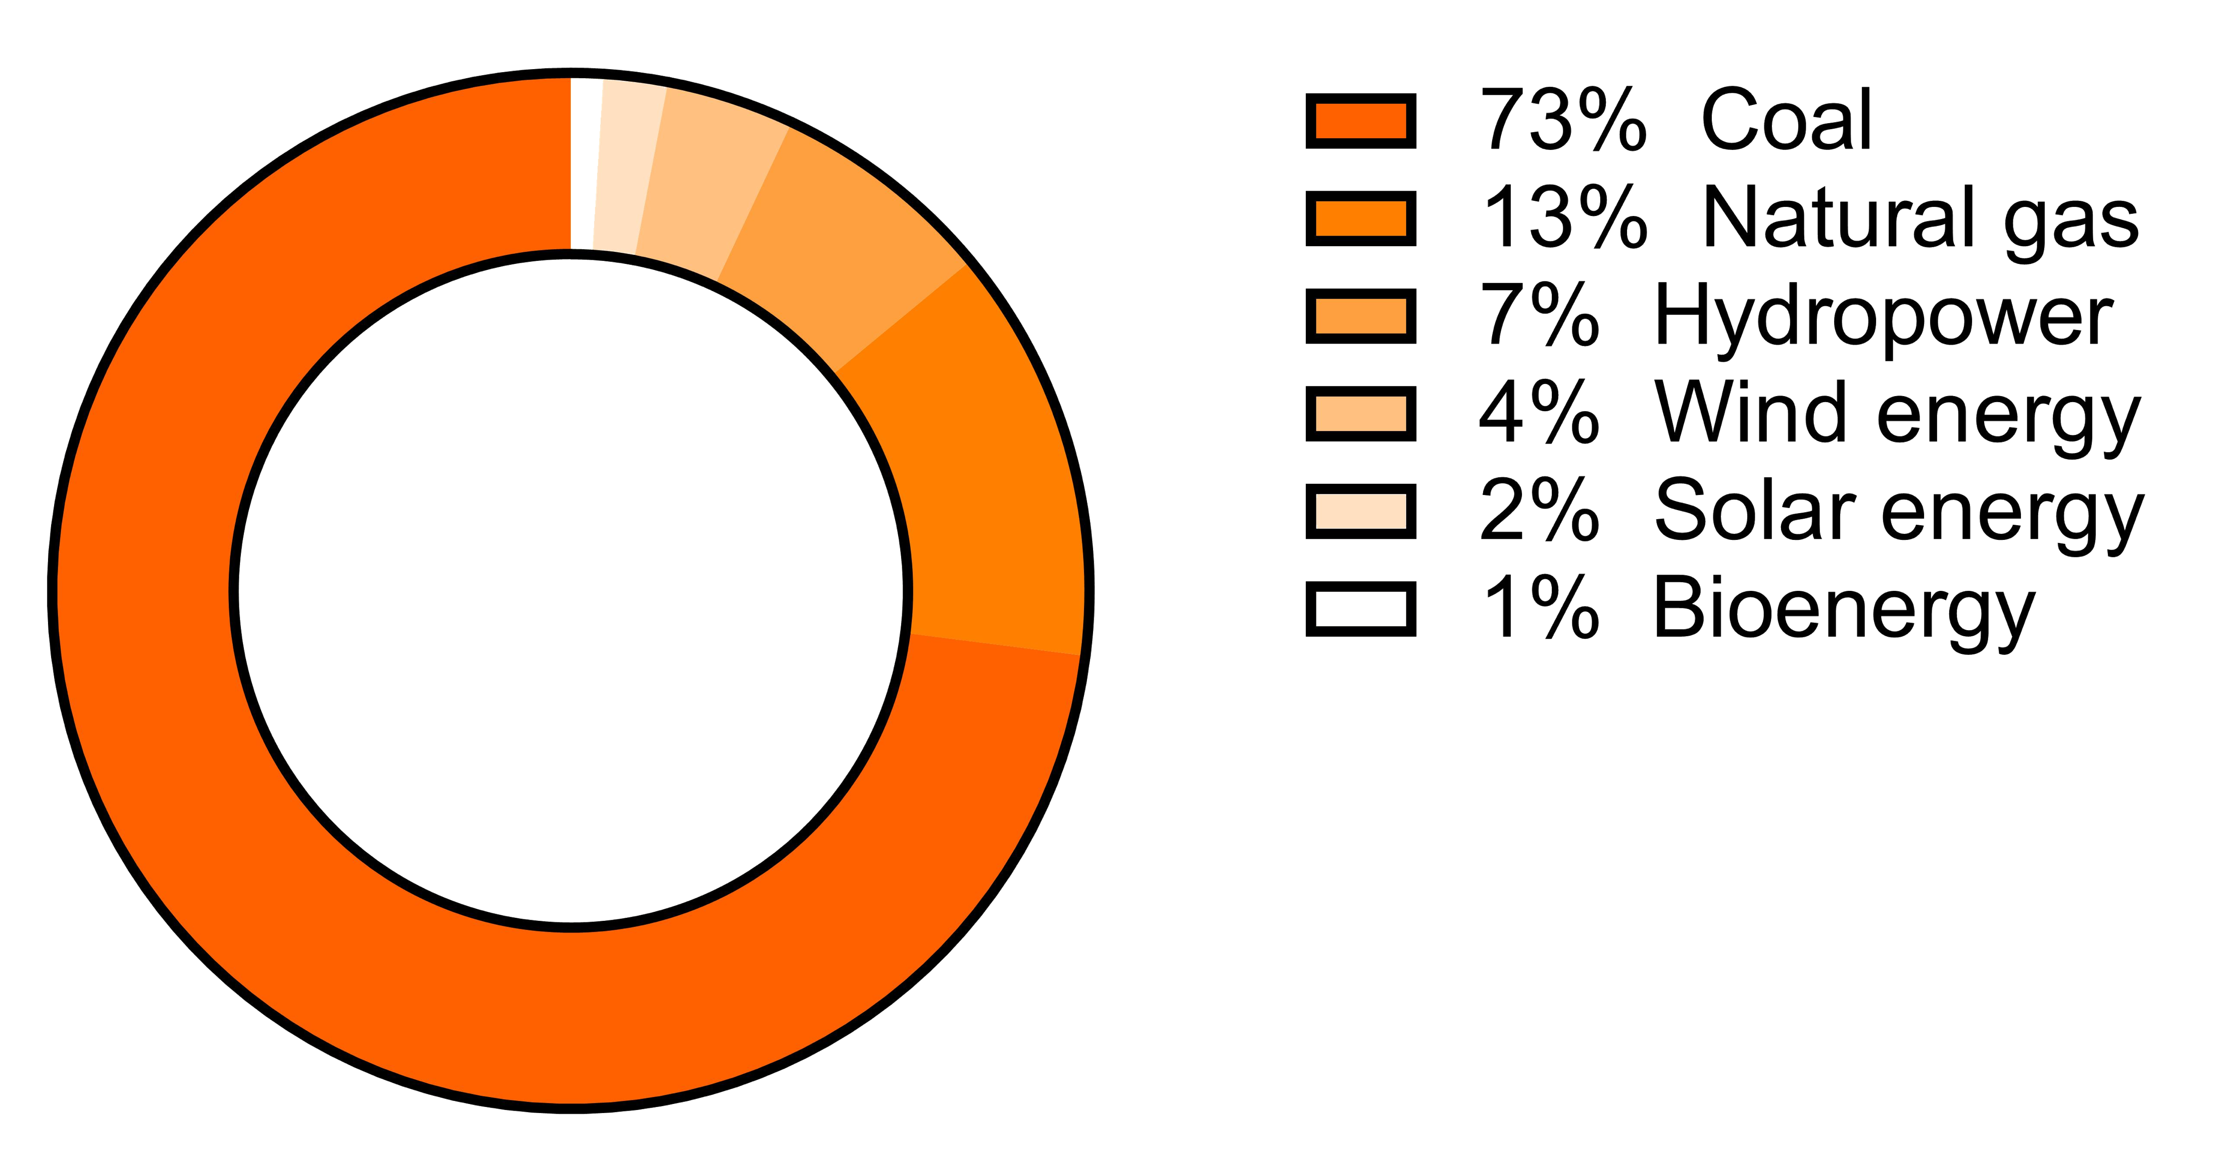
ELECTRICITY GENERATION ACROSS AUSTRALIA
RETRIEVED FROM: ORIGIN ENERGY, 2018
EXTENDED INVESTIGATION
RESEARCH PRESENTATION

Slide 3






USING MICRO-ALGAE AS A SOURCE OF ENERGY
EXTENDED INVESTIGATION
RESEARCH PRESENTATION

Slide 4

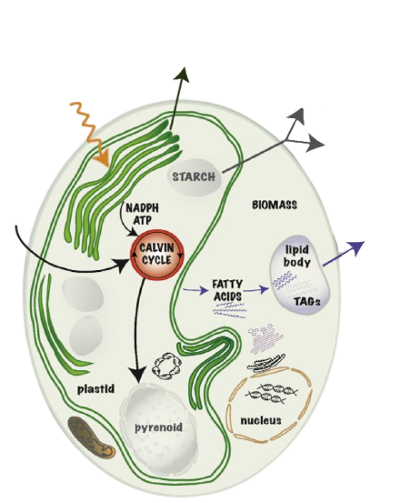
MICRO-ALGAE CULTURE
BIO - Hydrogen gas
BIO - Hydrogen gas
Ethanol
  Photosynthetic plant like organism
  Unicellular (contains only one cell)
  Aquatic species
Carbon Dioxide
EXTENDED INVESTIGATION
Biodiesel
RESEARCH PRESENTATION

Slide 5



Industrial Procedure
EXTENDED INVESTIGATION
RESEARCH PRESENTATION
Cultivation & Harvest
Micro-algae processing
Lipid Extraction

Slide 6
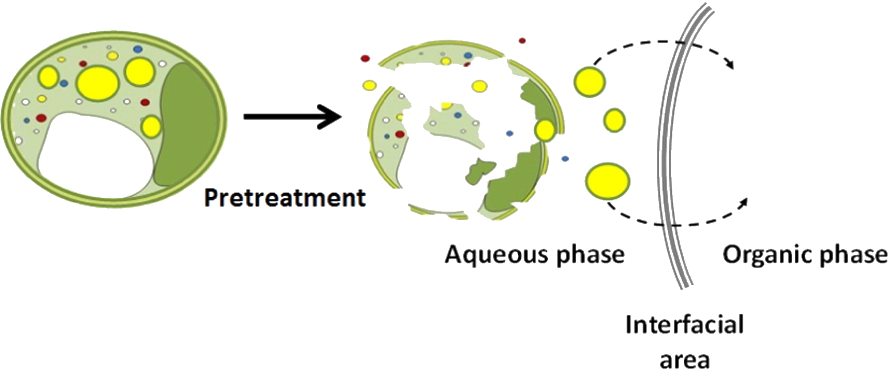
EFFECTS OF PRETREATMENT
EXTENDED INVESTIGATION
RESEARCH PRESENTATION

Slide 7

Osmotic Shock
TYPES OF
PRE-TREATMENTS
Water
EXTENDED INVESTIGATION
RESEARCH PRESENTATION
Thermal Heating

Slide 8

Which pre-treatment enhances solvent based extraction of lipids from Chlorella vulgaris: the use of Thermal Heating or Osmotic Shock?
EXTENDED INVESTIGATION
RESEARCH PRESENTATION

Slide 9
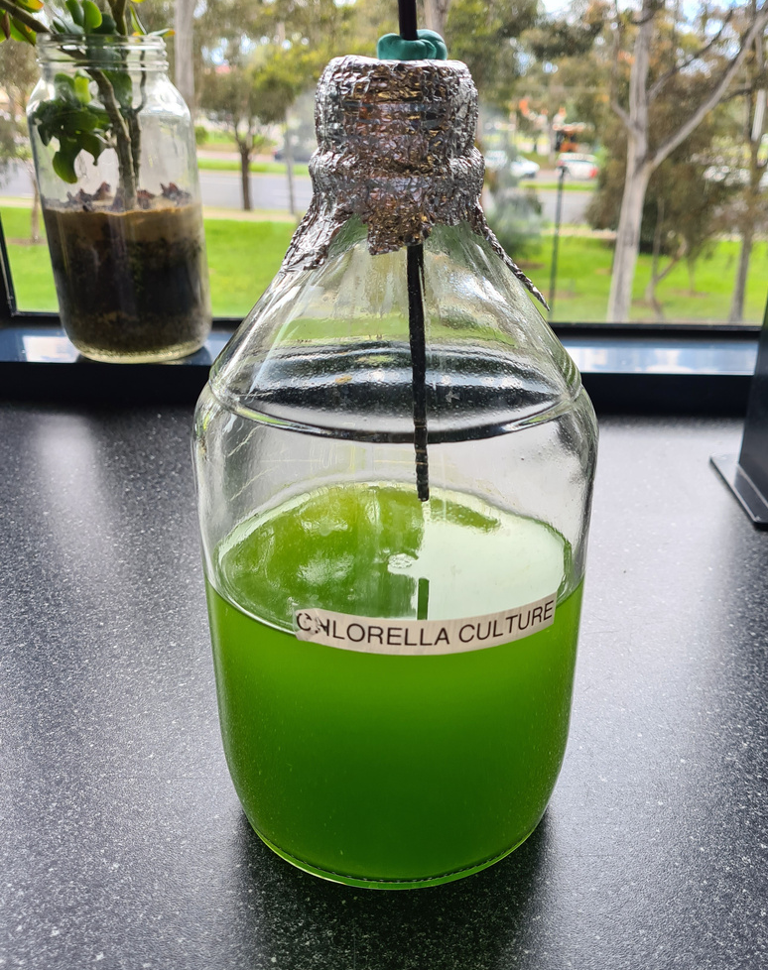
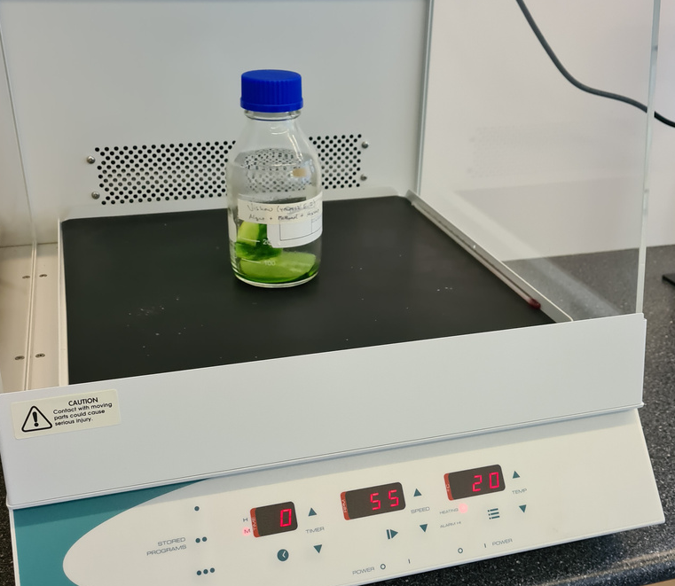
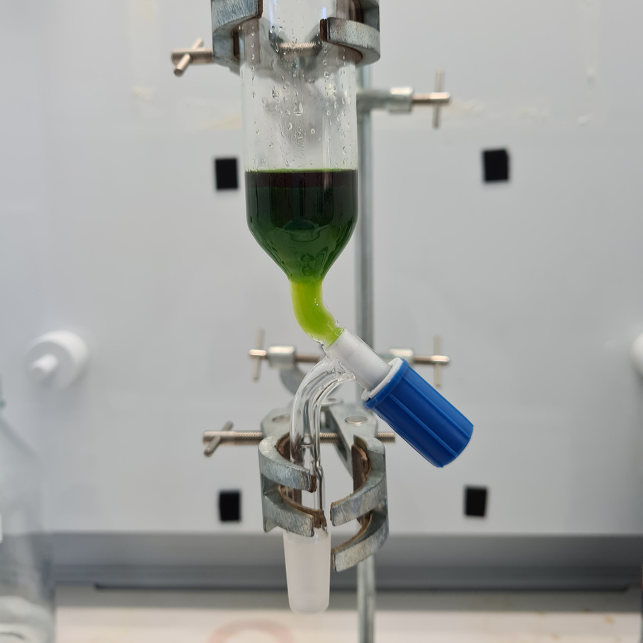
CONTROL
EXTENDED INVESTIGATION
RESEARCH PRESENTATION
Step - 1
Cultivation & Harvest
Step - 2
Hexane/Methanol based primary extraction
Step - 3
Separation of Lipids

Slide 10
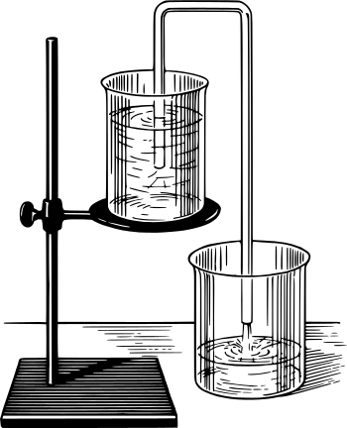
EXPERIMENTS A/B - WITH PREATMENTS
1 - CULTIVATION & HARVEST
2 - APPLICATION OF PRETREATMENT
EXTENDED INVESTIGATION
RESEARCH PRESENTATION
3 - PRIMARY EXTRACTION
4 - SEPARATION OF LIPIDS

Slide 11
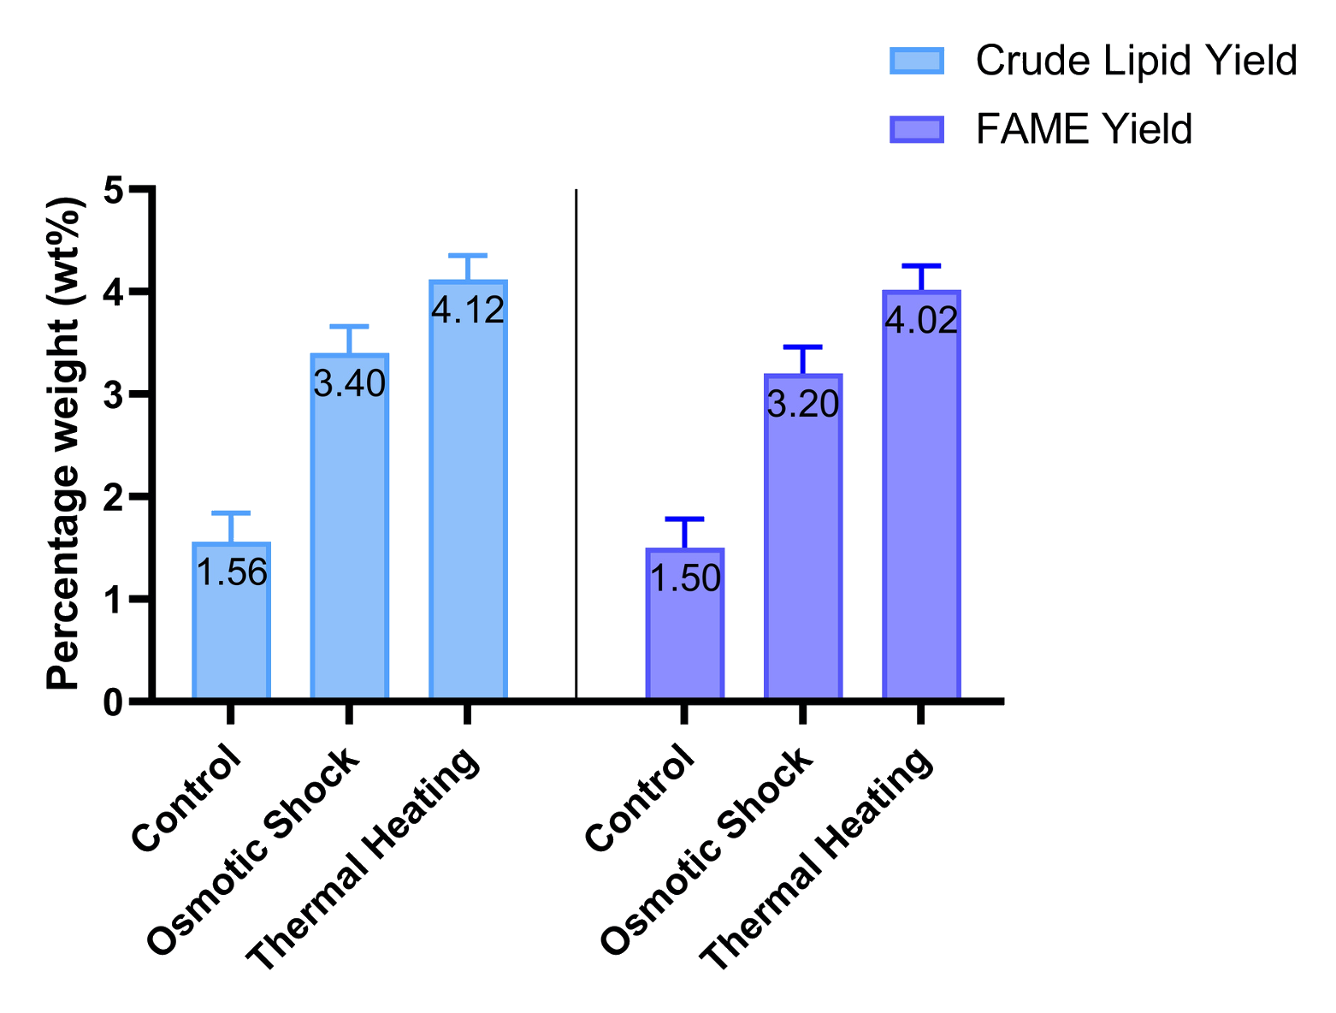
COMPARISON OF PRE-TREATMENTS
EXTENDED INVESTIGATION
Research Presentation

Slide 12
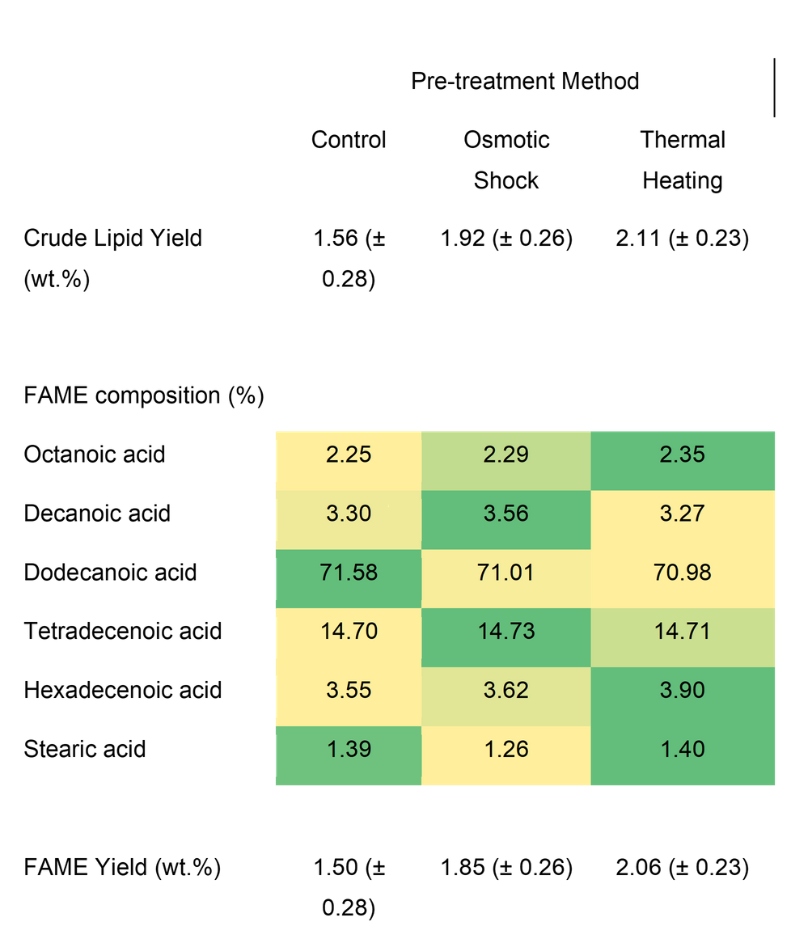
RESULTS/DISCUSSION
  Confirms that pre-treatment effects quantity and not quality
EXTENDED INVESTIGATION
RESEARCH PRESENTATION

Slide 13
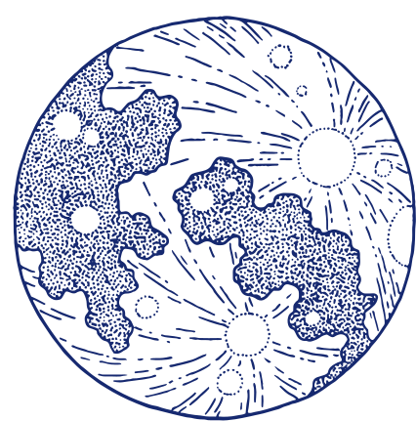
Implications
Can be used as an indication of the effects of pretreatments.
Osmotic shock should be preferred over thermal heating.
TRY AND LEARN / ACTIVITY
SOCIAL SCIENCE CLASS / LAMFORD SCHOOL

Slide 14

Calibration
SOURCES OF UNCERTAINTY
Incomplete separation
EXTENDED INVESTIGATION
RESEARCH PRESENTATION
Low concentration of lipid constituents

Slide 15



CHALLENGES FACED
EXTENDED INVESTIGATION
RESEARCH PRESENTATION
Limited supply of micro-algae
Separation of micro-algae from filter paper
Unavailability of Equipments

Slide 16

Future Direction - Maximising growth
Research on the optimal growth environment for micro-algae to enhance lipid content.
EXTENDED INVESTIGATION
RESEARCH PRESENTATION

Slide 17

SAVE THE PLANET.
EXTENDED INVESTIGATION
RESEARCH PRESENTATION
VTAC No - 182 561 38 X

