Slide 1

Cryoprotectants and their uses in protein preservation
By – Vishnu Sivakumar

Slide 2
Environmental effects on proteins
Degradation
Denaturation

Slide 3
Effects of freezing on protein analysis
Mechanical Damage
Solution effects injury
Freeze concentration
Diffraction of light due to ice formation

Slide 4
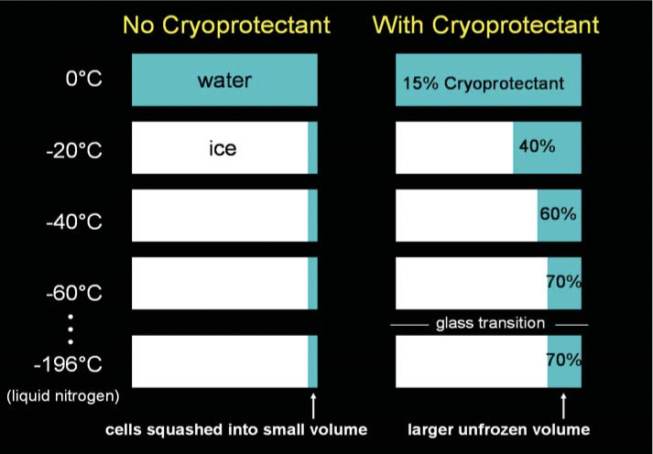
What are cryoprotectants?
Dissolves in Water
Decreases the melting point of water
Causes larger amounts of water to remain in liquid state at cryo-temperatures
Minimal ice formation

Slide 5
How cryoprotectants are applied…
Flash Freezing
Avoid phosphate buffers
Minimize freeze-thaw cycle
Store in Working aliquots

Slide 6
Other factors in avoiding protein degradation…
Making sure samples are stored correctly in the correct buffer and flash frozen
Aliquoting samples on first use so they don’t undergo repeated freeze-thaw cycles
Making sure samples aren’t left at room temperature for long periods of time
Storing at -80 degrees Celsius rather than -20 degrees Celsius where possible to increase sample longevity.
Not storing samples long term
Using proteomics to check samples remain fit-for-purpose following freezer storage
Using alternative reagents that are stable at room temperature where possible to avoid the issue altogether

Slide 7
THANKYOU !!!

Slide 8
Bibliography
https://image.shutterstock.com/image-photo/life-cycle-apples-260nw-136973735.jpg
https://reviewed-com-res.cloudinary.com/image/fetch/s--fM99a-c8--/b_white,c_fill,cs_srgb,f_auto,fl_progressive.strip_profile,g_center,h_1200,q_auto,w_1200/https://reviewed-production.s3.amazonaws.com/1519336867000/This-is-why-your-fridge-smells-hero.jpg
http://www.onlinebiochem.com/wp-content/uploads/2018/05/denaturation4.jpg
http://1.bp.blogspot.com/-NdjUUDb3aTI/Vd6cWZ2uR5I/AAAAAAAAJog/--XjWhS1uOE/s1600/pharmatutor-art-2381-1.jpg
Wowk, B. (2017). How Cryoprotectants Work. [online] Alcor.org. Available at: https://alcor.org/Library/pdfs/How-Cryoprotectants-Work.pdf.
Proteinstructures.com. (2017). Instrumentation for X-ray Data Collection: Home Lab and Synchrotrons. [online] Available at: https://proteinstructures.com/Experimental/Experimental/protein-crystallography2.html
Ansto.gov.au. (2019). Synchrotron | What is Synchrotron Light? | ANSTO. [online] Available at: https://www.ansto.gov.au/education/nuclear-facts/what-is-synchrotron-light.
Elliott, G., Wang, S. and Fuller, B. (2017). Cryoprotectants: A review of the actions and applications of cryoprotective solutes that modulate cell recovery from ultra-low temperatures. - PubMed - NCBI. [online] Ncbi.nlm.nih.gov. Available at: https://www.ncbi.nlm.nih.gov/pubmed/28428046.

