Slide 1
Exercise 12A
Populations and samples
Specialist Mathematics 11

Slide 2
Populations and samples
A population is the set of all eligible members of a group which we intend to study.
A sample is a subset of the population which we select in order to make inferences about the population.
Generalising from the sample to the population will not be useful unless the sample is representative of the population.
The simplest way to obtain a valid sample is to choose a random sample, where every member of the population has an equal chance of being included in the sample.

Slide 3
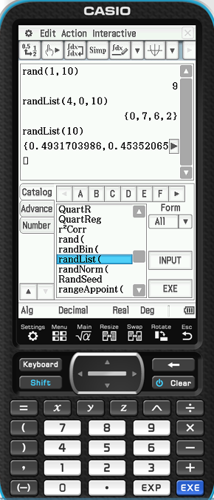
Using the CAS
Use the function rand( ) to generate a random integer between a given range
Use randList( ) to generate a list of interegers between a given range or generate a list of random numbers between 0 and 1

Slide 4
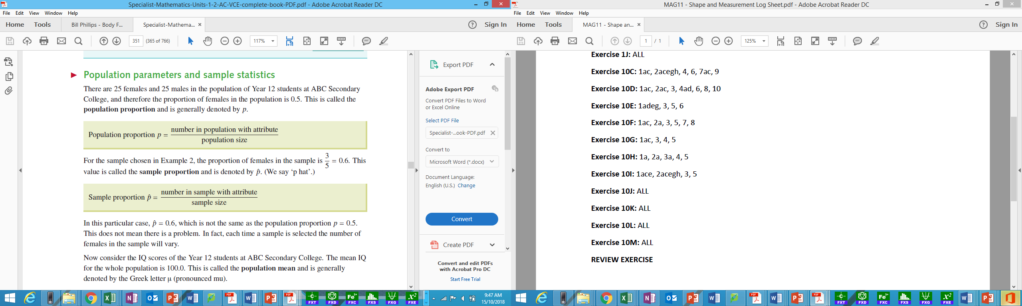
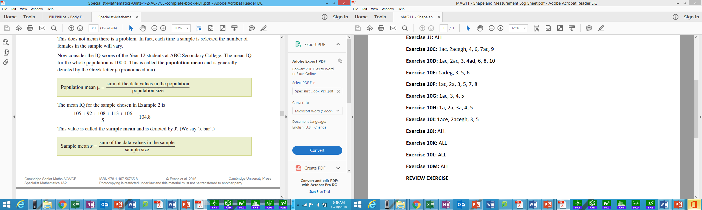
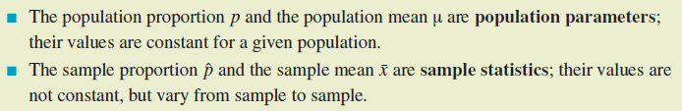
Population parameters and sample statistics

Slide 5
Example 1
At Riverdale High School, 21% of students travel to school by roller-skates. A group of 100 students selected in a random sample, and 31 of them travel to school by roller-skates. In this example:
What is the population?
What is the value of the population proportion?
What is the value of the sample proportion?

Slide 6
Exercise 12B
The distribution of the sample proportion
Specialist Mathematics 11

Slide 7
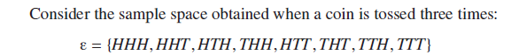
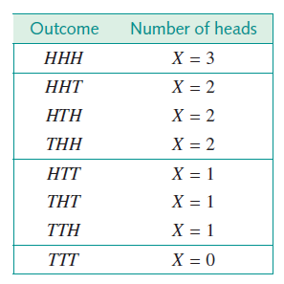
Random variables
From the table we can see that the possible values of X are 0, 1, 2 and 3. Since the actual value that X will take is the result of a random experiment, X is called a random variable. A random variable can be discrete or continuous.

Slide 8
Discrete and continuous random variables
A discrete random variable is one which may take on only a countable number of distinct values, such as 0, 1, 2, 3, 4.
Discrete random variables are usually (but not necessarily) generated by counting.
The number of children in a family, the number of brown eggs in a carton of a dozen eggs, and the number of times we roll a die before we observe a ‘six’ are all examples of discrete random variables.
A continuous random variable is one that can take any value in an interval of the real number line, and is usually (but not always) generated by measuring.
Height, weight, and the time taken to complete a puzzle are all examples of continuous random variables.

Slide 9
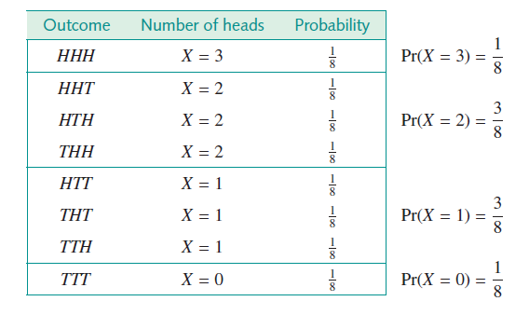
Discrete probability distributions

Slide 10
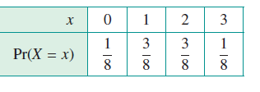
Discrete probability distributions
The list of all possible values of the random variable X, together with the probability associated with each value, is known as the probability distribution of X.
More usually, we would summarise the probability distribution associated with the number of heads observed when a fair coin is tossed three times in a table as follows.
Note that, since every possible value of the random variable is included, the probabilities must add to 1.

Slide 11
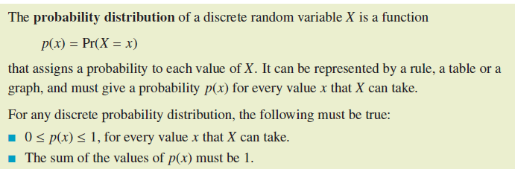
Discrete probability distributions

Slide 12
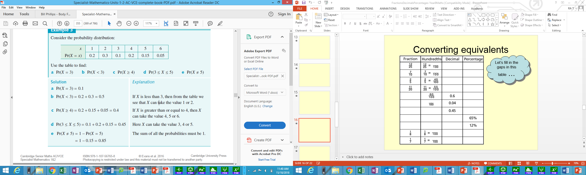
Example 1
Consider the probability distribution:
Use the table to find:
x | 1 | 2 | 3 | 4 | 5 | 6
Pr(X=x) | 0.1 | 0.2 | 0.02 | 0.14 | 0.14 | 0.4

Slide 13
Exercise 12B (continued)
The distribution of the sample proportion
Specialist Mathematics 11

Slide 14
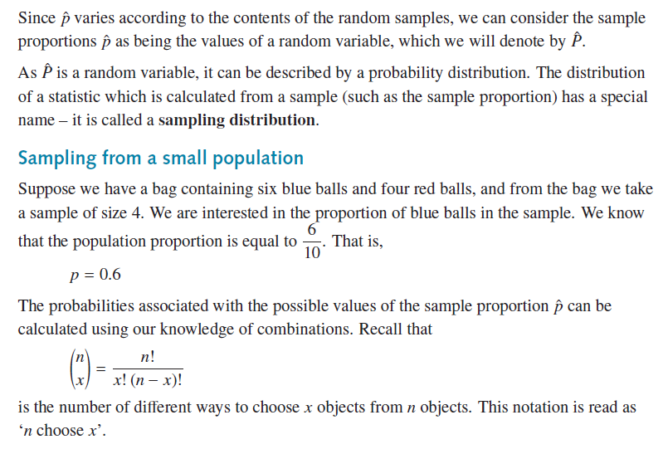
The sample proportion as a random variable

Slide 15
Example 1
A bag contains 4 black balls and 6 white balls, and a random sample size of 4 is drawn. Find the probability that there is one black ball in the sample.

Slide 16
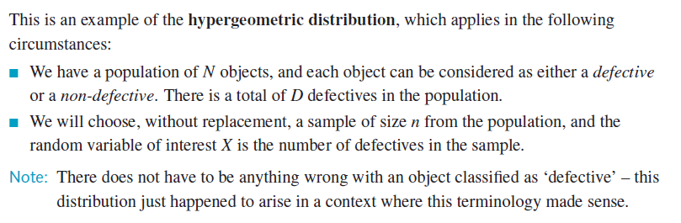
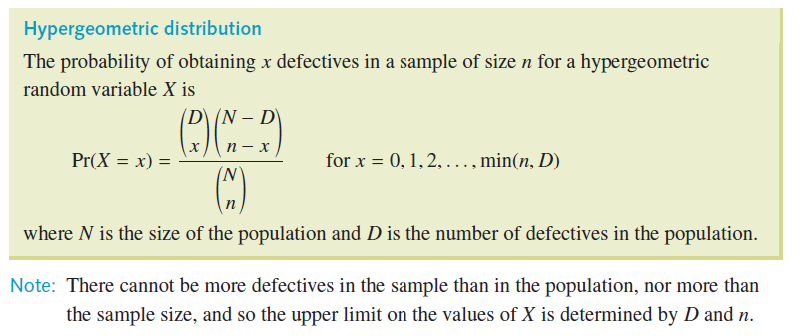
Hypergeometric distribution

Slide 17
Example 2
A bag contains 4 black balls and 6 white balls, and a random sample size of 4 is drawn. Create a sampling distribution table showing the probabilities of obtaining 0, 1, 2, 3 and 4 black balls in the sample.

Slide 18
Example 3
Using the table in the previous exercise, determine the probability that the proportion of black balls in the sample is greater than 0.5.

Slide 19
Example 4
It is known that 25% of a group of 20 students have been attacked by a Eastern European Tiger Wasp. Use the hypergeometric distribution to find the sampling distribution of the sample proportion of students attacked by an Eastern European Tiger Wasps if a random sample of 5 students is selected from this group.

Slide 20
Exercise 12B (continued)
The distribution of the sample proportion
Specialist Mathematics 11

Slide 21
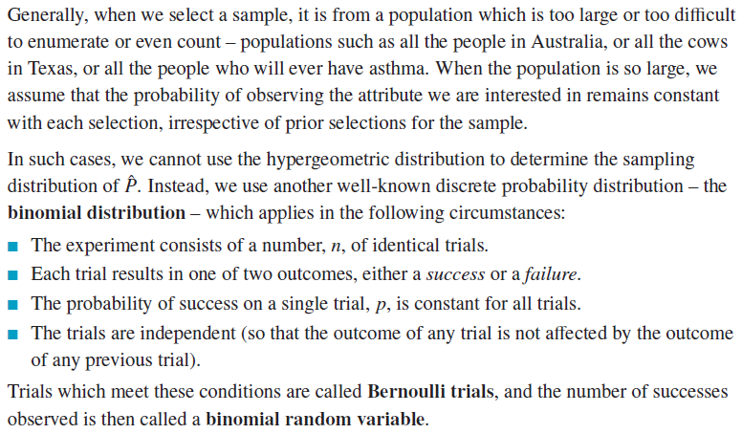
Sampling from a large population

Slide 22
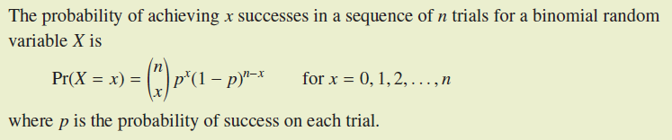
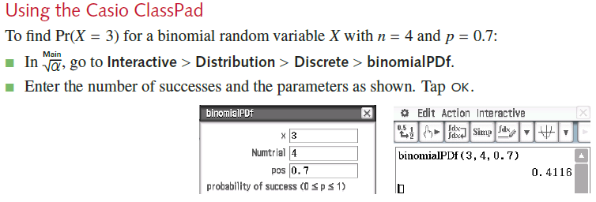
Binomial distribution

Slide 23
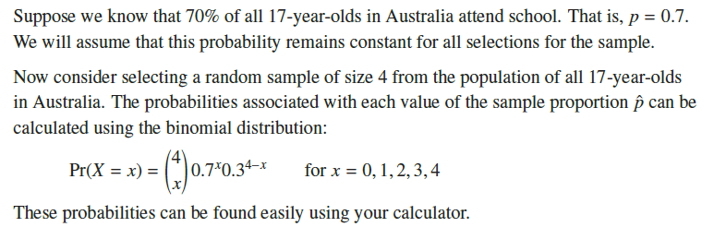
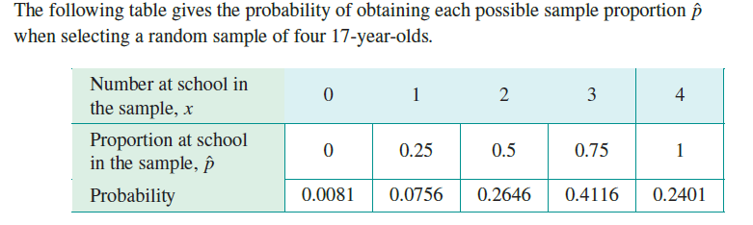
Binomial distribution

Slide 24
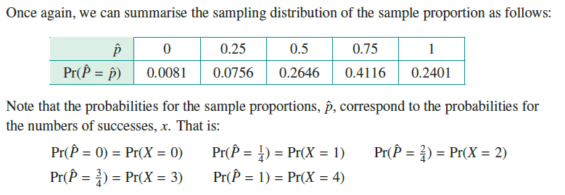
Binomial distribution

Slide 25
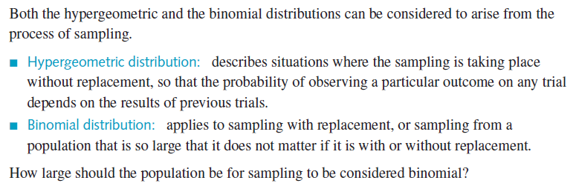
Comparing the hypergeometric and binomial distributions

Slide 26
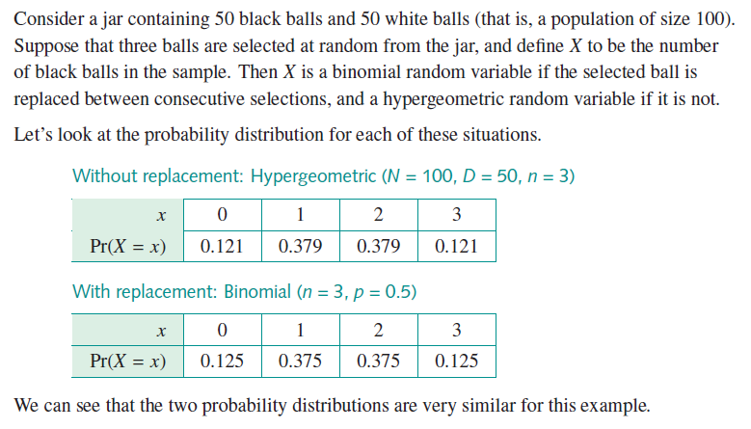
Comparing the hypergeometric and binomial distributions

Slide 27
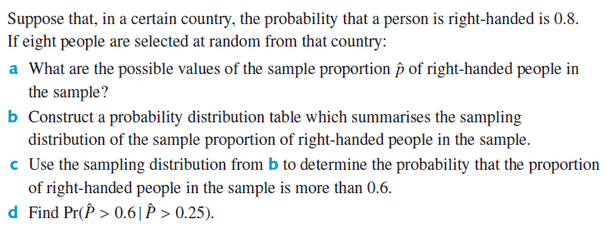
Example 1

