Slide 1
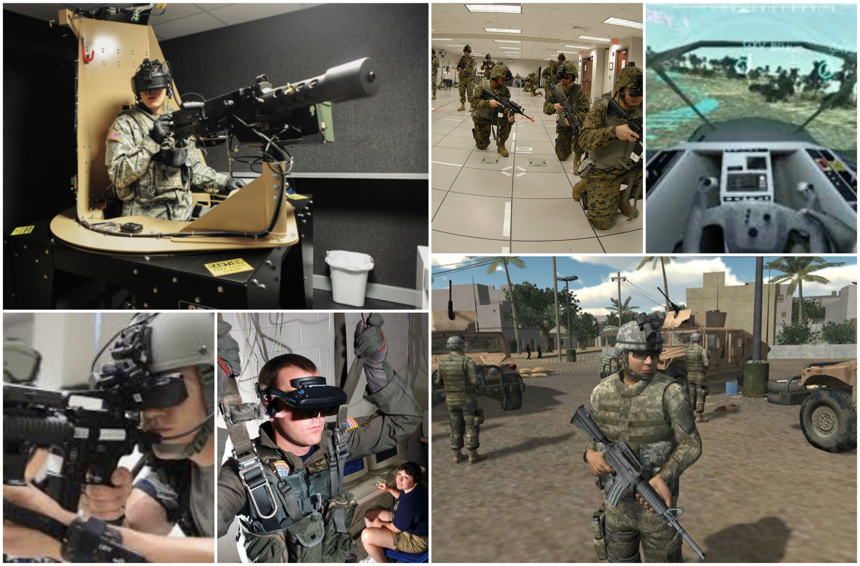
MILITARY IMPLICATIONS OF VIRTUAL REALITY
By – Vishnu Sivakumar & Aneesh Yellishetty
WHAT IS VIRTUAL REALITY?
FUTURE OF VIRTUAL REALITY
V.R EQUIPMENT IN THE MILITARY
Virtual Reality, or else referred to as VR, is technology to allow the user to be immersed into a virtual world. VR headsets can include 4 of the 5 senses: vision, hearing, touch and even smell. Through vision, the operator will obtain a three dimensional view of how a real life battlefield will look like. Virtual reality headset also offer a world class surround sound system which is capable of mimicking sounds generated in real life. The sense of touch within the system, adds onto giving the operator a real life feel of the scenario. In addition, experts have confirmed that they have been able to incorporate the sense of smell into the hardware, but only selected odors.
VR in the military is becoming a large scale operation that will improve the combat skills of future, but our predictions differ from this course. Instead of implementing ways that will indirectly help soldiers in the battlefield, what if we could make soldiers have a direct view of the attack zone and their resources? So far the military has implemented remote controlled drones which are mainly being used for stealth purposes. However, one of the main disadvantages is that the cadets flying the drones are unable to obtain a clear picture of the surroundings. Although, there are a few ethical issues concerning virtual reality as company will have disputes to map out the environment as this information may be easily hacked by enemies. Moreover, only ‘drones’ have been manufactured so far, but an alternative can be to construct remotely controlled military aircraft where virtual reality can be used to mimic the environment of a fully functional cockpit. Through this marvellous piece of technology controllers or else ‘pilots’ can receive a clearer picture about there flight condition. The U.S military have already began to invest into research, such as the F/X fighter jet which has the potential to be both: manned and unmanned.
ADVANTAGES | DISADVANTAGES
Allows the person to trial various techniques without risking his life in the case of a failure. Has the potential to remotely operate machinery and avoid casualties in the military. Provide a better feel of the battlefield, giving the operator a three-dimensional view of what they may potentially be facing. | All of the five senses haven’t been included yet, such as the sense of taste. Virtual reality headsets are really expensive.
ESTIMATED COURSE OF THIS TECHONOLOGY
HOW DOES V.R WORK?
VR and AR has revolutionised the world by implementing a way of simulating advanced models and simulating environments that are very hard to create using physical means such as making a setting and gathering equipment in order to maintain the environment as realistic as possible.
VR works by using a gyroscopic device that detects the movement and angle at which the device is set and sends this message into a computer. The computer then processes the information within a millisecond and sends a picture that has moved corresponding to the angle of the device. This illusion creates a movement illusion, which “tricks” the eye into believing that the video is moving along with us. The actual screen works by using a stereoscopic screen, which is just a combination of two identical images viewed from different angles to produce a three-dimensional effect on the user. Other devices such as consoles or controllers can be added to the video such that it is used a replacement for arms in the real world
APA FORMAT - BIBLIOGRAPHY
Vrsorguk. (2017). Virtual Reality Society. Retrieved 26 March, 2018, from https://www.vrs.org.uk/virtual-reality-military/
Time.com. (2015). Why Virtual Reality Is About to Change the World. Available at: http://time.com/3987022/why-virtual-reality-is-about-to-change-the-world/ [Accessed 6 Aug. 2015].
How does virtual reality work?. (2016). Android Authority. Retrieved 15 July 2016, from https://www.androidauthority.com/virtual-reality-work-702049/
Brown, L. (2017). What is virtual reality and how does it work?. Wondershare. Retrieved 24 November 2017, from https://filmora.wondershare.com/virtual-reality/how-does-vr-work.html
Benefits And Drawbacks Of Using Virtual Reality In Learning And Development - eLearning Industry. (2016). eLearning Industry. Retrieved 15 October 2016, from https://elearningindustry.com/virtual-reality-in-learning-and-development
Cakebread, C. (2017). Virtual reality gets smelly thanks to this Japanese startup. Business Insider Australia. Retrieved 28 June 2017, from https://www.businessinsider.com.au/japanese-startup-vaqso-adding-smells-virtual-reality-2017-6?r=US&IR=T

