Slide 1
Topological Maps
Evaluation of Maps

Slide 2
What are the key features that need to be in any Map?
B - Border
O - Orientation
L - Legend
T - Title
S - Source
S - Scale

Slide 3
What are the key features of a Topological Maps?
use pictures to identify places
are not drawn to scale
give no sense of distance
give general directions
often exaggerate the size of places
do not show exact routes

Slide 4
Task 1:
For each map identify the features of BOLTSS that are missing
Map | Missing BOLTSS
Australia
O’ahu
Pyramids
France

Slide 5
Task 2: Evaluate these Topological Maps
Map | Positive | Negative | Interesting | Improve
Australia
O’ahu
Pyramids
France

Slide 6


Slide 7
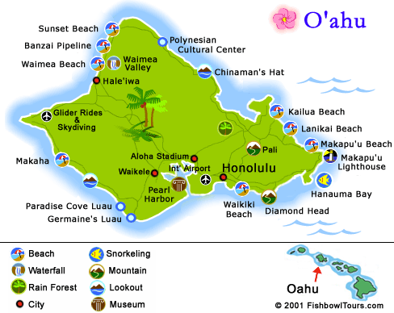

Slide 8
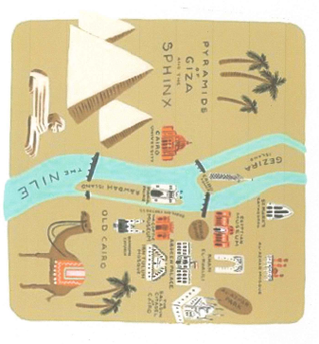

Slide 9


Slide 10
Task 3: Evaluate your own Topological Map
Map | Positive | Negative | Interesting | Improve
My Neighbourhood Map

