Slide 1
Citizens political party
Australia for the better

Slide 2
Our party…
Members:
Vishnu Sivakumar – leader
Vishakan Pasupathidasan
Ishan Jayaweera
Jatan shah
Established:
21st of July 2017
Our Priorities..
Anti-terrorism
Climate Change
Economic Stability

Slide 3


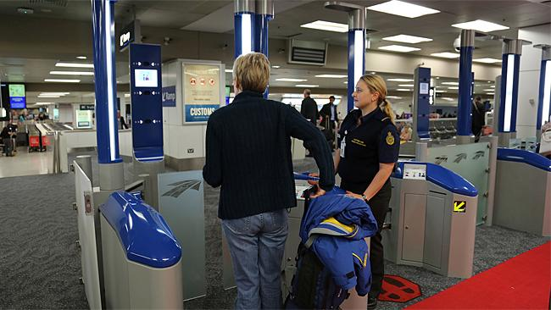
Anti-terrorism

Slide 4
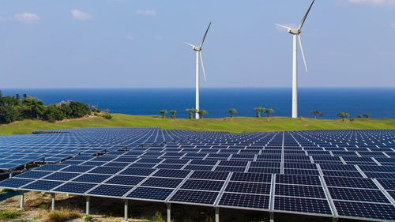
Climate change

Slide 5

Economy

Slide 6
Thankyou
Vote for us

