Slide 1
Comparison Of Bay Beach and Ocean Beach
By – Vishnu Sivakumar

Slide 2
Key Features – Sorrento Ocean Beach
Cave
Cool
Wavy (perfect for surfing)
Sand dunes
Cliff
Vegetation
Sandy

Slide 3
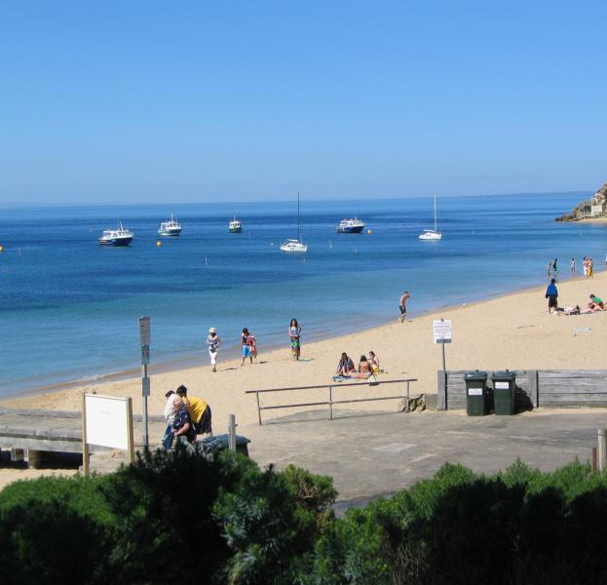
Key Features – Portsea Bay Beach
Wavy
Deep
Sandy
Cool
Beautiful
Vegetation

