Slide 1
Slogans
By – Vishnu, Manthan & Vishakan

Slide 2

Ice – Cream Flavour
FOR A CHANGE.

Slide 3

Deodorant (for boys and girls)
Too attractive.

Slide 4

Computer for Teenagers
NEXT GENERATION.

Slide 5

Soft Drink
FIZZ UP

Slide 6

Cat Food
What real cat lovers should be giving.

Slide 7
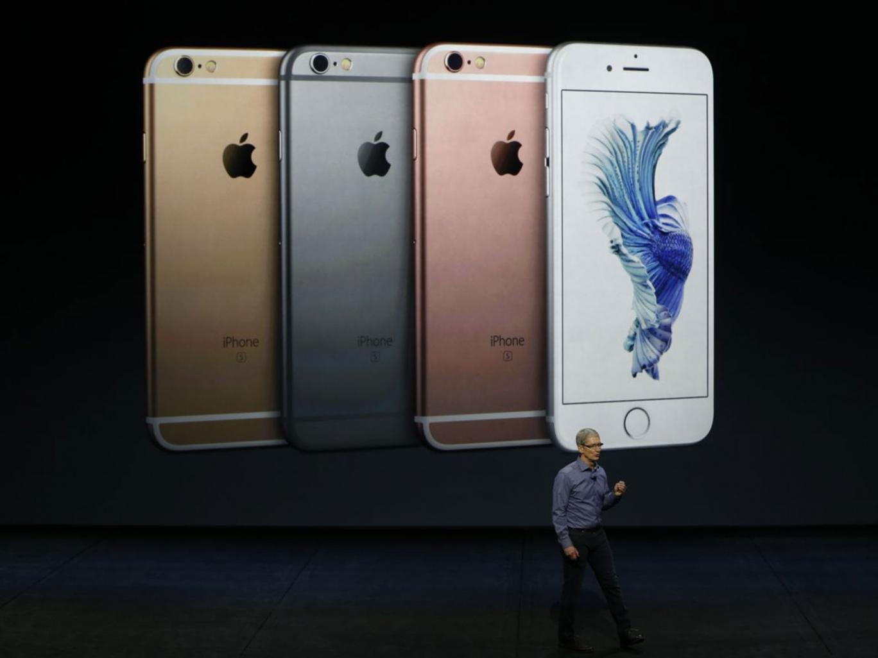
Mobile Phone
THE FUTURE.

Slide 8
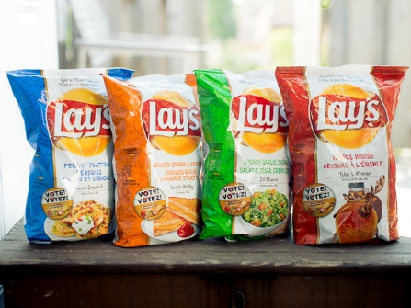
Chip Flavour
TOO TASTY FOR YOU !!!!!!!!!

Slide 9

Backpack
LIGHTER THAN POSSIBLE.

