Slide 1

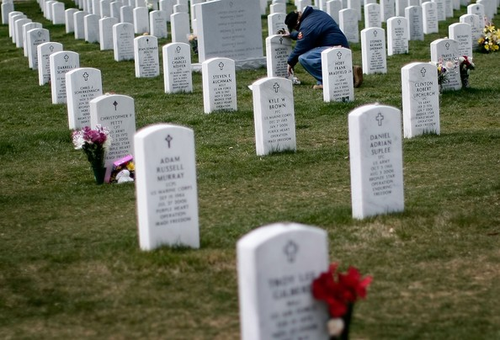
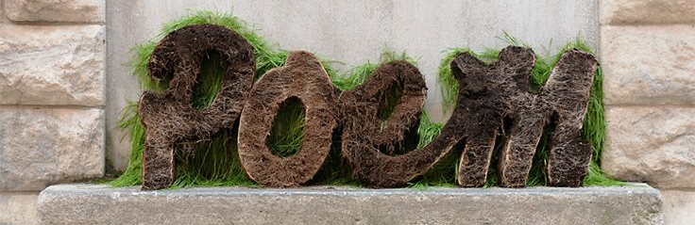
Poems on Love, War and Death
By – Vishnu Sivakumar

Slide 2
So what is a poem?
Poetry is a Greek word (pronounced poeio) that defines I create, is an art form in which human language is used for its aesthetic qualities. The first poem or rather the oldest was the Greek epics lliad, odyssey and the Indian Sanskrit epics Ramayana and Mahabaratha. Poetry is mainly used to convey emotion or ideas to the reader’s or listener’s mind or ear. In poetry it is common to use figurative language such as similes and idioms however, there are different form of poems that do not make use of these techniques. Poetry can be differentiated most of the time from prose, a language implemented in a more expansive and less condensed way. This implies that poetry is not logical, instead that poetry is often created from the need to escape the logical, as well as expressing feelings and other expressions in a tight, condensed manner.

Slide 3
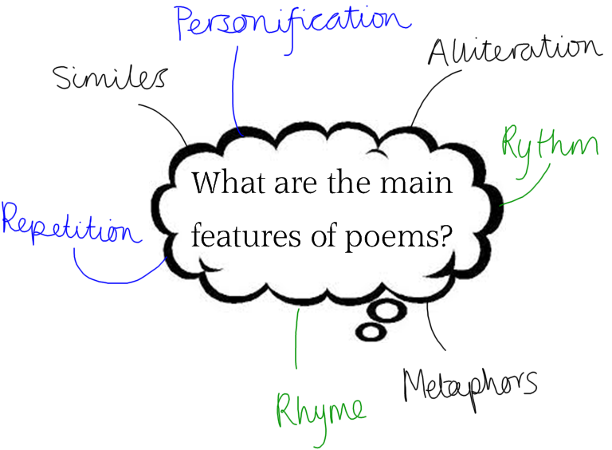
Features of poems
A poem normally features personification, alliteration, rhythm, metaphors, rhyme, repetition, similes. People always have an opinion that poems have to rhyme but sometimes other poems are more meaningful and logical.

Slide 4
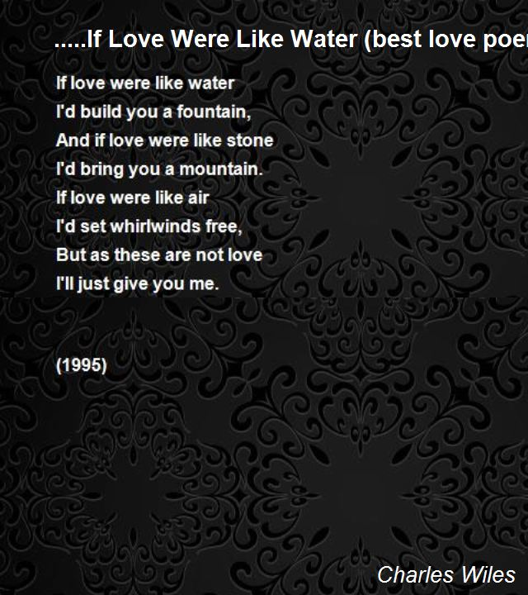

Poetry on Love

Slide 5
What does the poem If Love were like water define and why I like this piece?
If Love were like water…..
If love were like water
I’d build you a fountain,
And if love were like stone
I’d bring you a mountain.
If love were like air
I’d set whirlwinds free,
But as these are not love
I’ll just give you me.
This piece of art work uses a lot of simile and comparison. This truly defines the amount of love and how much an individual likes another person. This poetry was created by Charles Whiles during the year 1995.

Slide 6
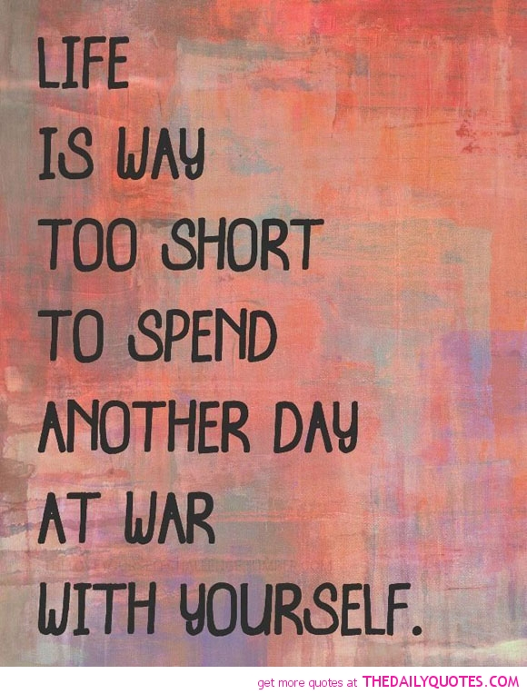

Poetry on War

Slide 7
What does the poem Life show us and why it is attractive?
Life
Life
Is way
Too short
To spend
Another day
At war
With yourself
Normally everyone talks how the war saved us and how peace is brought to this world, but this is the only poetry that explains that how it is without war. Around the globe there are many fights between a family, friendship or else a country but why should we fight? In my opinion this is the only poem that explains the true nature of war in life. Life indeed is short, so why not enjoy it!

Slide 8
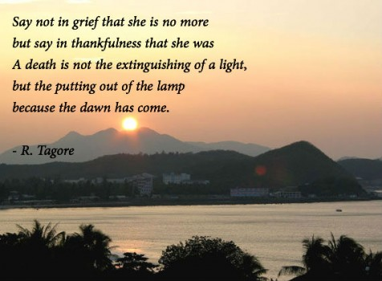
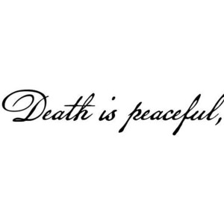
Poem on Death

Slide 9
What does the poetry define and why is it attractive?
Death
Say not in grief that she is no more
But say in thankfulness that she was
A death Is not the extinguishing of a light,
But the putting out of the lamp
Because the dawn has come.
Death is always a phase in our life, in fact we do not know if we are going to be alive the next day, our future is not in our hands. It is morally and scientifically not right to regret the death of a person as everyone is going to die today or tomorrow. This poem is the perfect example for this fact, it show that death is peaceful more than painful. In instances people are better off dying rather than living in nerve wrecking pain. ‘Death is heaven’ is one of many various quotes, the world should change, people must change their attitude towards death.

Slide 10



Thanks for watching!

