Slide 1

ACTIVITY table: novel to film
By – Vishnu, Vishakan, Pratham and Daniel
Notes:
NOTE:
To change the image on this slide, select the picture and delete it. Then click the Pictures icon in the placeholder to insert your own image.

Slide 2
Omissions
In the movie, the scene when he comes back to china he meets his family has been left out of it, considering he just meets the family and not the entire village. He does not perform in front of them all too. And the part where lee says “money comes out of the wall” was also not included too. The part where him and his friend climbing onto the roof to help the birds is left out. Many parts of the text were not included in the film. The bandit and his friends in the village were also left.
The changes in the film had given a different view of it all. The story was not clear, for the audience who may of not read the book, it may be very difficult to understand the concept of this film.

Slide 3
Additions
There were no additional scenes except the last scene where he performs in front of the entire village.

Slide 4
Adapting the Narrative
The director has expressed the concern of language through their expression in the film. In the text it is not possible to do that, however, the director has understood the advantage of film expressions and has used it wisely for his benefit. If this was not included the film would of possibly been dull and boring.

Slide 5
Characterisation
Characters in the film are portrayed through images, speeches, actions and gestures which is consistent with the narrative of the text. For example, Li is portrayed the same in the text and in the book, he has the same attitude, will power and emotions, this can be proven in numerous situations such as, when he struggles with his exercises in the Beijing Dance Academy, he overcomes it with nothing but pure will power. However, the one and only difference is that in the movie the characters are stronger where as in the text the characters are weaker, for instance the movie gives a more detailed explanation of why Li and Elizabeth split apart.

Slide 6
Actions and Gestures
I found that there were only a few differences between the text and the movie relating to actions or gestures.
Another example would be when, Li is shown the dance moves by Ben Stevenson (when Li was acting as a substitute for a dancer).
The conversation Li has with Lori (when he finds out that Lori is not going to be doing Swan Lake with him).
Therefore, this results in the movie having more actions and gestures, making the film seem more better compared to the auto-biography.

Slide 7
Relationships
The dynamics of the various relationships have been maintained, only mere changes have been made.
Marriages:
Li and Elizabeth
Li and Mary McKendry
Romantic Liaisons:
Between Li and Elizabeth
Friendships:
The bandit and Li
Li and Lori
Li and Delworth
Parent/child and sibling relationships:
Li has 6 siblings.
Li’s fourth aunty and uncle adopted Li’s 3rd brother.

Slide 8
Key Moments
In the Film and the novel there are lots of moments that were important to understand. One Key moment that I think struck me as a definite deviation from reading the novel and watching the film was when the selectors came to Li’s school to choose students to go to the Beijing Dance Academy to learn ballet, but no one got selected form Li’s class. As the selectors were about to leave the classroom, Li’s teacher (Ms Song) stopped them and pointed at Li and said “What about that one”. The selectors agreed and choose Li. This moment is unforgettable because if Ms Song did not stop the selectors then Li would not be the person he is nowadays. My reaction to this was that I was shocked because I did not know why Li’s teacher choose him and not anyone else form his class. Other key moments were:
Li’s parents came to America to watch Li perform

Slide 9
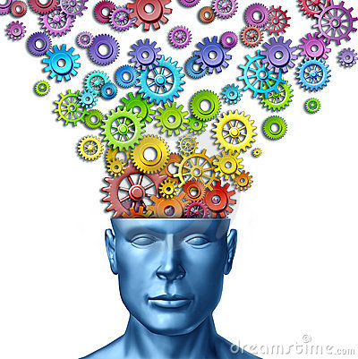

Setting
The setting compared to the film to the novel is very far off. The film starts of at when Li has just arrived at the airport in America and is looking for his friend Ben. On the other hand, the novel starts at Li’s naing’s wedding and how she got married and so on. The film and novel settings are both different, it can confuse the viewer/reader because the film starts of in America and the novel starts of in America. It is like telling the story from end to the start in the film. Some of the things that happen in the novel are not shown in the film, if the reader/viewer read’s the novel and watches the film then the reader/viewer will get confused because the film and the novel has parts that the other one does not have.

Slide 10

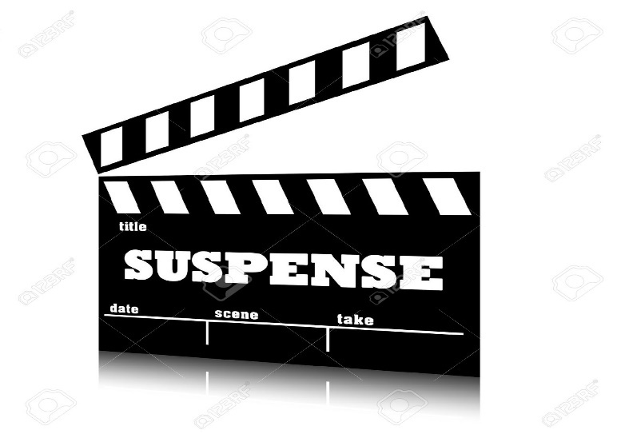
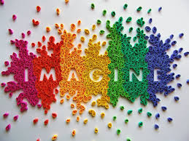
Music
Music is very important in the film to show how the characters feel and think. Music is not as important in the book as it is in the film because we can only imagine about how the music is played but in the film you can hear the music and tell exactly how it is being played. In the film music is used in the background of scenes. The music is mostly played to create suspense, show the mood and feelings of a character, establish historical events or times. To create a connection between a character and an event, music is used to make the viewer feel the emotions that the character is feeling.

Slide 11
Imagery
Recurring imagery is used when they show us Li’s morning routines and when they show us the evolution of child to adolescent to teenager while he is running. This recurring image is linked to Li Cunxin.

Slide 12
Special Features: Adapting a Nonfiction Text
The transaction between different episodes of the story happened naturally, however, the director sometimes used flashbacks to link Li’s past to the present. The movie started off with Li arriving in America, and they showed us what had happened previously with flashbacks, so they were not as faithful to the timeline. Personally, I don't really think these changes affects my interpretation of the movie that much, however the director focused more on the last part of the story and the aftermath instead of the following the more important part of the story. I think he did that because the last part of the book has more romance, and the modern society would prefer romance over a story of a young Chinese dancer.
The author (Li) and most of the characters are still alive, because Li’s Dia and Niang have already passed away. This impacts the movie because they could have told the director what really happened instead of having to make up a scene that never happened during Li’s life. The movie adaptation has been mostly faithful to the book, but the director left out some important characters such as the Bandit, the Chongs and teacher Xiao (they replaced him with teacher Chan). They also left out Li’s Niang and in the movie teacher Chan gets arrested, however that never happens in the movie. The movie shows us the time period by putting the appropriate music for each scene, as well as showing us a major historical event - the death of Chairman Mao

Slide 13

THANKYOU FOR LISTENING

