Slide 1
Year 9 City Experience

Slide 2
Introduction
A fun thrilling opportunity to learn about city
Visit the major landmarks as part of the city experience
Enjoy food from different culture
Understand the history of Melbourne

Slide 3
Places being visited

Slide 4

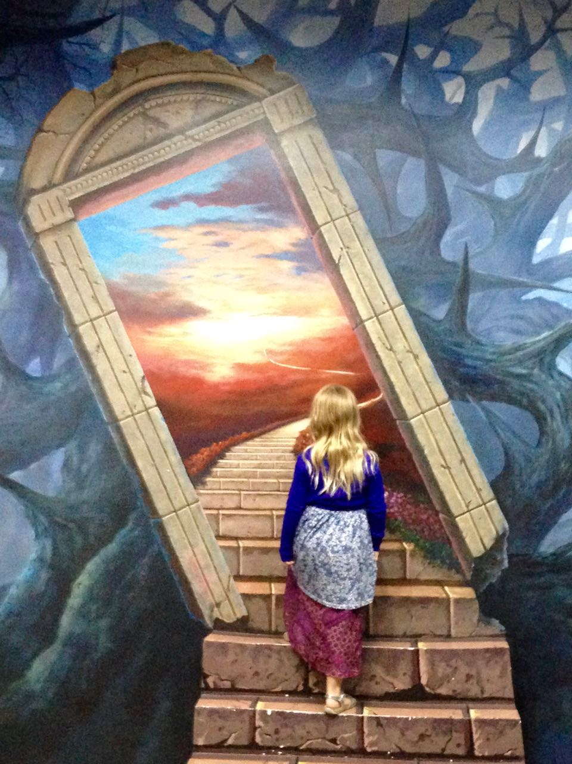
artvo

Slide 5
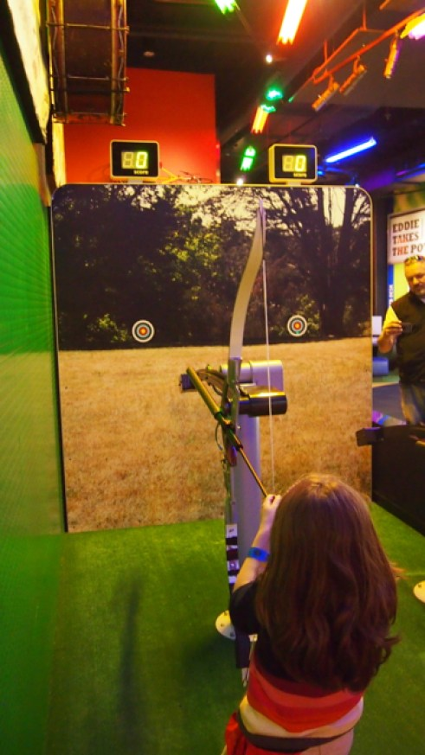
National Sports Museum

