Slide 1


MKC1200 – Principles of Marketing
Getting started with the STP essay

Slide 2

Assessment 4 – The STP essay (15%)
Individual written assignment
Structured Essay (1500 words)
  ➢10 marks will be deducted if the submitted essay is less than 1350 words or over 1650 words
Deadline: 11pm, Friday Week 8 of Semester (check the date!)
➢Softcopy ONLY – via Moodle
  ➢Submit earlier to avoid technology failure
  ➢Penalty : 10% of the marks will be deducted for each 24hrs (or part thereof) that it is late (including weekends)

Slide 3

Assessment 4 – The STP essay (15%)
Other penalties that may apply:
➢50 marks will be deducted if you do NOT have references cited in your essay at all (i.e. no in-text citation and reference list)
➢25 marks will be deducted from your final essay mark if you do not have either in-text citations or a reference list

Slide 4
What you can do to enhance the quality of your essay
Read the assignment brief comprehensively
➢Understand the task
➢Carefully look at the suggested structure
➢Read the marking rubrics a few times
Get additional support
Tutor – in class and consultation hours
Library help (Learning skills advisors)
  Dedicated workshops and drop-in sessions

Slide 5
Dedicated workshops for this STP Project
Several workshops are scheduled in weeks 6-8
➢Go to the MKC1200 Moodle‘s site to register (in the Assignments Section> Library help, the link for registering is in the folder).
Limited seats available so act fast
Highly recommended to attend these workshops:
➢If you have never written an academic essay before
➢If you are new to the business/marketing discipline
➢If you need help to polish your academic writing skills

Slide 6
What exactly is this assignment about?
  Put yourself in the position of a marketing analyst. From an Australia (only) perspective, research the company and product extensively (based on promotional materials and other relevant sources of information) to do the following :
Discuss the brand’s targeting strategy for their market
Identify the specific target market of your brand
    Describe the market segment profile of the target market
    Discuss the segmentation variables used to derive this target market
Analyse the bases used to position the product
Create a perceptual map for the brand
    Choose two evaluative criteria (not the price/quality combination)
    Plot the brand and 3 x competitors on your perceptual map

Slide 7

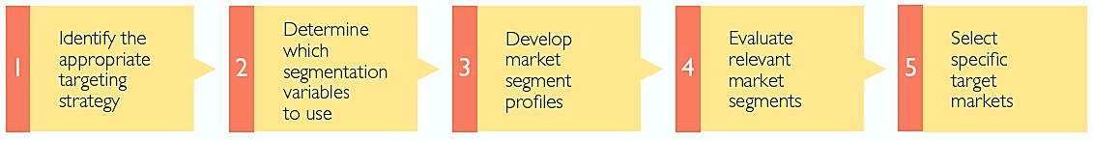
(Figure 5.4., Pride 2e, p. 170)
Segmentation, Targeting, Positioning
6
Undifferentiated
➢ Concentrated
➢ Differentiated
➢ Geographic
Differentiated
➢ Psychographic
➢ Behaviouristic
Product positioning
Product feature
Product benefit/advantage
Competitors

Slide 8

Example:
‘Ecoriginals Baby’

Slide 9

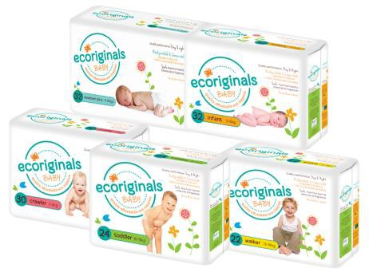

Slide 10
Identify the targeting strategy used by the company in the disposable nappy market
Targeting strategies
  Undifferentiated strategy
  Concentrated strategy
  Differentiated strategy
  Inspect target-market needs and characteristics
  Check product attributes
  Check the company’s objectives
  Check the company’s resources

Slide 11


Identify the target market of the product

Slide 12
Market vs. Market Segment vs. Target Market
For some products, product users are not the target market
INDIVIDUALS THAT HAVE THE SAME PRODUCT NEED(S) AND THE ABILITY, WILLINGNESS, AND AUTHORITY TO BUY THE PRODUCT
INDIVIDUALS THAT HAVE THE SAME PRODUCT NEED(S) AND THE ABILITY, WILLINGNESS, AND AUTHORITY TO BUY THE PRODUCT
AUSTRALIAN PARENTS
BUDGET CONSCIOUS
HEALTHY BABIES
OCCASIONAL NAPPY USERS
NOT ENVIRONMENTALLY CONSCIOUS
AUSTRALIAN PARENTS
LESS BUDGET CONSCIOUS
HEALTHY BABIES
HEAVY NAPPY USERS
NOT ENVIRONMENTALLY CONSCIOUS
AUSTRALIAN PARENTS BUDGET CONSCIOUS HEALTHY BABIES OCCASIONAL NAPPY USERS
AUSTRALIAN PARENTS
BUDGET CONSCIOUS
BABIES WITH SKIN ISSUES
OCCASIONAL NAPPY USERS
ENVIRONMENTALLY CONSCIOUS
AUSTRALIAN PARENTS
LESS BUDGET CONSCIOUS
BABIES WITH OR WITHOUT SKIN ISSUES
HEAVY NAPPY USERS
ENVIRONMENTALLY CONSCIOUS
DISPOSABLE NAPPY MARKET
POTENTIAL MARKET SEGMENTS

Slide 13
Profiling the Target Market
    Critically analyse the segmentation variables. Who are these people? What do they have in common (with other members of the group)? How are they different from others (outside the target market)?
AUSTRALIAN PARENTS
LESS BUDGET CONSCIOUS
BABIES WITH OR WITHOUT SKIN ISSUES
HEAVY NAPPY USERS
ENVIRONMENTALLY CONSCIOUS
SEGMENTATION VARIABLES | DESCRIPTION
DEMOGRAPHIC | Gender: Female Age: 25 – 35 yo Household income: $80K +
GEOGRAPHIC | In Australia
PSYCHOGRAPHIC | Lifestyle: environmentally conscious
BEHAVIOURAL | Benefit sought: allergy-free nappies, strong performance nappies Usage rate: heavy users
GREEN AFFLUENT AUSTRALIAN PARENTS
YOUR TARGET MARKET PROFILES
WHO ARE EXACTLY THESE PEOPLE?
LABEL YOUR TARGET MARKET

Slide 14
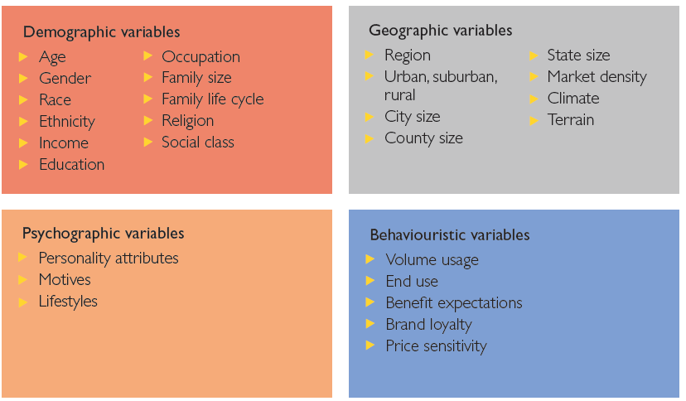

Segmentation variables
Segmentation variables: characteristics of individuals, groups or organisations used to divide a market into segments
Figure 5.1, Pride 2e, p. 159

Slide 15
Profiling the Target Market
    Critically analyse the segmentation variables. Who are these people? What do they have in common (with other members of the group)? How are they different from others (outside the group)?
AUSTRALIAN PARENTS
LESS BUDGET CONSCIOUS
BABIES WITH OR WITHOUT SKIN ISSUES
HEAVY NAPPY USERS
ENVIRONMENTALLY CONSCIOUS
INSIGHTS SHOULD BE SUPPPORTED BY
RELIABLE EVIDENCE SUCH AS:
PROMOTIONAL MATERIALS
COMPANY WEBSITE
ABS DATA
SEGMENTATION VARIABLES | DESCRIPTION
DEMOGRAPHIC | Gender: Female Age: 25 – 35 yo Household income: $80K +
GEOGRAPHIC | In Australia
PSYCHOGRAPHIC | Lifestyle: environmentally conscious
BEHAVIOURAL | Benefit sought: allergy-free nappies, strong performance nappies Usage rate: heavy users
GREEN AFFLUENT AUSTRALIAN PARENTS
YOUR TARGET MARKET PROFILES
WHO ARE EXACTLY THESE PEOPLE?
LABEL YOUR TARGET MARKET

Slide 16

Product Positioning
BASES FOR POSITIONING:
PRODUCT FEATURE
PRODUCT BENEFIT/ADVANTAGE
PRICE, QUALITY, BRAND REPUTATION
COMPETITORS
Look at their logos and slogans
Look at their company missions
Look at how they promote their products
Look at where they promote their products
Look at their product updates/news
ECO
AFFORDABLE

Slide 17

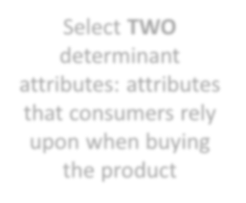

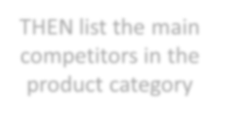
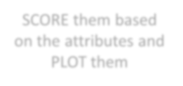
Perceptual Map
Consumers’ perceptions of their brands compared to competing products
on important buying dimensions
Select TWO determinant attributes: attributes that consumers rely upon when buying the product
THEN list the main competitors in the product category
SCORE them based on the attributes and PLOT them

Slide 18
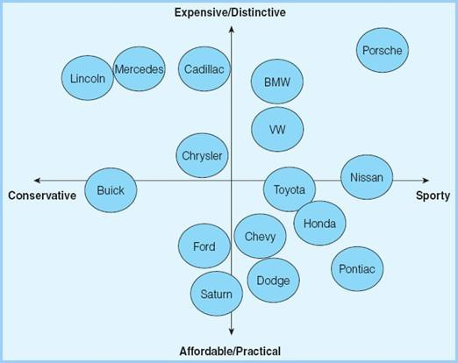
Hypothetical perceptual map of the automotive brands
(Ferrell & Hartline, 2014, p. 211)

Slide 19
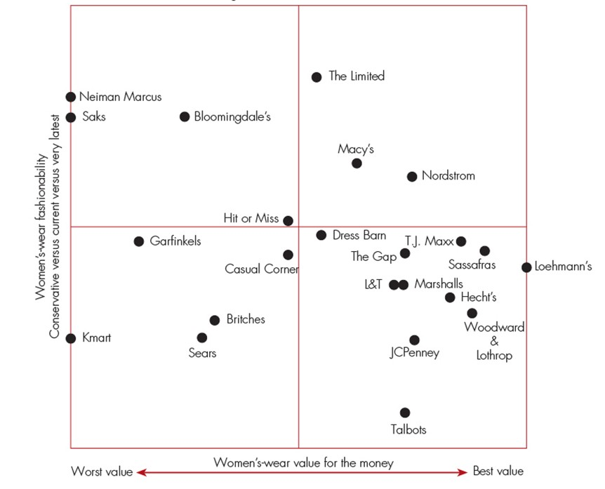
Hypothetical perceptual map of women’s fashion retailer brands
(Walker et al, 2015, Exhibit 7.9)

Slide 20



Perceptual Map
Consumers’ perceptions of their brands compared to competing products
on important buying dimensions
High price
Less
environmentally friendly
More
environmentally friendly
Justify the two determinant attributes.
What does the perceptual map tell you?
Low price

Slide 21
My last piece of advice

Slide 22
