Slide 1
Welcome to BFC1001
Foundations of Finance
Workshop 1: Subject Orientation
Chief Examiner: Dr Jason Choo
Unit Coordinators:
Vincent Lau, Mikhail Bhatia

Slide 2
Orientation Program
Unit Guide Review (15 min)
  Learning Objectives
  Flipped Teaching Approach
  Email & FAQ system
  Staff consultation
Unit Assessment (20 min)
  Understanding In-class and out-of-class assessment activities
  Team Assessment and the Within-semester test
Demonstrating Technology (15min)
  Learning Catalytics (LC) trial run
  Moodle Quiz trial run
5 min intermission
Group Icebreaker (10 min)
  Getting to know your classmates
  Never have I ever …
PBL & LC Practice (45 min)
  Starting our Week 1 Pre-load
  What is Finance?
  Critical thinking concept
  Understanding and being able to articulate the relationship between finance and investment.

Slide 3
Subject Learning Objectives:
From your Unit Guide …
    Understand key Foundations of Finance (see topics)
    Identify & Describe key Foundations of Finance
    Relate these concepts to other disciplines.
This is achieved through an active learning, on-campus, interactive teaching approach and subject assessment. Let’s explore what this means …

Slide 4
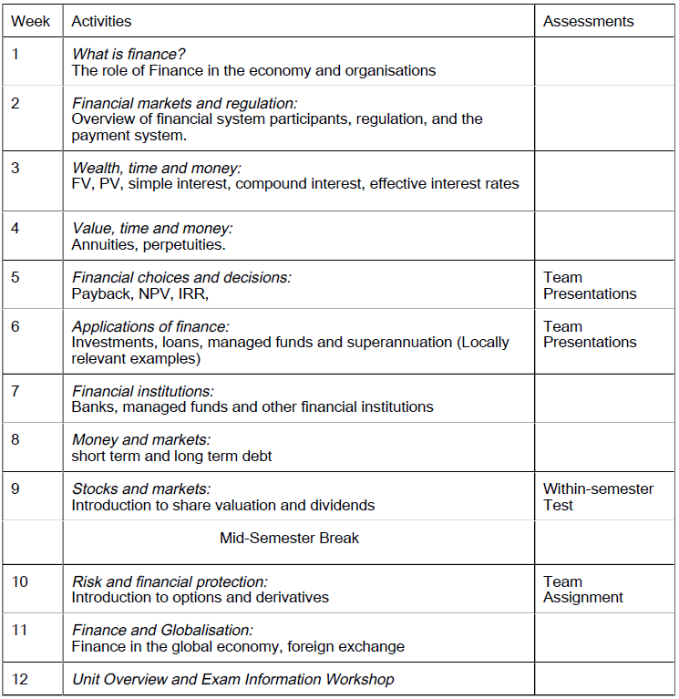
Topic Map

Slide 5
What is Flipped Learning?
(View as a slideshow)
The traditional Passive learning of each week’s topic is through; Pre-class reading, followed by a Lecture then a Tutorial.
Topic learning & comprehension
This is Passive Learning because:
Pre-class reading is “blind” without a teacher to introduce topic learning objectives, relevance of key concepts, and explanation of key relationships
Topic explanation is then concentrated within a 2hr lecture, where there is typically no interaction between the lecturer and students. It is usually a 2hr speech where the presenter has little idea as to the level of comprehension of teaching.
The tutorial experience is typically passive with the discussion of homework question solutions about the lectured material rather than students doing questions live.
Pre-class Reading
Any time before the lecture
2hr Lecture
2hr Lecture
Held each week
1hr Tutorial
1hr Tutorial
Following week after the lecture
Topic application

Slide 6
What is Flipped Learning?
(View as a slideshow)
Active learning is a teaching approach that maximises student interaction and engagement with staff and course material; to achieve better learning outcomes. To do this, we use a Flipped course format.
Topic learning & comprehension
Flipped
1hr Pre-load: Topic Introduction
Learning Objectives
Definition of key concepts
Discussion of relationships
Pre-class Reading
Thurs/Fri
Learning Catalytics:
Live, on-line polling questions
2hr Lecture
Self-study
Topic reading & Quiz
Weekend
2hr Workshop: Topic Completion
1hr Tutorial
1hr Interactive Study:
Completion of topic explanation and comprehension.
Mon - Wed
Topic application
1hr Problem Based Learning:
Live questions on topic application done in class.
Learning Catalytics:
Live, on-line polling questions

Slide 7
What is Flipped Learning?
The Flipped format promotes Active learning because …
Rather than concentrating all Topic learning and comprehension into a single 2hr lecture, student comprehension is built up progressively through learning spanning 3 activities over the course of a week; from Pre-load to Self-study to Workshop Interactive study.
Required reading is no longer “blind” as in the Pre-load, students have been introduced to the key concepts, learning motivation and important relationships of the topic. Due to the Flipped format, there is no pre-released Library or Unit reading guide where students can do required reading before class. Reading is done AFTER the Pre-load.
Both Pre-load and Workshop utilise Learning Catalytics; an online, live question polling system which allows the instructor to deliver live questions to students in class, receive answers immediately and provide feedback and on-the-fly, tailor teaching to the revealed level of student comprehension.
During the Workshop Problem Based Learning (PBL) students apply their topic knowledge and comprehension with structured, live questions based on a realistic scenario or industry problem. Students benefit from the rigor of doing the work under staff supervision. The act of applying knowledge immediately after topic comprehension in the same workshop, rather than waiting till next week’s tutorial, provides for better learning outcomes.

Slide 8
Flipped Learning & Topic Progression
Mon - Wed
Thurs/Fri
Weekend
Week 1
Subject Orientation
What is Finance?
Workshop 1
Pre-load 1
What is Finance?
Self-study
Week 2
What is Finance?
Financial Markets & Regulation
Workshop 2
Pre-load 2
Financial Markets & Regulation
Self-study
Week 3
Financial Markets & Regulation
Wealth, Time & Money
Workshop 3
Pre-load 3
Wealth, Time & Money
Self-study
Week 4
Wealth, Time & Money
Value, Time & Money
Workshop 3
Pre-load 3
Value, Time & Money
Self-study
Etc...

Slide 9
Flipped Learning & Topic Progression
Mon - Wed
Thurs/Fri
Weekend
Etc...
Week 9
Money & Markets
Stocks & Markets
Workshop 9
Pre-load 9
Stocks & Markets
Self-study
Week 10
Stocks & Markets
Risk & Financial Protection
Workshop 10
Pre-load 10
Risk & Financial Protection
Self-study
Week 11
Risk & Financial Protection
Finance & Globalisation
Workshop 11
Pre-load 11
Finance & Globalisation
Self-study
Week 12
Finance & Globalisation
Unit Overview & Revision Workshop
Workshop 12
Self-study
Revision Workshops are held in SWOTVAC Week

Slide 10
Email & FAQ system
In BFC1001, we use a streamlined system of email correspondence working in conjunction with the BFC1001 Frequently Ask Question (FAQ) forum boards.
Rather than email an individual staff member, students will direct all email enquiries to a central subject address:
BFC1001.Clayton-x@monash.edu
The reason for such a system is to efficiently deal with the common occurrence of mass, repetitive email queries sent by students to staff in large units. BFC1001 has an enrolment this semester of 600 students.
For example, in prior semesters, multiple staff have received collectively dozens of emails in one day about the exact same query. Instead of replying with the same answer dozens of times, a central subject email and FAQ system most efficiently handles mass, repetitive queries to benefit of both students and staff.

Slide 11
Email & FAQ system
So what should students expect after sending a query to central subject email?
If the question has been already answered on the Unit Guide, Moodle or FAQ, the student will be directed to the appropriate document with the instruction to see staff in consultation if questions persist.
If a question is not a FAQ but added to the FAQ, the FAQ will be updated with the question answer and the student will be directed to the appropriate section of the FAQ.
If a question is deemed by staff as requiring a direct, custom response, the student will be answered with a custom reply email.
If a question is deemed to require face-to-face consultation, the student will be informed of which staff member(s) to see and the student is expected to see that staff member during consultation to resolve their query. Further email correspondence will not be required.
Staff who are emailed directly by students will inform students to send the query to the central subject email.
Any student asking a question that has already been addressed by the unit guide, FAQ or Moodle documentation will receive an automatic email directing them to read the relevant information and to see staff in consultation should any questions persist.

Slide 12
Staff Consultation
As a foundation subject, many concepts taught here are used in later subjects. Consultation with staff is an essential part of learning these foundational concepts and is often an under-utilised or overlooked resource.
To ensure student learning is most efficiently handled, questions about curriculum topics, readings, assessment, pre-load and workshop study are to be handled via face-to-face consultation with staff. Students emailing such questions to staff or the central subject email will be automatically redirected to see staff in consultation.
A key reason for this policy is that most questions about curriculum or assessment involve complex problems. To appropriately answer such queries, staff often need to diagnose the problem with probing questions of their own that illuminate the students misunderstandings and unique learning circumstance. Then, the answer is often detailed and requiring hand written illustrations of diagrams and formula.
Such a process cannot be achieved effectively via email and requires a back and forth conversation. Further, to maximise student learning in an on-campus subject, staff also wish to encourage as much positive interaction between themselves and students.

Slide 13
BFC 1001 Staff Consultation
Staff: | Consult time: | Venue: (in Menzies)
Jason Choo (CE) | Tues. 11am-12pm, Thurs. 1.30-3pm, Fri. 1.30-3pm | W1012
Ali Sheikhbahaei | Wed. 3-4pm | W1024
Vince Lau (UC) | Wed. & Thurs. 10-11am | W1024
Mikhail Bhatia (UC) | Tues. 2-3pm | E1058
Sarah Allen |  | E1058
Apeksha Arun | Mon. 10.30-11am & 12–1pm | E1058
Cheryl Lim | Wed. 4-5pm | E1058
Polly Leng | Tues. 4-5pm | E1058
Anh Tran | Thurs. 10-11am | E1058
CE = Chief Examiner, UC = Unit Coordinator

Slide 14

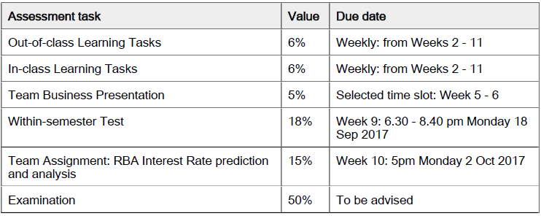
Let’s Review Unit Assessment

Slide 15
Assessment Summary
In-class Assessment (6%) consists of 2 components …
Weekly Learning Catalytic (LC) Participation (5%)
In-class Financial Literacy Survey (1%)
Out-of-class Assessment (6%) consists of 2 components …
Weekly Self-study Quizzes (5%)
On-line Financial Literacy Survey (1%)
Within-semester Test (18%)
An 2hr test following the same format as the exam to help students prepare for that assessment.
Comprises of MCQ and Short Answer questions.
Assessable Topics: 1 – 7.

Slide 16
Assessment Breakdown
Team Assessment (20%)
Team Business Presentation: (5%)
Team Assignment: Predicting the RBAs next interest rate decision. Consists of a business report (10%) and a video presentation (5%) of the team’s analysis and recommendations.
End-of Semester Exam (50%) …
A 2 hr exam on all assessable material in the subject.
Comprises of MCQ and Short Answer questions, same format as the test.
Students need to pass the exam to pass the subject.
All students need to read carefully and repeatedly through pages 11 – 24 of the Unit Guide which provide the required detail and marking criteria of these assessment tasks at present. Further assessment information will be release at the appropriate time.
Any further questions about assessment are to be answered during consultation. Any student emailing staff or the central subject email will be directed to see staff in consults.

Slide 17
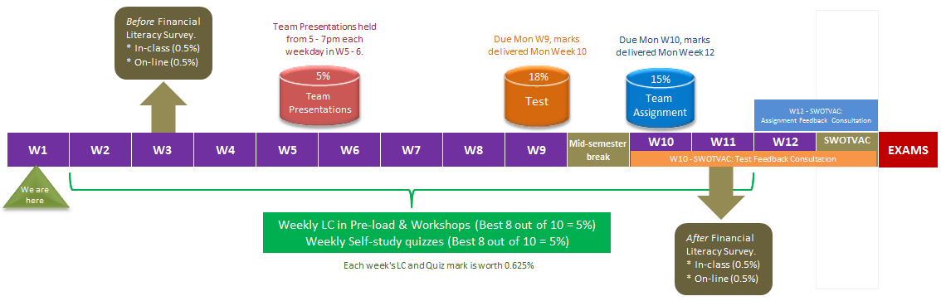
Unit Assessment Timeline
The Unit Assessment Timeline is useful to help students plan and schedule their individual and group study. It is the banner of the Unit Information section of Moodle and will be updated weekly so students can gauge the progress of the unit.

Slide 18
Team Assessment
Learning how to work as a team is a critical skill in your future career. So, we place particular emphasis on team based assessment.
You need to form teams of 3 – 4 students.
Can be with any student in the cohort. You are not restricted to your workshop mates.
No other team sizes are allowed. You cannot submit team assessment individually.
You need to nominate a team representative who will liaise with unit staff on behalf of your team.
Your team representative tasks:
Download from Moodle, fill out and send back to the central subject email the team registration form.
Select the Team Presentation Time slot and send you power point slides to you team judge.
Submit your Team Assignment electronically on Moodle and relay feedback to your team mates.

Slide 19
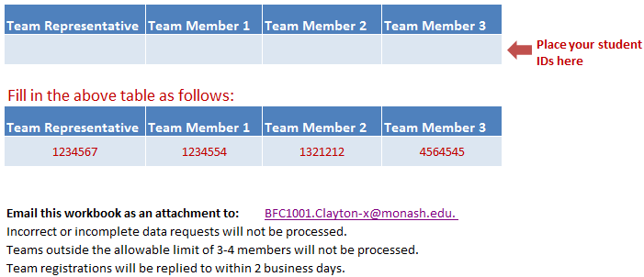
Team Registration Form
From the Team Business Presentation section on Moodle, Team Representatives will need to download, fill out and send back the Team Registration.xls Excel workbook to the central subject email as soon as possible.
Further instructions about Team Assessment will follow. The same team will being performing two assessment tasks; the Team Business Presentation and the Team Assignment. This encourages students to develop stronger team bonds and proper team work ethic and accountability.

Slide 20
Team Management
Students are solely responsible for forming and managing their teams. Part of the skill you need to develop is the social ability to mingle, interact and get to know your classmates and future workmates.
There will be a Team Formation forum where students can post their availability to join a team and where Team Representatives can post their need for team members.
When posting on the forum make sure you also post your student email contact and also be proactive in contacting other students rather than waiting for others to contact to you.
Your team composition can change. To enact a change …
      The Team Representatives of both the teams you are leaving and entering will have to email the central subject email to verify the change. No change will be registered unless this condition is followed. If a Team Representative leaves a team, a new team representative will have to make him/herself known by emailing the central subject email. Teams with no representative are invalid.
      The person leaving the team also has to see either the Chief Examiner or Unit Coordinator to explain their reason for leaving the team.
Any further questions about team management are to be asked during consultation. Any student emailing staff or the central subject email will be directed to see staff in consults.

Slide 21
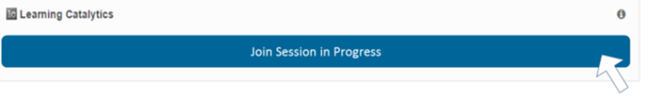
Demonstrating Technology
We will now demonstrate Learning Catalytics and how to work through a sample Self-study Quiz.
All students, with your computing device, open up Moodle for BFC1001. (Please enable Pop-ups on your browser)
Click on after which a new LC window will open.
You are now ready to join a Learning Catalytics session. Click on …
After joining the session, you can now wait for the first question to be delivered. The instructor will now deliver LC questions 1 – 3, guide you through how to answer and show you the performance feedback.
Accessing Learning Catalytics

Slide 22

Demonstrating Technology
Leave your LC window open, we will need it for our sample Problem Based Learning session later. Navigate back to your BFC1001 Moodle window.
In the Section Unit Information
Click on
Your instructor will now guide you through the quiz format and answering the set of sample questions.
Self-study Quiz

Slide 23
Technical Issues
Students who are having technical issues with LC need to see staff during consultation to get the issue resolved. Consultation times will be posted on Moodle. Any student emailing staff or the central subject email about technical issues will be directed to see staff in consultation.
Upon seeing staff, please replicate the problem on your computing device so that we can troubleshoot for you.
LC Tip: When LC is finished and you wish to shut it down, do so by closing the window that LC is on. Do not click on the Log Out button as this will break your student credentials with the Pearson system and you will be forced to provide login details the next time you use LC that you do not have.

Slide 24
Unit Calculator
The Faculty of Business and Economics requires that all students use only one calculator; the HP10Bll+.
All students can go to Student Services on the 2nd floor of the Menzies Building to pick up your new HP calculator free of charge.
There will be posts on the FAQ forum on calculator use with tutorial videos.
Steam Leaders will also be showing students in class how to use the HP financial calculator.
You will need to bring your HP calculator to every class, both Pre-load and Workshop.
Only this HP calculator is allowed into the Test and Exam venues.
If your calculator is faulty, you may exchange it at Student Services.
Any further questions about the HP calculator are to be asked during consultation. Any student emailing staff or the central subject email about the calculator will be directed to see staff in consults.

Slide 25
What to bring to class?
For every Pre-load and Workshop, students are required to bring:
      Their HP calculator
      Pen and paper to take down your own learning and study notes. This is especially important for the topics on financial math where students will need to apply formula and draw cash flow timelines on paper.
      A mobile computing device; e.g. smart phone, tablet or laptop. This is needed for you to log into Learning Catalytics which will be used in every class.
Students who do not have these resources will not be able to actively partake in class.

Slide 26
Unit Textbook
The textbook for the unit is …
Arthur J. Keown, John D. Martin (2016), Foundations of Finance, Pearson Australia (Softcover)
Hardcopies are available for purchase in the bookshop. Ebook versions are available from …
http://www.pearson.com.au/9781292155142
Do remember that the unit follows a Flipped approach which is not textbook centric. The textbook forms the majority of topic reading to be done AFTER the Pre-load and reading instructions will be provided in each Topic’s Moodle section.

Slide 27
Group Icebreaker
An introduction to Problem Based Learning (PBL) is the 2nd part of our orientation.
The traditional tutorial was where students received questions in advance, were expected to do those questions independently and discuss solutions in tutorials.
PBL is where questions are delivered live during class (via LC), set in a problem or scenario context relevant to the Topic. Students work individually or in groups to answer the questions on the spot and the solutions are discussed.
Part of performing well in PBL is working in a group, which will consist of the classmates sitting at the same table as yourself. We'll now set the groups for the semester, your TAs will organise this. Then, to get to know each other a bit better, we’ll play a small game to break the ice.
Never have I ever …
Your stream leader will now demonstrate.

Slide 28
Sample PBL Session
The remainder of our orientation program will be using PBL to start an extended Pre-load of the first Topic, What is Finance?
The pre-load will be continued this Thursday and Friday.
The pre-load of subsequent weeks will be conducted only in the Thursday and Friday sessions.
Being able to define Finance and Investment and knowing the relationship between these concepts in a corporate environment is an essential Foundation of Finance.
The PBL will now start with a role-play scenario delivered via LC questions 4 – 6 …
After the scenario is finished, let us conclude by summarising the 1st Critical Thinking Concept of this subject.

Slide 29
Our Perspective; a business /company. View as slideshow
What is Finance?
What is Investment?
=
=
The raising of money (Capital)
We do not use the word “money”, we look at it from a corporation perspective.
The making of money, using capital
Existing funds of owners
Sharing ownership
  Selling part of the business to the public
Borrow money
How do we Invest?
How do we Finance?
Raising
Equity
Used to buy assets that make money (generate a return)
Assets bought depend on the type of business being run.
The process of using capital to buy assets is called…
capital expenditure
Capital
Raised…
Raising
Debt
*Concept Check: What are the two types of Capital?
Depth and equity
* Link to Accounting: Which financial statement shows
the Finance & Investment structure of a company?
Balance Sheet

Slide 30
Follow your stream leader who will demonstrate the link between finance and investment using a balance sheet.
Liabilities/debt= Kd= cost of liability is interest and cost of debt is coupon payments
Equity= ke= cost of equity is dividends
Expected return (ER) should always greater than required rate of raised capital (RROR)

Slide 31

Foundation Conclusion: The link between Finance & Investment
Is Capital free? No.
Shareholders need a return for owning the business
Creditors (whom money is borrowed from) require interest.
Thus…there is a Cost of Capital
As Investment is the use of capital to buy assets that generate a return…
How is the choice of assets (capital budgeting) affected by the cost of capital?
The assets bought with capital should earn more than the cost of capital
$${E(R)}_{Assets}> {RRoR}_{Capital}$$
If total assets earn < total cost of capital, the business is insolvent and may not be able to continue operation.
* This foundational conclusion can be further developed in later subjects which examine the Fisher Separation Theorem

Slide 32
Before your Topic 1 Pre-load, please read Chapter 1, pg. 26 – 43 of your textbook to continue your introduction to finance. It introduces important background ideas and knowledge used throughout the subject.
Students are required to carefully review the Unit Guide (UG) and this Orientation Program (OP).
Any queries directed to the central subject email about anything already covered in the UG or OP will receive an automatic reply to review these documents and to see staff in consultation if questions persist.
BFC1001 is an on-campus subject. Students will need to attend class to benefit from the active learning of the subject. This unit is not suitable for students seeking an off-campus, distance learning approach which does not require students to attend class. Students who wish to complete units without attending class are directed to seek out other units.
Orientation Concludes

