Slide 1

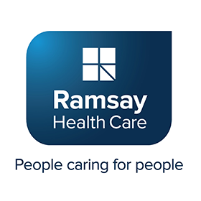

Ramsay healthcare ltd
POOJA, CHLOE

Slide 2
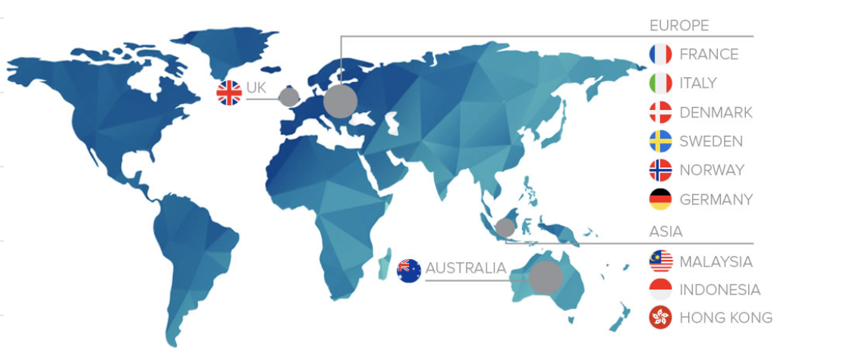
CURRENT POSITION
480 FACILITIES
11 COUNTRIES
WORLD’S LARGEST AND MOST DIVERSE HEALTH CARE COMPANIES IN THE WORLD
OPERATES IN;
1. AUSTRALIA
2. EUROPE
3. ASIA
4. UNITED KINGDOM

