Slide 1
Week 8
Managing Quality chapter 16

Slide 2
Our learning goals today
To understand what quality means and how to manage it
  The cost of quality
    Four categories and their relationships
  Total quality management (TQM)
    Accounting impediments to TQM
  Other approaches; quality accreditation
  Quality and the BSC

Slide 3
Introduction - what is quality?
What is quality?
  Often defined in terms of products/ services meeting customers’ needs and expectations. In other words,
  The total features and characteristics of a product or a service made or performed according to specifications to satisfy customers at the time of purchase and during use
  Two basic concepts need to be understood:
Quality of design
  Degree to which a product’s design specifications meet customers’ expectations
Quality of conformance
  Degree to which a product meets formal design specifications

Slide 4
Two aspects of quality
Actual
performance
Design
specifications
Customer
satisfaction
Conformance
quality
failure
Quality of
design
failure
A clear understanding of customer value is needed to provide customers with a high-quality product

Slide 5
Focus on quality
Seeks to reduce costs and increase customer satisfaction
Focus on the quality of a product will generally:
  build expertise in producing it
  lower the costs of making it
  create customer satisfaction for customers using it, and
  generate higher future revenues for the company selling it

Slide 6

Why is quality cost management important?
Quality costs can be substantial
Source of significant cost savings
Source of competitive advantage

Slide 7
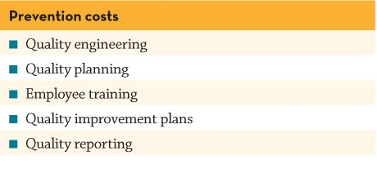
Cost of Quality Reports
Prevention costs – incurred to preclude the production of products that do not conform to specifications

Slide 8
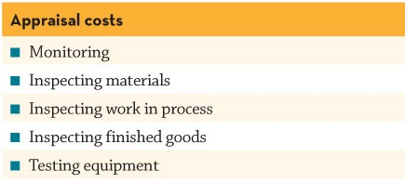
The costs of quality
Appraisal costs – incurred to detect which of the individual units of products do not conform to specifications

Slide 9
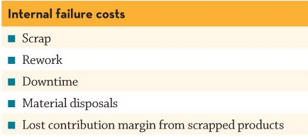
The costs of quality
Internal failure costs – incurred on defective products before they are shipped to customers

Slide 10
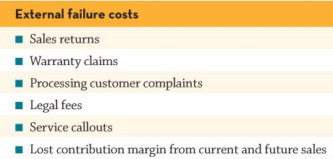
The costs of quality
External failure costs – incurred on defective products after they are shipped to customers

Slide 11


The costs of quality
Prevention costs
Appraisal costs
Internal failure costs
External failure costs

Slide 12
Using cost of quality information
Cost of quality report
  Places a dollar figure on the costs of poor quality
  Looks at trends over time
  Classifies costs as fixed or variable
  Considers interactions between the four categories

Slide 13
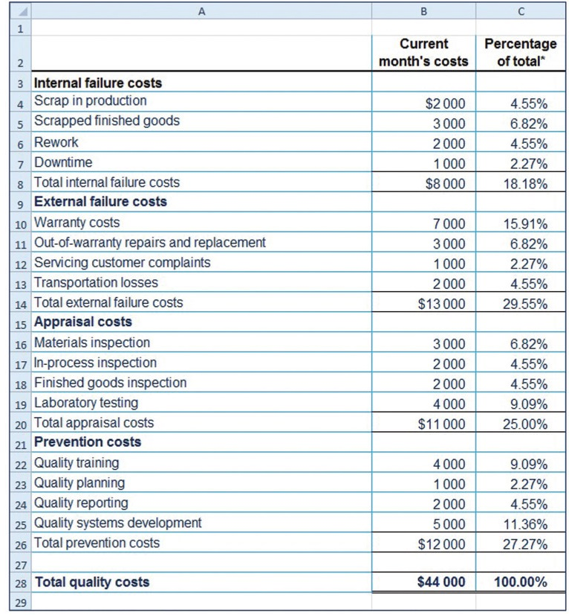
Cost of quality report

Slide 14
Lecture example
      Lightning Technologies Ltd (LTL) produces two extrusion machines that are very popular with plastics manufacturers: model ABC and model XYZ. Model ABC has an average selling price of $60 000, and model XYZ sells for about $55 000. The company is concerned about the differing performance of the two machines in relation to quality, and has collected the following information:

Slide 15
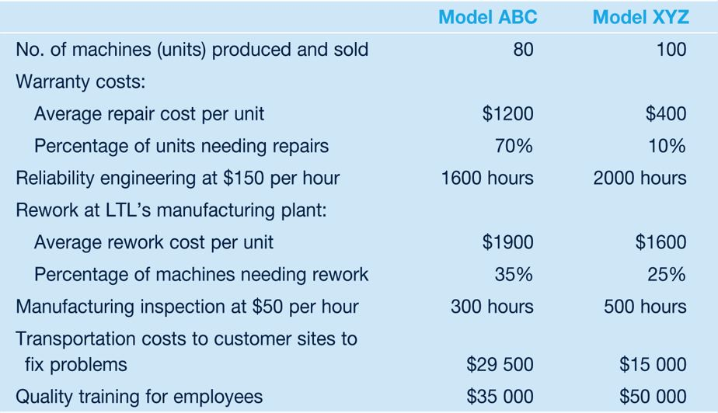
Lecture example (Contd..)

Slide 16
Lecture example (Contd..)
Required:
Classify the above quality costs as prevention, appraisal, internal failure or external failure.
Prepare a cost of quality report for model ABC in dollars. In addition, add a further column showing all quality costs as a percentage of sales revenue.
Prepare a similar cost of quality report for model XYZ. (A file is on Moodle to help you do this)
Comment on the two reports, noting whether the company is ‘investing’ its quality expenditure differently for the two machines.

Slide 17
Using cost of quality information
Benefits of COQ information
Creates opportunities
  focuses managers’ attention on the costs of poor quality by placing a dollar figure on it
  helps managers reduce costs and improve quality
  helps managers monitor the effects of the ‘quality effort’ and identify the optimal level of quality for the firm
Provides visibility
  Helps prioritise quality improvement programs
  Shows that firms typically spend money on the wrong categories

Slide 18
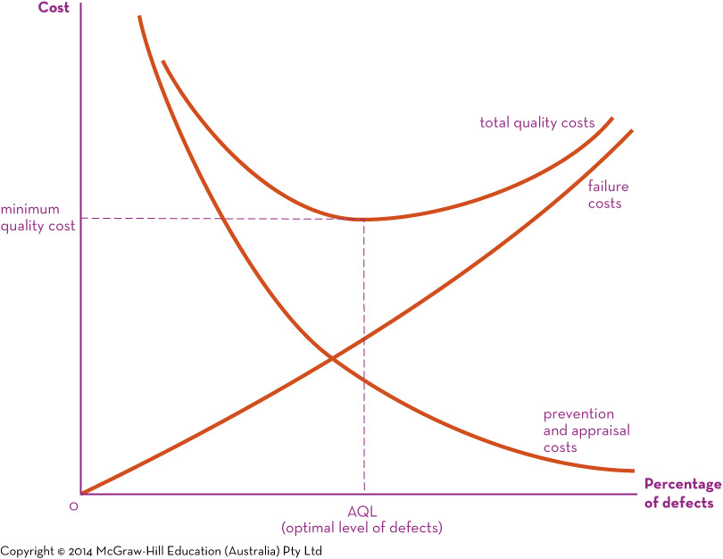
Optimal level of quality performance

Slide 19

Cost of quality - unobserved costs
Some costs of quality are frequently not accounted for due to estimation difficulties and being unrecorded in the company accounting records
Opportunity costs as a result from poor quality:
  Contribution to profit foregone from lost sales
  Loss of goodwill
  Lost production
  Lower prices

Slide 20
COQ information – a word of caution
Need to recognise expenditure lag
  Quality costs first increase, then decrease
  managers may be reluctant to incur initial expenses
The “optimal level of quality” for the firm is a debatable concept
  two schools of thought

Slide 21
Schools of thought about “optimal level of quality”
Aim for optimal level of quality | Aim zero defects
Always look for COQ trade-offs | Source of customer value
AQL* where expenses in Prevention + Appraisal = savings in Internal failure + External failure | Consequences of external failure
 | COQ relationships & experience
  *AQL stands for ‘Acceptance Quality Limit’
Some companies don’t use COQ reports because they regard cost tracing as inadequate for quality management

Slide 22
Total quality management (TQM)
“a holistic management philosophy that strives for continuous improvement in all functions of an organization” (Kaynak 2003, p.406).
TQM focuses on meeting customer expectations by achieving continuous improvement in processes
    Meeting customer requirements is central to all activities.

Slide 23

Total quality management (TQM)
  Organisation-wide
  Customer-driven
  Involves empowerment
  Has a process perspective
  Supported by a quality management system
  Involves continuous improvement
    Continual incremental improvement towards perfection

Slide 24

Total quality management (TQM)
Making it right the first time
    Zero defects should be the goal
    Costs of non-conformance are so high that evaluating the costs of quality are unnecessary
Aims to improve the quality
of life for producers,
consumers and investors
Quality is a journey,
not a destination

Slide 25
Accounting Impediments to TQM
System not set up to capture COQ costs
Process costing – scrap and rework normal allowances
No non-financial measures
Variance analysis
  Volume variances - maximise production
  Raw material variance – reduce input prices
Meet predetermined standard costs
Additional quality costs incurred now, benefit later
Don’t record opportunity costs

Slide 26

Techniques for identifying and analysing quality
Relates to quality of conformance.
Statistical quality control (SQC) is used in modern production lines. Techniques include:
Control charts
Pareto diagrams
Cause-and-effect diagrams

Slide 27
Other approaches to quality management: Six Sigma
Six Sigma is a business improvement methodology that uses a structured approach involving rigorous data analysis and unique team based structures
  E.g. Motorola
Improvement to existing processes / improvement for new products or processes
  Collection and detailed analysis of data is key
  Projects are prioritised based on improvements to financial performance
Could Six Sigma could stifle creativity and innovation?

Slide 28

Other approaches to quality management: Quality accreditation
Organisations may achieve quality accreditation by meeting international ISO 9000 quality standards
  Accreditation is no guarantee of TQM practice, but probably a good indicator
  TQM is a philosophy / body of ideas
  Accreditation is a process of assurance, highly process driven and based on documentary evidence
  See http://www.iso.org/iso/home/standards/management-standards/iso_9000.htm for more information.

Slide 29
Quality and the BSC
Financial Perspective
  COQ
Customer Perspective
  Surveys on satisfaction
  Market share
  Number of defective units shipped to customers
  Number of customer complaints
  Product fail rates
  Delivery delays / on-time deliveries

Slide 30
Quality and the BSC
Internal business
  Percentage of defective products
  Average repair time at customer site
  Percentage of reworked products
  Number of different types of defects found
  Number of design and process changes made

Slide 31
Quality and the BSC
Learning and growth
  Employee turnover ratio
  Employee empowerment – number of processes in which employees have the right to make decisions without consulting supervisors
  Employee satisfaction
  Employee training

Slide 32
Summary
The management of quality contributes to customer value
Cost of quality reports are a useful means to help manage quality
TQM, Six Sigma and ISO 9000 provide ways of developing and reinforcing a quality culture and meeting customer expectations

Slide 33
Acknowledgement
The contents of this presentation was adapted from:
PowerPoint Slides
Langfield-Smith, K., Thorne, H., Smith, D., & Hilton, R. W. (2015, 2017). Management accounting: Information for creating and managing value (7th ed.). Sydney, NSW: McGraw Hill. ISBN:
9781743075906

