Slide 1
Week 7
Managing and reporting performance in decentralised organisations
Chapter 12

Slide 2
Our learning goals today
Understand what the MCS is
Structuring for control
Complex structures
Managing challenges of decentralisation
  Goal congruence and Transfer pricing
  (you’ll need the word document for the lecture examples)
[See notes to some of the slides, they are just there for your revision, not to be covered in the lecture]

Slide 3
Let’s locate MCS in an organisation
We can break down the broad area of management in different ways (Merchant, 1998):
Functions
Development
Operations
Resources
People
Machines
Processes
Objective setting
Strategy formulation
Marketing/ Sales
Finance
Money
information
Management control

Slide 4
What does a well-designed MCS do?
Primary function: influences behaviour in desirable ways
Benefit/ outcome?
  Increases probability of achieving organisational objectives (by correctly implementing the strategies)
Research shows (Merchant, 1998):
  Focusing on improving MCS provides better payoffs than focusing on improving strategies
  Seven out of ten CEOs who fail do so not because of bad strategy but because of poor implementation

Slide 5
Management Control Systems
Consists of formal and informal control systems:
  Formal systems include explicit rules, procedures, performance measures, and incentive plans that guide the behaviour of its managers and other employees
  Informal systems include shared values, loyalties, and mutual commitments among members of the company, corporate culture, and unwritten norms about acceptable behaviour
© 2009 Pearson Prentice Hall. All rights reserved.

Slide 6
Purpose of performance management
Communicate strategy and plans, align employee’s goals
Track management performance against targets
Evaluate and reward subordinates’ performance
Guide future development of strategies and operations
Notes:
Just for a refresher- we discussed this before

Slide 7
Characteristics of effective performance measurement systems
Links to strategies and goals
Recognises controllability
Embraces participation and empowerment
Simple and understandable measures
(cont.)
Notes:
Just for a refresher- we discussed this before

Slide 8
Characteristics of effective performance measurement systems
Emphasises the positives
Is reported in a timely manner
Includes benchmarking
Limited measures
Links to rewards
Notes:
Just for a refresher- we discussed this before

Slide 9
Structuring for control: decentralisation
Decentralisation
  Dividing the organisation into smaller units
  Each unit is assigned particular operational and decision-making responsibilities
Goal congruence
  Ensuring goals throughout the units are aligned with organisational goals
(cont.)

Slide 10
Structuring for control: decentralisation
Responsibility accounting
  Assigning responsibility to managers to run their units
  Managers are held accountable for the performance of their units
(cont.)
Notes:
Just for a refresher- we discussed this before

Slide 11
Structuring for control: decentralisation
Benefits of decentralisation for managers
  More accurate and complete local information about markets and operations
  Training for future higher-level managers
  Greater motivation and job satisfaction
  More time for strategic issues
  Delegation allows quicker responses to opportunities and problems as they arise
(cont.)

Slide 12
Structuring for control: decentralisation
Costs of decentralisation
  Narrow focus on own unit’s goals
  Unnecessary duplication
Goal congruence: a behavioural challenge

Slide 13
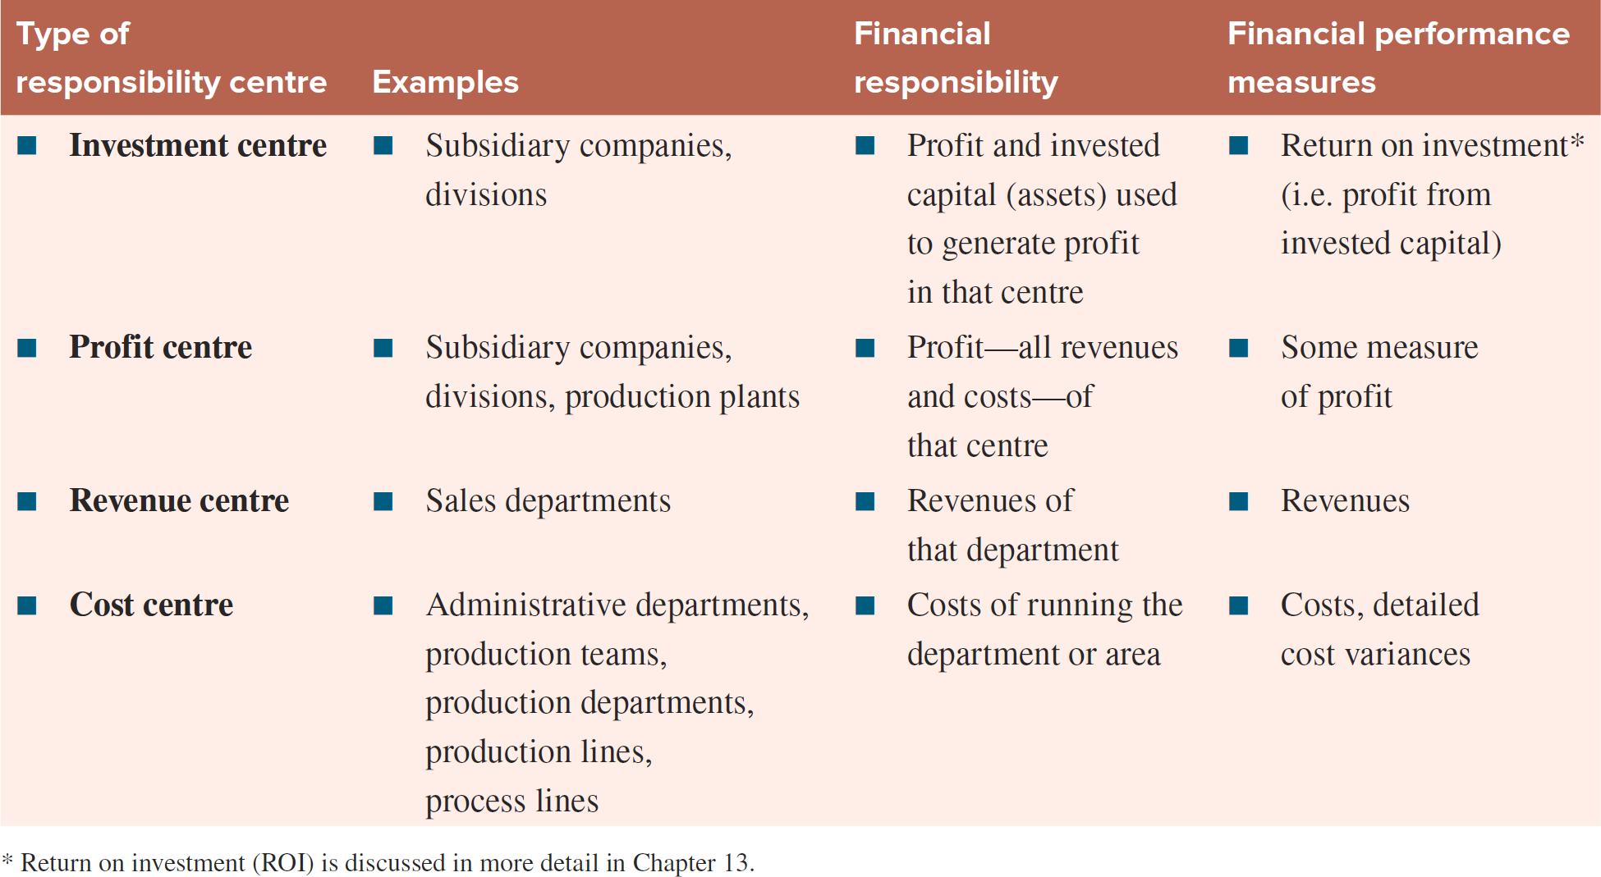
Responsibility centres and financial performance
Notes:
Just for a refresher- we discussed this before

Slide 14
Responsibility centres
In practice
  Cost centre is commonly used
  Revenue centre is seldom used
  Profit centre may refer to both profit centres and investment centres
  Strategic business unit (SBU) is often used to refer to investment centres and occasionally to profit centres that have their own distinct markets and strategies
Notes:
Just for a refresher- we discussed this before

Slide 15
More complex structures
Shared services
  The concentration of support services formed into a separate unit to service multiple internal customers
  Aim to reduce cost and improve quality of service
  High level of autonomy and incentives
  Often set up as profit centres with the aim to break even
(cont.)

Slide 16
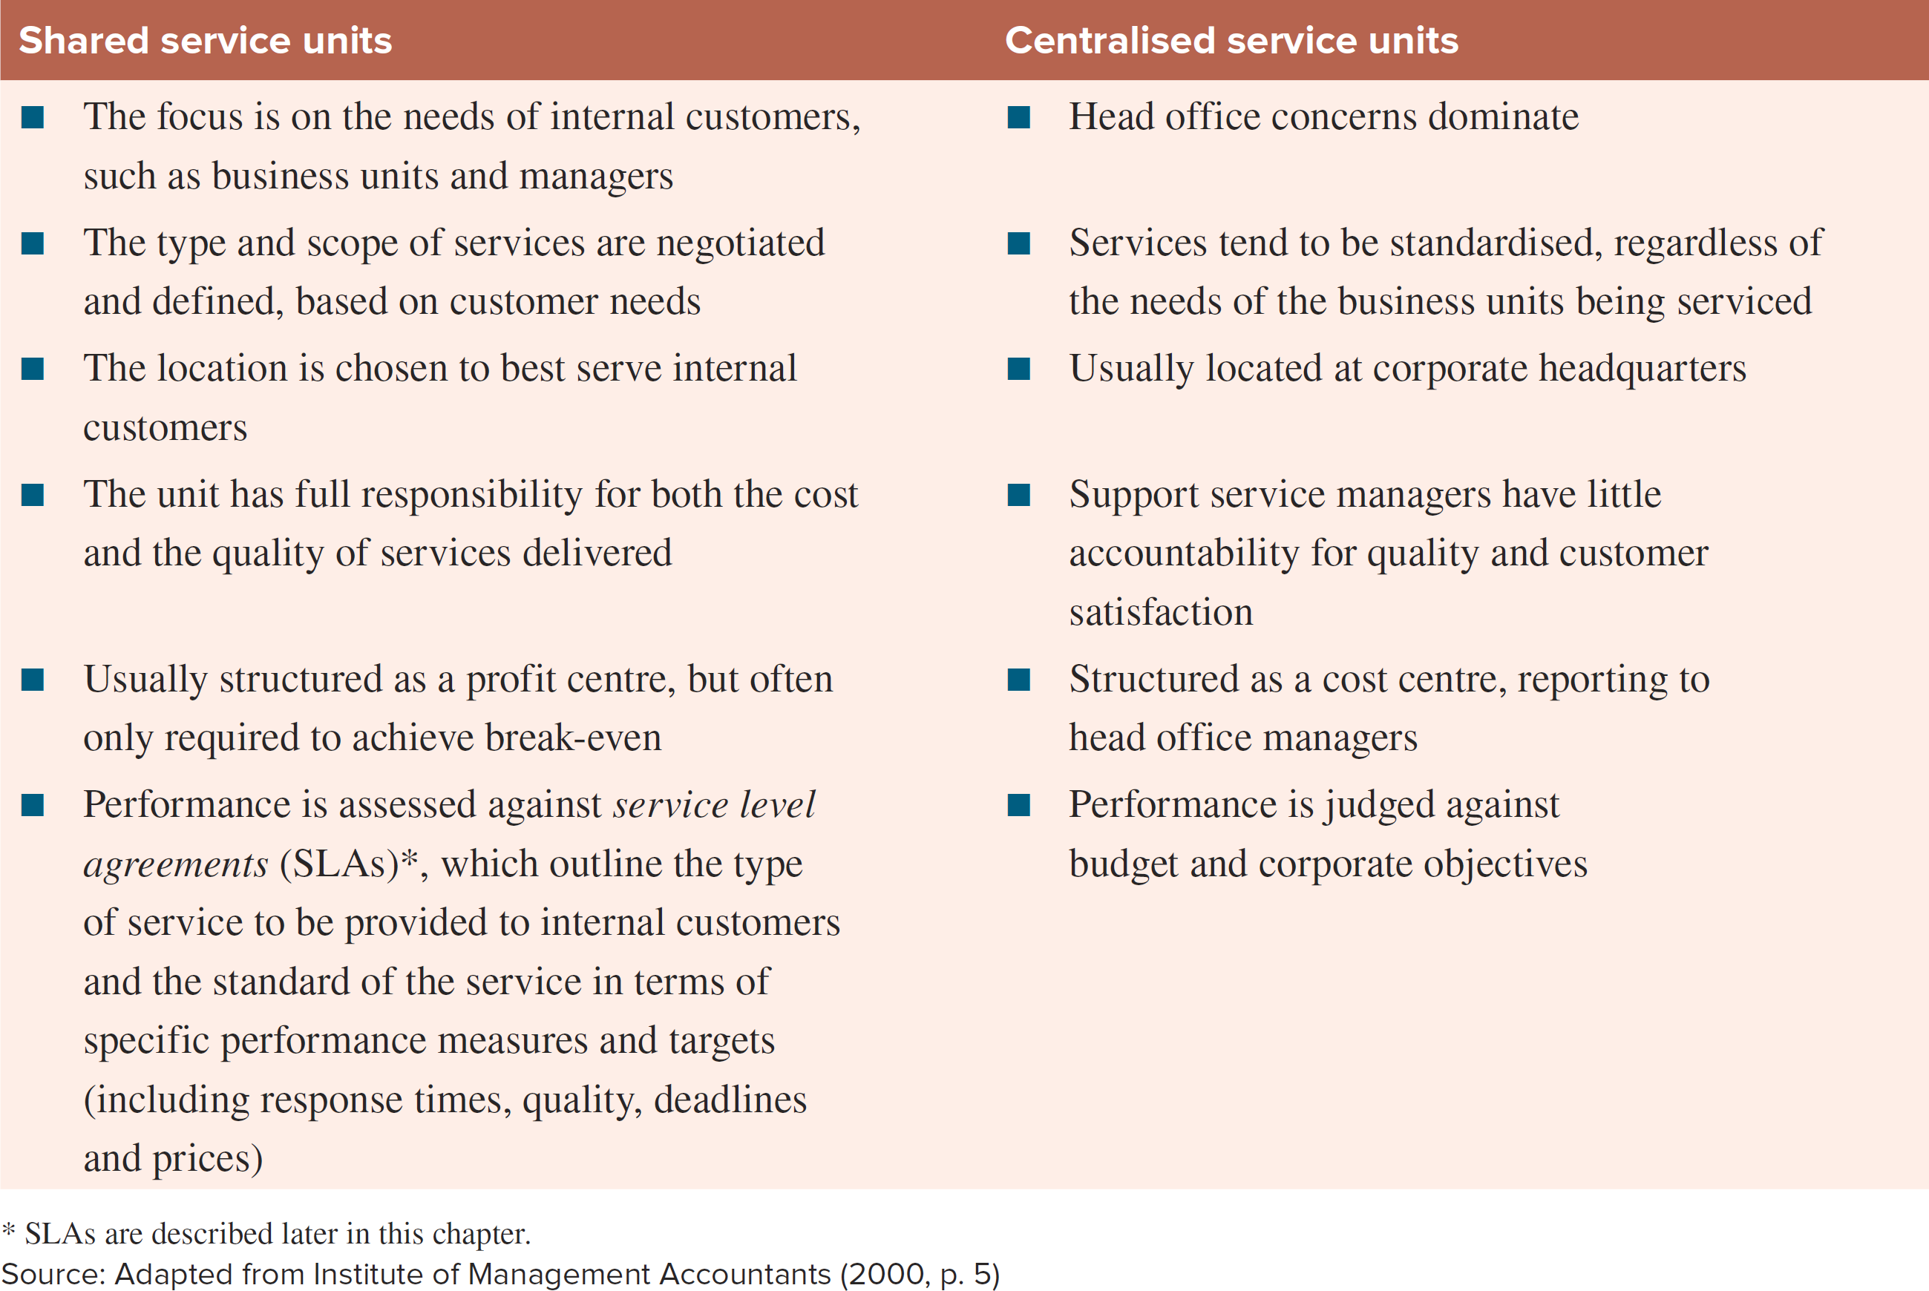
Shared services versus centralised services
(cont.)

Slide 17
More complex structures
Team-based structures
  Move towards flatter organisational structures
  Self-managed work teams
  Members of team will be multiskilled
  Promote employee satisfaction and improved productivity
(cont.)

Slide 18
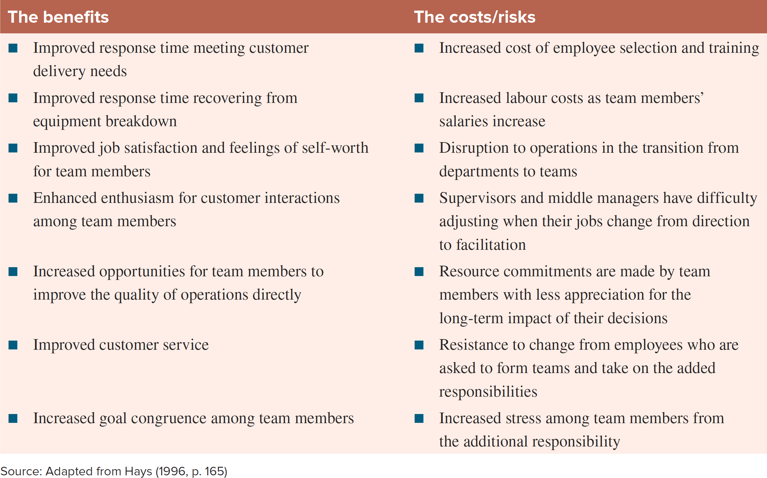
Trade-offs in the implementation of self-managed work teams

Slide 19
Financial performance reports
Show key financial results appropriate for the type of responsibility centre
Segmented profit statements
Contribution margin format
Typically highlight variances between budgeted and actual results
(cont.)
Notes:
Just for a refresher- we discussed this before

Slide 20
Financial performance reports
Distinguish between profit margin controllable by manager and profit margin attributable to unit
Cost allocations
  Traditional or ABC methods can be used
  Some common costs may not be allocated
Real-time reporting
Notes:
Just for a refresher- we discussed this before in week 1

Slide 21
Transfer pricing
The internal selling price used when goods and services are transferred within a decentralised organisation
The transfer price is revenue for the supplying unit and cost for the buying unit
(cont.)

Slide 22
Transfer pricing
Transfer pricing should:
  result in units’ profits that are reliable and accurate
  preserve and encourage autonomy
  encourage goal-congruent behaviour

Slide 23
Who sets the transfer prices?
Managers of profit centres and investment centres may have considerable autonomy
Corporate management intervention is contrary to decentralisation philosophy
Corporate management may develop general policies to govern transfer pricing practices

Slide 24
Transfer pricing methods
Market-based prices
  Competitive external markets
Cost-plus prices
  Intermediate products
Negotiated prices

Slide 25
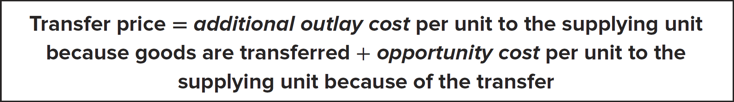
Transfer pricing
General transfer pricing rule
  Provides guidance on the appropriate transfer price
  Represents a minimum transfer price

Slide 26
Transfer pricing: the influence of income taxation
In multinational companies, transfer pricing effectively ‘transfers profits’ between business units in different countries
International transfer prices may be influenced by the different taxation rates and different regulations

Slide 27
Summary
Purposes and characteristics of MCS and performance measurement
Decentralisation and responsibility accounting
Complex organisational structures
Transfer pricing

Slide 28
Acknowledgement
The contents of this presentation was adapted from:
PowerPoint Slides
Horngren, C., Datar, S., Foster, G., Rajan, M., Ittner, C., Wynder, M., Maguire, W., & Tan, R. (2013). Performance Measurement & Management: Linking Strategy to Value Creation. Frenchs Forest, NSW: Pearson Australia.
Langfield-Smith, K. (2008, 2017) Management Accounting. McGraw-Hill Australia
Merchant, K. and Van der Stede, W. (2012). Management Control Systems: performance measurement, evaluation and incentives. Edinburgh Gate: Pearson.

