Slide 1
Week 6:
Standard costing and variance analysis
(part 2)
Chapter 10
10-1

Slide 2
Topic in week 4 and 5?
Budgeting- basics (what, why, how to prepare) plus variations, behavioural implications
Introduction to standard costing (what, why, how again)
  The use of flexible budget
  What is a variance, when to investigate a variance
10-2

Slide 3
Our focus today:
To understand what are the different levels of variances
To learn how to calculate some of them
Understand their limitations as a tool for cost control
10-3

Slide 4
Just compare!
Budget
Actuals
Variance
10-4

Slide 5
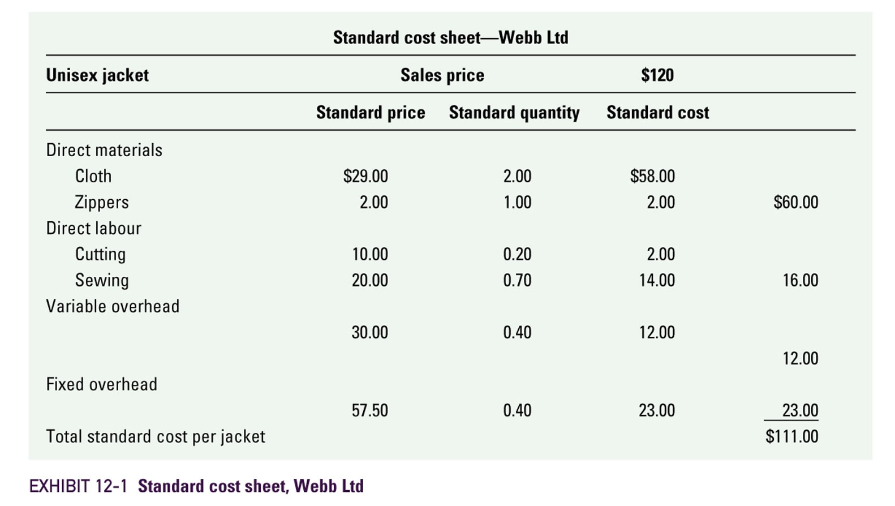
Standard cost

Slide 6
Variance calculation: basic concepts
Static-budget variance (let’s call it level 0) – the difference between the actual result and the corresponding static-budget (master budget) amount
Favourable variance (F) – has the effect of increasing operating income relative to the budget amount
Unfavourable variance (U) – has the effect of decreasing operating income relative to the budget amount
10-6

Slide 7
Variances
Variances may start out ‘at the top’
with a level 0 analysis.
This is the highest level of analysis, a super macro view of operating results.
The level 0 analysis is nothing more than the difference between actual and static-budget operating income
10-7

Slide 8
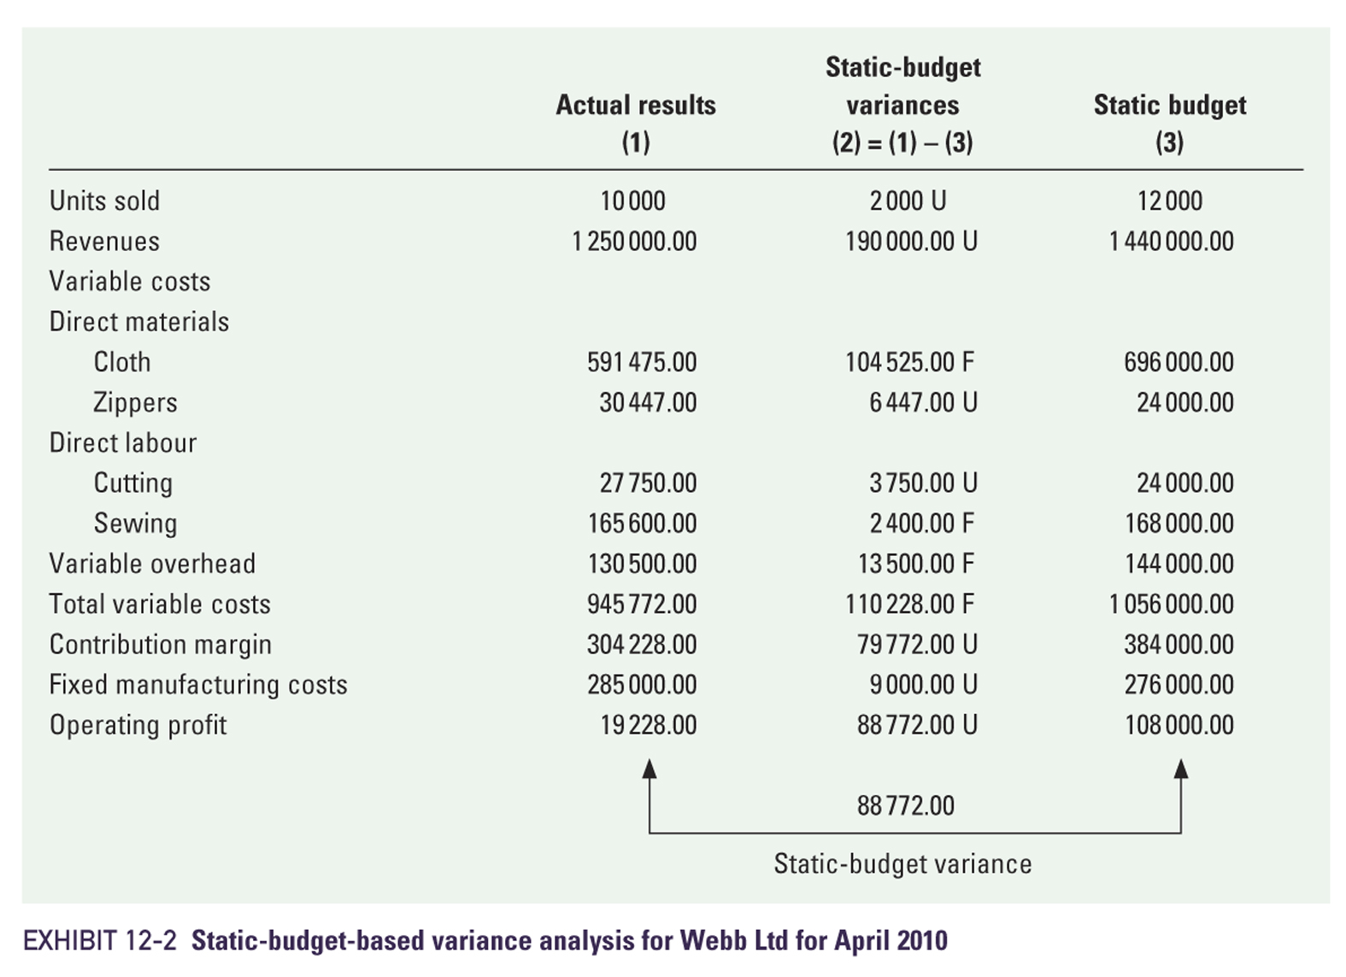
Level 0 Analysis Illustrated
10-8

Slide 9
Variances
Further analysis decomposes (breaks down) the level 0 analysis into progressively smaller and smaller components
  Answers: ‘How much were we off?’
Levels 1, 2, and 3 examine the level 0 variance into progressively more detailed levels of analysis
  Answers: ‘Where and why were we off?’
10-9

Slide 10
Level 1 Analysis Illustrated
10-10

Slide 11
Flexible Budget (reminder)
Flexible budget – shifts budgeted revenues and costs up and down based on actual operating results (activities)
Represents a blending of actual activities and budgeted dollar amounts
Will allow for preparation of level 2 and 3 variances
  Answers the question: ‘Why were we off?’
10-11

Slide 12
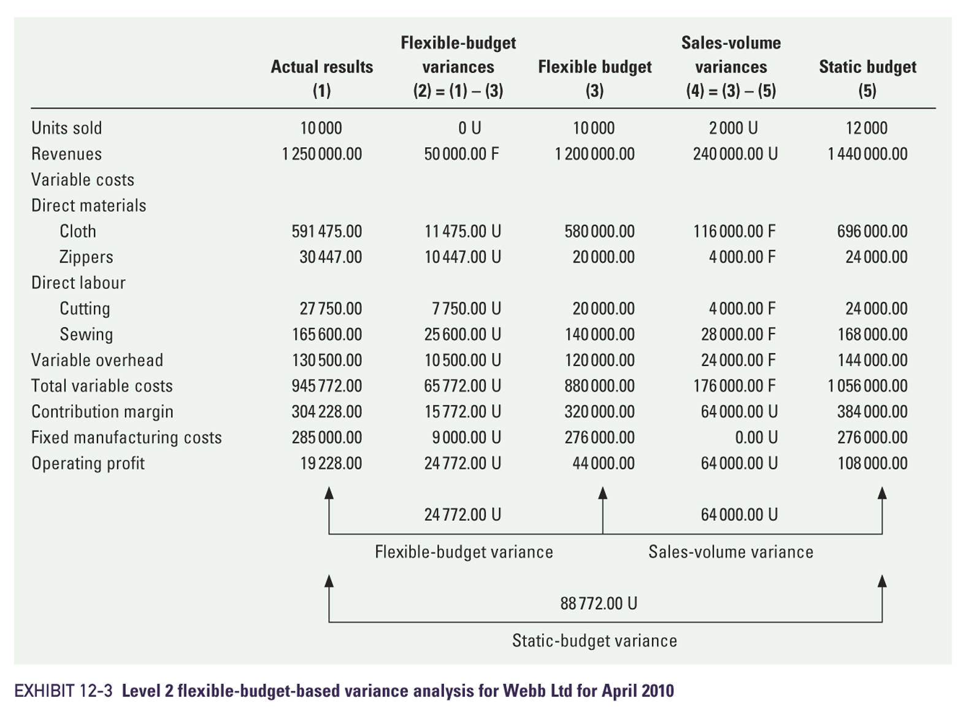
Flexible Budget
10-12

Slide 13
Level 2 Analysis Illustrated
10-13

Slide 14
Level 3 variances
10-14

Slide 15
Level 3 Variances
All product costs can have level 3 variances. We are covering only direct materials and direct labour
Both direct materials and direct labour have both price and efficiency variances, and their formulae are the same
10-15

Slide 16
Level 3 Variances
Price Variance formula:
Efficiency Variance formula:
10-16

Slide 17
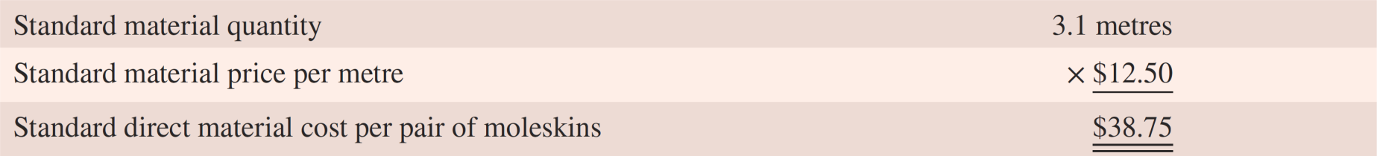
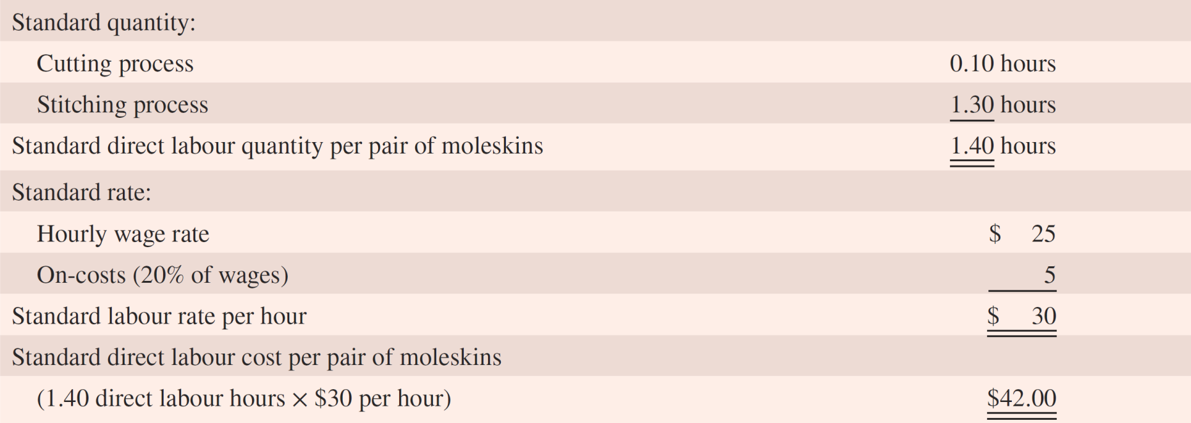
Direct material standards: R.M. Williams (moleskins)
Direct labour standards: R.M. Williams (moleskins)
Notes:
New slide from McGraw Hills ^

Slide 18
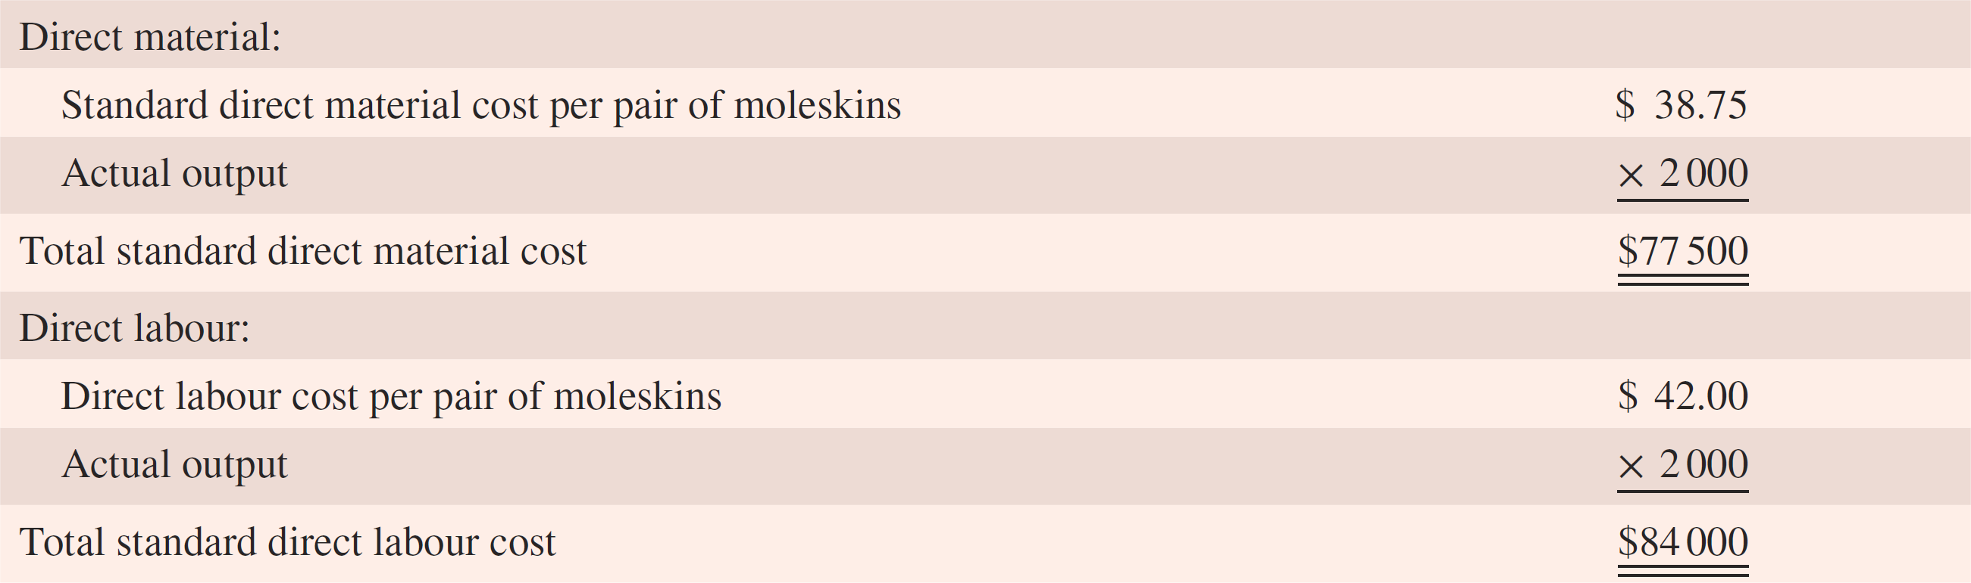
Standard cost given actual output: R.M. Williams (moleskins)
Based on 2000 units of output.
Notes:
New slide from McGraw Hills ^

Slide 19
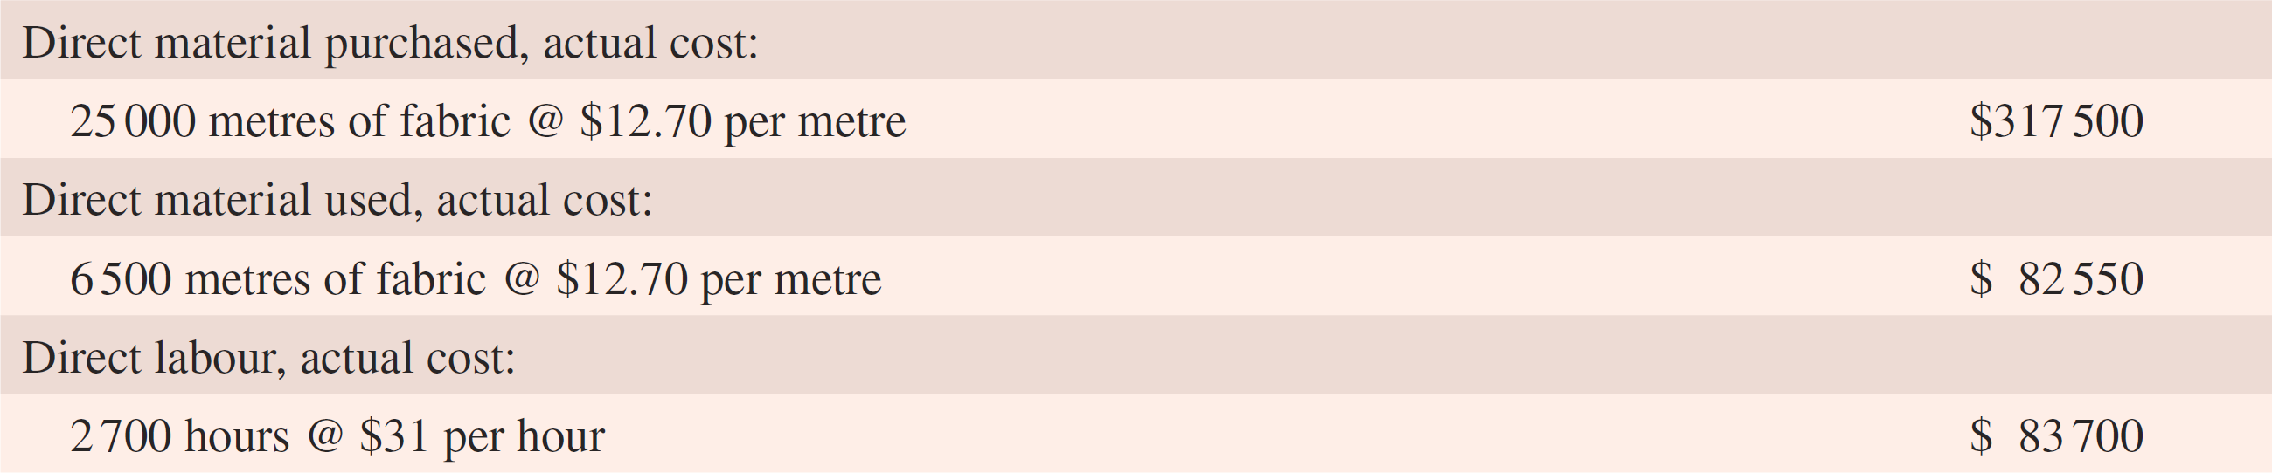
Actual costs for moleskin pants, R.M. Williams, September
Notes:
New slide from McGraw Hills ^
The actual costs for direct materials and direct labour for September are shown in Exhibit 10.2. When we compare these actual costs with the total standard costs for the production of 2000 pairs of moleskins, we can see that R.M. Williams spent more than the budgeted amount for both direct material and direct labour.

Slide 20
Direct material variances
Direct material price variance
  = PQ(AP – SP)
  Where PQ = quantity purchased
  AP = actual price
  SP = standard price
10-20

Slide 21
Possible causes
– Purchasing manager’s ability to bargain
– Quality of the materials purchased
– Price changes due to economic conditions
– Wrong standard
10-21

Slide 22
Direct material variances
Direct material quantity variance
  = SP(AQ – SQ)
  Where SP = standard price
  AQ = actual quantity used
  SQ = standard quantity allowed,
  given actual output
10-22

Slide 23
Possible causes
Quality of materials purchased
Engineering not maintaining machines
Wrong standard
  standards set without careful analysis of operating conditions, e.g. inferior quality labour
10-23

Slide 24
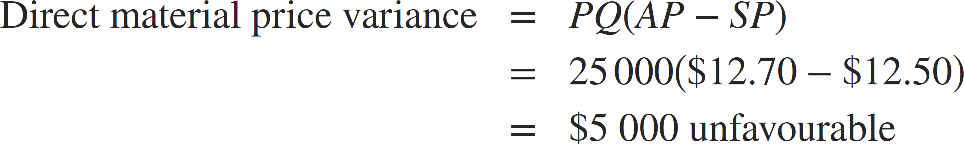
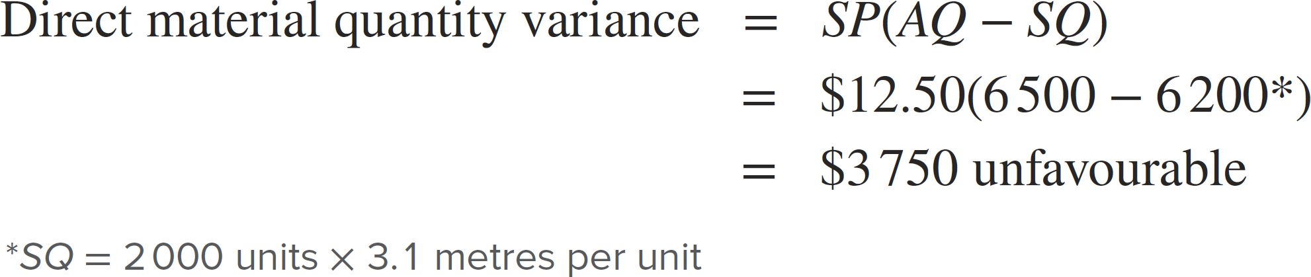
Direct material price and quantity variances: R.M. Williams (moleskins)
(cont.)
Notes:
New slide from McGraw Hills ^

Slide 25
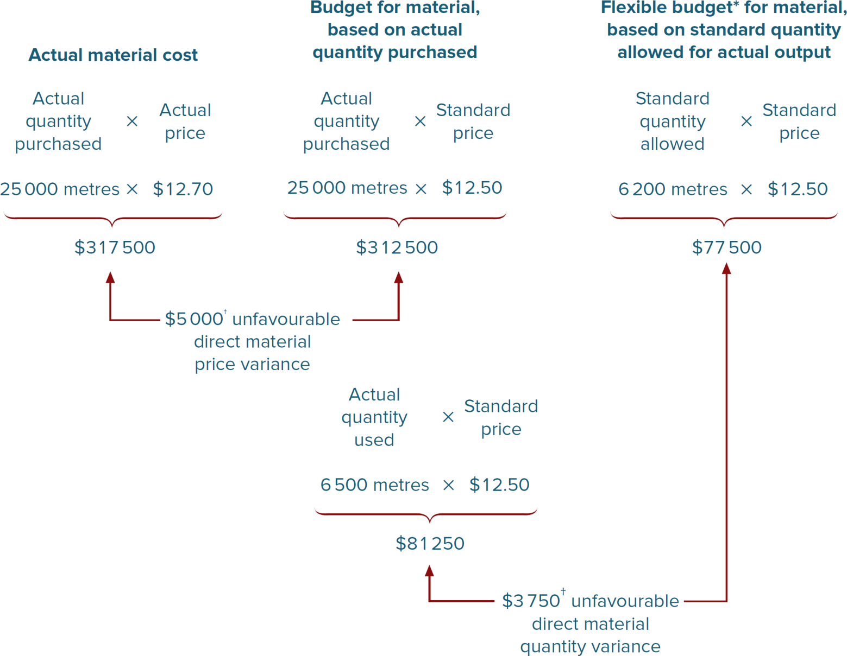
Direct material price and quantity variances, R.M. Williams
Notes:
New slide from McGraw Hills ^

Slide 26
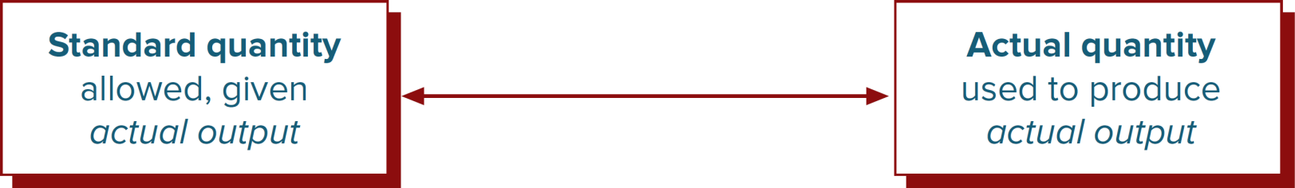
Direct material quantity variance, R.M. Williams
Note that the standard quantity of material must be based on the actual production output for the quantity variance to be meaningful
(cont.)
Notes:
New slide from McGraw Hills ^

Slide 27
Direct labour variances
Direct labour rate variance
  = AH(AR – SR)
  Where AH = actual hours used
  AR = actual rate per hour
  SR = standard rate per hour
10-27

Slide 28
Possible causes
– Using a mix of employees that differ from the anticipated mix
– Changes in basic wage levels
10-28

Slide 29
Direct labour variances
Direct labour efficiency variance
  = SR(AH – SH)
  Where SR = standard rate per hour
  AH = actual hours used
  SH = standard hours allowed,
  given actual output
10-29

Slide 30
Possible causes
Hiring under/over-skilled workers
Inefficient scheduling of work
Inadequate machine maintenance
Wrong standard
  budgeting time standards without careful analysis of operating conditions and the employee skills
10-30

Slide 31
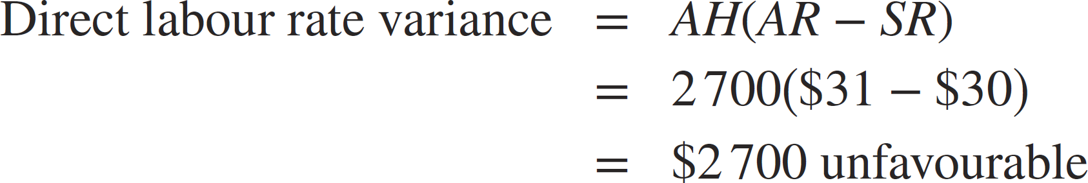
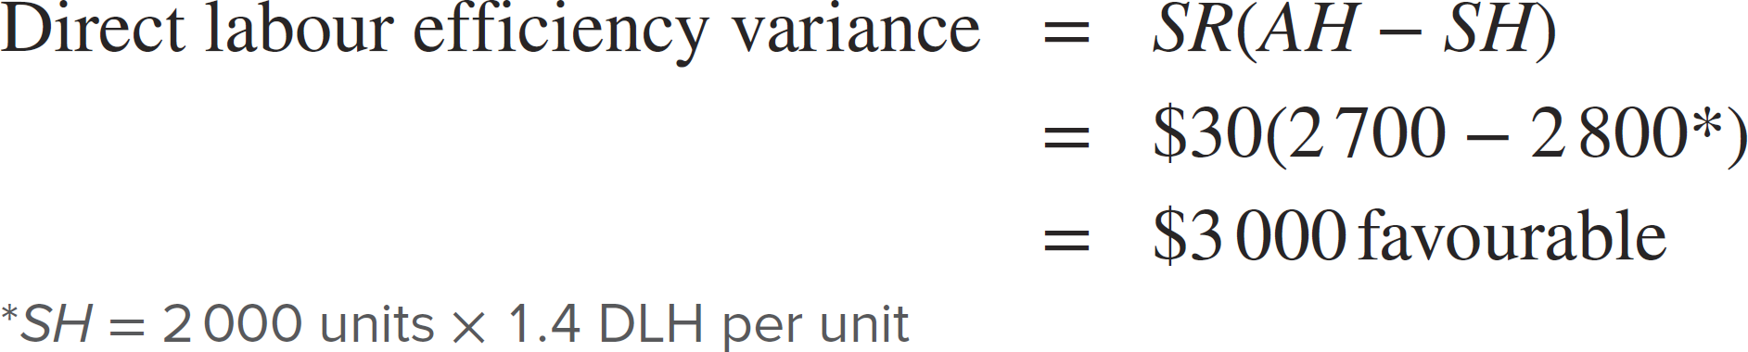
Direct labour rate and efficiency variances, R.M. Williams
(cont.)
Notes:
New slide from McGraw Hills ^

Slide 32
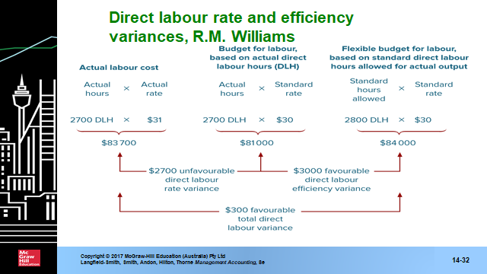
Direct labour rate and efficiency variances, R.M. Williams
Notes:
New slide from McGraw Hills ^

Slide 33
Standard costs for product costing
Standard costing system
  Can be used for product costing
  All inventories are recorded at standard cost
Variances are closed off at the end of the accounting period
  To cost of goods sold expense
  Prorate variances between WIP, FG and COGS, if significant
(cont.)
10-33

Slide 34
Good, bad and the ugly?
Good:
  Unfavourable variances do not always indicate a problem
Bad:
  Not all favourable variances are desirable
Ugly:
  They often interact
10-34

Slide 35
Limitations of variance analysis
Variances are too aggregated
Variances focus on the consequences rather than the causes of problems
Variance reports may be too late to be useful
  –Monthly reporting may be too late to correct problems
Tendency to focus on cost minimisation
  –May encourage cost reduction which can adversely affect other areas of strategic importance
10-35

Slide 36
Limitations of variance analysis
Takes a departmental rather than a process perspective
  –Miss opportunities for cost control
  –Assigning responsibility to managers in one department may increase costs in other departments
10-36

Slide 37
So, to wrap up...
Favourable variances warrant similar investigation to unfavourable variances
There are both costs and benefits of investigation
Recognise controllability
  sits in the heart of?
10-37

Slide 38
Lecture example (time permitting)
Lets’ work on Problem 10.33, page 511 of the text
  you can directly use the formulas learned in this lecture or a broken down version of them as shown in the solutions format posted on Moodle.
10-38

Slide 39
Summary
Standard costing systems can be used for cost control, through the calculation of cost variances
Decision rules will guide which cost variances are significant and thus need to be investigated
Variance reporting can form part of a responsibility accounting system
Can impact behaviour
10-39

