Slide 1
Week 5b:
Standard costing and variance analysis
(plus, introduction to Flexible budgets)
Chapter 10
10-1

Slide 2
Topic in week 4?
Budgeting!
Why?
PLANNING and CONTROL

Slide 3
Controlling costs
Businesses are ‘in control’ when operations proceed to plan and achieve objectives
Necessary requirements for control
  A predetermined performance level
  A measure of actual performance
  A comparison between standard performance and actual performance
Notes:
New slide from Mc-Graw Hills ^

Slide 4
Our focus today:
NOT
The Master Budget (big picture)
We’ll look into:
parts of production and purchasing budgets
Goal? Measure the efficiency of the production and purchasing departments given the set standards in pricing and usage of DM and DL

Slide 5
Standard Costing
The process of setting those standards and related accounting activities are called Standard Costing
Our focus today is on the standard costing of Direct material and Direct labour
(micro level budgeting!)

Slide 6
So what’s today’s topic again?
Week 5b: Standard costing (i.e., micro level budgeting for DM and DL) and variance analysis
(What’s that? See next slide!)
(plus, introduction to Flexible budgets)
(Couple of slides later)

Slide 7
Just compare!
Budget
Actuals
Variance

Slide 8
Just compare with a bit of modification!
Budget
Std. costing of DM&DL
Actuals
Actual costing of DM&DL
Standard cost
Variances

Slide 9
Standard costing
Standard costing is a part of the budgetary control system
  A predetermined or standard cost is developed
  The actual cost incurred in the product process is measured
  The actual cost is compared to the standard cost to determine a standard cost variance
Notes:
New slide from Mc-Graw Hill ^

Slide 10
Standard Costing (contd.)
Budgeted amounts and rates are actually booked into the accounting system to cost products and services or give quotes.
These budgeted amounts contrast with actual activity and give rise to variance accounts.
Flexible budgets play a part in those comparisons
Notes:
This slide is similar to the previous slide but I think previous slide is easier to understand.

Slide 11
Standard cost variances
Used to evaluate actual performance and control costs
Standard costs can be developed for direct material, direct labour and overheads
Significant cost variances must be investigated
Notes:
New slide from Mc-Graw Hill ^

Slide 12

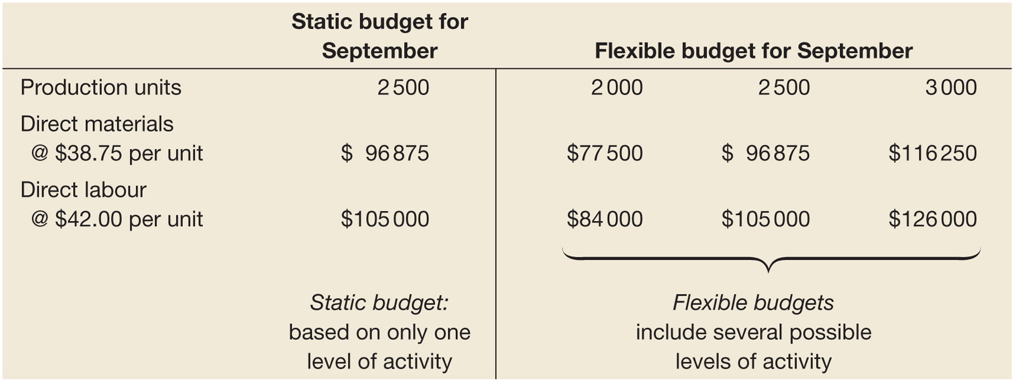
Static and flexible budgets
Why introduce flexible budgets now?
So that we can compare ‘apples’ with ‘apples’!

Slide 13
Flexible budgets
A detailed budget prepared for a range of levels of activity
  Compared to a static budget which relates to one specific planned level of activity
Allows us to select the most appropriate benchmark for cost control
Provides a valid basis for comparing actual and expected costs to budget, for the actual level of activity

Slide 14
So, we are learning today and in week 6..
What is standard cost
How to calculate standard cost variances between flexible budget and actual results
When to investigate a variances and take corrective action– challenges?
Behavioral impact of standard costing

Slide 15
But first, how to Set standards
A variety of methods used
  Analysis of historical data
  Engineering methods
  Combined approach
In practice, both
Remember “participative budgeting”?

Slide 16
Standards
Ideal/ Perfect Standard
Practical/ Currently Attainable Standard

Slide 17
Perfection standards
Reflect minimum attainable costs under nearly perfect operating conditions
  Assumes peak efficiency, the lowest material and labour prices, the use of the best quality materials and no production disruptions
(cont.)
Notes:
New slide from Mc-Graw Hill ^

Slide 18
Perfection standards
Motivational impact?
  Motivation to achieve lowest cost possible
  May discourage employees from working hard as standards unlikely to be achieved
  May encourage employees to sacrifice product quality to achieve low costs
Notes:
New slide from Mc-Graw Hill ^

Slide 19
Practical standards
Practical standards are the minimum attainable costs under normal operating conditions
Allowances made for downtime and wastage
(cont.)
Notes:
New slide from Mc-Graw Hill ^

Slide 20
Practical standards
Motivational impact?
  May encourage more positive attitudes towards targets
  May encourage inefficiency and waste
  Can build continuous improvement into standards to make them more demanding
Notes:
New slide from Mc-Graw Hill ^

Slide 21
Benchmarking cost standards
Identifying companies that have the best cost performance
  Assessing their level of costs
  Identifying the cost performance gap
Identifies areas needing to improve cost performance
Cost standards may be formulated to achieve external performance standards
Notes:
New slide from Mc-Graw Hill ^

Slide 22
Developing standards in service organisations
Services provided to customers may be non-repetitive
However, service firms may develop standard quantities to capture the time taken for key activities and processes
Notes:
New slide from Mc-Graw Hill ^

Slide 23
Direct material standards
Standard material quantity
Standard material price

Slide 24
Direct labour standards
Standard direct labour hours
Standard labour rate

Slide 25
Standard cost
Standard cost of a unit of output is a carefully determined cost based on standard quantity and standard price of DM, DL, MOH
Standard cost is important for planning and control

Slide 26

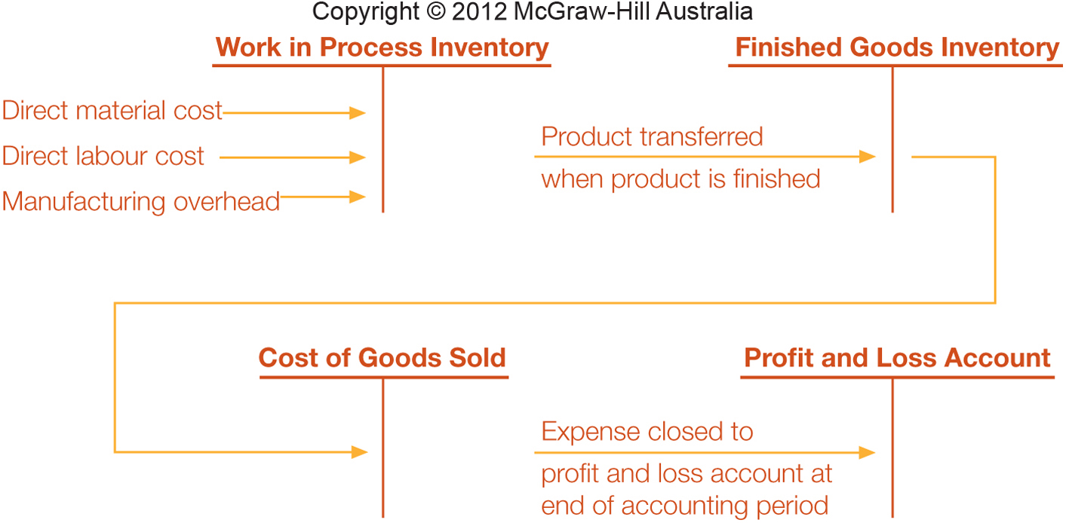
Standard costs for product costing (cont.)

Slide 27
Investigating significant variances and taking corrective actions
Management by exception
  Only significant cost variances are reported and investigated
(cont.)

Slide 28
Which variances are significant?
Size of variance (relative and absolute)
Recurring variances
Trends
Controllability
Management judgement

Slide 29
Investigating significant variances
Favourable and unfavourable variances warrant similar investigation
  May reveal efficiencies and new improved practices
  May mean that the standard is too loose
Notes:
New slide from Mc-Graw Hill ^

Slide 30
Behavioural impact
What is the behavioural impact of standard costing?

Slide 31
Similar to budgeting...
Can be used to evaluate performance
Hence, can be used to determine salary increases, bonuses and promotions
As a result?
  Motivate positive behaviours
  Encourage the manipulation of data and reports and dysfunctional activities and decisions

