Slide 1
Week 4: Budgeting systems
Chapter 9

Slide 2
Lecture outline
Budget- basics
What
Why
How

Slide 3
What are your goals?
How do you achieve them?
Strategic planning
  Long term, big picture
A budget
  Short term, nitty gritty!

Slide 4
Budget defined
The quantitative expression of a proposed plan of action by management for a specified period and
An aid to coordinating what needs to be done to implement that plan
May include both financial and non-financial data

Slide 5
Strategic planning and budgeting systems
A budget is:
  A detailed plan of future operating activities
  A financial model of future operations
  A core component of an organisation’s planning and control system
  A critical way of providing information to managers
  Regarded as short-term planning, typically for one year
(cont.)

Slide 6
Strategic planning and budgeting systems
Strategic planning is long-term planning usually undertaken by senior managers
  Decisions about corporate strategy
  Decisions about business strategy
  A time horizon of three or more years
  Formulated in broad terms
  Directly influences the formulation of budgets

Slide 7
Why do budgeting?
Planning and Control
Communication and coordination
Resources allocation
Performance evaluation and Rewards

Slide 8
The annual budget
Comprehensive
  Several interdependent budgets
    Financial budgets
    Operating budgets
Large organisations:
  formal, comprehensive, time consuming
Smaller organisations
  less formal process

Slide 9
The annual budget
Operating budgets
  Sales budget
  Various cost budgets
The financial budgets
  Budgeted income statement
  Budgeted balance sheet
  Cash budgets
  Capital expenditure budget

Slide 10
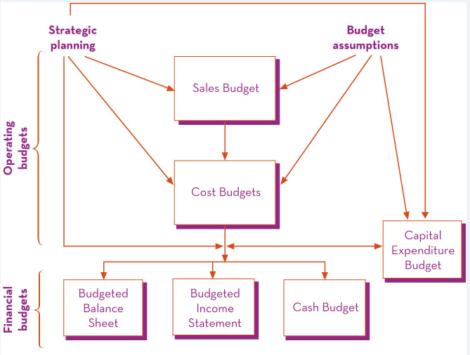
Components of the annual budget

Slide 11
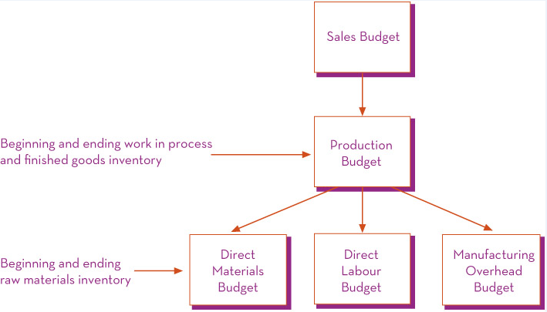
Detail of operating budgets for a manufacturing business

Slide 12
The annual budget: a planning tool
Budgets are developed for specific time periods
Rolling budgets are continually updated by adding a new time period and dropping the period just completed
Budgets vary in their level of detail, often dependent on the size and complexity of the organisation

Slide 13
Strategic plans and budget assumptions
Commence with an understanding of the organisation’s strategy
Based on various assumptions about the competitive and economic environment

Slide 14
The operating budgets
The sales budget
  Based on the sales forecast
    Internal factors?
    External factors?

Slide 15
The operating budgets
The cost budgets
  Manufacturing firms
    Production, DM, DL, OH, Selling & Admin
  Retailers and wholesalers
    A purchasing budget
  Service firms
    A set of budgets that show how demand for services will be met

Slide 16
The financial budgets
The cash budget
  Expected cash receipts and payments
  Timing is important
Budgeted income statement
  Expected revenues and expenses

Slide 17
The financial budgets
Budgeted balance sheet
  Expected assets and liabilities at the end of the budget period
Capital expenditure budget
  A plan for the acquisition of long-term assets, such as building, plant and equipment

Slide 18
Budget lecture example
You can use the format that was posted on Moodle or use one of your own

Slide 19
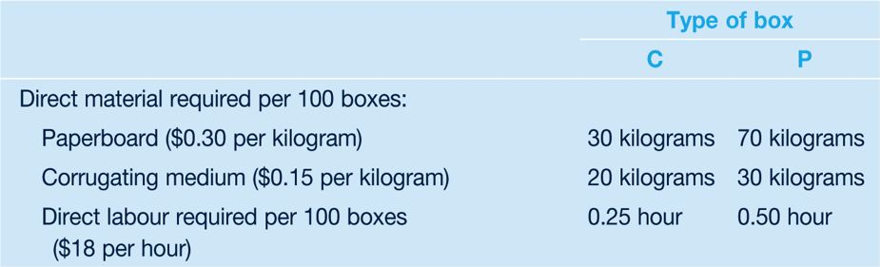
Budget lecture example
Athena Boxes manufactures two types of cardboard boxes used in shipping canned food, and fruit and vegetables. The canned food box (type C) and the perishable food box (type P) have the following material and labour requirements:
The following manufacturing overhead costs are anticipated for the coming year. The predetermined overhead rate is based on a production volume of 495 000 units for each type of box. Manufacturing overhead is applied on the basis of direct labour hours.

Slide 20
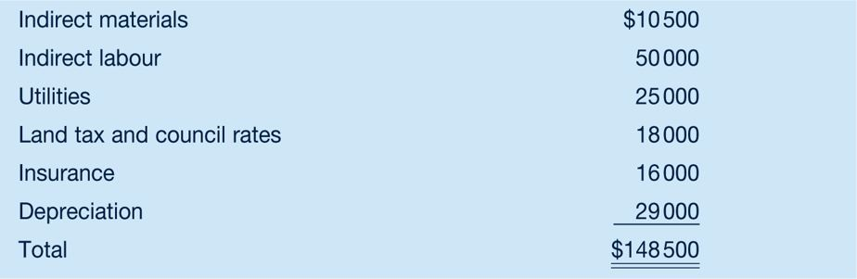
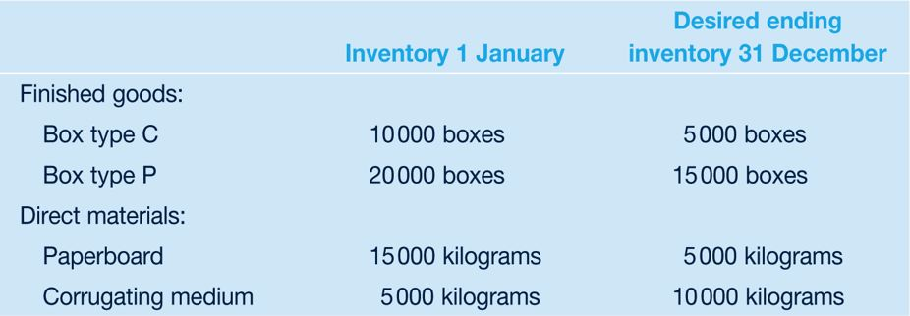
Lecture example (cont)
The following inventory information is available for the coming year:

Slide 21
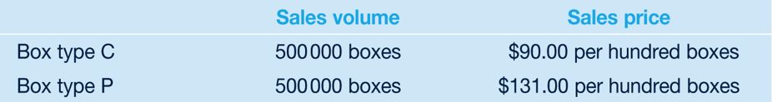
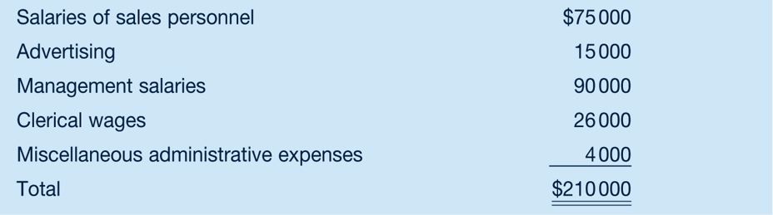
Lecture example (cont)
The sales forecast is as follows:
The following selling and administrative expenses are anticipated:

Slide 22
Required:
Prepare an annual budget for Athena Boxes for the coming year. Assume an income tax rate of 40 per cent. Include the following schedules:
1 Sales budget.
2 Production budget (in units).
3 Direct material budget.
4 Direct labour budget.
5 Manufacturing overhead budget.
6 Selling and administrative expense budget.
7 Budgeted income statement. (Hint: To determine cost of goods sold, first calculate the manufacturing cost per unit for each type of box. Include applied manufacturing overhead in the cost.)

Slide 23
Budgeting to be continued in week 5….

