Slide 1
Week 3
Chapter 17
Sustainability and management accounting

Slide 2
Outline
Broad overview of sustainability
Brief introduction to corporate sustainability, CSR and related reporting
Sustainability and management accounting
  Environmental management accounting (EMA)
  Environmental management system (EMS)

Slide 3
Broad overview of sustainability
‘Development that meets the needs of the present without compromising the ability of future generations to meet their own needs.’ (UN, 1987)
Three frontiers: a sustainable economy, a sustainable environment and a sustainable society
Recognises eco-justice in the use and distribution of the planet resources:
  Intergenerational equity
  Intragenerational equity

Slide 4
Sustainability and CSR
Corporate social responsibility (CSR) involves organisations taking into account the social and environmental impact of corporate activity when making decisions
Growing awareness of sustainability and reporting
  By 2013, 83% of top Australian companies (N100) produced stand-alone sustainability reports, up from 57% in 2011 and 23% in 2005
  In 2013, the N100 Australian firms that submitted sustainability reports, 83% of them referenced Global Reporting Initiative (GRI) guidelines.

Slide 5
Sustainability and stakeholders
Stakeholders
  Individuals or groups who can influence the business or be influenced by it
Risk management includes identifying stakeholders and assessing their influence

Slide 6
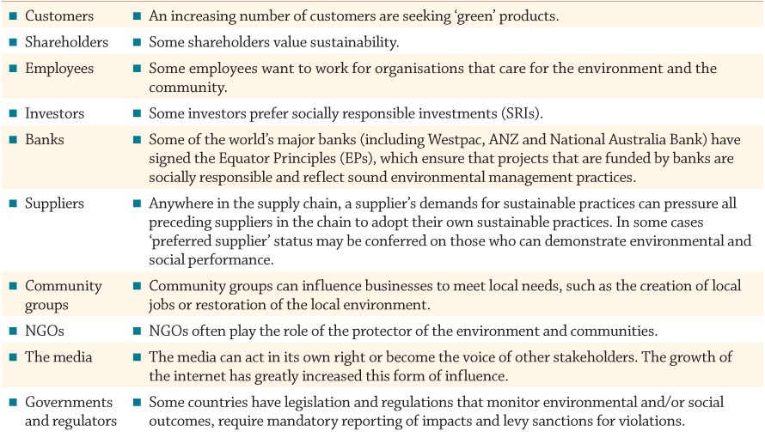
Stakeholders’ influence to adopt sustainability practices and reporting

Slide 7
Sustainability reports
Global Reporting Initiative (GRI) framework most widely recognised and regarded as the global standard
GRI Sustainability Reporting Standards will be required for all reports published after 1 July 2018

Slide 8
GRI Sustainability Reporting
Universal standards
  Foundation
  General disclosures
  Management approach
Topic-specific standards
  Social
  Environmental
  Economic
https://www.globalreporting.org/standards/

Slide 9
International Integrated Reporting Framework (IIRF)
Broader focus than sustainability reports but not intended to replace them
Aims to explain how an organisation creates value over time
Integrated report: six kinds of capital
  Financial, Manufactured, Intellectual, Human, Social and Relationship, Natural
https://integratedreporting.org/

Slide 10
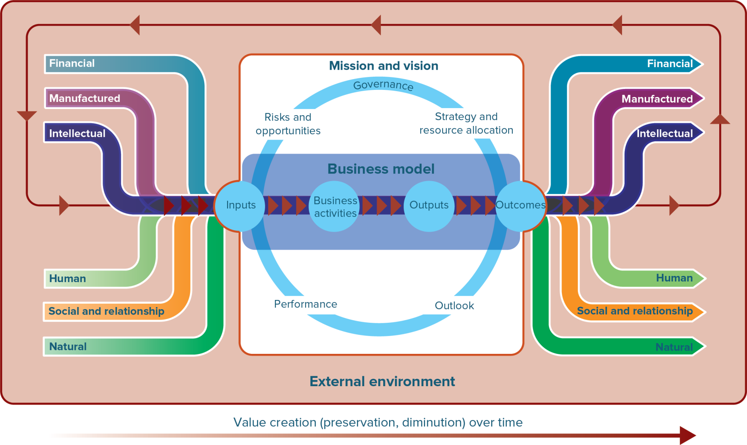
The value creation process under the IIRF

Slide 11
Benefits of reporting sustainable performance
Identify environmental and social changes
Develop a strategy to manage risk and opportunities
Create innovative new products
Engage in actions to grow their market share
Vehicle for ‘green wash’?

Slide 12
Sustainability and management accounting
Management accounting needs to incorporate a sustainability focus on costs and performance into a range of decision contexts
But there are a number of challenges
  Potential economic, social and ecological impacts are often difficult to identify and measure, but may be substantial- so, be conservative!
  Many costs and benefits are external to the organisation- they are called Externalities

Slide 13
What is an externality?
Externality is the ‘… failure of the material decision-making process to consider all the cost of producing and distributing the product.’ (American Accounting Association, 1973)
Externalities are difficult to identify and measure. They exist if:
  negative or positive impacts are generated by an economic activity and imposed on others
  The impact is not priced in the market place

Slide 14
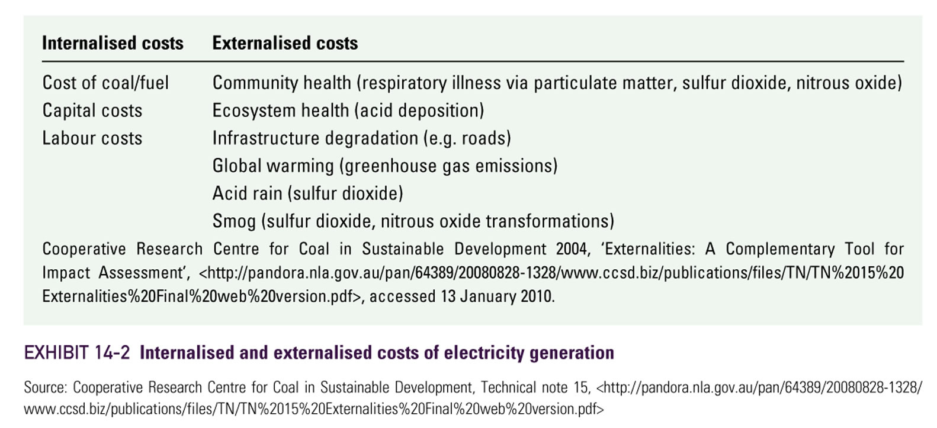
Example: internalised and externalised costs of energy generation

Slide 15
What to do with externalities?
If there are externalities, the ‘invisible hand’ of the market will not arrive to an optimal outcome for society
  What does not have a price (i.e. it is free) is over consumed
Externalities will be minimised if internalised into an organisation’s cost structure. How?
  Emission Trading Scheme (ETS)
    Australia used to have one but no more!
    Emissions Trading Wikipedia link
Notes:
This means we need to proactively manage externalities if we want to future-proof our organisations.

Slide 16
Environmental management accounting (EMA)
Consists of management accounting systems and practices that provide information about the environmental impact of an organisation’s activities (IFAC, 2005)
EMA Includes
Costing systems
Assessment of environmental benefits
Performance measurement systems
Strategic planning for environmental management (including CAPEX decisions)
(cont.)

Slide 17
EMA: costing systems what’s the purpose?
EMA costing systems contribute to the effort to make environmental costs of organisations visible to decision makers.
Some examples follow…

Slide 18
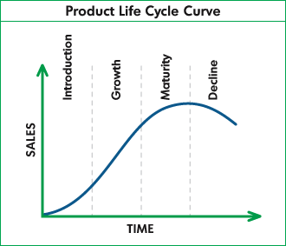
EMA: costing systems- LCC
Life Cycle Costing (LCC)
Life cycle analysis can include the costs of suppliers, customers and the environmental and social impacts associated with a product

Slide 19
EMA: costing systems- LCC
Organisations may work with suppliers and customers to reduce the adverse environmental and social impact of products
  e.g., Emissions, waste disposal, packaging, fuel used
Organisations can initiate formal supplier evaluation program
Sometimes customers may be willing to pay more for a more environmentally friendly product- opportunity for strategic positioning!

Slide 20
EMA: costing systems- other examples
EMA and activity based costing (ABC)
  Brief article on EMA, environmental ABC
Environmental cost accounting/ full cost accounting
  Environmental full-cost accounting Wikipedia link
Cost items in all of the above systems can be categorised as per the US EPA as follows:
    Tier 1: Conventional costs
    Tier 2: Hidden costs
    Tier 3: Contingent cots
    Tier 4: Relationship and image costs
    Tier 5: Societal costs

Slide 21
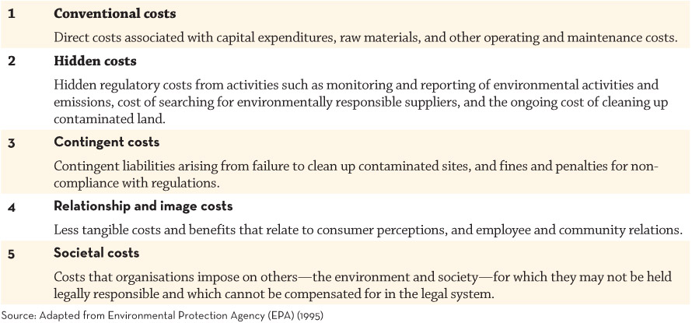
Five tiers of environmental costs

Slide 22
EMA: performance measurement systems
Within EMA, performance measurement systems can be influenced/guided by external reporting framework, ISO and internal performance measurement systems:
  Global Reporting Initiative (GRI)
  Dow Jones Sustainability Index (DJSI)
  Australian SAM Sustainability Index (AuSSI)
  Various ISO series: 140XX
  Sustainability Balanced Scorecard (BSC)

Slide 23
Sustainability BSC
Sustainability balanced scorecard can
  Integrate sustainability measures within the four BSC perspectives; or
  Add sustainability as a fifth perspective; or
  Include only sustainability measures
Strategy maps may be developed to
  Identify cause and effect relationships between objectives, strategies and to guide the selection of performance measures

Slide 24
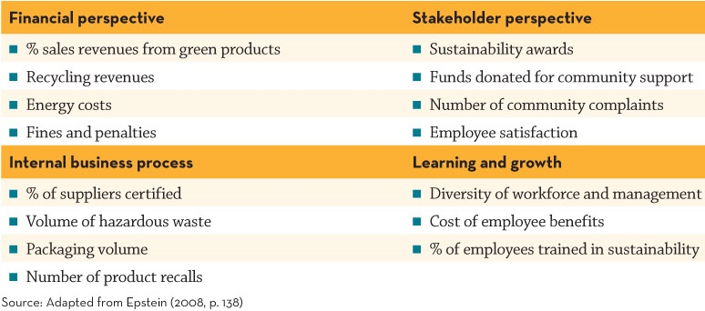
Sustainability BSC

Slide 25
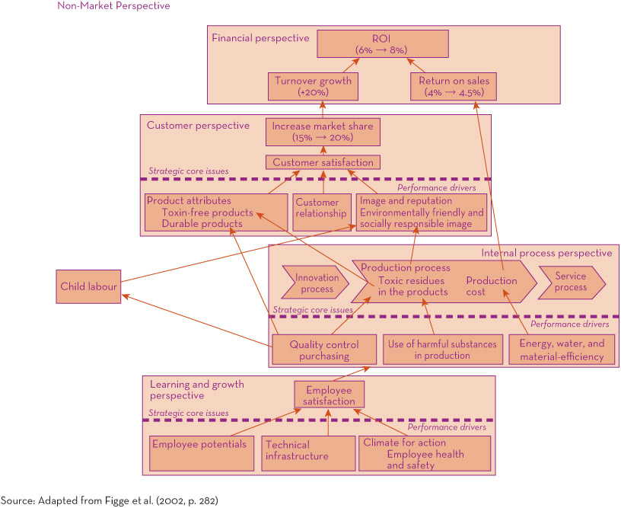
Strategy map for a sustainability balanced scorecard

Slide 26
EMA: strategic planning and CAPEX decisions
Inclusion of environmental costs and benefits may affect the attractiveness of a project
Weighting given to environmental factors depends on the organisation’s values and preferences
Some capital expenditures are driven by the need to be environmentally and socially responsible- hurdle rate may not be strictly applied

Slide 27
Environmental Management System (EMS)
An EMS is the organisation’s physical, formal and systematic process for guiding, measuring and benchmarking their environmental impact
    May include recycling systems, systems to monitor and control levels of liquids, material and atmospheric discharge and waste
By incorporating internationally recognised standards, an organisation can receive certification for its environmental performance (e.g., ISO certifications).

Slide 28
EMS and EMA
EMA works in partnership with an organisation’s physical EMS.
EMA provides financial and non-financial measures of environment related performance monitored by EMS and beyond
  Physical measures (for example, kilograms of noxious waste emissions, kilowatt hours of electricity used, decibels of noise) and monetary measures (e.g., environmental costs, revenues, CAPEX; environmental product costing)
EMA and EMS can be used to set targets, and monitor environmental performance

Slide 29
Summary
Corporate sustainability involves considering the economic, environmental and social impacts of an organisation’s activities
The major framework that guides sustainability is the Global Reporting Initiative (GRI) framework
Changing stakeholder demands is causing increasing adoption of sustainability practices and reporting though costs and benefits are difficult to measure in financial terms
Environmental management accounting (EMA) provide information about environmental impacts
(cont.)

Slide 30
Summary (cont.)
Environmental and social costs can be integrated into cost analysis to improve management decision making, including capital expenditure analysis
Performance measurement systems, including SPMS (e.g., BSC) can be adapted to include environmental and social measures

