Slide 1
Week 2: Contemporary approaches to measuring and managing performance
(Non-financial performance measures)
Chapter 14

Slide 2
Outline
Non-financial performance measures
Balanced scorecard (BSC)
Strategy maps
Problems with non-financial performance measures
Performance measurement system (PMS) design issues
Behavioural implications
Benchmarking

Slide 3
Why measure performance?
Feedback
Rewards
Communication tool; alignment of goals

Slide 4
Problems with financial performance measures
They are not actionable
Emphasise only one perspective
Provide limited guidance for future actions
May encourage short-term actions

Slide 5

Solution
Include non-financial
measures
Kaplan video – Management TV
  Extended interview (poor quality)

Slide 6
Non-financial measures
Reflect drivers of future financial performance
  ↑ non-financials → ↑ financials
More understandable
More actionable

Slide 7
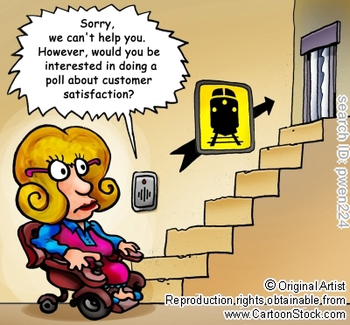
Non-financial measures
Examples
  Customer satisfaction
  Defect rates
  Quality
  Productivity
  Accident incident rates
  Machine downtime
  On-time delivery rates
  ....

Slide 8

Robert Kaplan and David Norton

Slide 9
The Balanced Scorecard
A performance measurement system that identifies and reports on performance measures for each key strategic area of the business.
Also identifies cause and effect relationships between these measures

Slide 10
But first, what is Strategy?
Strategy specifies how an organisation matches its own capabilities with the opportunities in the marketplace to accomplish its objectives
A thorough understanding of the industry is critical to implementing a successful strategy

Slide 11
Basic Business Strategies
Product differentiation – an organisation’s ability to offer products or services perceived by its customers to be superior and unique relative to the products or services of its competitors
  Leads to brand loyalty and the willingness of customers to pay high prices
Cost leadership – an organisation’s ability to achieve lower costs relative to competitors through productivity and efficiency improvements, elimination of waste, and tight cost control
  Leads to lower selling prices

Slide 12
Implementation of Strategy
Many companies have introduced a balanced scorecard to manage the implementation of their strategies

Slide 13
Balanced Scorecard
Financial
Customer
Vision
and Strategy
Internal
Business Processes
Learning
and
Growth

Slide 14
The Balanced Scorecard
The balanced scorecard translates an organisation’s mission and strategy into a set of performance measures that provides the framework for implementing its strategy
It is called the balanced scorecard because it balances the use of financial and non-financial performance measures to evaluate performance

Slide 15
BSC stages of development and use
Articulate the mission, overall goals or objectives and strategic priorities
Develop specific objectives for each perspective
Choose performance measures for each objective
Develop targets for each performance measure
(cont.)

Slide 16
BSC stages of development and use
Cascade the BSC down the organisation
Plan and undertake initiatives and activities to implement the chosen strategies
Generate reports to monitor and manage actual performance and assign units and personal BSCs to specific managers

Slide 17
Financial Perspective
Reflects perspective of the shareholder
Summarises the financial outcomes of decision and actions
Measures include cost and product measures, ROI, cash flow measures, shareholder value measures

Slide 18
Customer perspective
Measures the company’s success in achieving customer value
Outcome (lag) measures include customer profitability, market share, number of new customers
Lead indicators include on-time delivery, number of defects

Slide 19
Internal business processes
Objectives relate to specific and critical processes that contribute to customer and financial objectives
Product design, operations, marketing, sales, customer service processes
Measures of cost, product quality, time-based measures, new product development

Slide 20
Learning and growth
Focus is on the capabilities of the organisation to achieve superior internal processes that create both customer and shareholder value
  Employees, IS, organisational climate
To deliver long-term growth and improvement
Employee satisfaction, training, skills, employee suggestions

Slide 21
Lag indicators
Monitor progress towards the organisation's objectives
Difficult to monitor/ manage directly
Summary of financial measures, market share, customer satisfaction

Slide 22
lead indicators
Drivers of outcomes and provide information that is actionable and manageable
Relate to the processes and activities of the business
Improvements in these measures should, over time, flow through to improvements in lag indicators

Slide 23
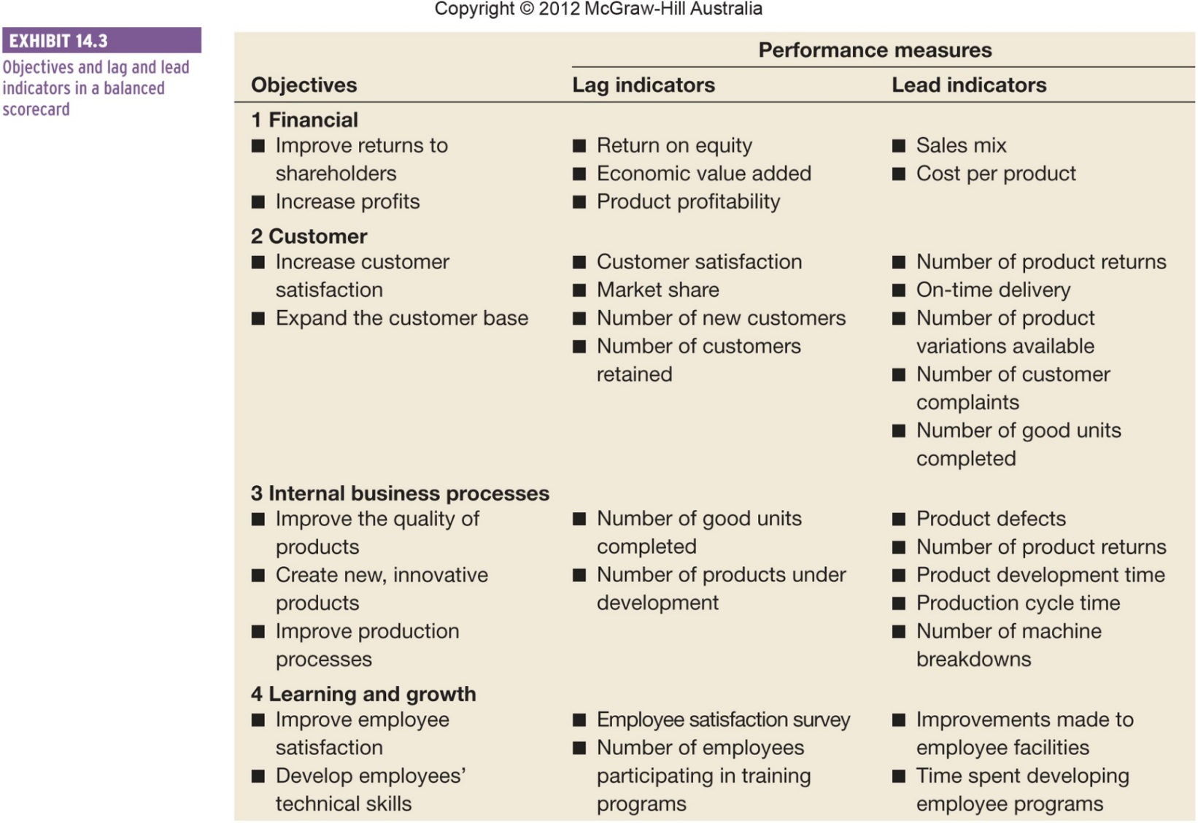
Lag and lead indicators within the four perspectives of the BSC

Slide 24
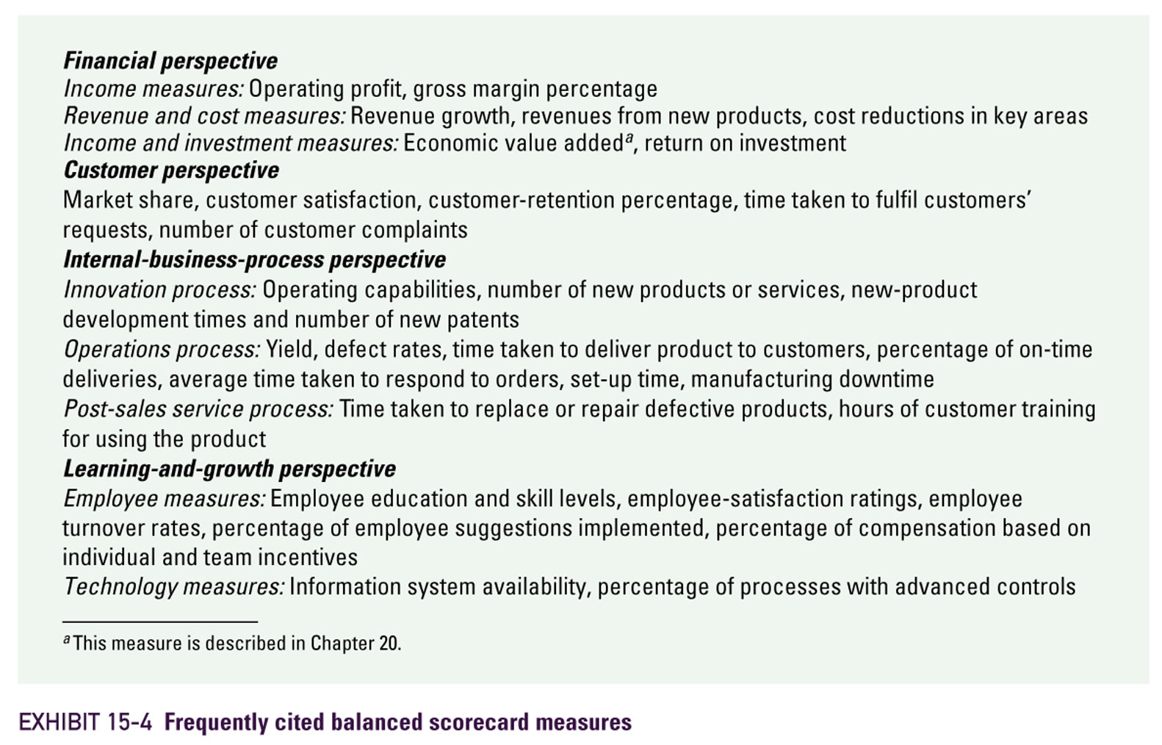

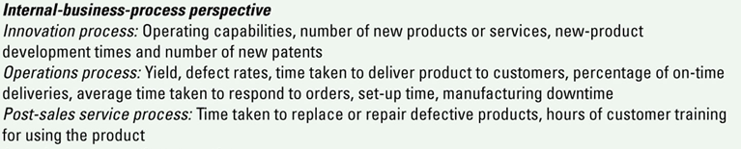
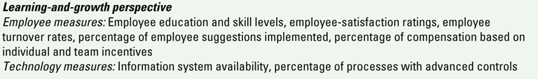
Common Balanced Scorecard Measures

Slide 25
Balanced scorecards in practice
Not all organisations use lag and lead indicators
Lag indicators may be called outcome measures or key performance indicators (KPIs)
Lead indicators may be called driver measures or key performance drivers (KPDs)
(cont.)

Slide 26
Balanced scorecards in practice
Organisations may identify and measure critical success factors
The number and types of perspectives in BSCs will differ across organisations
Strategy maps may focus on linkages between performance measures
Some companies combine the strategy map and BSC

Slide 27
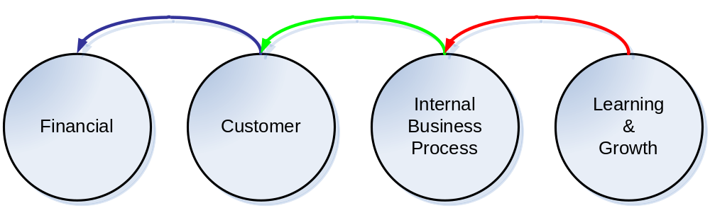
The Balanced Scorecard Flowchart*
*The above is a typical flow. Variation possible where one perspective directly influences the other rather than going through this chain reaction (e.g., IBP Financial because of higher productivity)

Slide 28
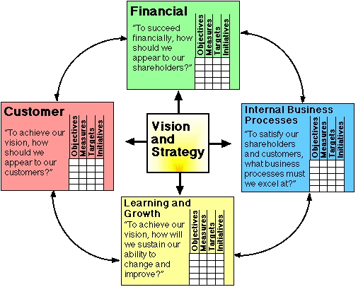
Balanced Scorecard
Source: www2.fcsh.unl.pt

Slide 29
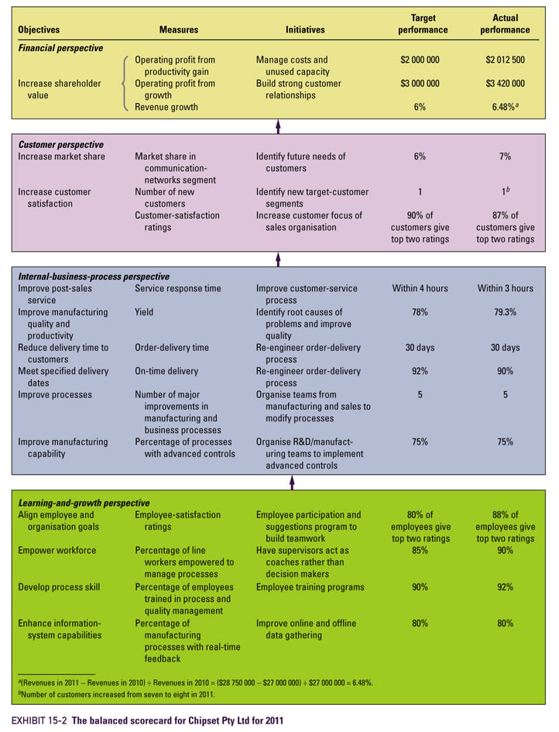
Balanced
Scorecard
Illustrated

Slide 30
Some BSC examples from real-life companies
See how the names of the perspectives change, and
how the number of perspectives change depending on the nature of business
[All of the BSCs below are partial/ incomplete]

Slide 31
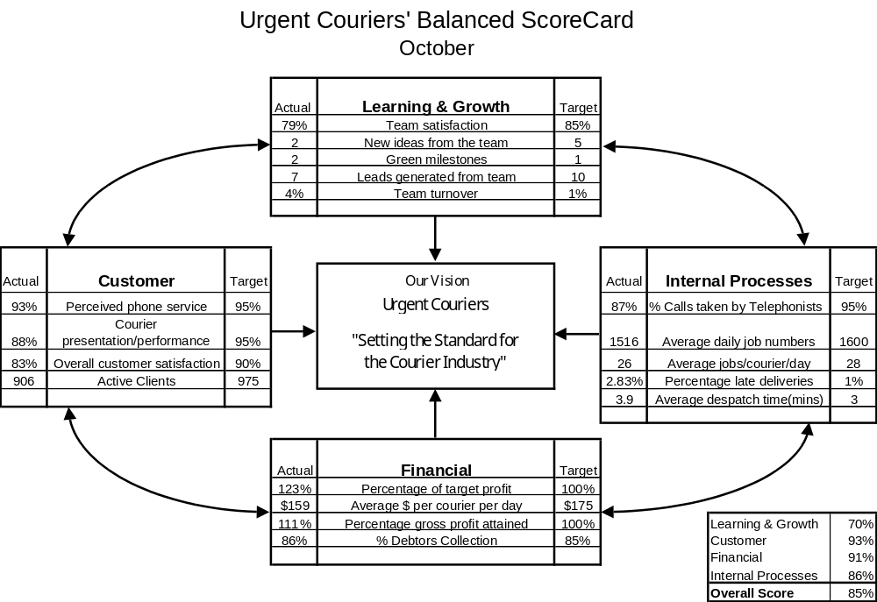


Slide 32
  New Zealand Hospitals Balanced Scorecard
Financial | Patient and quality (Customer) | Process and efficiency (Internal business process) | Organisational health & learning (Organisational learning & growth)
Return on net funds employed | Mean patient satisfaction rate | Resource utilisation ratio | Staff turnover (voluntary)
Operating margin to revenue | Hospital acquired blood stream infections | Performance to contract | Staff stability rate
Revenue to net funds employed | Emergency triage times– i.e. 3 separate measures | Inpatient ALOS x patient admission rate | Staff sick leave rate
Debt to debt plus equity ratio | Percentage of complaints resolved/closed | % eligible elective day case surgery | Staff workplace injury rate

Slide 33
Lecture example
Wilderness First is a travel company specialising in package tours to environmental conservation areas across Africa. The market for these tours is expanding rapidly (because of both domestic and international eco-tourists). This market growth, however, has attracted a number of new competitors to this specialised tourist industry segment.

Slide 34
Lecture example
In order to maintain its dominant market position in environmental tourism, Wilderness First has employed you to develop a performance measurement system that encompasses both short-term and long-term performance measures. During the first phase of this project, you decide to use the balanced scorecard. You have identified the following:

Slide 35
Perspective | Objectives | Performance measures
Financial | ? | ?
 | ? | ?
Customer | ? | ?
 | ? | ?
Internal business processes | ? | ?
 | ? | ?
Learning and growth | ? | ?
 | ? | ?

Slide 36

BSC Implementation
Must have commitment and leadership from top management
Must be communicated to all employees so that it is understood

Slide 37

Features of a Good BSC (i)
Tells the story of a firm’s strategy, articulating a sequence of cause-and-effect relationships
  the links among the various perspectives that describe how strategy will be implemented
Helps communicate the strategy to all members of the organisation by translating the strategy into a coherent and linked set of understandable and measurable operational targets

Slide 38
Strategy maps
A visual representation that explains the cause and effect relationships linking the objectives of the four perspectives of the BSC and the organisation’s objectives
May also identify linkages between lag and lead measures
A tool to communicate to mangers the components of the strategy and the processes that will help achieve it

Slide 39
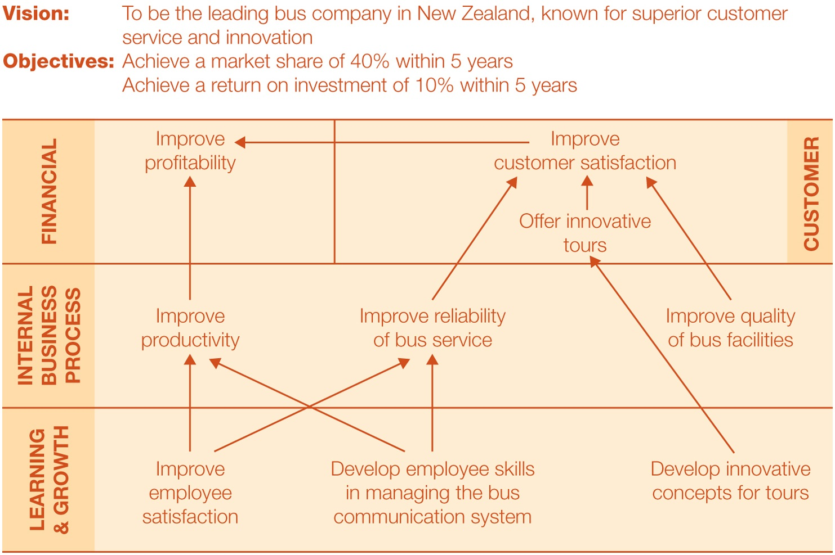

Strategy maps (cont.)

Slide 40
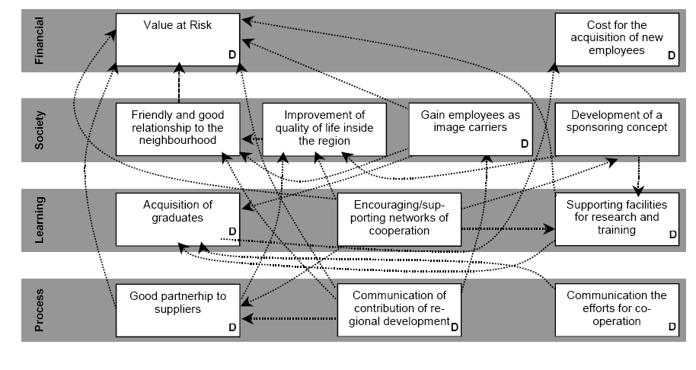
Strategy Map at Volkswagen
Bieker (2003)

Slide 41

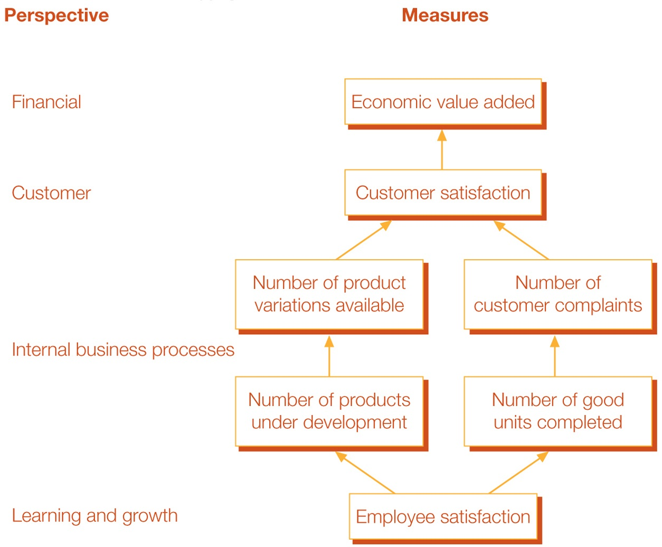
Causal linkages of measures

Slide 42
Features of a Good BSC (ii)
Must motivate managers to take actions that eventually result in improvements in financial performance
  predominately applies to for-profit entities, but has application to not-for-profit entities
Limits the number of measures, identifying only the most critical ones

Slide 43

BSC Implementation Pitfalls
Managers should not assume the cause-and-effect linkages are precise
  Typically, they are merely hypotheses
Managers should not seek improvements across all of the measures all of the time
  Managers must include both costs and benefits of initiatives placed in the balanced scorecard: costs are often overlooked

Slide 44
BSC Implementation Pitfalls
Managers should not use only objective measures
  subjective measures are important as well
  They should not ignore non-financial measures when evaluating employees
Managers should not use too many measures

Slide 45
Does non-financial performance lead to financial performance?
Improvements in non-financial measures will not result in improved profits if
  Management has selected the wrong critical success factors/ measures
  Management fails to utilise freed-up resources, following on from improvements in non-financial measures
  There is a lag between financial and non-financial performance
  There are incentives to engage in dysfunctional behaviour, such as manipulating measures or maximising performance of some measures at the expense of others (e.g. call centre: length of call vs customer satisfaction)

Slide 46
But !!
Problems also exist with non-financial measures in terms of behaviour:
  Hospitals creating ghost wards (The Age, 19 May 2008)
  Audit slams phantom wards scam (The Age, 2 April 2009)
  Hospital lied over wait lists (The Age, 31 March 2009)
  Losing patients (The Age, 2 April 2009)

Slide 47
The problems with non-financial performance measures
Wide choice of non-financial measures available
Development can be ad-hoc and undirected
Managers must necessarily make trade-offs between achieving some measures and not others
Measures may lack integrity
  Accuracy of the data, opportunity for manipulation
Measures may not easily translate into financial outcomes

Slide 48
Warning signs of an inadequate PMS
How does a firm know when its performance measurement system (PMS) is inadequate?
  Performance is acceptable on all dimensions, except profit
  Customers do not buy product, even when prices are competitive
  Managers are not concerned when performance reports are not supplied
  Measures have not changed for some time
  The business strategy has changed

Slide 49
Designing an effective PMS- some general guidelines
Link to strategy and goals of the organisation
  Encourages goal congruence
Keep it simple
  Measures should be understandable and easy to communicate with employees
Recognise controllability
  Responsibility for achieving measures should relate to activities and processes which employees can control
Emphasise the positive
Be timely (i.e., quick reporting)
(cont.)

Slide 50
Designing an effective PMS-some general guidelines
Relate to benchmarking
  Against external standards
Embrace participation and empowerment
  To promote motivation and goal congruence
Include only a few performance measures
  Rule of thumb is that no person should be responsible for more than four or five measures
Link to rewards
  Motivational

Slide 51
Behavioural implications of changing performance measures
Resistance to change may be more likely when
  Individuals consider targets unfair or unachievable
  Individuals’ rewards are affected by changes
Changes are most likely to succeed if
  They are supported across the entire organisation
  Bottom-up approaches are included
  New measures should not be seen as an ‘add on’ to an inadequate performance measurement system

Slide 52
Summary
Conventional financial-based performance measurement systems have many limitations and can be enhanced by non-financial measures
Non-financial measures have their own limitations
Strategic performance measurement systems (e.g. the balanced scorecard) track performance across key strategic areas of the organisation
Strategy maps assist in the communication of strategy and the articulation of the performance measurement system
Learned how to design an effective performance measurement system

Slide 53
Acknowledgement
The contents of this presentation were adapted from:
PowerPoint Slides and lecture examples
Horngren, C., Datar, S., Foster, G., Rajan, M., Ittner, C., Wynder, M., Maguire, W., & Tan, R. (2013). Performance Measurement & Management: Linking Strategy to Value Creation. Frenchs Forest, NSW: Pearson Australia.
Langfield-Smith, K. (2008, 2015, 2018) Management Accounting. McGraw-Hill Australia

