Slide 1
Management Accounting
(ACC 3200; ACF3200)
Unit Overview
Dr Ahmad Sujan – Chief Examiner Lecturer, Clayton campus Phone: 9905 2310 Ahmad.Sujan@monash.edu | Dr Aleksandra Pop-Vasileva Unit Coordinator & Lecturer Caulfield campus, Phone: 9903 4562 Aleks.Pop-vasileva@monash.edu

Slide 2
Major themes covered in the unit
Perfor-mance
Measure
Control
Enhance

Slide 3
Wk | Week starting | Lecture topic
1 | 29-Jul | Financial Performance Measures
2 | 5-Aug | Non‐financial performance measures
3 | 12-Aug | Sustainability
4 | 19-Aug | Budgeting
5 | 26-Aug | Budgeting; Standard costing and variance analysis
6 | 2-Sep | Standard costing and variance analysis
7 | 9-Sep | Managing Performance in Decentralised Organisations
8 | 16-Sep | Managing quality
9 | 23-Sep | Managing customers (including ABM)
30-Sept to 4-Oct mid-semester break
10 | 7-Oct | Managing suppliers
11 | 14-Oct | Strategic cost management (BPR, LCC & TC, TOC)
12 | 21-Oct | Course overview

Slide 4
Teaching and learning resources
Lectures
  Two parts with illustrations and hands-on-work (have your calculator handy)
Tutorials
  Advance preparation required; participation marked
  Attendance is not participation
Moodle: All academic queries, clarifications, discussions, etc. Help each other. Emails for personal issues only.
Consultation hours: will be posted for each tutor on Moodle.
How to succeed in ACC/ACF3200?

Slide 5
Week 1
Financial performance measures, Motivation and Rewards systems
Chapters 1 and 13

Slide 6
Our goals today
Learn some financial measures of performance and the behavioural implications
  ROI, RI and EVA
What a reward system is
Motivation and some related theories
Performance-related reward systems

Slide 7
Performance measurement
This week – Financial measures
Next week – Non-financial measures

Slide 8
Let’s now learn some financial measures of performance
You might be familiar with some already

Slide 9
Financial measures in profit/ investment centres
Focus on summary profit-based measures
  Return on investment (ROI)
  Residual income (RI)
  Economic value added (EVA)

Slide 10
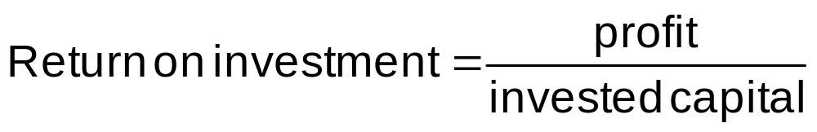
Return on investment (ROI)
Used to measure the performance of an investment centre
Invested capital
  The assets that the investment centre has available to generate profits

Slide 11
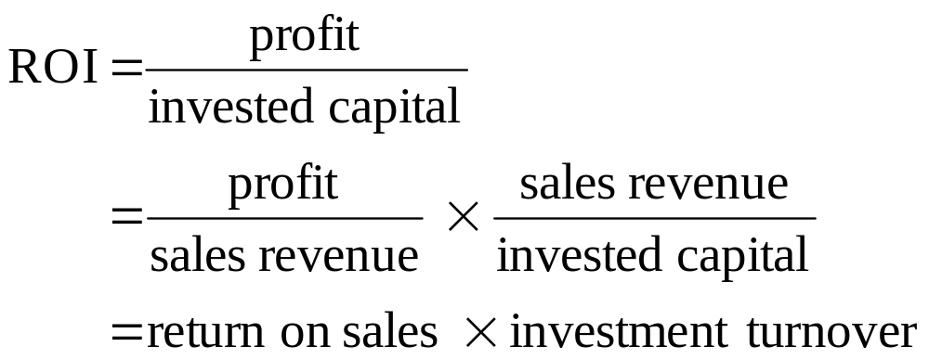
ROI from a different angle
Return on sales
  The percentage of each sales dollar that remains as profit after all the expenses are covered
Investment turnover
  The number of sales dollars generated by every dollar of invested capital

Slide 12
Improving ROI
Increase return on sales
Increase investment turnover

Slide 13
Advantages of ROI
Widely used
Encourages managers to focus on profits, and the assets required to generate those profits
Can be used to evaluate the relative performance of different sized investment centres

Slide 14
Limitations of ROI
Management myopia (short-term focus)
Encourages managers to defer asset replacement
Goal congruence
All of the above are behavioural implications of ROI

Slide 15
How to minimise the behavioural problems of ROI?
Short-term focus- use multiple measures
Encourages managers to defer asset replacement- Consider alternative ways of measuring invested capital
Goal congruence- use alternative financial measures, such as RI or EVA

Slide 16
Residual income (RI)
  RI = profit – (invested capital × imputed interest rate)
Imputed interest charge
  Based on RRR, Cost of capital

Slide 17
Advantage of residual income
More likely to promote goal congruence, compared to ROI
Takes account of the organisation’s required rate of return in measuring performance
Encourages investment in projects which yield a positive residual income to the organisation

Slide 18
Limitations of residual income
Cannot be used to assess the relative performance of businesses that are of different sizes, unlike ROI
Formula is biased in favour of larger businesses, unlike ROI
Can encourage short-term orientation/focus, as with ROI

Slide 19
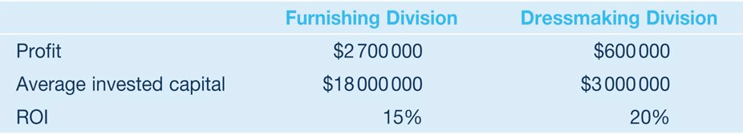
Lecture example 1
Padstow Fabrics Company has two retail divisions, which reported the following results for last year:
Required:
1 Which was the more successful division? Think carefully about this, and explain your answer.
2 Calculate each division’s residual income under each of the following assumptions about the firm’s required rate of return:
(a) 10 per cent. (b) 15 per cent. (c) 18 per cent.

Slide 20
Measuring invested capital
Total assets
Total productive assets
Total assets less current liabilities
Choose average or end-of-year balances
Asset measurement can vary

Slide 21

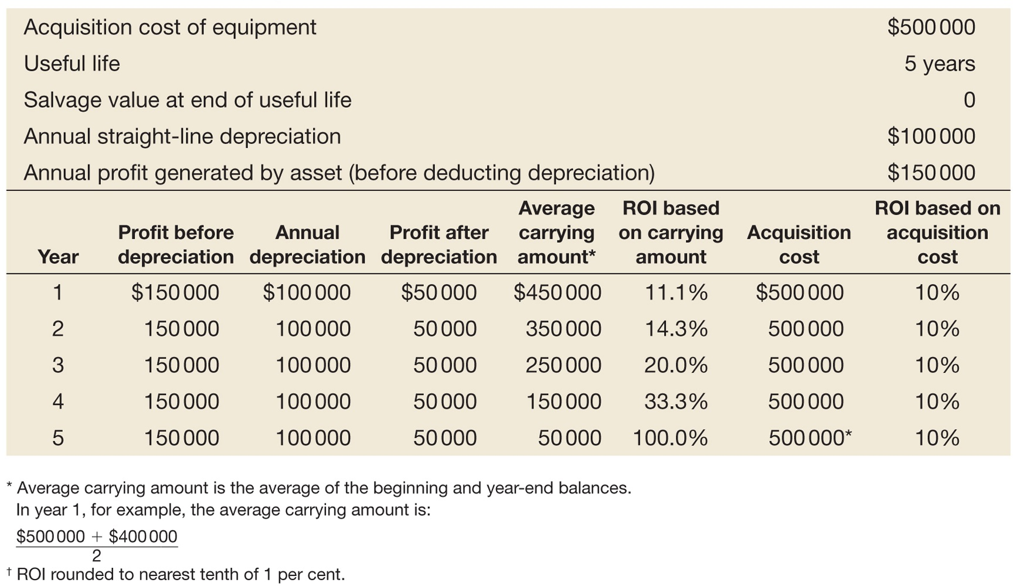
Asset measurement variation

Slide 22
Measuring profit
Profit margin controllable by investment centre manager
  Focus is on performance of the manager
  Recognises controllability
  Motivational impact

Slide 23
Measuring profit
Profit margin attributable to investment centre
  To calculate the investment centre ROI

Slide 24

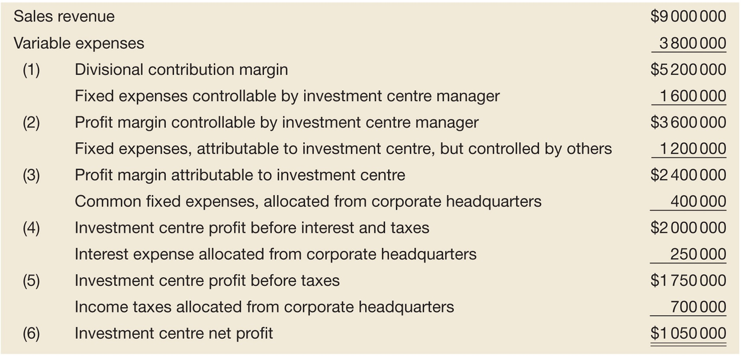
Measuring profit (cont.)

Slide 25
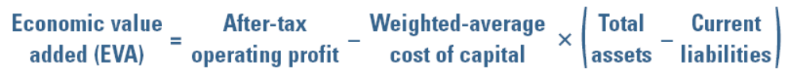
Economic Value Added (EVA)
EVA is a specific type of residual income calculation that has recently gained popularity
Weighted average cost of capital equals the after-tax average cost of all long-term funds in use

Slide 26
EVA
  Requires adjustments to eliminate potential distortions of accrual accounting
Supposedly closer to economic reality than other measures
  Claimed high correlation with market values (Hubbell, 1996)

Slide 27
How do we compute EVA?
After tax cost of debt and cost of equity
  Cost of debt = (1-tax rate) × interest rate
  Cost of equity
    Dividend capitalisation model
    Capital asset pricing model (CAPM)
Weighted average cost of capital (WACC)

Slide 28
How to improve EVA?
Improve profitability without employing additional capital
Borrow additional funds when profits earned are more than the cost of borrowing
Pay off debt by selling assets

Slide 29
But isn’t EVA the same as RI?
RI = = profit – (invested capital × imputed interest rate)
Biddle et al. (1997) 95% same information content
So why pay for EVA ??????

Slide 30
Limitations of EVA
Same as residual income !!

Slide 31
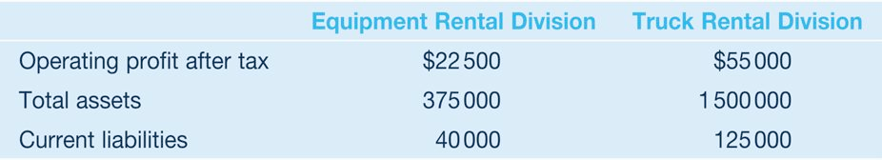
Lecture example 2
Dependable Rentals Ltd consists of two divisions. The Equipment Rental Division rents machinery, such as cement mixers and scissor lifts, to building contractors. The Truck Rental Division rents forklift trucks and removal trucks. The financial results for the two divisions for the most recent year are as follows:
Dependable Rentals obtains its financing from long-term debt and shares, and the weighted cost of capital is estimated to be 8 per cent. To calculate ROI, invested capital is defined as total assets less current liabilities.

Slide 32
LE2 (contd.)
Required:
1 Calculate the ROI for the two divisions.
2 Calculate the EVA® for each division. Note that Dependable Rentals does not make any adjustments to its NOPAT.
3 Which division has performed better? Explain your answer.

Slide 33
Reward systems
Processes, practices and systems which are used to provide levels of pay and benefits to employees
Rewards can be intrinsic or extrinsic

Slide 34
Types of rewards
Rewards
Extrinsic
Financial
Non-financial
Intrinsic
Direct
Indirect

Slide 35
Motivation
The processes that account for an individual’s intensity, direction and persistence of effort towards attaining goals
  Intrinsic motivation
  Extrinsic motivation

Slide 36
Theories of motivation
Theory of work motivation(Herzberg)
Satisfaction and psychological growth are a result of motivation factors
Dissatisfaction is a result of a lack of hygiene factors

Slide 37
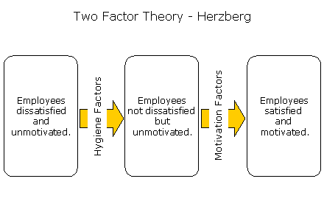
Two-factor theory in a diagram

Slide 38
Theories of motivation (cont.)
Expectancy theory (Vroom)
motivation is influenced by valued outcomes
to flow from particular levels of individual performance, and
the likelihood that those outcomes will be realised.

Slide 39
Theories of motivation (cont.)
Expectancy theory (Vroom)
Essentially it has three parts:
Valence- people’s emotional orientation with respect to outcomes (rewards)
Expectancy- confidence & capability (E P)
Instrumentality- promises to be kept? (P O)

Slide 40
Back to reward systems
Why reward your employees? What are the objectives of a reward system?
Required by law
Retention of talent
Motivational
Internal equity
Linkages to performance
Influence on culture

Slide 41
Performance-related reward systems
Link employee rewards for achieving or exceeding some performance target
Can be based on
  individual performance
  group performance

Slide 42
Individual incentive plans
Individuals are rewarded for achieving individual performance targets
Subjective criteria may also be used
Common at the senior levels of the organisation

Slide 43
Group incentive plans
Profit-sharing
  Cash bonuses are paid to each employee, based on a specified percentage of the company’s profit
  Does not tie individual effort to individual rewards

Slide 44
Group incentive plans
Employee share plans (share options)
  Provide employees with the right to purchase shares in their company, at a specified price at some specified future time
  Commonly used for senior managers, and sometimes more junior managers and employees
  Considered to encourage goal congruence

Slide 45
Group incentive plans
Gainsharing
  Cash bonuses are distributed to the employees when the performance of their segment of the company exceeds some performance target

Slide 46
Group incentive plans
Team-based incentive schemes
  Individuals are rewarded based on their work team exceeding certain performance targets
  Intended to encourage teamwork and cooperation between employees
  Does not tie individual effort to individual rewards

Slide 47
Group vs. individual performance
Consider the following issues
  Identification with the group
  Equity among employees
  Competitiveness between employees
  Relating individual effort to reward
  Rewarding only good performers
The timing of incentive payments can be crucial to achieving desired outcomes
  More frequent rewards may help ensure continual motivation

Slide 48
Summary of key ideas today
ROI although widely used may lead to myopic behaviour
It is important how you define profit and investments
Using multiple measures are always better than using one measure
All these financial measures are single period, so they are inherently short-term in focus

Slide 49
Summary of key ideas today
Reward systems can be used to encourage goal congruent behaviour
When designing performance-related schemes it is important to understand what motivates employees
Performance-related reward systems include individual incentives, profit-sharing, employee share plans, team-based incentives
The frequency and timing of payments may impact on effectiveness of the reward system

Slide 50
References
    Biddle, G., Bowen, R.M. and Wallace, J.S. (1997) Does EVA beat earnings? Evidence on associations with stock returns and firm values”, Journal of Accounting and Economics, Vol. 24, pp. 301-336
    Hubbell, W.W. (1996) “Combining economic value added and activity-based management”, Cost Management, Spring
    O’Hanlon, J. and Peasnell, K. (1998) “Wall St’s contribution to management accounting: The Stern Stewart EVA financial management system”, Management Accounting Research, Vol. 9, pp. 421-444)

Slide 51
Acknowledgement
The contents of this presentation was adapted from:
PowerPoint Slides and lecture examples
Langfield-Smith, K. (2008, 2015, 2018) Management Accounting. McGraw-Hill Australia

