Slide 1

Ramsay Health Care Ltd
PLT 4- Wednesday 10am class
Chloe Verbeek & Pooja Sivakumar

Slide 2
Ramsay expands its operations globally after establishing its core activities in Australia
Figure 1: Geographic scope
Ramsay Healthcare Ltd
480 facilities in 11 countries
Ramsay United Kingdom
Ramsay Sime Darby (Asia Pacific)
Ramsay Générale de Santé (France & Scandinavian countries)
Ramsay Australia
Pharmacy
Hospitals
Hospitals
Hospitals
Retirement Village
Sterlization Hubs
Hospitals
Nursing College
Healthcare Transport Business
Geographic scope of Ramsay Healthcare expands globally, and diversifies its service range while specializing in existing markets.

Slide 3
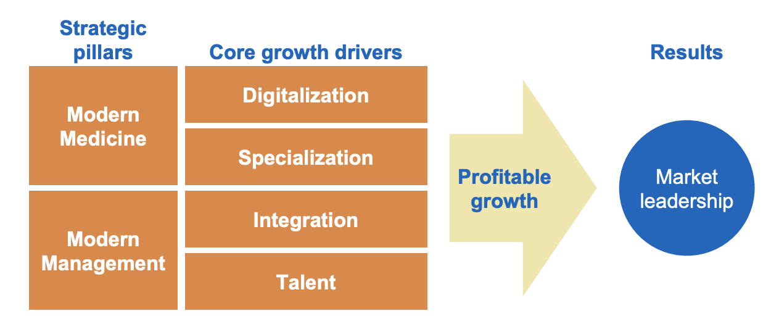
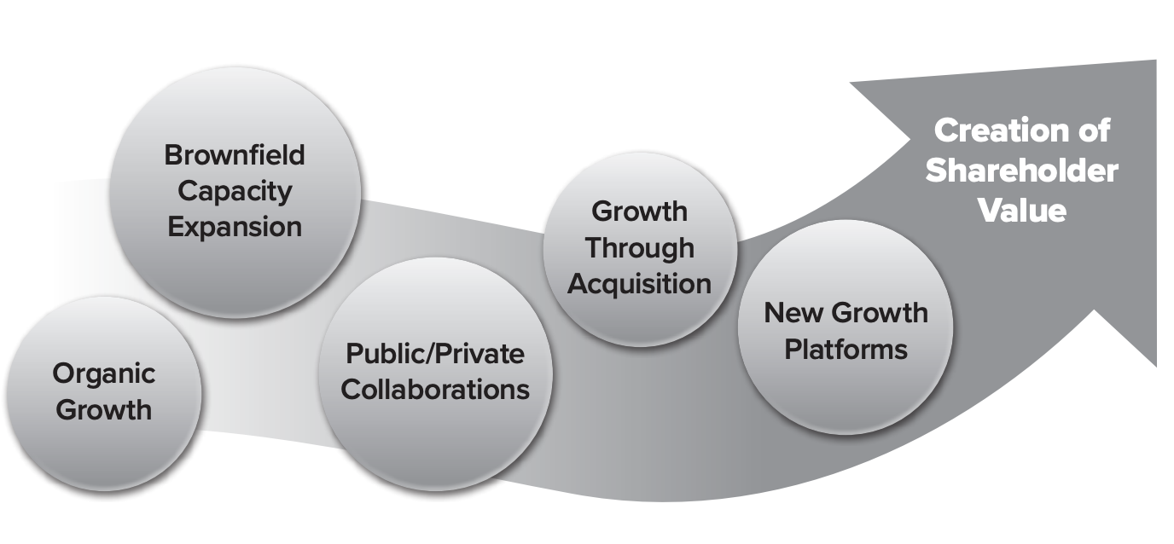
Determines its strategic growth drivers in order to attain market leadership
Ramsay breaks down it’s goals into strategic pillars, growth drivers and results. Further breaks it down into specific targets and activities that are necessary to create shareholder value.

Slide 4
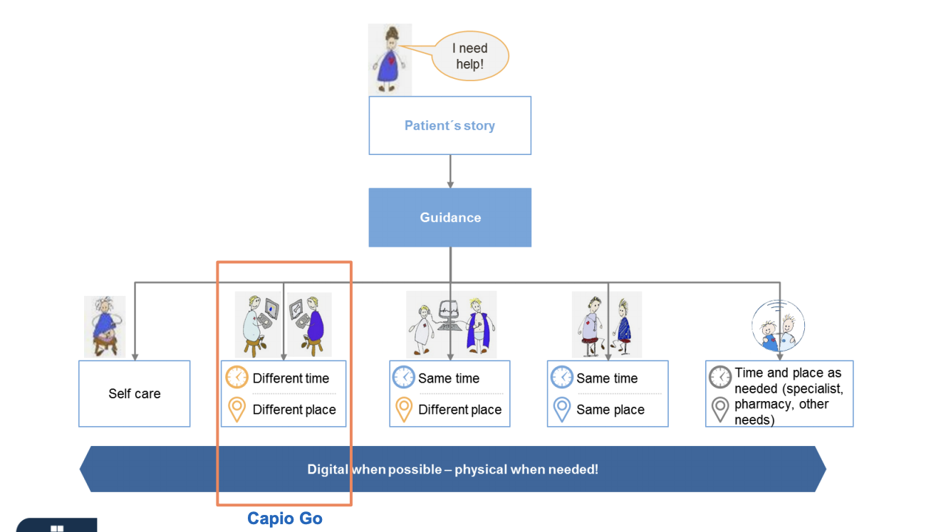
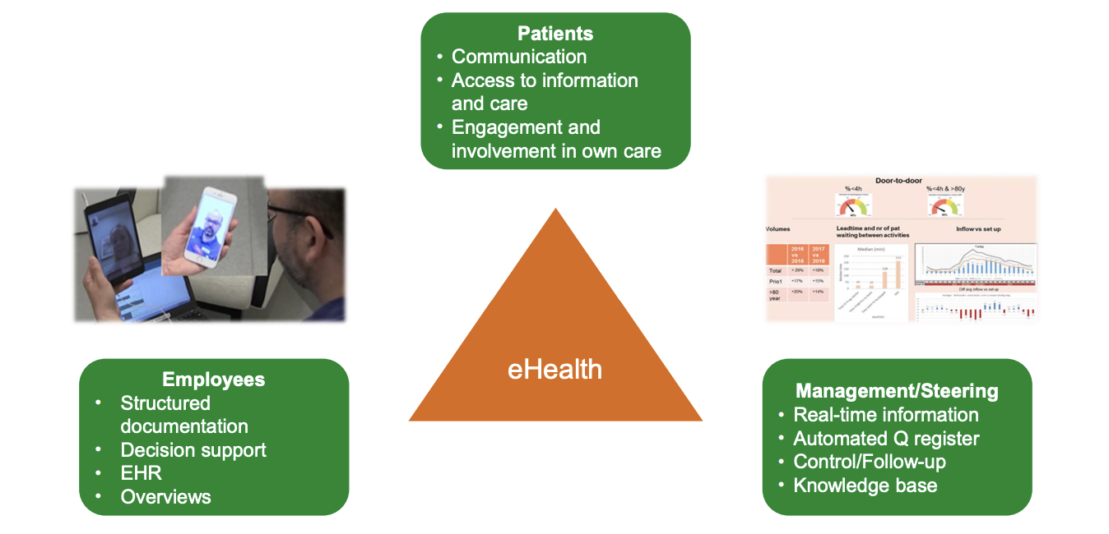
Digitalization of operations- Ramsay focuses on change management
Achieved through e-health
Out of many means of service delivery, Ramsay chooses to provide service at different time and place in order to emphasize patient convenience.

Slide 5
RAMSAY’S CORPORATE FINANCIAL PERFORMANCE OVER PAST 5 YEARS STEADILY INCREASES
Ramsay’s financial performance steadily increases, making it a profitable business for its shareholders.

Slide 6
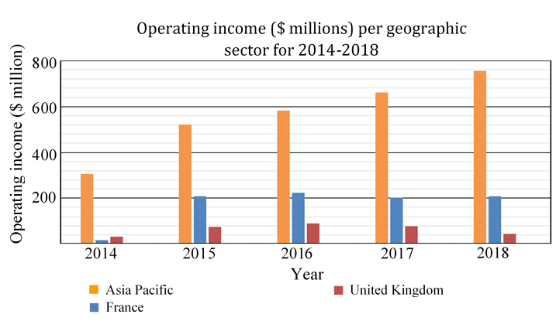
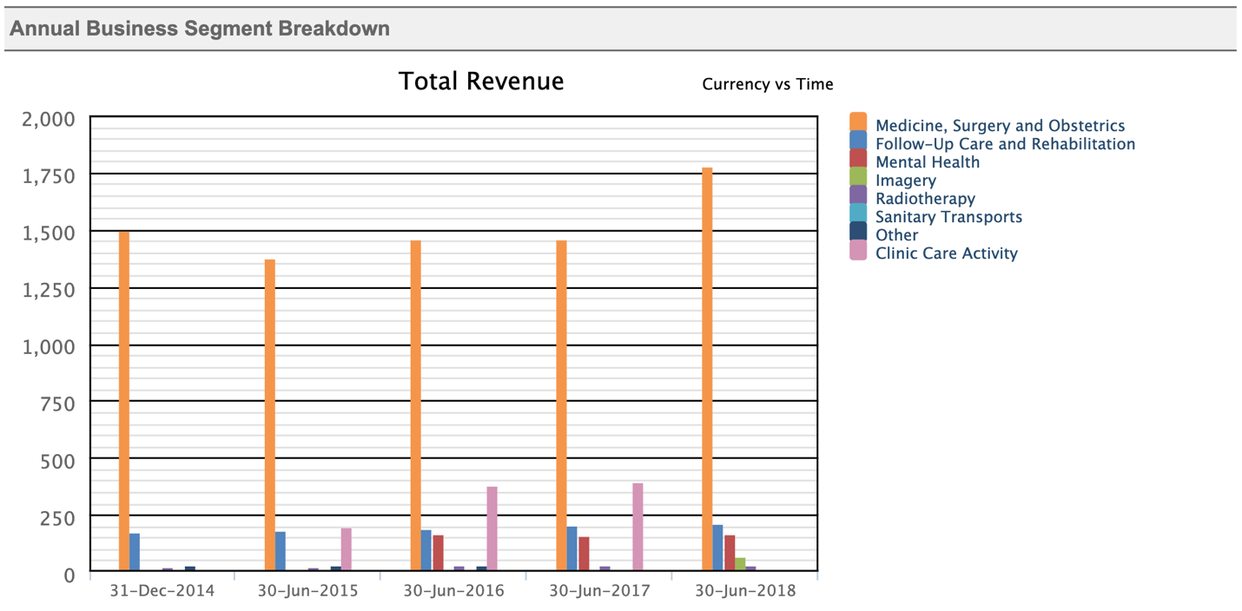
Entrance into new markets while retaining its market leader position in RGdS and Australia
Growth in Asia Pacific region and growth in medicine, surgery and obstetrics has been positive and indicates potential for future specialization. Follow-up care and rehabilitation area has future growth opportunities for Ramsay to invest.

Slide 7
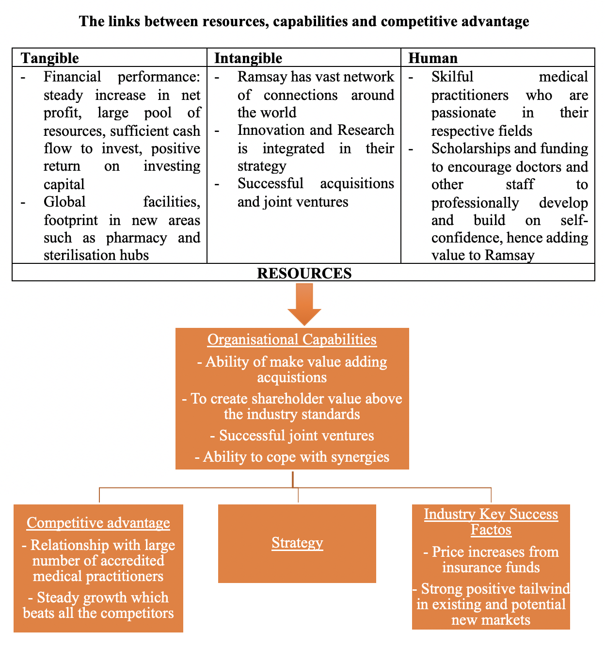
Ramsay’s dynamic capabilities and resources aids in gaining competitive advantage
Ramsay’s ability to innovate, acquire and exploit resources and capabilities to its optimum is key to maintaining their competitive advantage and preserving their market leader positions.

