Slide 1
ACC/ACF3100 Advanced Financial Accounting
Lecture 3
Measurement: Fair Value
Department of Accounting

Slide 2
Minimum Readings
Henderson Chapter 4
AASB13 Fair Value Measurement

Slide 3
Learning Objectives
After completing this topic you should be able to:
Understand the concept and importance of measurement in financial reporting.
Describe the standard setter’s approach to measurement and evaluate benefits and challenges associated with a mixed measurement approach.
Explain and evaluate different measurement alternatives.
Define and understand the concept of fair value.
Explain the controversial and political nature of measurement, particularly fair value accounting.
Explain how fair value can be determined.

Slide 4
Where does this fit into unit learning goals?
1. Examine contemporary financial accounting issues.
2. Apply a range of theories of accounting to explain accounting practices and appreciate the judgements, estimations and assumptions influencing accounting numbers.
3. Critically assess and appreciate changing influences in standard setting and regulatory requirements.
4. Apply judgement, communication and problem solving skills to deal with advanced financial accounting issues.

Slide 5
Measurement In Accounting
New AASB Conceptual Framework
6.1 Elements recognised in financial statements are quantified in monetary terms. This requires selection of a measurement basis. A measurement basis is an identified feature - for example, historical cost, fair value or fulfilment value – of an item being measured.
May involve calculation, estimation, and/or apportionment.
Impacts quality and therefore decision usefulness

Slide 6
Benefits of Measurement
Makes financial statements decision useful
  Gives meaning to the items included
Allows users of accounting information to:
Assess an entity’s financial performance and position
Compare the entity’s performance and position over time
Compare entities

Slide 7
Accounting Standards
Barker and McGeachin (2015):
    Is IFRS a “conservative” approach to accounting?
    Is IFRS consistent “at a conceptual level” and “in accounting standards themselves”?
The Conceptual Framework does not provide guidance as to which measurement bases should be used
In reality a range of bases are used
Historical Cost remains dominant
Shift towards Fair Value

Slide 8
Measurement and International Accounting Standards
IASBs use a mixed measurement model
      Different measurement bases are employed to different degrees and in varying combinations during the preparation of the financial statements.
      Variation across and within items
        Refer examples from Pacific Brands
This leaves a large amount of flexibility and choice within particular standards

Slide 9
Example: Mixed Measurement Approach
Pacific Brands 2015 Annual Report Note 32:
Inventories: lower of COST and NRV
      PPE: COST less accumulated depreciation and impairment
      Intangible assets (e.g. Brands): COST less accumulated amortization and impairment
      Long term employee benefits: PRESENT VALUE
      Derivative financial instruments: FAIR VALUE

Slide 10
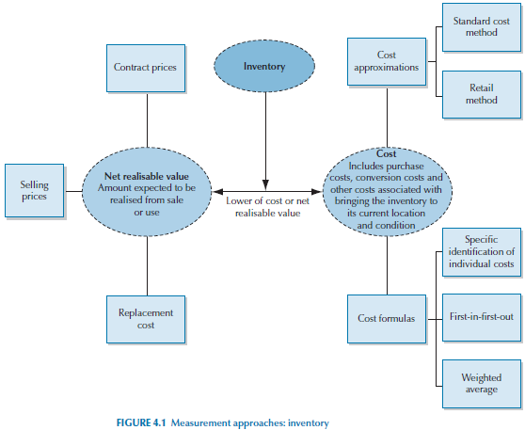
Example: Inventory

Slide 11
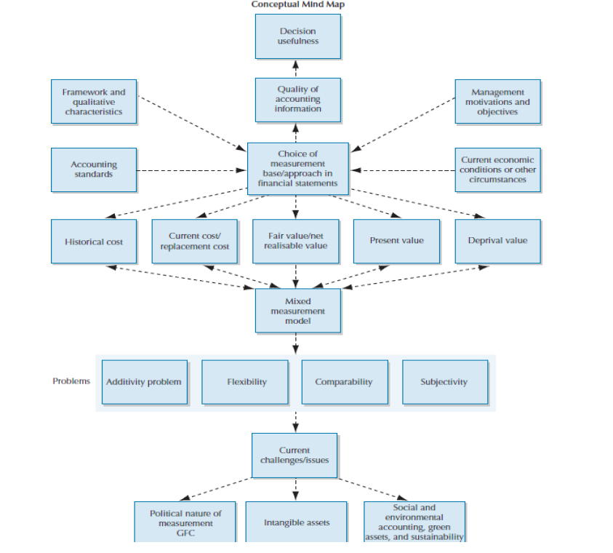

Slide 12
Limitations of Measurement
Little or no agreement on what measures should be used.
The inherent flexibility and the nature of a mixed measurement approach reduces comparability.
Measurement can be quite subjective.
With flexibility comes opportunistic accounting choices.
The current approach results in the additivity problem.

Slide 13
Historical Cost
Defined in the New Conceptual Framework as:
  6.4 Historical cost measures provide monetary information about assets, liabilities and related income and expenses, using information derived, at least in part, from the price of the transaction or other event that gave rise to them.
  6.5 The historical cost of an asset when it is acquired or created is the value of the costs incurred….The historical cost of a liability when it is incurred …is the value of the consideration received….

Slide 14
Historical Cost and Quality of Information
Relevance
        Low: Especially as time passes
Faithful Representation
        High: Measures an objective transaction
Understandability
        High: Concept well known and understood
Comparability
        Medium: Purchasing power of money changes over time

Slide 15
Current Value
Defined in the New Conceptual Framework as:
  6.10 Current value measures provide monetary information about assets, liabilities and related income and expenses, using information updated to reflect conditions at the measurement date.
  Because of updating, current values of assets and liabilities reflect changes, since the previous measurement date, in estimates of cash flows and other factors…

Slide 16
Current Value and the Quality of Information
Relevance
        High: Indicative of future potential
Faithful Representation
        High: Determined by reference to actual costs
Understandability
        Low: Can be subjective, depends
Comparability
        Medium: Can be subjective, depends

Slide 17
Current Cost
Defined in the New Conceptual Framework as:
6.21 The current cost of an asset is the cost of an equivalent asset at the measurement date plus the transaction costs that would be incurred a that date….
Current cost, like historical cost, is an entry value: it reflects prices in the market in which the entity would acquire the asset or incur the liability.

Slide 18
Fair Value
Defined in the New Conceptual Framework as:
6.12 Fair value is the price that would be received to sell an asset, or paid to transfer a liability, in an orderly transaction between market participants at the measurement date.
Defined in AASB 13, para 9
  The price that would be received to sell an asset or paid to transfer a liability in an orderly transaction between market participants at the measurement date.

Slide 19
Arguments for Fair Value
Relevance
        Focuses on future potential
Faithful Representation
        Determined using objective market prices
Understandability
      Simple representation of current market value
Comparability
      Focus on market value not individual entity

Slide 20
Arguments against Fair Value
Relevance
        Hypothetical and not relevant to specific entity
Faithful Representation
        If no objective market prices then highly subjective
Understandability
        Often based on complex assumptions and calculation
Comparability
        Different models lead to very different results

Slide 21





Quiz: Identify the measurement for the following items.
Biological assets
Water rights
Provision for rehabilitation costs
Government grants

Slide 22
Influences on Choice of Measurement Approach
Accounting standards
Potential users of the financial statements
      What will provide the most decision useful information, e.g., creditors – liquidity – fair value
Practical considerations
      Is it possible to calculate
      Cost versus benefit
Managements motivations and objectives
      Short-term versus long-term
      Impact on incentives
      Reputational impact

Slide 23
The Controversial/Political Nature of Accounting Measurement
Different interest groups may favour different accounting measurement approaches
Variable and subjective in practice
Impact on financial performance and position
Fair value the focus during the GFC
      May have made economic crisis worse
      May not be reliable
      May have hidden problems
      May be difficult to regulate

Slide 24
Characteristics of an Active Market
AASB 13 Para 15
A fair value measurement assumes that the asset or liability is exchanged in an orderly transaction between market participants to sell the asset or transfer the liability at the measurement date under current market conditions.

Slide 25
Fair Value and The Importance of an Active Market
AASB13 para 16
A fair value measurement assumes that the transaction to sell the asset or transfer the liability takes place either:
  in the principal market for the asset or liability; or
  (b) in the absence of a principal market, in the most advantageous market for the asset or liability.
  Appendix A Defined Terms
Para 19 - The entity must have access to the principal (or most advantageous) market at the measurement date.

Slide 26
Market Participants – Appendix A Defined Terms
Para 22
  An entity shall measure the fair value of an asset or liability using the assumptions that market participants would use in pricing the asset or liability, assuming that market participants act in their best interest.
  Para 23
  In developing those assumptions, an entity need not identify specific market participants.

Slide 27
Fair Value Focuses on an Exit Price — Why?
It is current. It allows users to focus on a value today, not some historical cost that may/may not be relevant.
It is specific. It focuses on the asset or liability at hand, rather than the price to purchase a generic equivalent.
It has a level of independence by introducing an external party into the transaction.
Appendix A Defined Terms – Exit Price
The price that would be received to sell an asset or paid to transfer a liability.

Slide 28
Fair Value, Active Market, and Valuation Technique
Is the market really inactive?
    Assume a market is active, burden of proof on the accountant to show it is inactive.
If it is inactive
    Make adjustments (possibly substantial)
    Use an alternative valuation technique

Slide 29
Characteristics of an Inactive Market
An inactive market would be characterised by:
  Few recent transactions.
  Price quotations are not developed using current information.
  Price quotations vary substantially.
  Indices that previously were highly correlated with the fair values of the asset or liability are demonstrably uncorrelated.
  The market has gone toxic.
  There is a wide bid-ask spread.
  There is a significant decline in the activity.
  Little information is publicly available.

Slide 30
Valuation techniques
AASB 13 Para 61
An entity shall use valuation techniques that are appropriate in the circumstances and for which sufficient data are available to measure fair value, maximising the use of relevant observable inputs and minimising the use of unobservable inputs
Appendix A Defined Terms

Slide 31
Inputs to Valuation
Observable inputs:
are those values that can be obtained independently from available market data, possibly with some adjustment for the specific asset, which would be used by market participants when valuing an asset or liability.
Unobservable inputs:
are based on information that is not available to the market but must be inferred or estimated based on the best information available.

Slide 32
Fair Value Hierarchy
Level 1 Inputs Para 76-80
      Quoted prices (unadjusted) in active markets for identical assets or liabilities.
Level 2 Inputs Para 81-85
      Inputs other than quoted prices included within Level 1 that are observable.
Level 3 Inputs Para 86-90
      Inputs that are not based on observable market data (unobservable inputs).

Slide 33
Is there a quoted price in an active market for an identical asset or liability?
(Level 1 input)
Yes
No
Are there any observable inputs* other than quoted prices for an identical asset or liability?
Use the Level 1 input = Level 1 measurement
Must use without adjustment
Yes
No
* Maximise the use of relevant observable inputs. Observable inputs include market data (prices and other information) that is publicly available
‡ Unobservable inputs include the entity’s own data (eg budgets, forecasts), which must be adjusted if market participants would use different assumptions
No use of significant unobservable
(Level 3) inputs‡ =
Level 2 measurement
Use of significant unobservable
(Level 3) inputs‡ =
Level 3 measurement

Slide 34
Valuation Techniques AASB13 Paras 62-66
Market approach | The ability to identify a market for an identical or comparable asset or liability Preferred by the standards Depending on the nature of the market, adjustments may need to be made
Income approach | Converting future cash flows or income and expense into a single present value Discounted cash flow models More complex: Black–Scholes–Mertons options pricing approach
Cost approach | An estimate of the cost of replacing the ‘service capacity’ of the asset under consideration (current replacement cost) The cost is calculated not based on a new asset, rather an asset that would substitute to derive comparable benefit, considering the ‘obsolescence’ of the current asset

Slide 35
Highest and Best Use for Non-Financial Assets
AASB13 Para 27
A fair value measurement of a non-financial asset takes into account a market participant’s ability to generate economic benefits by using the asset in its highest and best use or by selling it to another market participant that would use the asset in its highest and best use.
As determined by the market Para 28
      (a) Physically Possible
      (b) Legally Permissible
      (c) Financially Feasible

Slide 36
Fair Values are Specific, What Factors Should be Considered?
AASB13 Para 11
A fair value measurement is for a particular asset or liability. Therefore, when measuring fair value an entity shall take into account the characteristics of the asset or liability if market participants would take those characteristics into account when pricing the asset or liability at the measurement date. Such characteristics include, for example, the following:
      (a) the condition and location of the asset; and
      (b) restrictions, if any, on the sale or use of the asset.

Slide 37
Specific Issues
How to deal with transaction costs
      Although transaction costs are considered when determining the most advantageous market, the price used to measure the fair value of the asset or liability shall not be adjusted for those costs. Para 25
      Exception: transportation costs are considered (as a negative) in the value an asset.

Slide 38
Example: Dealing with Transaction Costs
Measuring a widget machine
There is no principal market but we have identified two markets where almost identical machines are being actively traded.
In Market A the price that would be received is $30,000 incurring transport costs of $2,000 to deliver the machine to that market and would incur $1,000 of advertising costs.
In Market B the price that would be received is $28,000 and transport costs of $3,000.

Slide 39
Example: Dealing with Transaction Costs
Market A $30,000 - $2,000 - $1,000 = 27,000
Market B $28,000 - $3,000 = $25,000
Most advantageous market – Market A
Fair Value = $30,000 - $2,000 = $28,000.

Slide 40
Fair Value - Application to Liabilities and Equity: General Principles
AASB13 Para 34
Fair value measurement assumes that a financial or non-financial liability or an entity’s own equity instrument (e.g. equity interests issued as consideration in a business combination) is transferred to a market participant at the measurement date.

Slide 41
Fair Value - Application to Liabilities and Equity: General Principles
Liabilities can be valued based on the corresponding asset
      When public prices are not available for the debt or equity the entity should, where possible,
      Para 37 an entity shall measure the fair value of the liability or equity instrument from the perspective of a market participant that holds the identical item as an asset at the measurement date.

Slide 42
Fair Value - Application to Liabilities and Equity: General Principles
If no corresponding asset exists
      Para 41 When applying a present value technique an entity might take into account:
      (a) the future cash outflows that a market participant would expect to incur in fulfilling the obligation…
      (b) the amount that a market participant would receive to enter into or issue an identical liability or equity instrument…

Slide 43
Fair Value Disclosures
Para 91 An entity shall disclose information that helps users of its financial statements assess both of the following:
  For assets and liabilities that are measured at fair value on a recurring or non-recurring basis in the statement of financial position after initial recognition, the valuation techniques and inputs used to develop those measurements.
  For recurring fair value measurements using significant unobservable inputs (Level 3), the effect of the measurements on profit or loss or other comprehensive income for the period.

Slide 44
Power (2010): Fair value and reliability
In Level 1, accounting systems are, in theory, passive observers of prices.
Level 3 measurements have been criticized for their subjectivity, uncertainty, and the difficulty this poses for auditors (however, the use of cost-based approaches in place of Level 3 measurements often lack legitimacy - e.g., employee share options; derivatives).
Subjectivity and uncertainty can be transformed into acceptable facts when they are embedded in taken for granted routines.
Such routines are often outsourced to valuation experts who apply models from financial economics.

Slide 45
Next week
Intangible Assets

