Slide 1
ACC/ACF3100 Advanced Financial Accounting
Lecture 2
Accounting Theories and Research
Department of Accounting

Slide 2
Minimum Readings
Rankin et al. 2nd Ed Chapter 5
See Moodle

Slide 3
Learning Objectives
Upon completing this topic you should be able to:
Evaluate how theories can enhance our understanding of accounting practice.
Contrast positive with normative theories in accounting.
Explain positive accounting theory and examine how it explains disclosures and accounting practice (e.g., expense versus capitalisation, accounting estimates etc).
Understand agency costs; the agency problems between managers and shareholders; the agency problems. between managers and debtholders; and how accounting number can mitigate these agency problems.
Explain stakeholder theory and examine how it prescribes and explains accounting practice.
Explain legitimacy theory and examine how it explains accounting disclosure practice.
Explain institutional theory and examine how it explains accounting disclosure practice.

Slide 4
Where does this fit into unit learning goals?
1. Examine contemporary financial accounting issues.
2. Apply a range of theories of accounting to explain accounting practices and appreciate the judgements, estimations and assumptions influencing accounting numbers.
3. Critically assess and appreciate changing influences in standard setting and regulatory requirements.
4. Apply judgement, communication and problem solving skills to deal with advanced financial accounting issues.

Slide 5
Accounting Theory
Accounting is viewed as a practical discipline
      Rule focused
      With little use for theory
However, theory is necessary to
      Understand the world we live in
      Provide a basis for decision making
All accounting is premised on theories, e.g.:
      The Conceptual Framework
      Definition of accounting elements and recognition criteria
      Measurement bases

Slide 6
Theory Defined
Theory can mean a lot of different things
  Dictionary definition:
    A belief or principle that guides actions or behaviour
    An idea or set of ideas that is intended to explain something
    The set of principles on which a subject is based or of ideas that are suggested to explain a fact or event

Slide 7
Accounting Theory Defined
A description, explanation or a prediction of accounting practice based on observations and/or logical reasoning
Logical reasoning in the form of a set of broad principles that
  provide a general framework of reference by which accounting practice can be evaluated and
  (2) guide the development of new practice and procedures

Slide 8
What Value Does Accounting Theory Offer?
Accounting theories provide principles for decision making
Accounting theories help us understand
      Decisions of financial report preparers
      Actions of financial report users
      Influences of organisational environment
      Potentially better accounting and financial reporting practice

Slide 9
Types of Theories
Positive Theories
      Describes, explains or predicts activities
      Help us understand what happens in the world
      Based around Hypotheses
      Also called empirical theories
      e.g. Agency theory claims that self-interest drives managers to engage in opportunistic financial reporting
Normative Theories
      Recommend what should happen
      Prescribe action to achieve specific objectives
      E.g. The Conceptual Framework prescribes the objective of financial reports and the qualitative characteristics of information

Slide 10
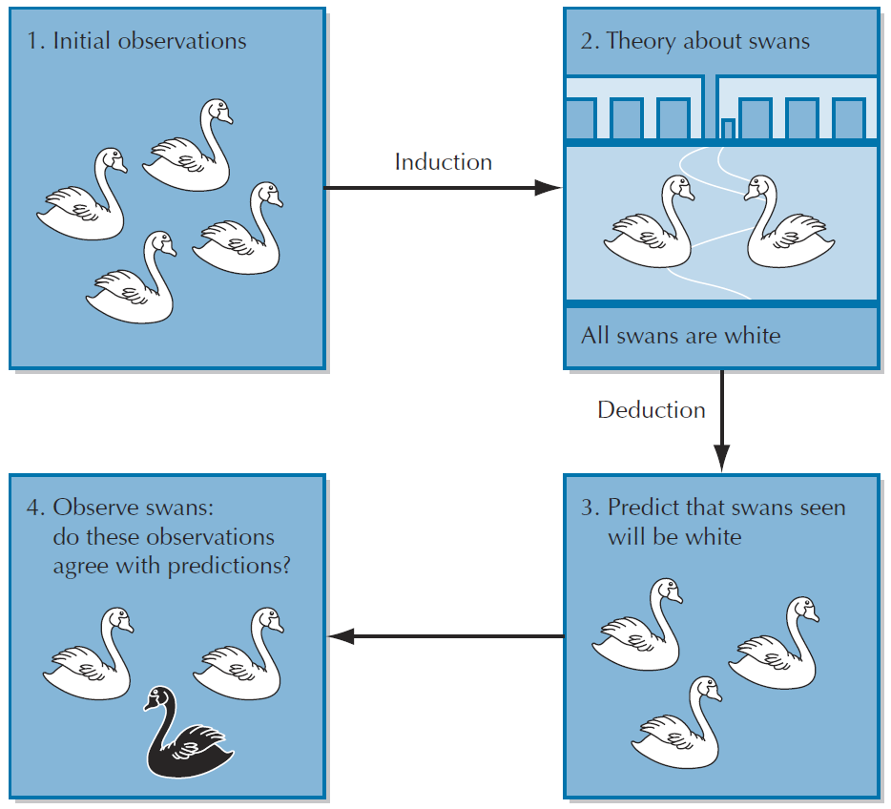
Where Positive Theories Come From

Slide 11
Quiz:
Theories/Statements | Positive or Normative?
The conceptual framework of accounting provides guidance on how assets, liabilities, expenses, income and equity should be defined, recognised and measured.
Agency theory predicts that managers have incentives to extract private rent in the world of information asymmetry.
According to the debt/equity hypothesis, the higher the firm's debt/equity ratio, the more likely managers use accounting methods that increase income.
According to the ethical branch of stakeholder theory, all stakeholders ought to be treated equally.

Slide 12
Example: Positive Accounting Theory
Used to explain and predict accounting practice.
      Often used to explain choice of accounting policies or the decision to provide information
It examines a range of relationships between the entity and
      suppliers of equity capital (owners),
      managerial labour (management)
      debt capital (lenders or debt holders)
Based on the ‘rational economic person’ assumption
Incorporates contracting and agency theories

Slide 13
Contracting Theory
Suggests that the organisation is characterised as a legal ‘nexus of contracts’.
With contracting parties having rights and responsibilities under these contracts.
Positive accounting theory focuses on
        managerial contracts, and
        debt contracts.
These are agency contracts used to manage relationships where there is a separation between management and capital providers.

Slide 14
Agency Theory
Used to understand relationships whereby a principal employs an agent.
Creates a moral hazard
      The risk that managers might undertake actions that are detrimental to owners
If the interests of principal and agent are not aligned there are incentives for agent to act in a way not in the best interest of the principal
      excessive perquisites (unnecessary consumptions of firm resources)
      shirking (reducing workloads)
      empire building (expanding firm size beyond shareholders’ interests)
      incorrect investment decisions (avoiding risky yet promising projects)
Leads to three agency costs: monitoring costs, bonding costs and residual loss.

Slide 15
Agency Costs
Agency costs | Who bear the costs? | Purpose
Monitoring | Shareholders | To monitor managerial behaviour e.g., Costs of preparing financial statements
Bonding | Managers | Managerial actions are constrained by the restrictions placed by shareholders to align the principal-agent relationship e.g., Time and effort incurred by managers to prepare more frequent reports
Residual loss | Shareholders | The reduction of wealth suffered by shareholders due to managerial sub-optimal behaviour that cannot be eliminated by monitoring and bonding costs, as it is too costly to do so given the costs of full enforcement of contracts exceed the benefits e.g., Misuse of business travel expenses

Slide 16
Quiz
Classify the following agency costs as an example of monitoring costs, bonding costs or residual loss.
1. Managers consume company resources such as stationery or printing facilities for their own use
3. Costs of establishing corporate governance
4. Personal revenue foregone as managers are prohibited from disclosing/selling company information
5. Audit costs to certify financial statements

Slide 17
Owner–Manager Agency Relationships
Agency theory identifies a number of problems that can exist between managers and owners.
Contracts and accounting information can be used to ‘bond’ the interests of owners and managers.
Addresses three specific problems
        Horizon problem
        Risk aversion
        Dividend retention

Slide 18
Agency problems between shareholders and managers | Conflicts |  | Mitigated through remuneration design and accounting information
 | Shareholders | Managers
Horizon
Risk aversion
Dividend retention
Long term horizon in the entity
Interested in long term growth, future cash flows
Short term horizon in the entity
Interested in short term profit to show effective management
Give shares or options
Link managerial pay to share price movements
Prefer risks
Hold well diversified portfolio
Limited liability
Prefer less risk than shareholders
Human capital tied up in the firm
Salary as main income
Profit based measurement
Share based compensation
Prefer to receive dividends
Retain cash to expand business
Link bonuses to dividend payout ratio
Link bonuses to profits

Slide 19
Manager–Lender Agency Relationships
When a lender agrees to provide funds to an entity there is the risk that the lending party may not repay those funds.
        Excessive dividend payments
        Underinvestment
        Asset substitution
        Claim dilution
To avoid higher interest costs managers have incentives to show they are acting in a way that is not detrimental to lenders.

Slide 20
Agency problem | Conflicts between managers and lenders?
Excessive dividend payments
Underinvestment
Asset substitution
Claim dilution
Shareholders dividends, managers distribute excessively
Lenders are concerned with firms paying too much dividend: cash ↓, asset↓, default risk↑
In the event of liquidation, lenders get the funds first
Managers, on behalf of owners, have incentives not to invest in positive NPV projects that can increase funds available to lenders
Managers choose riskier investment to maximize shareholder returns
Lenders bear the downside risk, but do not share upside benefits of such riskier investments (the repayment to lenders is fixed)
Increase borrowing from higher priority debt can reduce security to lenders

Slide 21
Role of Accounting Information in Reducing Agency Problems
Accounting information forms one of the major components of both manager remuneration and lending contracts.
For managers accounting information plays two roles in the contracting process:
  To write the terms of managerial contracts.
  To determine performance against the terms of the contracts and consequently the amount of bonus and other pay components managers will receive.
Lenders look to regular financial updates to ensure companies are maintaining the terms of their covenants.

Slide 22
Information Asymmetry
Results from managers having more information about the current and future prospects of the entity than outsiders.
Managers can choose when and how to disseminate this information.
Under positive accounting theory there are incentives to disclose most news, good or bad, to the market.

Slide 23
Role of Accounting Standards in Reducing Agency Problems
Barker and McGeachin (2015):
As a result of information asymmetry between preparers and users, conservatism is a way to reduce opportunistic financial reporting practices.
IFRS mitigates agency problems since it tends to recognize losses earlier than gains.
However, “the weakness in IFRS that the paper highlights is that the Framework acknowledges neither the existence of agency problems, nor the role of financial statements in mitigating those problems” (p. 202).

Slide 24
Criticisms of PAT
Does not provide prescription so does not provide a means of improving accounting practice
Not value-free but rather is value-laden
Underlying assumption of wealth maximisation is simplistic
Issues being addressed have not shown any significant development
Scientifically flawed

Slide 25
Normative accounting theories
In contrast with positive theories, normative theories:
seek to provide guidance in selecting accounting procedures that are most appropriate
prescribe what should be done

Slide 26
The Conceptual Framework:
is considered a normative theory
seeks to identify the objective of GPFRs
seeks to provide accounting guidance within a ‘coherent’ and ‘consistent’ framework
identifies the qualitative characteristics financial information should possess
makes recommendations that sometimes depart from current practice

Slide 27
Systems-oriented theories
These theories focus on the role of information and disclosure in the relationships between organisations, the State, individuals and groups
The entity is assumed to be influenced by the society in which it operates and to have an influence on it
Include:
  Stakeholder Theory
  Legitimacy Theory
  Institutional Theory

Slide 28
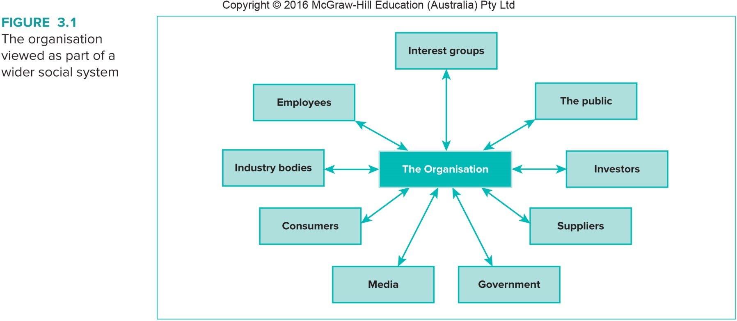
The organisation viewed as part of a wider social system

Slide 29
Stakeholder Theory
Considers the relationships that exist between the organisation and its various stakeholders.
Stakeholders are ‘any group or individual who can affect or is affected by the achievements of an organization’s objectives’
There are two versions of stakeholder theory
      a normative theory, known as the ‘ethical branch’,
      an empirical theory of management, which is a positive theory

Slide 30
Normative Branch of Stakeholder Theory
Argues that organisations should treat all their stakeholders fairly.
An organisation should be managed for the benefit of all its’stakeholders.
Stakeholders are identified, and should be considered in organisational decisions because of their interest in the activities of the organisation.

Slide 31
Managerial Branch of Stakeholder Theory
Seeks to explain how stakeholders influence organisational actions.
The extent to which an organisation will consider its stakeholders is related to the power or influence of those stakeholders.
        A stakeholders’ power is related to the degree of control they have over resources required by the organisation.

Slide 32
Role of Accounting Information in Stakeholder Theory
One important way of meeting stakeholders’ needs and expectations is providing information about organisational activities and performance.
Stakeholder theory has been used to examine disclosure of voluntary information to stakeholders, most commonly relating to social and environmental performance.

Slide 33
Legitimacy Theory
Based on the idea of a social contract
      Relates to the explicit and implicit expectations society has about how businesses should act to ensure they survive into the future.
      Organisations need to show they are operating in accordance with the expectations in the social contract.

Slide 34
Legitimacy is a generalised perception or assumption that the actions of an entity are desirable, proper, or appropriate within some socially constructed system of norms, values, beliefs and definitions.

Slide 35
Legitimacy Theory
Organisational legitimacy
      The values and norms evident in the social contract have changed over time.
      In the past legitimacy was considered only in terms of economic performance.
      Now businesses are expected to consider a range of issues, including the environmental and social consequences of their activities.

Slide 36
Accounting Disclosures and Legitimation
Lindblom (1994)* identifies four ways an organisation can obtain or maintain legitimacy:
  Seek to educate and inform society about actual changes in the organization’s performance and activities
  Seek to change the perceptions of society, but not actually change behaviour
  Seek to manipulate perception by deflecting attention from the issue of concern to other related issues
  Seek to change expectations of its performance.

Slide 37
Accounting Disclosures and Legitimation
Disclosure of information about an organisation’s effect on, or relationship with society can be used
        An entity might provide information to offset negative news which may be publicly available.
        An organisation may draw attention to strengths.
Public reporting through the annual report or the entity website can be a powerful tool in showing an organisation is meeting the expectations of society.

Slide 38
Institutional Theory
Comes from management literature.
It considers how rules, norms and routines become established as authoritative guidelines, and considers how these elements are created, adopted and adapted over time.
Practices within organisations can be predicted from perceptions of legitimate behaviour derived from cultural values, industry tradition, entity value etc

Slide 39
Contingency theory
Also comes from management literature
Proposes that organisations are affected by a range of factors that differ across organisations
Therefore need to adapt to external environment, size and business strategy to perform well
No one best way

Slide 40
Using Theories To Understand Accounting Decisions
Accountants use judgement to make a range of accounting decisions on a daily basis.
Examples include:
        Whether to expense or capitalise costs.
        What accounting estimates to use.
        What, where and how to disclose information.
Theories offer some assistance in explaining managers’ and accountants’ decisions.

Slide 41
Expensing and Capitalising Costs
Agency theory would hold that
      Managers on compensation contracts which have bonuses tied to a current measure of entity performance
      Entities with lending agreements with a lending covenant
  would prefer to capitalise costs.

Slide 42
Accounting Estimates
Agency contracts can explain managerial decisions in this regard.
      Managers and accountants, acting in self interest, are likely to ensure their own bonuses are maximised and the entity is not at risk of breaching debt contracts.
Legitimacy and stakeholder theory suggest there are times entities, for political reasons, will actively reduce their reported profits.

Slide 43
Disclosure Policy
Disclosure policy relates to additional disclosure within the annual report or media releases.
Stakeholder theory would explain these disclosures in terms of providing relevant information to maintain relationships with powerful stakeholders.
Legitimacy theory sees voluntary disclosure as a way of maintaining or regaining legitimacy by demonstrating how the entity is meeting societal expectations.

Slide 44
Next week
Measurement and Fair Value

