Slide 1
ACC/ACF3100 Advanced Financial
Accounting
Lecture 1
The Australian Accounting Environment
Department of Accounting

Slide 2
Minimum Readings
Henderson: Chapter 1 and 2
Financial Reporting Handbook 2020
*new AASB Conceptual Framework for Financial Reporting

Slide 3
Topic Overview
Unit adopts ‘the balance sheet approach’.
Weeks 1-2 Set the scene
    Regulatory environment central theme
    Conceptual environment
    Separation of economic interest and control
Week 3 Measurement – Fair Value
    Impact of regulatory environment
Weeks 4-11 Definition and disclosure issues
Week 12 Revision

Slide 4
Learning Objectives
Understand the meaning of ‘financial accounting’ and its relationship to the broader areas of accounting and accountability.
Be able to explain users of general purpose financial statements.
Understand the scope and sources of regulation relating to Australian external financial reporting.
Be able to explain the central requirement that financial statements be ‘true and fair’.
Be able to explain the general functions of the IASB and its direct relevance to Australian accounting standard-setting.
Understand the Conceptual framework for financial reporting.

Slide 5
Where does this fit into unit learning goals?
1. Examine contemporary financial accounting issues.
2. Apply a range of theories of accounting to explain accounting practices and appreciate the judgements, estimations and assumptions influencing accounting numbers.
3. Critically assess and appreciate changing influences in standard setting and regulatory requirements.
4. Apply judgement, communication and problem solving skills to deal with advanced financial accounting issues.

Slide 6
Financial accounting defined
Financial accounting is a process involving the collection and processing of financial information to meet the decision-making needs of external parties
Financial accounting is heavily regulated, and a great deal of regulation changes each year.
It is ever evolving and changing

Slide 7
General vs special purpose financial statements
General-purpose financial statements
  Comply with the Conceptual Framework and accounting standards
  Meet the information needs common to users who are unable to command the preparation of reports tailored to satisfy all their information needs
  Represent financial statements and supporting notes included within an Annual Report.
Special-purpose financial statements
  Designed to meet the needs of a specific group or to satisfy a specific purpose
  Example: a bank demanding as part of a loan agreement that the borrowing entity provide information about projected cash flows

Slide 8
Sources of financial reporting regulation
Four main bodies
The Australian Securities and Investments Commission (ASIC)
The Australian Accounting Standards Board (AASB)
The Financial Reporting Council (FRC)
The Australian Securities Exchange (ASX)

Slide 9
Australian Securities and Investments Commission (ASIC)
The Corporations Act 2001 (enforced by ASIC)
Outlines the responsibilities of company directors in relation to various activities, including:
  the nature of their conduct
  financial statement preparation, lodgment and distribution.
Requires preparation of ‘true and fair’ financial statements by directors of public companies, large proprietary companies, organisations with securities listed on the ASX, and some small proprietary companies.

Slide 10
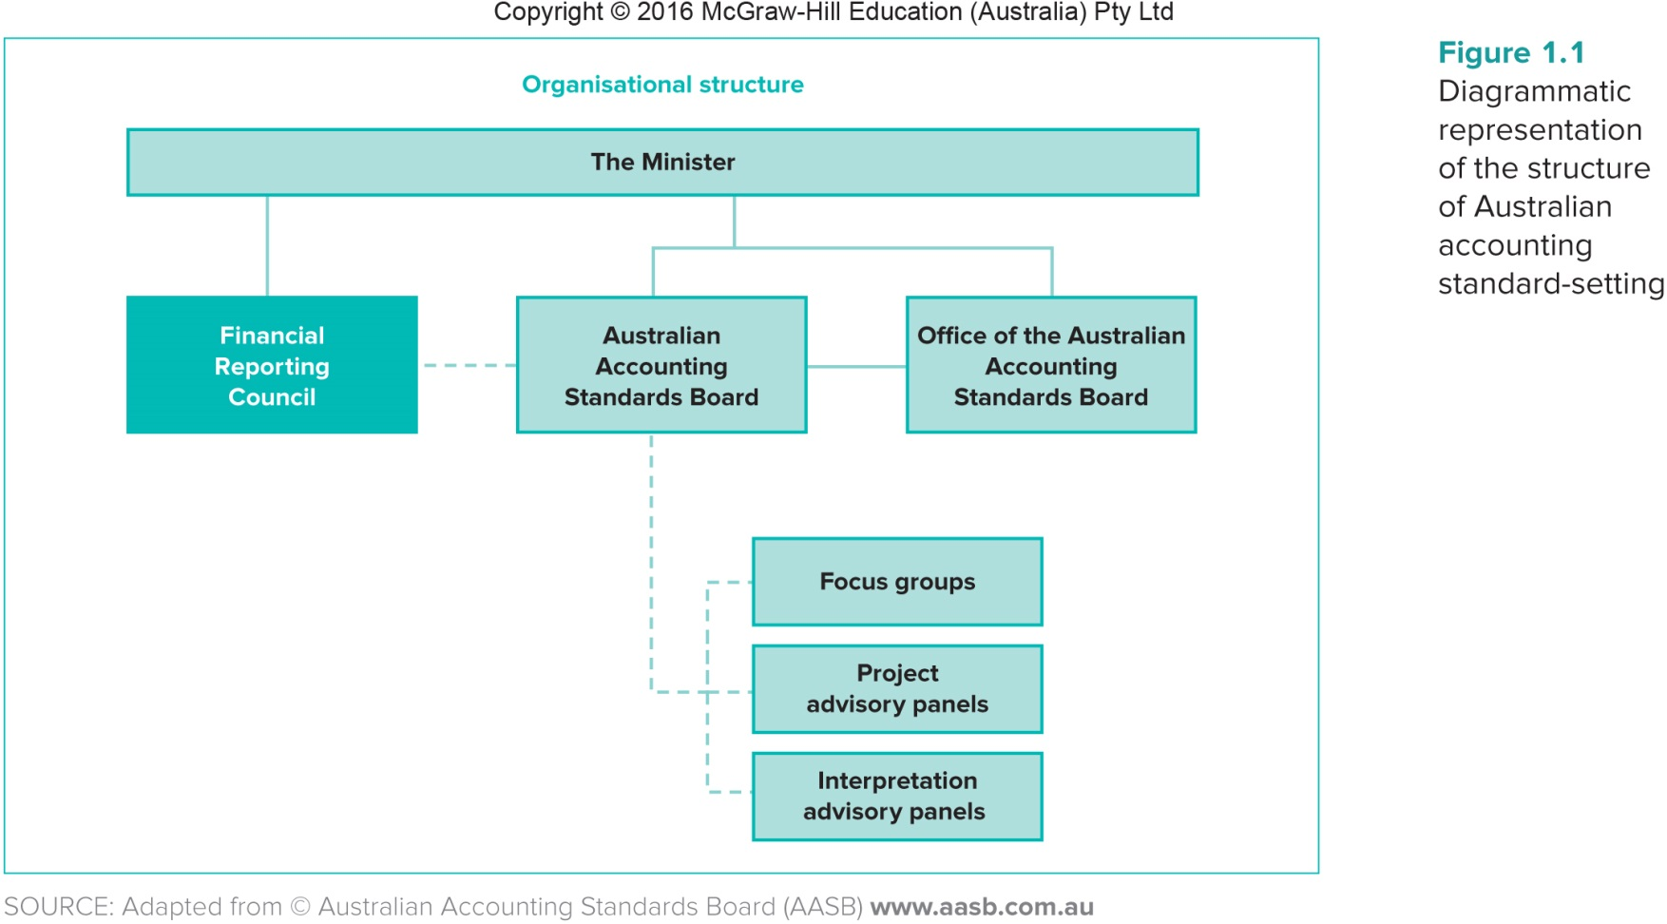
Overview of Australian accounting standard-setting structure

Slide 11
Australian Accounting Standards Board (AASB)
Within Australia, accounting standards issued by the AASB have ‘power’ by virtue of the Corporations Act 2001
Functions of the AASB (pursuant to s. 227 of the ASIC Act):
  developing a conceptual framework
  making accounting standards that have force of law under s. 334 of the Corporations Act
  formulating accounting standards for other purposes:
    for entities not governed by the Corporations Act
  participating in and contributing to the development of a single set of accounting standards for worldwide use

Slide 12
Financial Reporting Council (FRC)
The AASB reports to the Financial Reporting Council (FRC), which oversees the operations of the AASB.
The FRC
  appoints members of the AASB
  approves and monitors the AASB’s priorities, business plan, budget and staffing
  gives the AASB directions, advice or feedback on matters of general policy

Slide 13
Accounting Standards
• The Conceptual Framework – objective of financial reporting is:
    to provide information to report users for making and reviewing resource allocation decisions,
What is the purpose of standard setting?
Accounting standards regulate the way in which:
    financial transactions are accounted for and how
    transactions are aggregated and financial information is presented/disclosed (financial reporting).
To ensure high quality financial reporting.

Slide 14
Rules-based Versus Principles-based Standards
Rules-based standards are sets of detailed rules that must be followed when preparing financial statements.
Principles-based standards are based on a conceptual framework that provides a broad basis for accountants to follow
    The focus is on the economic substance of a transaction, engaging the professional judgement and expertise of those preparing financial statements.
Rules-Based | Principles- Based
Plant & equipment purchased – have to use 10% depreciation straight line | Plant and equipment – look at the pattern of use and/or its contribution to revenue and the determine how to depreciate it
Provide rules to be followed | Required professional judgement

Slide 15
Advantages of Rules-Based Standards
Financial statements are easier to prepare
Financial statements are more comparable
Specific rules – compliance is easier
        there is less interpretation and subjectivity
        so less opportunistic behaviour

Slide 16
Disadvantages of Rules-Based Standards
Rules-based standards can be very complex.
Organisations can structure transactions to circumvent unfavourable reporting.
Standards are likely to be incomplete or even obsolete by the time they are issued.
Manipulated compliance with rules makes auditing more difficult.

Slide 17
Advantages of Principles-Based Standards
Principles-based standards are simpler.
They supply broad guidelines that can be applied to many situations.
They improve the representational faithfulness of financial statements.
They allow accountants to use their professional judgement.
Evidence suggests that managers are less likely to attempt earnings management.

Slide 18
Disadvantages of Principles-Based Standards
Managers may select treatments that do not reflect the underlying economic substance.
The judgement and choice involved in many of the decisions mean that comparability among financial statements may be reduced.
Choice = creative accounting e.g.
    Choice of accounting policy
    Estimates or predictions of future events
    Disclosure of transactions or events
    Timing of transactions

Slide 19
Quiz:
“The IFRS requires that a lease should be capitalized as an asset and a liability when it “transfers substantially all the risks and rewards” to the lessee. The IFRS contains no numerical or other technical rules surrounding that vague principle, which is itself based on the principle of substance over form.”
“In order to make the same principle practicable and auditable in the U.S., SFAS 13 requires capitalization when any one of four technical tests are satisfied, including cases where the length of the lease equals or exceeds 75 percent of the useful life of the asset or where the present value of the lease payments equals or exceeds 90 percent of the fair value of the asset.”
Source: Nobes (2004), Rules-based Standards and the Lack of Principles in Accounting.
Standards | Rules- or Principles- Based?
IFRS
US GAAP
AASB

Slide 20
Quiz:
“The IFRS requires that a lease should be capitalized as an asset and a liability when it “transfers substantially all the risks and rewards” to the lessee. The IFRS contains no numerical or other technical rules surrounding that vague principle, which is itself based on the principle of substance over form.”
“In order to make the same principle practicable and auditable in the U.S., SFAS 13 requires capitalization when any one of four technical tests are satisfied, including cases where the length of the lease equals or exceeds 75 percent of the useful life of the asset or where the present value of the lease payments equals or exceeds 90 percent of the fair value of the asset.”
Source: Nobes (2004), Rules-based Standards and the Lack of Principles in Accounting.
Standards | Rules- or Principles- Based?
IFRS | P
US GAAP | R
AASB | P

Slide 21
Large Proprietary companies
Corporations Act 2001
A proprietary company is considered to be ‘large’ if
it meets two of the following three tests:
  Its gross operating revenue is greater than $50 million
  Its gross assets are greater than $25 million
  It has more than 100 employees
  See Media Release

Slide 22
‘Interpretations’ and APES’s
Interpretations are issued by the AASB
See Henderson pp.16-17
Address accounting issues that are likely to receive divergent or unacceptable treatment
Required to be followed pursuant to AASB 1048
*APES 205 Conformity with Accounting Standards
Requires members to comply with accounting standards
Mandatory for members of CAANZ, CPA and NIA
See Henderson p.10
Financial Reporting Handbook 2020

Slide 23
Australian Securities Exchange (ASX)
One nationally operated securities exchange
Failure to comply may lead to removal from the Board
ASX Listing Rules Continuous disclosure
See Henderson p.700
Listing Rule 3.1
  If an entity becomes aware of any information concerning it that a reasonable person would expect to have a material effect on the price or value of the entity’s securities, the entity must immediately disclose that information to the ASX.

Slide 24
Political Nature Of Setting Accounting Standards
There is a mix of private and public participation in the standard setting process.
Parties that have an interest in accounting standards often have conflicting interests. E.g.
      Internal stakeholders may like flexibility
      External stakeholders may like comparability
      Auditors like objective (auditable) reporting

Slide 25
Lobbying
Those affected by accounting standards have an incentive to lobby standard setters to achieve a favourable outcome.
Lobbying is viewed as a mechanism through which regulators are informed about policy issues.
Those affected must decide:
        Whether they should lobby.
        Which method of lobbying they should use.
        When they should lobby.
        What arguments they should use to support their position. Must provide a conceptual argument.

Slide 26
Lobby Groups in Australia
Major players in Australia seem to be:
      G100
      Large accounting firms
      Professional accounting bodies
      ASX
      Major banks

Slide 27
Advantages of Regulation
Increased efficiency in allocating capital
Cheaper production
Check on perquisites
Public confidence
Standardisation
Public good

Slide 28
Disadvantages of Regulation
Difficult to achieve efficiency and equity
Determining the optimal quantity of information is problematic
Regulation is difficult to reverse
Communication is restricted
Reporting entities are different
There is lobbying

Slide 29
Timeline: Australian Accounting Standards
1966 AARF
1981 national Co Act
2005
Adoption IFRS
1991 AASB
2000 new AASB
2000
FRC established Harmonisation
2002 Decision to adopt IFRS
1989 ASIC Act
1984 ASRB

Slide 30
International Accounting Standards
From 2000 Australia adopted a policy of harmonisation with international accounting standards
In 2002 the FRC made the decision that Australia would adopt international accounting standards from 1 January 2005.
Compliance with AASB ensures compliance with IFRS but the standards are not identical
  Less choices in accounting treatment
  Additional requirements
  Australian standards are sector neutral

Slide 31
Effect of Adoption of IFRS
From 2005
    Australia has less influence over the development of standards that Australian companies use
Australia participates in international standard setting process
Australia is part of the Asian-Oceania Standard Setters Group
Many changes made to the standards e.g. intangibles, leases
The IASB and the FASB: convergence of accounting standards

Slide 32
Accounting Harmonisation
Benefits:
International comparability
Reduced cost of capital
Reduced conflicting reporting requirements
Problems:
Various methods of implementation leads to inconsistencies
Listed entities underestimated the complexities, effects and cost of IFRSs
Compromise leads to diversity

Slide 33
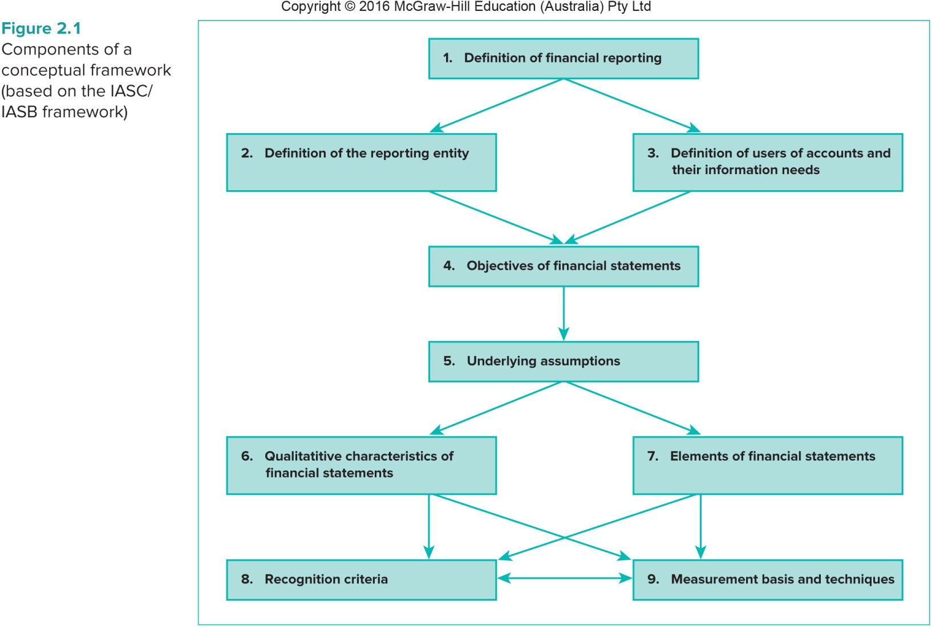
Components of CF

Slide 34
Benefits of a Conceptual Framework
Accounting standards would be more consistent and logical because they are developed from a clearly developed set of concepts
Increased international comparability of financial information
Boards (e.g. IASB, AASB) are more accountable for their standard-setting decisions
Enhanced process of communication
More economical accounting standard development

Slide 35
Conceptual Framework for Financial Reporting
Issued May 2019
The reporting entity
3.10
A reporting entity is an entity that is required, or chooses, to prepare financial statements.
A reporting entity can be a single entity or a portion of an entity or can comprise more than one entity.
A reporting is not necessarily a legal entity.

Slide 36
Conceptual Framework for Financial Reporting
Applicable 1 January 2020
The reporting entity
3.14
Determining the boundary of the reporting entity is driven by the information needs of the primary user of the reporting entity’s financial statements.
Those users need relevant information that faithfully represents what it purports to represent.

Slide 37
Qualitative characteristics
Two fundamental qualitative characteristics:
  Relevance
  2.6 Relevant financial information is capable of making a difference in the decisions made by users.
  Faithful representation
  2.13 To be a perfectly faithful representation, a depiction would have three characteristics. It would be complete, neutral and free from error.

Slide 38
Assets
Assets defined in 4.3
  a present economic resource controlled by the entity as a result of past events, that has the potential to produce economic benefits.
Three aspects of those definitions
  Right (4.6-4.13)
  Potential to produce economic benefits (4.14-4.18)
  Control (4.19-4.25)

Slide 39
Liabilities
Liabilities defined in 4.26
  a present obligation of the entity to transfer an economic resource as a result of past events.
Three criteria
The entity has an obligation (4.28-4.35)
The obligation is to transfer an economic resource (4.36-4.41)
The obligation is a present obligation that exists as a result of past events (4.42-4.47)

Slide 40
Next week
Accounting theories and research

