Slide 1
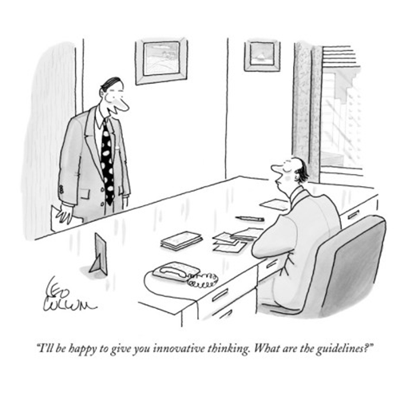
Introduction to the unit and Managing Change.
MGC3130 Lecture
Week 1

Slide 2

Contact Details
Chief Examiner
Associate Professor Tui McKeown
Email: tui.mckeowm@monash.edu
Phone: 03 9905 2347
Lecturer & Tutor: Mr Brian Smith
Email: brian.smith@monash.edu

Slide 3

Aims
(what are we doing here?)
Develop an understanding and appreciation of:
  The background to how we view & react to change today
  The social and historical context of this and…
  How this has shaped theory and continues to (re)shape it today
Develop skills in:
  Research and reporting (oral and written)
  Reflection and evaluation as a change agent
  Relevance and application of theory to help solve organisational problems and issues today & into the future
Notes:
Managing change and change management are two fundamentally different things.
We are looking at the external and internal factors that assist with change and challenge change

Slide 4

Administrivia
Recommended text
Burke, B. (2014) Managing Change 7th edition
  Hard-copy available
  OR
  e-book version for $60 directly from Pearson
  http://www.pearson.com.au/products/A-C-Burnes/A-C-Burnes-Bernard/Managing-Change/9781292156040?R=9781292156040

Slide 5

Managing Change
For organisations, if not for academics, the key purpose of any organisation theory or approach is to help them analyse and rectify the weaknesses and problems of their current situation, and to assist them in bringing about the changes necessary to successfully achieve their future objectives.
As we shall see, over the past 100 years, the design and management of organisations has moved from an ad hoc process based on – at best – guesswork, to one that is highly complex and informed by a host of practical and theoretical considerations.

Slide 6

Managing Change
To the uninitiated, it might appear that this has made running organisations an easier and more certain process; yet a close examination of most organisations will reveal that this is far from being the case.
Even today, as 60 years ago, the success rate of major corporate change programs remains essentially unchanged — it still hovers around 30%.
One estimate suggests that 70% of change initiatives fail to meet expectations and Towers & Watson’s 2013 Study “Change and Communication ROI” found only 25% of Change Initiatives were successful in the long‐term
Totally non-acceptable figures by anyone’s standards. Let’s see some examples……..

Slide 7
Successful change management?
Recent examples of major corporate change initiatives that failed to meet expectations
  Overseas:
  Paris Euro Disney – $2.3b (77%) over cost
  Mutliplex’s Wembley Stadium (London) - $250m over cost & 2 more years to complete
  Australia:
  NAB IT Systems - $409m write off
  Westpac's C90 Project - $300m loss
  RMIT’s IT enrolment system - $11m/cancelled
  WA Governments share corporate services - $76m/2yrs
  Sydney Waters customer billing system - $61m/cancelled
  Myki in Vic originally costed at $494 overran to $1.56billion (315%+ over budget) & still has many issues.
Notes:
The rate of change and type of change needs to be examined
Although there has been so much content out there to help
7

Slide 8
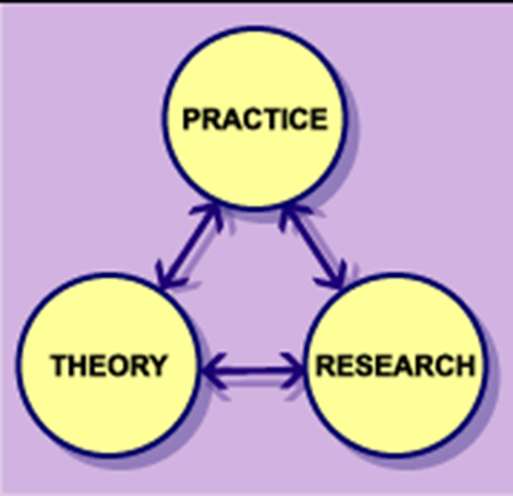
Managing Change
So today we’ll be looking at a quick history of how we got to where we are now…
I’m calling it “From trial and error to the science of management - The rise of organisation theory”
Chapter 2,3 and 4 will give you the detail

Slide 9
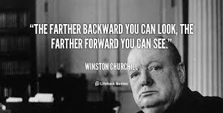
From Trial and Error to the Science of Management
Why are we looking at history?
–Looking back helps us to see forward
History Helps Us Understand Change and How the Society We Live in Came to Be
The second reason history is inescapable as a subject of serious study follows closely on the first………
i.e. The past causes the present, and so the future.
Notes:
We need to look at the history of a company to identify the genetics of the company

Slide 10

The ‘science’ of management
Why are we looking at history?
The metaphor of dwarfs standing on the shoulders of giants expresses the meaning of "discovering truth by building on previous discoveries“
Its most familiar expression in English is by Isaac Newton in 1675

Slide 11

…back to our topic…..Managing Change
The value of theory?
Past & current Management Theory is the basis for today’s management practices (i.e. Managing Change)….…so we will be examining the various “Managing Change Theories” and…
We will try to understand WHY they are critically important in their contribution to today’s ”successfully managed firms”.

Slide 12
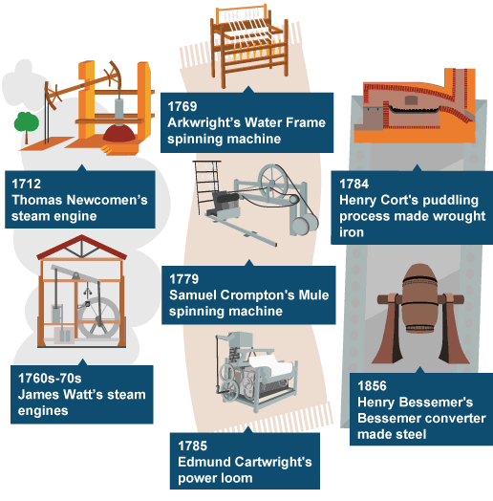
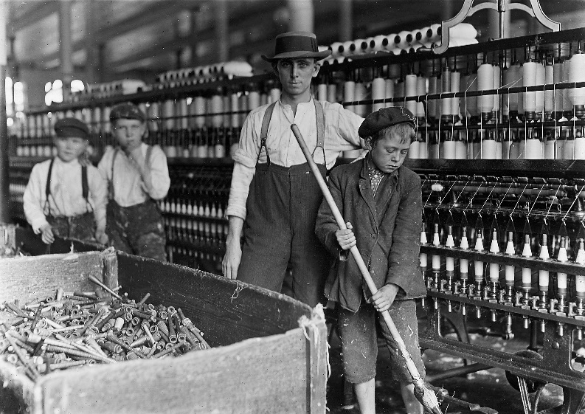
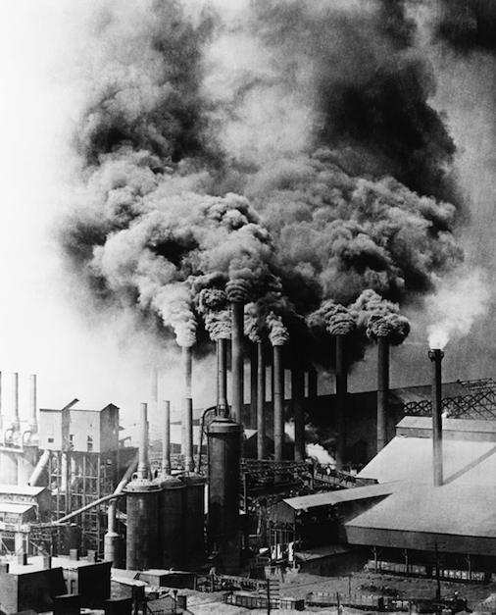
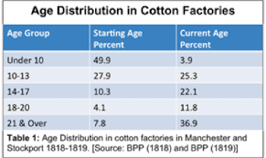
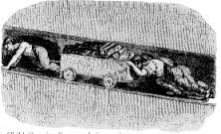
The factory system
It began with the British Industrial Revolution (around 1720-1740 - today called IR 1.0) And it quickly ‘spread’ to other parts of the ‘Western World’
Notes:
Derby Silk Mill
Note to the chimneys; look at the change that has occurred in the meantime, going from a house form without chimneys to a building with multiple chimneys.
Industrial revolution

Slide 13

From trial & error to the science of management
18thC Europe & the Industrial Revolution 1.0
The key themes were:
Industrialisation - from a subsistence to a money-market economy
The main enabling mechanism - the creation of the factory system - Characterised by poor management–labour relations
  Why? Because prior to this industrial revolution there was a preference for stability over change, after it started- the preference was for change…. & change is NEVER popular
The creation of larger and more complex organisations created:
  increased problems in managing labour and
  changes to working practices and technology.
The rise of organisation theory was synonymous with the need by managers to legitimate and enhance their authority to initiate change.
Notes:
Awen
Social Darwinism

Slide 14
The Industrial Revolution and employee relations
In the transition from a subsistence economy to a money economy, one clear image stands out above all else: the antagonism between employers and employees.
Western employers based their attitude towards employees on two basic propositions:
Labour is unreliable, lazy and will only work when tightly controlled and closely supervised.
The main controllable business cost is labour: therefore, the key to increased profits is to:
  make it cheaper and/or
  increase its productivity… by getting employees to work harder, or for longer hours, for the same, or less, money.
  Q. Is this attitude the same today by ‘entrepreneurs’ in many 3rd world economies e.g. Bangladesh?
Notes:
Methodism- alcohol is evil, so he locked them up and made them work
Rano plaza

Slide 15
The 19thC & the need for a systematic approach to work organisation
By the end of the 19th century, the factory system was well established in western economies.
It was a time of rapid social, political, technological and organisational change where entrepreneurs had the right to impose change.
Working conditions were often poor – death, disability, inequality...
There was great pressure to find organisational arrangements that would allow employers to control and organise their employees in a manner that reduced conflict and was cost-effective.
a systematic approach that would persuade workers to accept management-imposed change.
Notes:
Is there a consistent method we could use, to keep the labor costs low and increase productivity
And this new approach was to be known as the classical school of work organisations
It was based on the (then new) scientific rational approach to solving problem
Frederick taylor, scientific management, one best way to do a task, Mc Donalds uses this management technique today

Slide 16

Managing Change
As the nineteenth century progressed, managers became increasingly aware of the shortcomings of their ad hoc and inconsistent responses to new challenges and opportunities, and the counter-productive nature of resistance to change that they were experiencing.
The need for a more coherent approach to structuring and running organisations was required: one that legitimated managerial authority, especially to initiate change.
This crystallised into a new approach to ‘organising labour’ and making the required changes to working practices and technology.

Slide 17
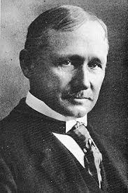
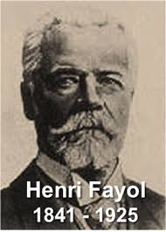
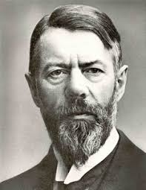
And this was to be known as the
Classical School of Work Organisation
It based on the (new)
Scientific–Rational approach
to solving problems
Key figures
Frederick Taylor (1856–1915)
  Scientific Management
Henri Fayol (1841–1925)
  Principles of Organisation
  He was contrary to the norm, he highlighted the
  fact that you choose what you want to be!
Max Weber (1864–1920)
  Bureaucracy
Notes:
Bureau- table cracy- table
Rule from the table: Bureaucracy

Slide 18

The Scientific–Rational approach
Core propositions
Organisations are rational entities
Organisation design is a science
People are economic beings
There is ONLY ‘One best way’
Division of labour
Elimination of human fallibility
Then, change was based on rationality and legitimate managerial authority.

Slide 19
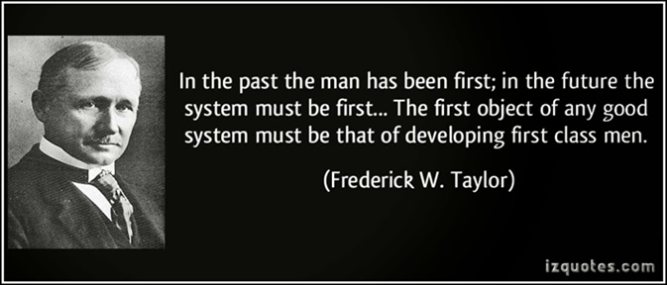
The Classical school
Summary of its’ views
One best way
Closed system
Rule of law
Legitimates managerial authority
Economic man
Human fallibility is eliminated
Division of labour was created (Adam Smith)
Change was based on rationality and managerial authority.

Slide 20
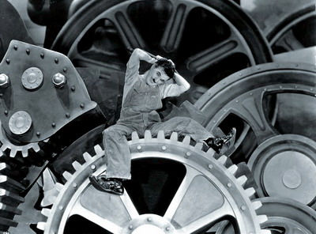
The Classical school - Criticisms
Lack of scientific rigour
Over-emphasises the division of labour
One-dimensional view of human nature
Sees people as ‘greedy robots’
Leads to alienation
Leads to failure, frustration and conflict
Organisations without people.
BUT these models worked in practice!
Are they ‘still’ being “followed”?

Slide 21

Managing Change;
The Classical School of Work Organisation
Seen in the context of the early twentieth century, when there appeared to be a substantial questioning of – and challenge to – managerial authority by workers, the Classical approach had many merits: not least in its attempt to replace arbitrary and capricious management with rules and procedures that apply equally to everyone in the organisation.
Similarly, it is important to see their work in terms of what went before it.
Weber explicitly drew on history to support his views; the historical debts of Taylor and Fayol, though not openly acknowledged in their work are, however, clearly there.

Slide 22
Managing Change
From Adam Smith, through Wedgwood, Boulton and Watt, Babbage and Ure can be traced key elements of the Classical approach: the division of labour, the distrust of human variability, the need for written rules, procedures and records, and the need for rational and consistent management and objectives.
Parallel to these were the key themes that ran through other aspects of nineteenth-century life:
the search for the rational, scientific, universal principles that govern the natural world,
the belief in the Protestant work ethic,
the emergence of Social Darwinism,
the greater democratisation of societies, and
the gradual reduction of laws favouring one class or group over another.

Slide 23

Developments in Organisation Theory
From certainty to contingency (the what if?)
Come the early part of the 20thC and the world was to face a period of post WWl accelerated change and, despite its growing dominance, from the 1930s, the Classical approach began to encounter both intellectual and practical opposition, much from practising managers.
What emerged were two new approaches to managing and changing organisations: the Human Relations approach, which originated in the 1930s and the Contingency approach, which was developed in the 1960s.

Slide 24
Developments in Organisation Theory
From certainty to contingency (the what if?)
The Human Relations approach and the Contingency approach in organising work
This approach was a reaction against the mechanistic view of organisations and the pessimistic view of human nature put forward in the Classical approach.
It attempted to reintroduce the human element into organisational life, and claim for itself the title of the ‘one best way’.
In particular, it contended that people have emotional as well as economic needs, that organisations are cooperative systems that comprise informal structures and norms as well as formal ones, and that workers have to be involved in change if it is to be successful.
This left managers with something of a dilemma as to which ‘one best way’, was best for them to adopt – the Classical or the Human Relations approach.

Slide 25
From certainty to contingency (the what if?)
The Human Relations approach and the Contingency approach in organising work
It was in response to this dilemma that Contingency Theory developed in the 1960s.
Contingency Theory began by questioning and rejecting the idea that there is a ‘one best way’ for all organisations.
Instead, it argued for a ‘one best way’ for each organisation.
It did not, therefore, reject the Classical approach and the Human Relations approach; instead it maintained that the structures and practices of an organisation are dependent (i.e. contingent) on the circumstances it alone faces.
So let’s briefly review the Human Relations movement of the 1930’s

Slide 26
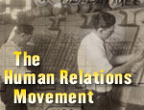
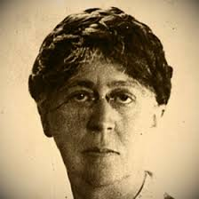

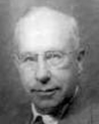
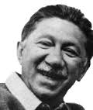
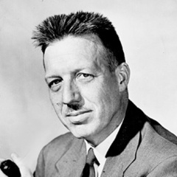
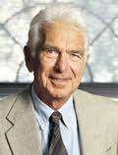
The Human Relations school
(1930s onwards)
Key figures
Mary Parker Follett
  From Scientific Management to Human Relations
Elton Mayo
  Hawthorne Experiments
Chester Barnard
  Cooperative Systems
Abraham Maslow
  Hierarchy of Needs
Douglas McGregor
  Theory X and Theory Y
Warren Bennis
  The Death of Bureaucracy.
Notes:
Mary parker follet- mid path to classical theories and human relations
Elton mayo- making it harder people got better
Chester Benard- we need to look at the external environment too

Slide 27
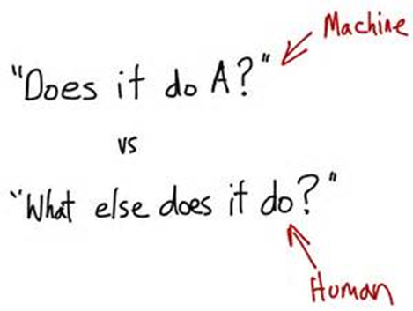

The Human Relations school (Continued)
Central propositions of the School
Humans have emotional needs.
Organisations are cooperative social systems.
Organisations have informal structures and (social) rules.

Slide 28

The Human Relations school
Summary
It rejects the approach of the Classical School as too mechanistic.
It stresses:
Leadership
Communication
Intrinsic motivation
Flexibility
Involvement
Change by consent.
The critical role of people in the organisation

Slide 29

The Human Relations school Criticisms
Intrinsic rewards are weak.
Portrays people as irrational.
Portrays people as emotionally immature.
It is manipulative.
Hawthorne Experiments are flawed.
No empirical support for Maslow’s motivation theory.
It ignores the outside world &
It is a ‘one best way’ approach.

Slide 30
Managing Change

Slide 31

Contingency Theory/Systems theory
So, in response to “which is the best way?”, a third and equally influential School of “Industrial Organisation” was to take centre stage from the early 1960’s onwards.
Its approach and philosophy was to dominate World Commerce for the next 30 years.
This “School” had a very different philosophy and approach from its predecessors; it advocated “There is no one best way!”

Slide 32

It became known as “Contingency Theory/Systems theory”. The ‘dominant theory’ from the 1960s–1980s
A contingency theory is an organizational theory that claims that there is no ONE best way to organize a corporation, to lead a company or to make decisions.
Instead, the optimal course of action is contingent (i.e. dependent) upon the internal and external situation (that means the best choice will depend on what the situation allows/calls for)
So, we need to be aware of “our environments” and learn to adapt to them OR (even) ‘adapt them’ to our likings, or risk becoming, like the dinosaurs….”irrelevant”
(Shades of Barnard’s “Co-Operative Systems”?)

Slide 33
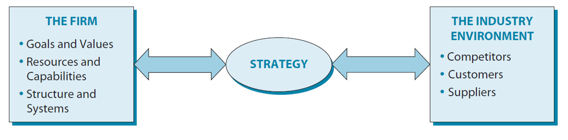
Contingency Theory/Systems theory
Four important basic ideas of Contingency Theory are:
1. There is no universal or one best way to manage
2. The design of an organization and its subsystems must 'fit' with the environment (Called “Strategic Fit”, if ‘not’ = A gap exists)
3. Effective organizations not only have a proper 'fit' with the environment but also between its subsystems (e.g. internally)
4. The needs of an organization are better satisfied when its strategy is properly designed and implemented and the management style is appropriate both to the tasks undertaken and the nature of the work group.
Gaps? See next slide

Slide 34
Contingency Theory/Systems theory?
The design of an organization and its subsystems (i.e. its strategy) must 'fit' with the environment (Called “Strategic Fit”, if ‘not’ = A gap exists)
Where can we have “gaps” (strategic misalignments) in our effectiveness?
The possibility of strategic misalignment occurs wrt the following areas:
The firm (e.g. lack of capable staff; under-resourced) Gap 1
The firm’s Environment (e.g. new aggression by major competitor; Government changes Legislation) Gap 2
The firm’s performance in that environment (continuing poor dividends) Gap 3
The “Key” Stakeholders of the firm (e.g. Shareholders unhappy or key supplier withdraws support) Gap 4
Let’s see these gaps? See next slide

Slide 35
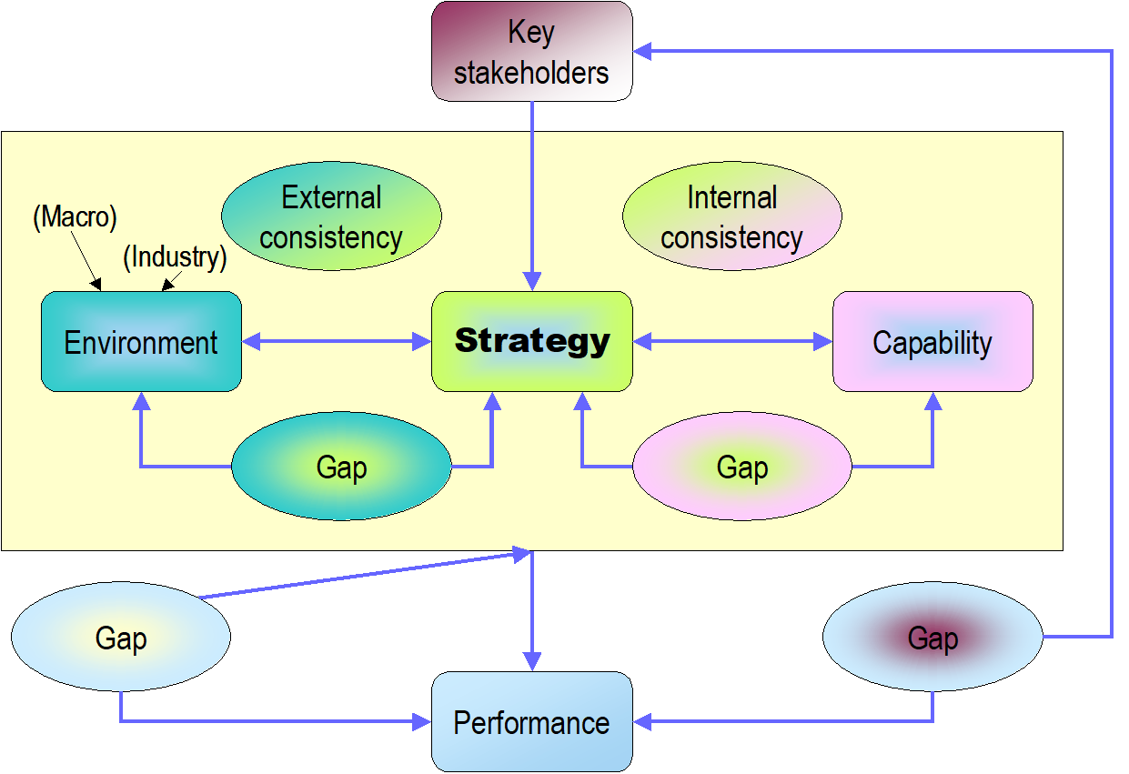
Strategic Fit & Gap Analysis?
The Firm’s
Internal
2
1
3
4

Slide 36
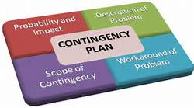

Contingency Theory
Key figures in its early development
Tom Burns and George Macpherson Stalker
  Environmental uncertainty and dependence (VUCA)
Joan Woodward
  Technology & structure
The Aston school
  Size.
Thus their focus was on:
The relationship between overall structure and performance i.e. “move the magnets”.
Organizations as ‘open systems’.
Given what is happening, then what, right now, is the one best way to manage (later a major area of research; “Leadership”)
For more detail. Please consult V1 Slides
Notes:
You could use these three people
How to measure things statistically

Slide 37
Contingency Theory
Summary
Organisations are open systems.
Performance depends on structure.
Structure must match situational variables.
The main situational variables are:
  Environmental uncertainty
  Technology
  Size.
Change is a rational process of collecting and evaluating information.

Slide 38
Contingency Theory - Criticisms
No agreed definition of good performance.
Conflicting and multiple contingencies.
Organisations do not have clear-cut goals.
Contingencies can be manipulated.
No agreed definition of technology.
No agreed definition of environment.
Structure does not equal performance.
It focuses exclusively on formal structures.
It ignores managerial choice.
It ignores organisational complexity.

Slide 39


