Slide 1
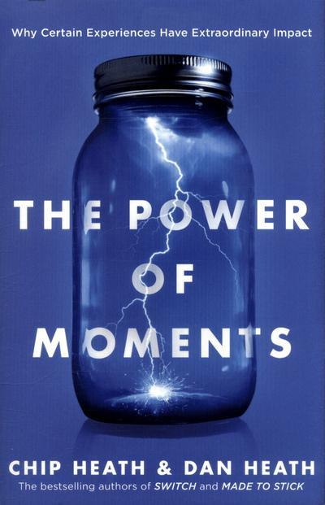
The Power of Moments
Why certain experiences have extraordinary impact.
BY- POOJA AND BHAGYA

Slide 2
ABOUT THE BOOK
Most memorable positive moments → dominated by elevation, insight, pride and connection.
What if a teacher could design a lesson that he knew his students would remember twenty years later?
Why we tend to remember the best or worst moment of an experience, as well as the last moment, and forget the rest?
Why our most cherished memories are clustered into a brief period during our youth?
Many of the defining moments in our lives are the result of accident or luck

Slide 3
Why this book?
Different perspectives
a hospital view
a billionaire’s view
Doesn’t just focus on business perspective, a person who is from the public can read and take away concepts home
?

Slide 4
The importance of the topic
OPTIMISM
POSITIVE EMOTIONS
ELEVATION
INSIGHT
PRIDE
CONNECTION
* WE REMEMBER IT AS EPIC BUT I BEFORE THE P :) *

Slide 5
How is it value to you ?
Value our life experiences better
Ignore negatives in life
focus on life’s bright side (optimism)
Business implication for the future

Slide 6
Outcome of reading this book to us ...
Fate and destiny have a very small role to play in our life
Our life is in our hands, we shape it the way we want
Learn to accept the moment you live in and make the most of it

Slide 7
Ideas or lessons we learnt
Defining moments are created
Moments matter and can be shaped- each moment is important
There are common traits in defining moments.
We can intentionally enhance our own lives and the lives of those around us

Slide 8
Inspiration the book provides
Believe in yourself and your capabilities
Use your skills to transform any moment into a peak
“Destiny is not a matter of chance, it is a matter of choice. It is not the thing to be waited for but a thing to be achieved.”

Slide 9
Existing ideas Vs. Ideas in the book
This book challenges:
Concept of optimism
Concept of locus of control
Every pit in our life can be turned into a peak

Slide 10
Ideas to critique
Book says- Normal day-to-day life’s happenings are not defined
We say- Not everyone’s life is undefined, it depends on each person’s role
Moving from one story to another is engaging
Disturb the flow of connection between the reader and the text

Slide 11
Pieces of Advice to you!
Make moments memorable/defined (EPIC)
Celebrate milestones
Have landmarks, fresh starts to help in transitions

Slide 12
“You can’t appreciate the solution until you appreciate the problem. So when we talk about “tripping over the truth”, we mean the truth about a problem or harm. That’s what sparks sudden insight.”
Chip Heath, The Power of Moments: Why Certain Moments Have Extraordinary Impact

Slide 13


