Slide 1
Business ethics
JUN GU, PHD

Slide 2
Business ethics
Purpose: introduce the key concepts and theories in the study of business ethics
Ethical dilemma
Universal ethical values
Moral development stage
Ethical philosophy
Moral intuition
Moral emotions
Necessary evil
Moral disengagement

Slide 3
Defining ethics
A particular type of social value, that having to do with how humans cooperate and coordinate their activities in the service of furthering human welfare, and how they adjudicate conflicts among individual interests (Rest, 1986)
Moral systems are interlocking sets of value, virtues, norms, practices, identities, institutions, technologies, and evolved psychological mechanisms that work together to suppress or regulate selfishness and make cooperative social life possible (Haidt, 2010).

Slide 4
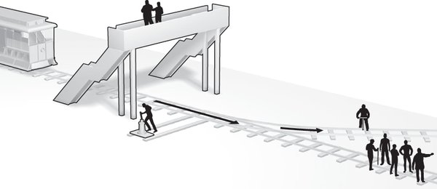
Ethical dilemma
Moral dilemma: a decision where you need to choose one from two or more actions that have moral implications.
Moral dilemmas help us understand the ethical decision process
Two classic ethical dilemmas

Slide 5
Universal ethical values
There is a set of ethical values that can be found across different countries and cultures
What is your price?
  You will see a series of behaviors, please write down the minimum price that you will get paid (anonymously and secretly) to engage in each behavior
  For each action, assume there will be no social, legal, or material consequences to you afterward
  You can go as high as you want, but if you think you will not engage in a behavior no matter how much money you are offered, please write down $999,999,999,999
Notes:
Material pertinent to this discussion is found under “Values.”

Slide 6
What’s your price
1A: Stick a pin into your palm
2A: Accept a plasma screen television that a friend of yours wants to give you. You know that your friend got the television a year ago when a company that made it sent it, by mistake and at no charge, to your friend
3A: Say something slightly bad about your nation (which you don’t believe to be true) while calling in anonymously to a talk-radio show in your nation
4A: Slap a friend in the face (with permission) as part of a comedy skit
5A: Attend a performance art piece in which the actors act like idiots for 30 min, including failing to solve simple problems and falling down repeatedly on stage

Slide 7
Universal ethical values
Calculate difference scores (e.g., 1B-1A, 2B-2A, etc.)
Does anyone have negative scores?
The following five ethical values are universal in human societies
  Harm/care
  Fairness/reciprocity
  Ingroup/loyalty
  Authority/respect
  Purity/sanctity
Notes:
Material pertinent to this discussion is found under “Values.”

Slide 8
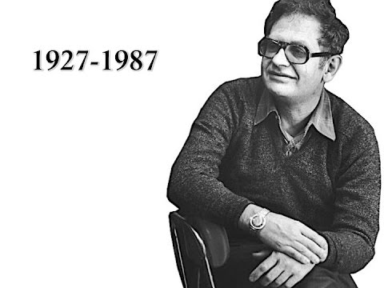

Moral developmental stages
The logic and reasoning used to decide what’s the right thing to do in a moral situation
Developed by Lawrence Kohlberg who studied the moral reasoning of young children over time
Our moral reasoning ability develops through six stages as we grow into adults

Slide 9
Moral developmental stages
Stage 1- Heteronomous morality: avoiding physical damage to persons and property & avoiding punishment associated with breaking the rules
Stage 2 - Instrumental morality: serving one’s own needs and interests & being fair and engaging in equal exchange of benefits with others
Stage 3 - Relationship focused morality: living up to the expectation of others & maintaining quality social relationships (e.g., trust, loyalty, respect, gratitude, etc.)

Slide 10
Moral developmental stages
Stage 4 - Social system conscience: maintaining existing social institutions (e.g., the legal system, the economic system) & fulfilling one’s social duties as a good citizen
Stage 5 - Social contract and individual rights: promoting the greatest good for the greatest number & respecting basic human rights (e.g., sanctity of life, free will and liberty, etc.)
  Stage 6 - Universal ethical principles: Following self-chosen ethical principles (e.g., justice, equality, etc.) and violating laws and social norms when necessary

Slide 11
Moral philosophy
Consequentialism: the ethicality of a behavior lies in its consequences; worse consequences = more unethical
Deontology: the ethicality of a behavior lies in its consistency with a set of established rules, regardless of its consequences (e.g., traffic rules)
Kantian ethics: the ethicality of a behavior lies in the intention behind the behavior, and only acts done with the right intent are moral

Slide 12
Moral intuition hypothesis
We feel strong emotions (e.g., disgust, anger) in certain moral situations and reach a moral judgment intuitively and then we engage in rational and logical analyses to provide rationales for our judgment
Moral intuition examples
Supporting the moral intuition hypothesis, research has found that people make more harsh moral judgments when
  They are hypnotized with a feeling of disgust
  There is a slight bad/disgusting smell in the environment
  They have watched a disgust-inducing video

Slide 13
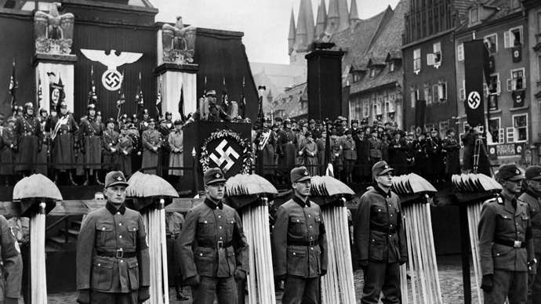
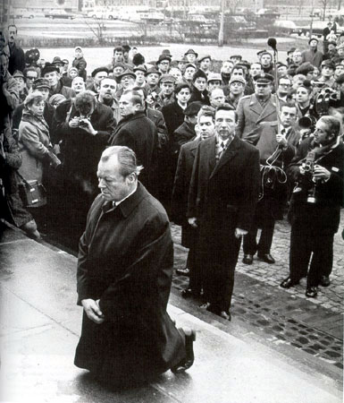
Moral emotions
The emotions linked to the interests or welfare either of society as a whole or at least of persons other than the judge or agent.
Guilt & Shame
  Guilt is more associated with a specific behavior that failed morally, whereas shame is more associated with one’s overall identity that failed morally
  Guilt leads to remorse and other-oriented empathy and increases confession, apology, and corrective behavior
  Shame leads to self-oriented distress and increases denial and escape
Vicarious guilt and shame: feelings experienced in response to the transgressions and failures of social others

Slide 14
Moral pride
Pride: An emotion generated by appraisals that one is responsible for a socially valued outcome or for being a social valued person
Moral pride: pride associated with meeting or exceeding moral standards
Alpha moral pride
  Pride in one’s moral self
  Can be maladaptive, distorting and inventing situations to enhance the self, which can lead to interpersonal problems
Beta moral pride
  Pride in a specific moral behavior
  Adaptive, self-regulating and consistently engaging in moral behaviors

Slide 15
Embarrassment
An aversive state of mortification, abashment, and chagrin that follows public social predicaments
Common causes
  Situations where a person behaves in a clumsy, absent-minded, or hapless way
  Awkward social interactions and being conspicuous
  Generally something is amiss, some aspect of the self or behavior need to be changed

Slide 16
Moral elevation
A positive emotion elicited when observing others behaving in a particularly virtuous, commendable, or superhuman way
Phenomenology
  Warm, pleasant
  “tingling” feelings in the chest
  Open to others
  Wanting to help others

Slide 17
Necessary evil
Tasks in which a person must knowingly and intentionally cause emotional or physical harm to another human being in the service of achieving some perceived greater good or purpose
Common necessary evil for managers and executives
  Laying off employees
  Firing people
  Disciplining others
  Terminating contracts
  Delivering negative performance reviews

Slide 18
Moral disengagement
A set of psychological and social mechanisms that disengage self-sanctions from unethical conduct (Bandura, 1990, 1991)
Individuals who score higher on the moral disengagement scale (i.e., those who are better at utilizing moral disengaging mechanisms)
  Are more likely to engage in unethical behaviors
  Experience less emotional stress after engaging in harmful behaviors
  Might be more likely to be promoted in organizations

Slide 19
Moral disengagement
Moral justification: Detrimental conduct is made personally and socially acceptable by portraying it as serving socially worthy or moral purposes
  E.g., the US send army overseas to “defend the free world” and “protect world peace”
Euphemistic labeling: use euphemistic language to make harmful conduct respectable and to reduce personal responsibility for it
Serving the target
Career alternative enhancement opportunity
A different version of the truth
Atmospheric deposition of anthropogenically derived substances

Slide 20
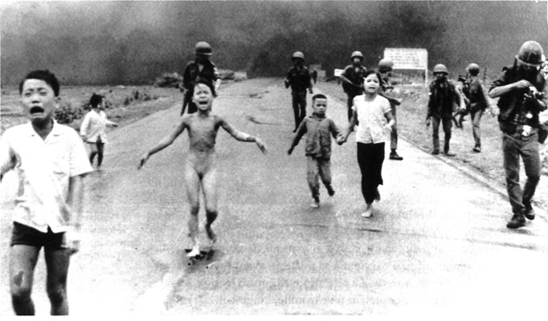
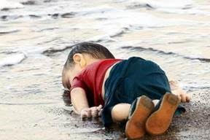
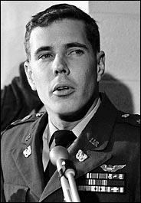
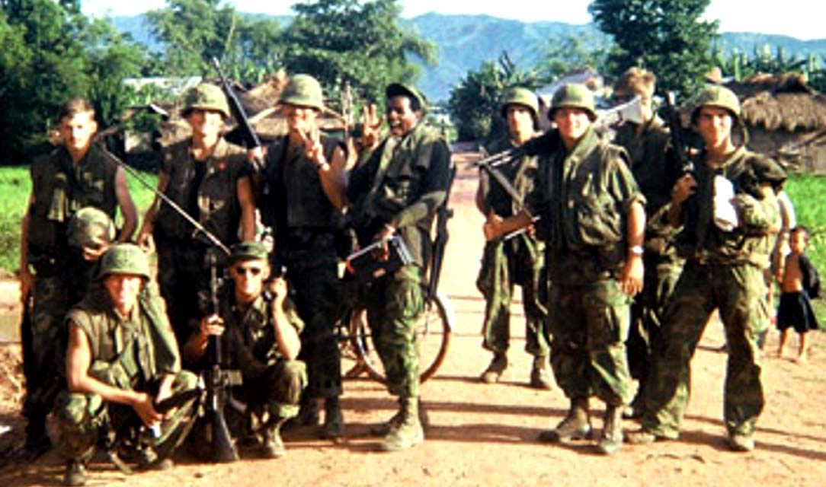
Moral disengagement
Disregard consequences: When people pursue activities that are harmful to others for reasons of personal gain or social pressure, they avoid facing the harm they cause, or they minimize it
  Dehumanization: Stripping the target of human qualities (e.g., with feelings and hopes), because perceiving a person as having common humanity activates empathy, which makes it difficult to mistreat him/her

Slide 21
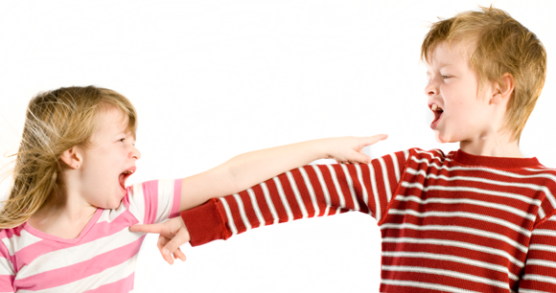
Moral disengagement
  Attribution of blame: after hurting others, people tend to blame the victims for bringing suffering on themselves
  E.g., “They started this”
  E.g., “I wouldn’t have done this if he didn’t do that”
Diffusion of responsibility: sometimes a social arrangement is set up so that the personal agency in engaging in detrimental behavior is obscured by diffusing responsibility among multiple individuals

