Slide 1
Leadership excellence
JUN GU, PHD

Slide 2
Leadership theories
Purpose: introduce basic leadership concepts and theories
  Introduce the classical leadership theoretical approaches
  Show examples of good and bad leadership examples
Leader traits
Leader categorization theory
Identity-based leadership
Managerial grid
Situational theory
Leader-member exchange
Transformational leadership
Servant leadership
Ethical leadership
Destructive leadership
Narcissistic leadership
Abusive supervision

Slide 3
Leadership trait theories
There is a set of traits associated with being a good leader
Distal traits
  Personality (e.g., extraversion and agreeableness)
  Motives and values
  Cognitive abilities
Proximal attributes
  Social appraisal skills
  Problem solving skills
  Expertise/tacit knowledge
There might be biological and neurological processes that explain leadership emergence and effectiveness

Slide 4
Leader categorization theory
we categorize individuals with characteristics similar to the leader prototype as “leaders” and those with opposite characteristics as “non-leaders”
In the west, the prototypical leader = White male
  Female/Asian leaders face the glass/bamboo ceiling
Prototypical leader behavior = set of behaviors that
we generally associated with being a leader
  Exercising great influence on her subordinates
  Wanting her own way on issues at hand
  Asking her subordinates to work harder
  Talking to her subordinates frequently

Slide 5
Social identity theory of leadership
Group prototype = the impression of individuals most representative of group values and behaviors
  Can be different of others’ stereotype of the group
Resembling group prototype benefits a leader
  Prototypical employees are more likely to be promoted as leaders
  Prototypical leaders are perceived as more effective, suitable, charismatic, and persuasive
  Prototypical leaders are blamed less when the organization is ineffective

Slide 6
Blake and Mouton’s Managerial Grid
An effective leader need to balance two aspects of leadership:
  Concern for relationship: emphasizes interpersonal relationship quality
  Concern for task: emphasizes the technical aspects of the job

Slide 7
Hersey and Blanchard’s
Situational theory of leadership
A leader should use the appropriate approach based on a subordinate’s readiness (i.e., ability and willingness to accomplish a specific task)
Follower maturity
Telling: high task, low relationship
Unable and unwilling
Unable and willing
Selling: high task, high relationship
Able and unwilling
Participating: low task, high relationship
Able and willing
Delegating: low task, low relationship
Similar to parenting styles at different stages of child development
  From toddler to school-aged to adolescent to young adult
  Use different parenting styles depending on the stage the child is at

Slide 8
Leader-member exchange
Key idea: leadership occurs when leaders and followers are able to develop effective relationship/partnerships with effective influence and resource benefits
Followers who experience high LMX tend to
  Receive higher performance rating from the leader
  Experience higher satisfaction with the leader
  Exhibit higher commitment to the organization
  Experience higher role clarity and less role conflict
  Exhibit less turnover intentions and behavior

Slide 9
Transformational leadership
Similar concepts: charismatic leadership, visionary leadership, inspirational leadership, etc.
Five key dimensions
  Idealized influence attributes: leader traits that show confidence, power, purpose, and ethics.
  Idealized influence behaviors: leader behaviors centered on values and a sense of mission
  Inspirational motivation: energizing followers with an optimistic future and an idealized vision
  Intellectual stimulation: appealing to follower’s sense of logic to solve difficult problems creatively
  Individualized consideration: supporting followers’ individual needs and allowing them to self-actualize

Slide 10
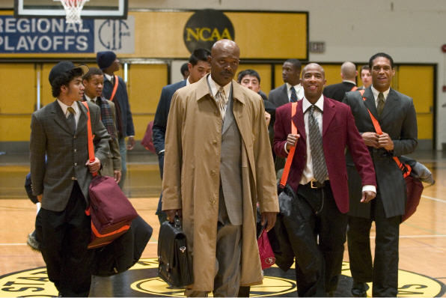
Servant Leadership
A leadership approach that focuses on making positive impacts in the followers’ growth and wellbeing
    Genuine servanthood from the heart
    Focuses more on followers than on organizations
  Main dimensions:
  Altruism - consider others’ needs and interests
  Authenticity - not defensive when confronted
  Intimacy - treats followers as equal partners
  Morality - takes a resolute stand on moral principles
  Spirituality - helps followers identify clear purpose
  Transformation - remove obstacles of follower growth
Notes:
10

Slide 11
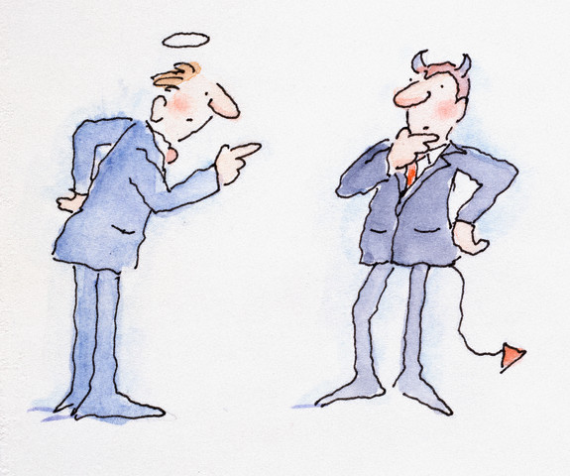
Ethical leadership
The ethical dimension of the leading process
  Right vs. wrong, moral vs. immoral
Moral person
  Honest and trustworthy
  Fair, principled, and socially responsible decision-makers
  Generally behave ethically in personal and professional lives.
Moral manager
  Communicate messages on ethics and values
  Visibly and intentionally role model ethical behaviour
  Manage followers’ ethical behaviour with rewards and discipline

Slide 12
Destructive leadership
Similar concepts: aversive leadership, intolerable bosses, petty tyrants, derailed leaders, psychopaths, harassing leaders, etc.
The systematic and repeated leader behaviours that
  Violate the legitimate interest of the organisation
  Undermine the organisation’s goals, tasks, and resources
  Sabotage subordinates’ effectiveness, motivation, and well-being

Slide 13
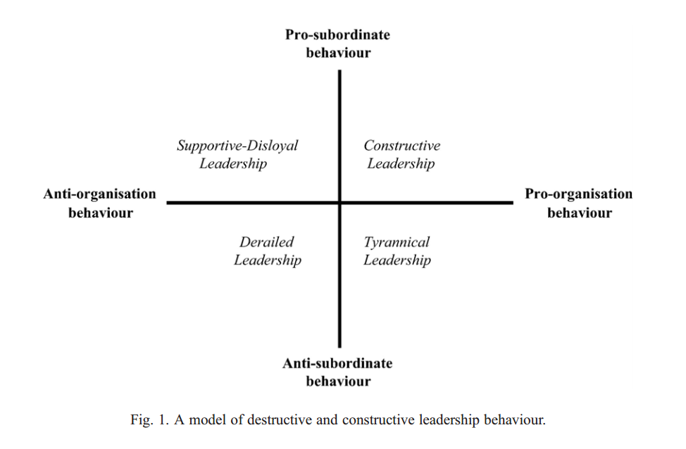
Destructive leadership
Prevalence of destructive leadership
  Tyrannical leadership
  Supportive-disloyal leadership
  Derailed leadership
  Laissez-faire leadership

Slide 14
Consequences of destructive leadership
Organization-related outcomes
  Increased counter-productive behavior and turnover
  Reduced organizational justice perception
Leader-related outcomes
  Increased resistance toward leader
  Reduced trust toward leader
Follower-related outcomes
  Increased stress and negative emotions
  Reduced well-being, satisfaction, and commitment

Slide 15
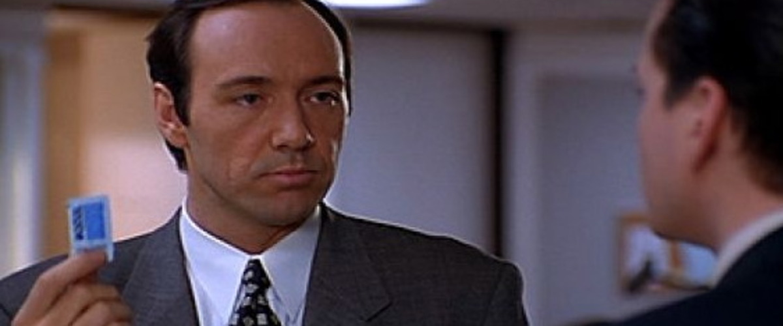
Narcissistic leadership
A leader whose actions are principally motivated by their own egomaniacal needs and beliefs, superseding the needs and interests of the constituents and institutions they lead.
  Related to narcissistic personality disorder: grandiosity, arrogance, self-absorption, entitlement, fragile self-esteem, and hostility
  Might be effective with certain followers in a particular context (e.g., Mr. Trump)
  Leads to enhanced self-rating of leadership but reduced other-rating of leadership

Slide 16
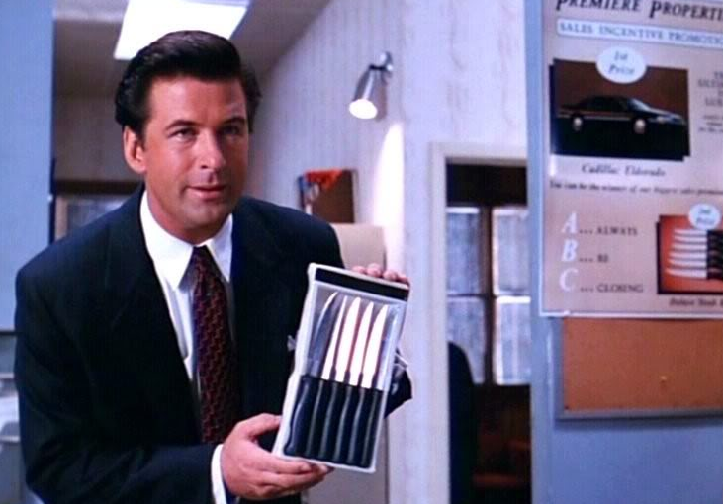
Abusive supervision
The extent to which supervisors engage in the sustained display of hostile verbal and nonverbal behaviours, excluding physical contact
Subordinates who experience abusive supervision tend to exhibit
  Voluntary turnover
  Low job satisfaction and life satisfaction
  Low normative and affective commitment
  Higher continuance commitment
  Lower OCB

