Slide 1
Group and team dynamics
JUN GU, PHD

Slide 2
Group and team dynamics
Purpose: introduce the basic concepts of team building and the main social and psychological dynamics in a group setting
Main concepts
Team task characteristic
Team size
Team composition
Team development
Team roles
Team cohesion
Multi-cultural teams
Need to belong
Social conformity
Social loafing & Social facilitation
Group decision (creativity, polarization, and groupthink)
In-group favouritism
Out-group hostility
Intergroup contact

Slide 3
Team
Definition: Two or more people interact with each other to work towards a common goal
Widely used in business organizations
Types of teams
  Problem solving teams
  Self-managed teams
  Cross functional teams
  Virtual teams

Slide 4
Team task
Three types of team tasks
  Additive: team performance is the sum of all individual performance
  Disjunctive: team performance is the best group member’s performance
  Conjunctive: team performance is the worst group member’s performance (i.e., the weakest link of the group)
 | Member 1 Perf | Member 2 Perf | Member 3 Perf | Member 4 Perf
Team A | 8 | 8 | 8 | 3
Team B | 6 | 6 | 6 | 6
Team C | 4 | 4 | 4 | 10
Which team will perform the best?
  Additive: Team A, Disjunctive: Team C, Conjunctive: Team B

Slide 5
Team size
What is the optimal group size?
Answer: Depends!
  additive and disjunctive tasks: group performance increases with greater size – up to a certain point
  conjunctive tasks: group performance decreases with greater size

Slide 6
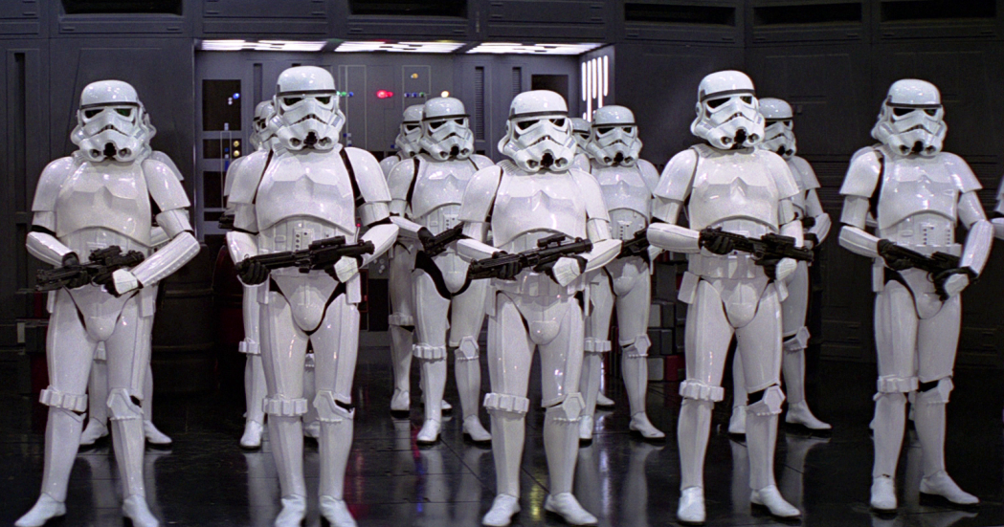
Composition
Better to have similar or dissimilar group members?
Homogeneous group: less conflict, fast team development, better at coordinated and cooperative tasks
Heterogeneous group: more conflict, longer team development, better at complex tasks that require creativity

Slide 7
Composition
Why are heterogeneous teams better at creative tasks?
  Team members can create a bigger and more diverse pool of information and expertise
  Team members can learn new information and skills through exchange and interaction with other members
  Diverse information and skills can interact with each other to create novel solutions in a complex situation

Slide 8
Team development stages
Teams usually go through several distinct stages during their life span, where members connect with each other in unique ways
  Forming: Dependency & Inclusion
  Storming: Counterdependancy & Fight
  Norming: Trust & Structure
  Performing: Coordinating & Working

Slide 9
Team development stages
Forming
Storming
Norming
Performing
Individual
Questions
“How do I fit
in?”
“What’s my
role here?”
“What do the
others expect
me to do?”
“How can I best
perform my
role?”
Group
Questions
“Why are we
here?”
“Why are we
fighting over
who’s in
charge and who
does what?”
“Can we agree
on roles and
work as a
team?”
“Can we do the
job properly?”

Slide 10
Team roles
Roles: A set of expected behaviors associated with a given position in a team.
Role expectations: How others believe a team member should act in a given situation.
Role Conflict: A situation in which an individual is confronted by divergent role expectations.
Role Ambiguity: A person is unclear about her role.
Role Overload: Too much is expected of someone.
Role Underload: Too little is expected of someone, and that person feels that they are not contributing

Slide 11
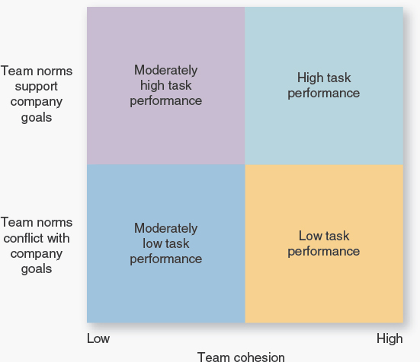
Team cohesion
The degree of attraction people feel toward the team and their motivation to remain members
Is it always good to have high team cohesion? It depends on the team norms

Slide 12
Multi-cultural teams
Cross-cultural communication and coordination are challenging
Increase your cultural intelligence (CQ)
  CQ-Drive: interest and confidence in functioning effectively in culturally diverse situations
  CQ- Knowledge: systematic information on how cultures differ (e.g., business and legal system, interpersonal interaction, etc.)
  CQ-Action: one’s behavioral capability to engage in verbal and non-verbal cross-cultural interaction
  CQ-Strategy: one’s willingness and ability to learn from first-hand cross-cultural interactions

Slide 13
Need to belong
A fundamental human motivation to form and maintain frequent and non-aversive interactions within an ongoing relational bond
  Consistent with need theories (e.g., Maslow’s hierarchy of needs)
  The Grant Study – 75-year longitudinal study by Harvard Medical School – revealed that warmth of relationships throughout life is the key to happiness
  Deprivation of stable and good relationships leads to pathological outcomes
A strong need to belong leads individuals to
  Interpret situations and events regarding their implications for relationships
  Experience happiness, contentment, and calm when accepted
  Experience anxiety, depression, and jealousy when rejected

Slide 14
Social conformity
In a group, people tend to behave in a way that they believe will be approved by the majority of the group members
  An real life behavioral example
Why do people conform?
  Using group norm as a reference point to decide appropriate behavior
  Avoid criticism and exclusion
How to reduce conformity?
  Appoint a devil’s advocate
  Provide ways for members to express opinions without being criticized
  Develop the right group culture

Slide 15
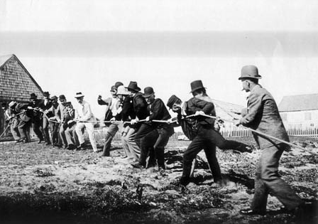

Social loafing (free riding)
Definition: people’s tendency to withhold effort when performing a group task
First demonstration of social loafing:
  1 p: 63 KG, 2 ps: 118, 3 ps: 160, 8 ps: 248
Sucker effect: the tendency to reduce one’s efforts when believing that other group members are engaging in social loafing
Reduce social loafing
  Smaller groups
  Specialize tasks
  Measure individual performance
  Increase motivation

Slide 16
Social facilitation
Definition: people’s tendency to work harder in others’ presence
  E.g., gym buddy system, open office space with glass walls
Social facilitation is especially evident when one is good at the task
  E.g., some artists/performers do much better when there is an audience
Social loafing vs social facilitation
  Individual task vs. group task
  Commitment to the group
  Task meaningfulness
  Individual team member characteristics
  Team culture

Slide 17
Group decision
Strengths: more information and knowledge, diversity of views, higher quality decisions, more creative, more acceptance of a solution
Limitations: time consuming, conformity pressure, ambiguous responsibility.
Main group decision methods
Decision by authority without discussion
Expert member
Average of members’ opinions
Decision by authority after discussion
Minority control
Majority vote
Consensus

Slide 18
Group decision: creativity

Slide 19
Group polarisation
Definition: the tendency of a group to reach a collective decision that’s more extreme than the initial positions of individual members.
  Risk preference (conservative/risky individual positions leads to even a more conservative/risky group decision)
  Attitude strength (individual members’ general negative/positive attitude towards a target will be magnified after group discussion)
Why?
  Social identification and comparison: group members tend to compete with others by being more extreme to show loyalty to the group
  Confirmation bias: group members receive information from peers that confirm and strengthen their existing position

Slide 20
Groupthink
Members try very hard to agree with one another that they make mistakes that could easily be avoided, symptoms include
        Overestimation of the group (illusions of invulnerability and morality)
        Close-mindedness (rationalizations, stereotypes about the outgroup)
        Pressures toward uniformity (self-censorship, the illusion of unanimity, direct pressure on dissenters).
Example: the Abilene dilemma
Example: Challenger launch tragedy

Slide 21
Reduce groupthink
Nominal Group Technique
1. A small group gathers around a table and
receives instructions; problem is identified.
2. Participants privately write down
ideas about problem solving.
3. Each participant’s ideas are presented, one at a time, and are written on a chart until all ideas are expressed.
4. Each idea is discussed, clarified, and evaluated by group members.
5. Participants privately rank the ideas
in order of their preference.
6. The highest-ranking idea is taken as
the group’s decision

Slide 22
Intergroup behavior
What happens when one group encounters another?
Social Identity Theory & Self-categorization theory
  We divide people into ingroup members and outgroup members and use group prototypes (fuzzy attribute sets) to represent “us” and “them”
  Depersonalization (self-stereotyping): when self-categorized, we base our perceptions and behaviors on the group prototype, not our unique characteristics.

Slide 23
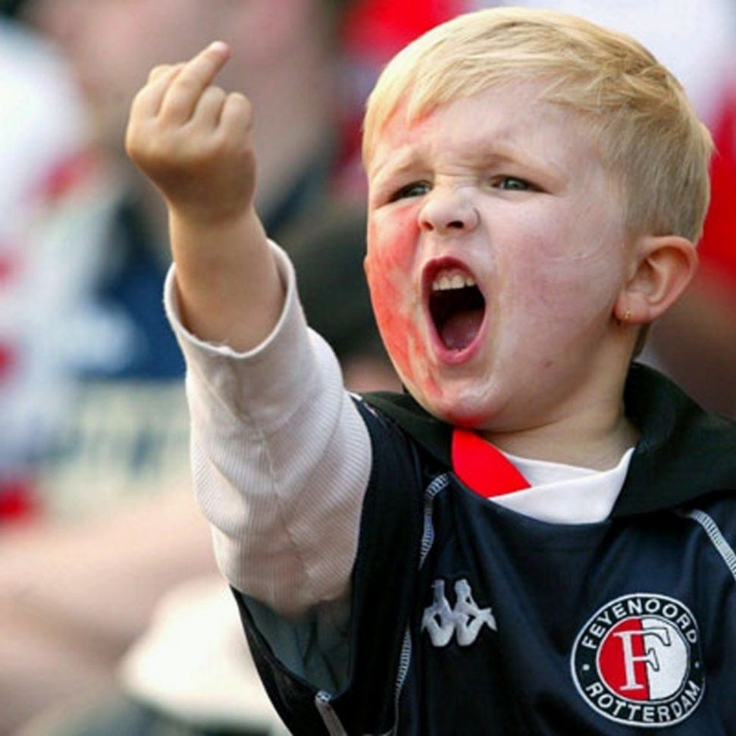
Intergroup behavior
Ingroup favouritism: our tendency to favour our ingroup members over outgroup members in evaluation and resource allocation
Outgroup hostility: out tendency to exhibit hostility toward someone simply because they belong to a different group, especially in a competitive context

Slide 24
Intergroup contact theory
Positive contact with a member of another group (often a negatively stereotyped group) can reduce prejudice toward the whole group
Optimal conditions of contact
  Equal status between the groups
  Common goals
  Focus on intergroup cooperation
  The support of authorities, law, or custom

