Slide 1
Social networking, power, and politics
JUN GU, PHD

Slide 2
Social networking, power, and politics
Power
  Legitimate power
  Reward power
  Expert power
  Information power
  Coercive power
  Referent power
Influence strategies
  Reciprocity
  Scarcity
  Authority
  Consistency
  Consensus
  Liking
Social network
  Network centrality
Empowerment
Organizational politics
  Specific forms
  Consequences for employees
  Antecedents of organizational politics

Slide 3
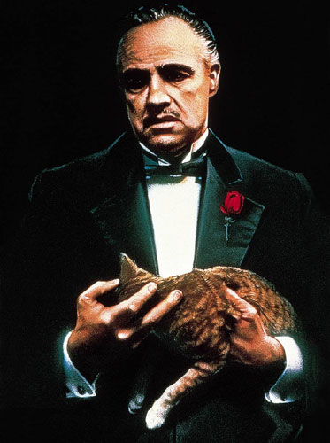
Power
Definition: relative control over valued outcomes
The amount of power an individual has represents the relative value she has in a social system
Six basic types of power
  Legitimate power
  Reward power
  Expert power
  Information power
  Coercive power
  Referent power

Slide 4
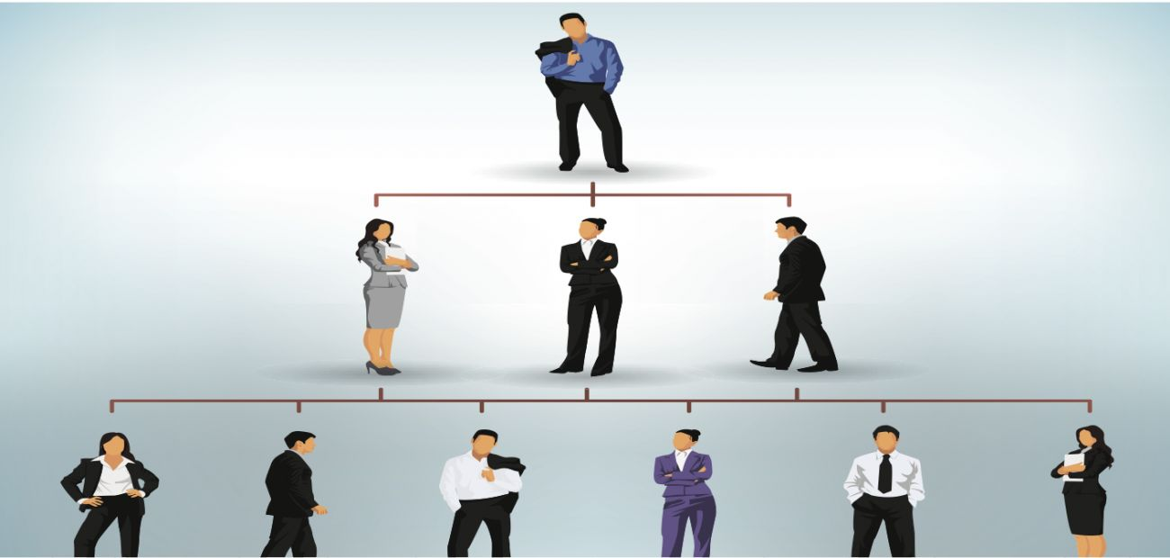
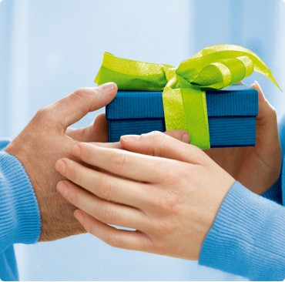
Types of Power
Legitimate power: the power from an individual’s formal title and/or position within an organization
Reward power: the power from an individual’s ability to confer valued rewards and benefits

Slide 5
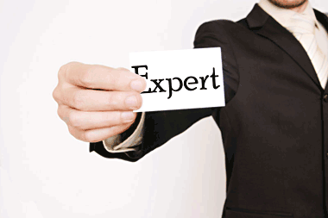
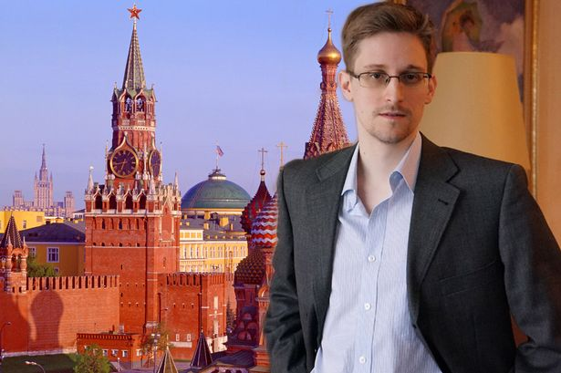
Types of Power
Expert power: Comes from the skills, knowledge, expertise of an individual that are desirable to others and the whole society
Information power: the power from one’s access to and control over important information
What’s the difference between information power and expert power?

Slide 6

Types of Power
Coercive power: power from an individual’s ability to negatively influence others wellbeing
Referent power: from an individual or organization’s charisma and interpersonal skills, and the person’s ability to attract others and build loyalty
  E.g., nationalism or patriotism

Slide 7
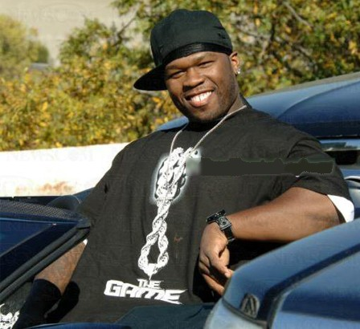
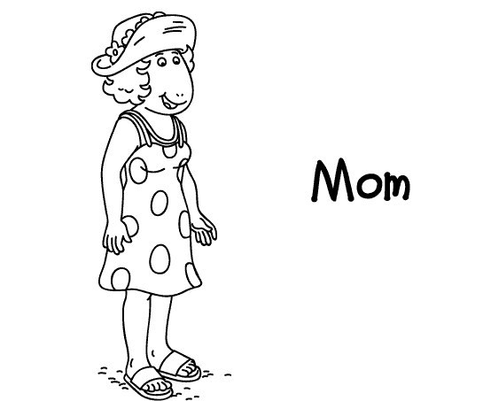
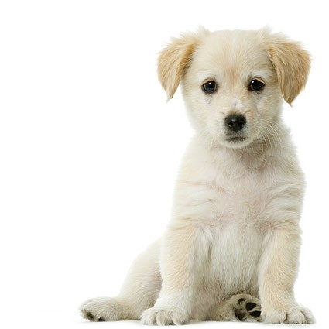
What powers do they have?

Slide 8
Gain power
Individual competences
  Analytical skills
  Decision-making skills
  Emotion skills
  Leadership skills
  Negotiation skills
  Interpersonal skills
  Etc.
Cultivate the right people
  Find a good employer
  Live in the right neighbourhood
  Choose the right boss
  Make the right allies
  Social network
  Etc.

Slide 9
Social network
Definition: a social structure that consists of a group of social parties (e.g., individuals or groups), sets of dyadic ties, and other social exchange between parties.
Common networking strategies: socializing, maintaining contacts, professional activities, community activities, increasing internal visibility
The key of social networking is develop connection and personal branding through interpersonal influence

Slide 10
Interpersonal influence strategies
Six fundamental principles underlying interpersonal influence
  Reciprocity
  Scarcity
  Authority
  Consistency
  Consensus
  Liking

Slide 11
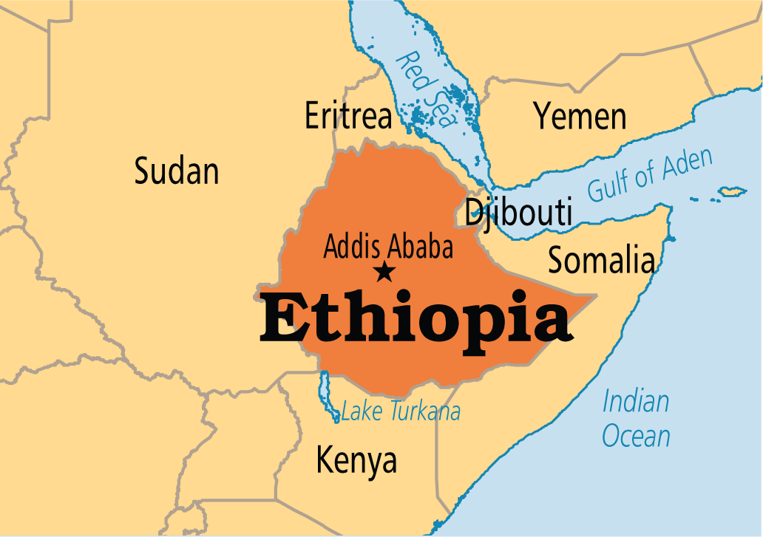

Reciprocation
We are genetically programmed to give back if we are given
  Take a sick child to the zoo
  Ethiopia & Mexico

Slide 12
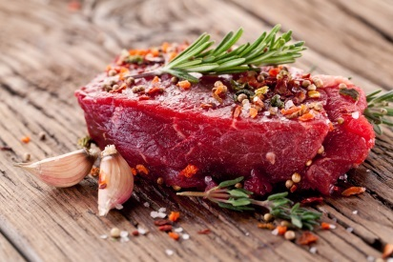
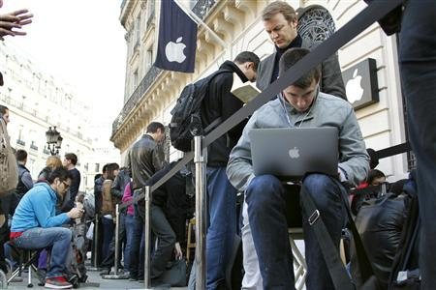
Scarcity
People tend to consider goods and services that are scarce to be of higher value
  Example: Selling Australian beef in Canada
  Example: Hunger marketing strategy

Slide 13
Authority
People tend to value information or advice from individuals with authority/power/expertise more
  Example: using experts/doctors in advertisement
  Example: using celebrities in election campaign

Slide 14
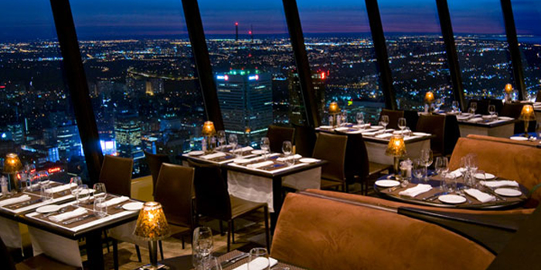
Consistency
People need consistency between what they do and what they say, or between their past behavior and current behavior
E.g., Reservation
  Please call if you have to cancel your reservation
  Add two words to reduce no-shows
Yes momentum

Slide 15

Consensus
People tend to follow the crowd and do what similar others are doing.
E.g., fashion magazines show the hottest trends
E.g., Shopping channel wants to attract more customers
  Operators are waiting, please call now

Slide 16
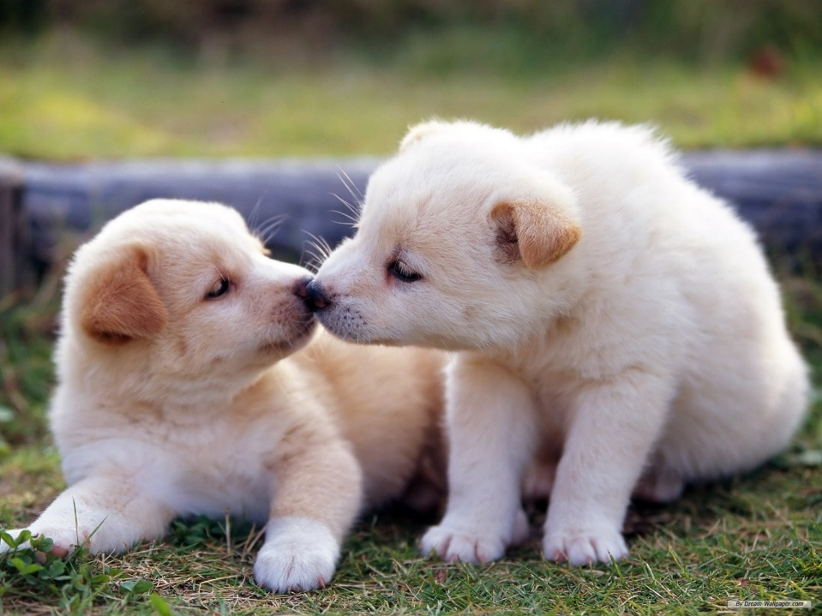
Liking
We are more influenced by people who we like
How do you make someone like you?
We like those with
  Similarity
  Compliment
  Cooperation

Slide 17
Social network centrality
A main purpose of networking is to increase one’s network centrality
  Definition: the extent to which one is central and valuable to the social network that she belongs to.
  Individuals with more network centrality tend to have more social capital and more power
  Individuals with more network centrality tend to perform better and more creatively

Slide 18
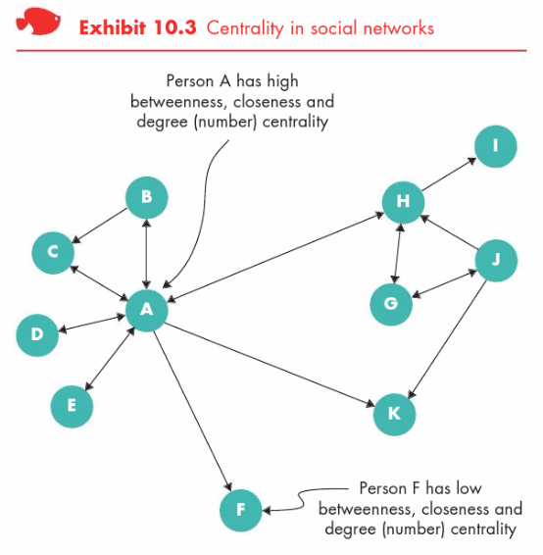
Social network centrality
Three dimensions of network centrality
  Degree centrality: the number of connections one has to others
  Closeness: the strength of ties one has with others
  Betweenness: how much one is located between others

Slide 19
Employee empowerment
Definition: increasing the freedom and the ability of employees to make decisions and commitments.
Empowerment content
  Job content: Tasks and procedures necessary for carrying out a particular job.
  Job context: the setting in which the job is done, including organization’s structure, culture, and reward systems.

Slide 20
Employee empowerment
Empowered employees tend to experience:
  Sense of self-determination - employees are free to choose how to do their work; they are not micromanaged.
  Sense of meaning - employees feel that their work is important to them; they care about what they are doing.
  Sense of competence - employees are confident about their ability to do their work well; they know they can perform.
  Sense of impact - employees believe they can have influence on their work unit; others listen to their ideas.

Slide 21
Organizational politics
Political behaviors: those that influence, or attempt to influence, the distribution of advantages and disadvantages within the organization.
Examples of political ”rules”
  Get others to do the work for you, but always take the credit
  Pose as a friend, work as a spy
  Keep people dependent on you
  Do not commit to anyone
  Discover each man's thumbscrew
  …….

Slide 22
Organizational politics
Specific political behaviors in business organizations
  Managing impressions, attacking and blaming, controlling information, forming coalitions, cultivating networks
When perceiving high organizational politics, employees would
  experience decreased job satisfaction
  experience increased anxiety and stress
  be more willing to leave the organization voluntarily
  exhibit reduced performance

