Slide 1
Will power and work motivation
JUN GU, PHD

Slide 2
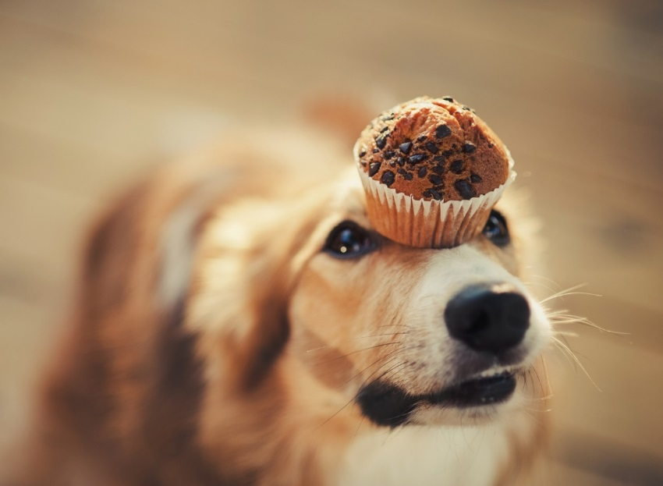
Will power and motivation
Purpose: introduce the key concepts and theories that help you understand how people have strong will power and motivation at works (self-discipline, delayed gratification, self-control, volition, etc.)
Definition: the intensity, direction, and persistence of effort a person shows in reaching a goal:
  Direction: Where effort is channelled
  Intensity: How hard a person tries
  Persistence: How long effort is maintained

Slide 3
Motivation practices and theories
Theory X and Theory Y
Self-regulation theory
  Ego-depletion
  Regulatory focus theory
Goal setting theory
  Self-efficacy
  Goal orientation
Expectancy theory
Equity theory
Cognitive evaluation theory
Job characteristic model
Job satisfaction
Organizational citizenship behavior
Organizational commitment

Slide 4
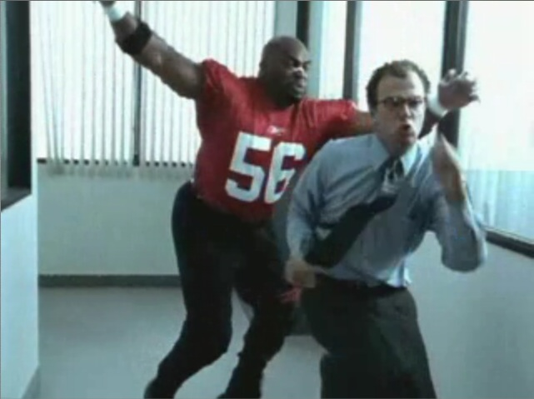
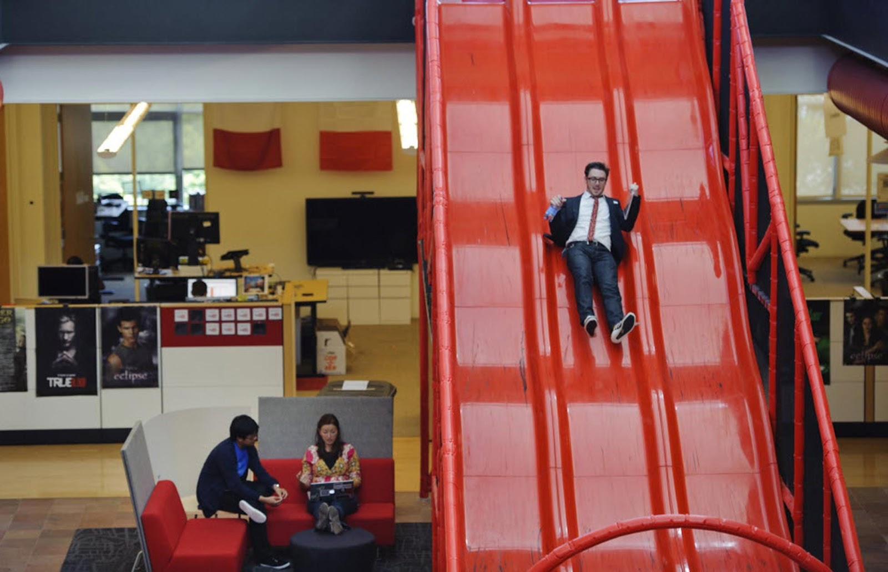
Theory X and Theory Y
Theory X
  Employees dislike work and attempt to avoid work
  Employees must be coerced, controlled, or threatened with punishment if they are to perform.
Theory Y
  Employees like to work and are creative, and seek responsibility
  Employees can exercise self-direction and self-control.
Notes:
.25 google

Slide 5
Self-regulation
A two-system framework
  The cool system: cognitive, emotionally neutral, contemplative, strategic
  The hot system: emotionality, passions; Impulsive and reflexive
Self-regulation is the process where you refrain from impulsive tendencies and choose to behave rationally (e.g., choose long-term benefit, choose delayed gratification, etc.)

Slide 6
Ego-depletion
Ego depletion: our self-regulation ability (i.e., will power) resembles a muscle, and exerting self-regulation consumes resources and reduces the amount of resources available for subsequent self-control efforts.
Example: workout before a demanding quiz might impair performance
Self-regulation processes that might deplete you:
  Coping with stress
  Regulating negative affect
  Resisting temptations
  …

Slide 7


Productivity tricks
Pomodoro technique
Don’t break the chain!

Slide 8
Regulatory focus
We approach a goal in two distinct ways
  Promotion focus: emphasizing growth and opportunity and the pursuit of positive outcomes
  Prevention focus: emphasizing safety and security and the minimization of negative outcomes
Regulatory focus has been shown to influence a wide variety of outcomes
  Decision-making
  Social interaction
  Negotiation outcomes

Slide 9
Promotion vs. prevention focus
Individuals with a promotion focus tend to
  Focus on their ideals and aspirations
  Sensitive toward positive outcomes or progress toward the goal
  See a “gain” as success and a “non-gain” as failure
  Strategies: strive for gains, insure against errors of omission
Individuals with a prevention focus tend to
  Focus on their duties and obligations
  Sensitive toward negative outcomes or setbacks toward the goal
  See a “non-loss” as success and a “loss” as failure
  Strategies: correctly reject losses, insure against errors of commission

Slide 10
Goal-Setting Theory
Thesis: specific and difficult goals together with feedback lead to higher performance.
  Specific goals (vs. do your best) increase performance.
  Difficult goals, when accepted, result in higher performance than do easy goals.
  Feedback leads to higher performance than does non-feedback.
For goals to be effective, they should be SMART:
  Specific, Measurable, Attainable, Results Oriented, Time bound
Notes:
Material pertinent to this discussion is found under “Process Theories of Motivation.”

Slide 11
Self-efficacy
An individual’s belief that he or she is capable of performing a task
  From social cognitive theory and social learning theory
  High self-efficacy will help employees accomplish goals more successfully
Four ways to effectively increase one’s self efficacy
  Enactive Mastery: Practicing and gaining relevant experience
  Vicarious Modelling: Confidence gained by seeing someone else perform the task successfully.
  Verbal Persuasion: Confidence gained because someone convinces you that you have the necessary skills to succeed.
  Arousal: An energized state can drive a person to complete the task.

Slide 12
Goal orientation
Learning goal orientation: see the task as an opportunity to acquire new skills and knowledge
Performance goal orientation: focus on demonstrating performance to prove competence and avoid failure
Compared to a performance goal orientation, a learning goal orientation leads to
  More motivational beliefs
  Higher self-efficacy
  Less task anxiety
  More effort
  Higher performance

Slide 13
Expectancy Theory
One’s motivation to engage in a task is dependent on three critical conditions. The motivation is high only when ALL three are satisfied.
Expectance: belief that exerting a certain amount of effort will lead to the desired performance level
Instrumentality: belief that performing at a particular level will lead to certain reward from the organization
Valence: an estimate of the extent to which organizational rewards can satisfy one’s needs or are attractive to the individual
“I will offer you $100,000,000 if you can memorize the Oxford English Dictionary by tomorrow morning”
  Why is this offer not motivating to you?

Slide 14
Increasing expectancy
Expectance
  Skills & training
  Reasonable goals and tasks
Instrumentality
  Recognize performance, deliver reward as promised
  Establish employees’ trust that good performance will be rewarded
Valence
  Analyze what employees truly need
  Customize reward for employees with different needs
Notes:
Material pertinent to this discussion is found under “Process Theories of Motivation.”

Slide 15
Equity theory
Employees compare the inputs they invest in a job and the outcomes they receive from the job to the inputs and outcomes of other workers
You
Your co-worker
Performance Very high
Performance medium
$65,000
$85,000
Response to inequity
  Ask for more reward
  Reduce her effort in the job
  Adjust perception of self performance
  Adjust perception of co-worker performance
  Choose a different co-worker to compare with
  Quit the job

Slide 16
Cognitive Evaluation Theory
Intrinsic Motivators: A person’s internal desire to do something, due to such things as interest, challenge, and personal satisfaction
Experience of intrinsic motivation: Sense of choice, sense of competence, sense of meaningfulness, sense of progress
Extrinsic Motivators: Motivation that comes from outside the person, such as pay, bonuses, and other tangible rewards
The introduction of extrinsic rewards for work effort that was previously rewarded intrinsically will tend to decrease an employee's motivation
  e.g., artists paint to live vs. artists live to paint

Slide 17
Job design
Job Characteristic Model (JCM) identifies five core job dimensions of a job position and their relationship to personal and work outcomes.
  Skill Variety: the scope of skills involved in the job (e.g., CEO vs. cashier)
  Task Identity: the extent to which one is involved in all parts of an end product (e.g., making a whole table vs. making table legs only)
  Task Significance: the meaningfulness of the job (e.g., capturing murders and major criminals vs. giving out parking tickets)
  Autonomy: the amount of freedom one has while on the job (e.g., writing a manuscript from home vs. serving in a restaurant)
  Feedback: the amount of feedback one receives when doing the job.

Slide 18
Job design

Slide 19
Results of work motivation
Job Satisfaction: one's general attitude toward her job
Key sources of Job Satisfaction
  Work itself, pay and advancement, supervision, co-workers
Enjoying the work itself is almost always most strongly correlated with high levels of job satisfaction
Once a person reaches the level of comfortable living the relationship between pay and satisfaction virtually disappears
Satisfaction affects:
  Individual productivity, organizational productivity, organizational citizenship behaviour, customer satisfaction

Slide 20
Organisational Citizenship Behaviour (OCB)
Voluntary, informal behaviours that contribute to organisational effectiveness, but are not rewarded or detected by formal performance evaluation systems.
  Altruism (e.g., helping a co-worker with her work tasks)
  Courtesy (e.g., being friendly and considerate toward coworkers)
  Sportmanship (e.g., exhibit no negative beahvior when something at work doesn't go as planned)
  Conscientiousness (e.g., show more self-descipline than what's required at work)
  Civiv virtue (e.g., support a good image of the organization even outside work)

Slide 21
When job satisfaction is low
When an employee's job satisfaction is low, her reaction depends on whether she adopts a constructive or destructive approach, and whether she seeks to resolves the dissatisfaction in an active or passive way

Slide 22
Results of work motivation
Organizational Commitment: A state in which an employee identifies with a particular organization and its goals, and wishes to maintain membership in the organization
Major types of organizational commitment
  Affective commitment: An employee's genuine emotional connection with the organization
  Normative commitment: the obligation an employee feels to staying with an organization
  Continuance commitment: an employee’s calculation that it is in his or her best interest to stay with the organization based on the perceived costs of leaving it

