Slide 1
ACC1100 / ACF1100
Introduction to Financial Accounting
Lecture 1:
Introduction to Accounting and the Conceptual Framework
Alan Serry - Department of Accounting
Reference: Financial Accounting Reporting, Analysis and Decision Making (5th Edition)
Chapter 1: pp. 2 -20
Chapter 3: pp .156 – 161
Chapter 13

Slide 2
Welcome
Accounting is FUN!!!
ACC1100 versus ACC1200: Accounting for Managers
The assessments and details of the unit will be discussed in this week’s tutorials.
Moodle!!!!!!!!
Accounting opens doors to the rest of the world!
The bean counter days are over!
Accounting provides so many opportunities!

Slide 3
Accounting is NOT easy
Work is required!
Keep up to date!

Slide 4
Going to lectures
Been to the movies lately?

Slide 5
Textbooks
Required
1. Financial Accounting: Reporting, Analysis and Decision Making
(5th Edition)
Carlon, McAlpine-Miladenovic, Palm, Mitrione, Kirk and Wong.
Publisher Wiley (2016)
Recommended
2. Financial Reporting Handbook 2017
Claire Locke FCA.
ICAA, John Wiley & Sons,

Slide 6
Ways to Fail
Ask either of these questions in the last week of semester

Slide 7
To Pass

Slide 8
Learning Objectives
Define what accounting is.
Identify the users of accounting information and the decisions they make.
Introduce Accounting Standards and the Conceptual Framework.
Explain the nature of a reporting entity.
Define assets, liabilities, income, expenses and owner’s equity.
Understand the two recognition criteria that must be met before an item can be included in the financial statements.
Apply the definitions and recognition criteria to an unusual transaction.

Slide 9
What is Accounting?
An information system or process that:
economic events of an entity to permit informed judgements and decisions by interested users of the information.

Slide 10
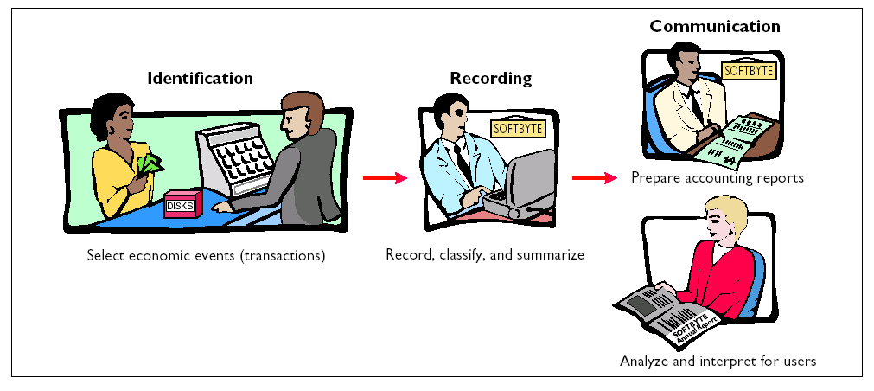
What is Accounting? (continued)
The Accounting Process

Slide 11
Why is Accounting Important?
Decisions are made based on the information provided.
Accounting information conveys information about business performance to others.
Poor accounting practices by businesses can produce information that is inaccurate or misleading.
This can lead to corporate collapses and financial ruin for many people involved.

Slide 12
The Role of Accounting
So overall, think of accounting as a process that identifies, records and communicates information to internal and external users of financial information for decision-making purposes.
Users of accounting can be classified as either:

Slide 13
Internal Users
Managers who plan, organise and run the business
Examples:
Chief executive officers (CEOs)
Chief financial officers (CFOs)
Marketing managers
Production supervisors
Other employees
Detailed and frequent information is needed by these managers to make business decisions on a day-by-day basis.

Slide 14
External users
Vary in their nature and information requirements.
Examples:
Investors e.g., shareholders (use information to make decisions to buy, hold or sell shares)
Creditors/Lenders e.g., suppliers, bankers (use information to evaluate risks of giving credit and lending money)
Government and regulatory bodies e.g., ATO, ASIC (use information to determine an entity’s compliance with rules and regulations)

Slide 15
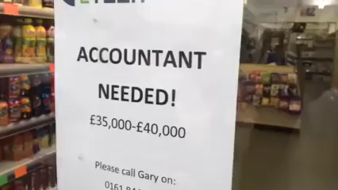

Slide 16
Forms of Business Organisations
Sole proprietorship (sole trader):
  Owned by one person:
    e.g., lawn mowing business, handyman business.
Partnership:
  Owned by more than one individual:
    e.g., accountants, solicitors, doctors.
Company:
  Organised as a separate legal entity and owned by shareholders:
    e.g., BHP, CSR, Westpac, RM Williams.
  Most companies have limited liability.
Notes:
Learning Objective Three

Slide 17
History of Regulation of Accounting
Over time, Generally Accepted Accounting Principles (GAAP) were developed to guide the practice of accounting.
As entities grew in size and complexity, more formal rules for accounting were required.
Today, ‘accounting standards’ are mandatory for many entities to follow in the preparation of financial statements.

Slide 18
History of Regulation of Accounting (continued)
While these accounting standards provide ‘rules’ for dealing with various accounting issues, there exists an underlying ‘conceptual framework’ upon which the standards should be based.
This framework attempts to derive a theory for determining the information to be provided in financial statements.
HIERARCHY OF ACCOUNTING REGULATION
CONCEPTUAL FRAMEWORK
The theory!!!!!!
2. ACCOUNTING STANDARDS
The rules!!!!!!!

Slide 19
What is the Conceptual Framework?
The conceptual framework can be considered the
Think of it as the underlying set of concepts and theory that underpins accounting.
The conceptual framework is used as the basis for developing specific accounting rules and regulations.
It is a set of concepts which define the NATURE, SUBJECT and CONTENT of accounting”

Slide 20
2 Components - in Summary:
1. SAC 1
a) Definition of a ‘reporting entity’
2. The AASB Framework
The objective of general purpose financial reporting
The qualitative characteristics of information
the assumptions underlying financial reports
the five elements of accounting and the criteria for their recognition

Slide 21
1. Statement of Accounting Concepts (SAC)1
Specifies which entities are required to prepare financial statements!!!!!!
1a) Definition of the Reporting Entity
Defines a ‘Reporting Entity’ as any entity in which it is reasonable to expect the existence of users who depend on general-purpose financial reports for information for making and evaluating resource allocation decisions.
If an entity meets this definition, it must prepare financial reports.
We will learn to apply this concept in a later in the semester!

Slide 22
2. The AASB Framework
The AASB Framework contains the following:
Assumptions underlying financial reports
Objective of financial reports (Appendix Chapter 1)
Qualitative characteristics of financial reports (Appendix Ch 3)
Elements of financial reports and their recognition criteria

Slide 23
2a. Assumptions underlying Financial Reports
Going Concern
    Entity assumed to continue indefinitely
Accrual Basis
    records transactions when they occur rather than only when cash is received / paid
    DISCUSSED IN DETAIL NEXT WEEK!!!!!!
    Has since been removed as an assumption

Slide 24
2b. Objective of Financial Statements
Found in the Appendix Chapter 1
To provide financial information:
About the reporting entity that is useful to existing and potential investors, lenders and other creditors in making decisions about providing resources to the entity

Slide 25
2c. Qualitative Characteristics of Useful
Financial Information (Appendix Chapter 3)
  Qualitative characteristics are the attributes that make the information provided in financial statements USEFUL to users
  The characteristics are:
  Fundamental Characteristics
    Relevance
        Materiality (aspect of relevance)
    Faithful representation (Reliability)
    Enhancing Characteristics
    Comparability
    Verifiability
    Timeliness
    Understandability

Slide 26
Qualitative Characteristics of Financial Reports
  Relevance: if it influences users’ economic decisions through feedback or confirmatory value and comparability
  Faithful Representation: complete, neutral and free from error
  Materiality: does its omission or misstatement affect decision making
  Understandability:
  Comparability: must be able to compare financial statements over time and between entities
  Verifiability: different knowledgeable and independent observers can reach consensus

Slide 27
2d. Elements of Financial Statements
There are five elements of accounting:
Assets
Liabilities
Owner’s Equity
Income
Expenses

Slide 28
1. Assets
Definition:
“… a resource controlled by the entity as a result of a past event and from which future economic benefits are expected to flow to the entity”
Essential characteristics:
For non accounting students
one word
object that gives you BENEFIT

Slide 29
Definition Criteria for Assets
(1) Future economic benefits (service potential)
    Potential to contribute, directly or indirectly, to the flow of cash to the entity
    Generate cash flows through the sale of, or use of, the asset
(2) Control by the entity
    Capacity of the entity to benefit from the asset and deny or regulate the access of others
    Does not necessary mean ownership (e.g., leases)
    Does the entity control the resource?
(3) Occurrence of past event
    Transaction or other event giving the entity control of the asset must have occurred
      e.g. Asset purchase or Non-reciprocal transfer (donation/grant)

Slide 30
Recognition Criteria for Assets
Once the definition is satisfied, an asset should only be recognised (included) in the financial reports if the recognition criteria are satisfied!

Slide 31
Recognition Criteria for Assets
The essential components of the recognition criteria are:
Probable future economic benefits
    More likely than not
    Greater than 50% chance of occurring
Reliable measurement
    Transaction to verify the cost
    Reasonable estimate
      E.g., internally generated goodwill, brand names (Coke)?

Slide 32
Important Terms
Recognised
Meets definition AND recognition criteria and is therefore included in the financial reports
Disclosed
Meets definition but NOT recognition criteria and is therefore included as a note to the financial reports

Slide 33
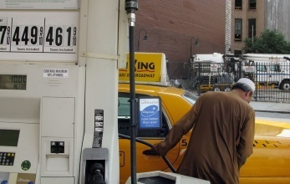
Example - Assets
‘Mike’s Inner City Cab Service’
purchased a taxi for $49,000 to carry
passengers around Melbourne.
Does the taxi meet the definition and recognition of an asset?
What do you think?

Slide 34


Example - Assets
‘Mike’s Inner City Cab Service’
purchased a taxi for $49,000 to carry
passengers around Melbourne.
Does the taxi meet the definition of asset?
    Provides future economic benefits?
    Controlled by Mike?
    Result of a past transaction?
Yes
Yes
Yes
Do not do this!!!!!!
Do not do this!!!!!!

Slide 35
Example - Assets
I do not mind Yes because ….
Definition Criteria
(1) Future economic benefits
(2) Control by the entity
  In this scenario, the company purchased the taxi and can do what they like with the taxi. (i.e., modify it, sell it, paint it)
  They can deny or regulate the access of others.
  They have legal ownership of the taxi.
    (3) Occurrence of past event
  Yes, the purchase of the taxi.

Slide 36
Does it get put into report?
Recognition Criteria
  Probable occurrence
  Yes, it is highly likely that the company will use the taxi to transport customers and therefore derive the future economic benefits (cash inflows).
  Reliable Measurement
  The cost of the taxi can be reliably measured.
  The amount was stipulated as $49,000 in the sales contract.
Conclusion
  As the purchase meets the asset definition and recognition criteria, Mike’s Inner City Cab Service would recognise it as an asset.

Slide 37
2. Liabilities
Definition:
“… a present obligation of the entity arising from past events, the settlement of which is expected to result in an outflow from the entity of resources embodying economic benefits”
Essential characteristics:
For non accounting students
one word
anything you OWE

Slide 38
Definition Criteria for Liabilities
Future outflow of economic benefits
    Settlement of the present obligation
      E.g., bank contract specifies future outflow
      Giving up resources to settle the obligation
Present obligation
    Legally enforceable obligations (consequences)
      Contractual arrangements (e.g., a bank loan)
    Good business practice or equitable obligations (e.g., repair faults outside warranty period)
    Constructive obligation – based on a pattern of events (e.g., paying out year-end bonuses regularly)
    Equitable obligation - fairness
    Does not include future commitments (e.g., decision to purchase asset in the future)
(3) Occurrence of past event
    Transaction creating the present obligation must have occurred
      A present obligation cannot be created by a future transaction

Slide 39
Recognition Criteria for Liabilities
The essential components of the recognition criteria are:
Probable future outflow of economic benefits
    More likely than not
    Greater than 50% chance of occurring
      E.g., a pending decision in a law suit
Reliable measurement
    Transaction to verify the cost
    Reasonable estimate
You will notice these are the same criteria as considered for assets

Slide 40
Example - Liabilities
‘Mike’s Inner City Cab Service’
borrowed $43,000 from the Bank
to purchase the taxi.
Does the bank loan meet the definition and recognition of a liability?

Slide 41
Example - Liabilities
Definition Criteria
  Future outflow of economic benefits
  Present obligation
    Yes, the company is legally obliged to repay funds borrowed from the bank under the loan contract it entered into.
  Past transaction
    Yes, entering into the loan contract.

Slide 42
Recognition Criteria
  Probable occurrence
  Yes, the company is legally obligated to repay funds and failure to do so will result in financial recourse. As such, it can be argued that it is more likely than not that the company will repay funds.
  Reliable Measurement
  Yes, the loan amount of $43,000 is stipulated in the contract.
Conclusion
  As the loan meets the liability definition and recognition criteria of the Conceptual Framework, Mike’s Inner City Cab Service would recognise it as a liability.

Slide 43
3. Owners Equity
Definition:
“… the residual interest in the assets of the entity after deduction of its liabilities”
This ‘definition’ is more of a formula, and creates the ‘Accounting equation’, the foundation of accounting:
Owner’s Equity = Assets – Liabilities
_{or}
Assets = Liabilities + Owner’s Equity
FORMULA DISCUSSED IN DETAIL NEXT WEEK!!
For non accounting students
one word
WORTH or WEALTH of the business

Slide 44
Owner’s Equity - Example
‘Mike’s Inner City Cab Service’ has a taxi worth $49,000, and a bank loan of $43,000 owing to the Bank. What is Mike’s owner’s equity?
Owner’s Equity = Assets - Liabilities
$6,000 = $49,000 - $43,000
This is Mike’s net wealth in his business.

Slide 45
4. Income (Revenue)
Definition:
“… increases in economic benefits during the accounting period in the form of inflows or enhancements of assets or decreases of liabilities that result in increases in equity, other than those relating to contributions from equity participants”
Essential characteristics:
  An inflow of economic benefits (increase in assets or decrease in liabilities)
  Result in an increase in equity, but
  Excludes owner’s contributions of equity
For non accounting students
action that makes us BETTER OFF

Slide 46
Definition Criteria for Income
Inflows (increases in assets or decreases in liabilities)
    Cash / credit sale (enhances debtors) / or forgiveness of debt (e.g., discount received)
(2) Resultant increase in equity
    Increase in net wealth
(3) Other than contributions by equity participants
    Income can not be capital contributed by owners

Slide 47
Recognition Criteria for Income
The essential components of the recognition criteria are:
Probable future inflows
    More likely than not
    Greater than 50% chance of occurring
Reliable measurement
    Transaction to verify the cost
    Reasonable estimate
      E.g., internally generated goodwill, brand names (Coke)?

Slide 48

Example - Income
‘Mike’s Inner City Cab Service’ received $10 from a passenger for a short trip in Melbourne.
Does the taxi fare meet the definition and recognition of income?

Slide 49
Definition Criteria
Inflows (increase in assets or decreases in liabilities)
(2) Resultant increase in equity
    Yes, assets (via cash) are increased (& no effect on liabilities) therefore equity increases
(3) Other than contributions by equity participants
    Yes, the cash was not contributed by Mike

Slide 50
Recognition Criteria
  Probable occurrence
  Yes, Mike has provided the service and has already received the cash
  Reliable Measurement
  Yes, the taxi would have a trip meter device that can accurately charge customers and provide an invoice. In this instance, $10
Conclusion
    As the taxi fare meets the income definition and recognition criteria of the Conceptual Framework, Mike’s Inner City Cab Service would recognise it as income

Slide 51
5. Expenses
Definition:
“…decreases in economic benefits during the accounting period in the form of outflows or depletions of assets or incurrences of liabilities that result in decreases in equity, other than those relating to distributions to equity participants”
Essential characteristics:
  An outflow of economic benefits (decrease in asset or increase in liability)
  Result in a decrease in equity, but
  Excludes distributions to owners
For non accounting students
action that makes us WORSE OFF

Slide 52
Definition Criteria for Expenses
Outflows (decrease in assets or increase in liabilities)
    Salaries paid or owed
Resultant decrease in equity
    Reduction in net worth
Other than distributions to equity participants
    Not dividends or withdrawals (drawings) by owner

Slide 53
Recognition Criteria for Expenses
The essential components of the recognition criteria are:
Probable outflow
    More likely than not
    Greater than 50% chance of occurring
Reliable measurement
    Transaction to verify the cost
    Reasonable estimate
      E.g., internally generated goodwill, brand names (Coke)?

Slide 54
Example- Expenses
‘Mike’s Inner City Cab Service’ used $100 worth of petrol after transporting passengers.
Does the use of the petrol meet the definition and recognition of an expense?

Slide 55
Example- Expenses
Outflows (decrease in assets or increase in liabilities)
    Yes, Mike used the fuel so there is a decrease in an asset (fuel)
Resultant decrease in equity
    Yes, the decrease in the asset (fuel) results in a decrease in equity
Other than distributions to equity participants
    Yes, it was not a distribution to Mike

Slide 56
Recognition Criteria
  Probable occurrence
  Yes, Mike has already used the fuel.
  Reliable Measurement
  Yes, the fuel company would have provided us with a receipt that documents the initial cost of the fuel ($100) and therefore we can quantify the usage amount.
Conclusion
  As the usage of the fuel meets the expense definition and recognition criteria of the Conceptual Framework, Mike’s Inner City Cab Service would recognise it as an expense.

Slide 57

Students should be able to:
Understand the definitions and recognition criteria of the elements
Apply to an unusual transaction

Slide 58
Approach to Answering a Question on How to Record this Unusual Transaction
    Identify 2 elements
    Analyse Definition step by step for the first element
    Analyse Recognition criteria step by step for the first element
    Repeat steps 2 & 3 for the second element
    Conclusion

Slide 59
Template
Definition
Future Economic Benefits
Control
Past Event
Recognition Criteria
Probable
Reliable Measurement
Conclusion

Slide 60


Put it Into Practice

Slide 61
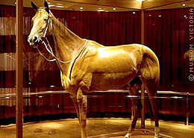
Question 1
You own a Museum.
The owner of the horse, Phar Lap (one of the greatest horses to ever race), has donated him to your museum as a gift
(after taxidermy)
How should the museum account for this gift using the Conceptual Framework for guidance?

Slide 62
Step 1
1. Identify two possible elements

Slide 63
Asset
Definition
Future Economic Benefits | Yes. Possible revenue from tickets sold to view Phar lap
Control | Yes. We now own; therefore control – can regulate access
Past Event | Yes. The donation of the horse by the previous owner.
Recognition Criteria | Meets definition of an asset, but can it be recognised?
Probable Occurrence | Yes. Given the popularity of Phar Lap, it is more likely that some people will buy tickets to view the horse. Furthermore, Phar Lap could also be sold for a price
Reliable Measurement | ?
Conclusion | ?

Slide 64
Income
Definition
Inflow through increase in A or decrease in L | Yes. Just argued that Phar Lap fulfils the definition of an assets. Therefore, increase in an asset.
Results in an increase in OE | Yes. A increased. No change in L. Since OE = A – L, OE increases
Not an owner’s contribution | Yes. It was donated/gifted from the previous owner
Recognition Criteria | Meets the definition criteria
Probable Occurrence | Yes. As mentioned, likely public will pay admittance fee, and can also be sold.
Reliable Measurement | ?
Conclusion | ?

Slide 65
Learning Objectives
Define what accounting is
Identify the users of accounting information and the decisions they make
Introduce Accounting Standards and the Conceptual Framework
Explain the nature of a reporting entity
Define assets, liabilities, income, expenses and owner’s equity
Understand the two recognition criteria that must be met before an item can be included in the financial statements
Apply the definitions and recognition criteria to an unusual transaction

