Slide 1
Review of September meeting

Slide 2

QUALITIES OF A GOOD INSTRUCTOR
Being Empathetic
Having a growth mindset
Willing to continuously learn and improvise
Has a strong belief in themselves and their students

Slide 3
7 STEPS OF INSTRUCTION
Establish
Educate
Empower
Eliminate
Evaluate
Encourage
Earn Trust
WHAT DOES EACH STEP MEAN?
WHAT EXACTLY WILL YOU BE DOING AT EACH STEP AND WHAT IS THE EXPECTED RESULT?
WHAT ARE SOME OF THE WORDS/ PHRASES YOU WILL BE USING AT EACH OF THESE STEPS?

Slide 4
Kumon Instruction
Training October 2019

Slide 5
Goals for our section
Each and every student should be an independent learner
Each student should be facilitated with the right work skills and attitude to tackle each worksheet

Slide 6
Each and every student should be an independent learner
What does Independent learner mean?
Doesn’t need to be told what to do
  Writing the name, date and time
  Underlining instructions
  Sits straight with hands on the worksheet
  Method of doing the worksheet (eg: 1+1, child knows it is the next number which is 2)
  Doesn’t get distracted
  Marking and recording, ensuring they have taken their homework
Knows when to seek for help, and doesn’t always need an instructor by their side
Takes time and learns from the examples in the worksheet

Slide 7
What do we need to do?
Consistent instructions
  As soon as the student enters, ask them to bring their folder and take a seat
  Initially, ask them to take out their homework as well as a sharpened pencil and eraser
  Get the child to record their homework
  Review the homework and give Classwork. If the student is waiting for instructions, ask them what is the first thing they need to do instead of telling them to write the NDT
  Ensure you quickly review their classwork and give homework (please ask me when you are unsure what homework to give)
  Before the child leaves, ask them to check whether they have taken their homework and all their belongings
Notes:
Too much instruction often leads to students becoming dependent on the instructor
Hence, always prompt students by asking them what they are required to do instead of telling them

Slide 8
Each student should be facilitated with the right work skills and attitude to tackle each worksheet
What does the right work skills and attitude mean?
  Doesn’t get distracted
  Neat handwriting
  Good posture
  Willingness to learn
  Has the enthusiasm to come to class
  Always follows the instructions (eg; NDT)
  Is consistent with their work, brings completed homework each class

Slide 9
JUST RIGHT AMOUNT OF WORK
The maximum learning happens when the student is doing the JUST RIGHT level of work with JUST RIGHT level of attitude and JUST RIGHT level of support from their teacher.
Too easy work that student can do themselves – Boring ( NO LEARNING)
Too hard work that student cannot do even with the teacher’s support – ANXIETY ( NO LEARNING)
ZPD or the SWEET SPOT

Slide 10
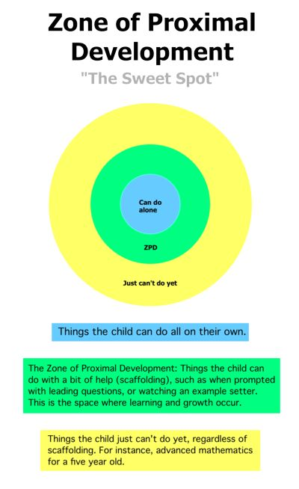
What do we need to do?
Observe their qualities and make a unique study plan that caters to the pace of the student so that they are given just right amount of work
Continuously review their classwork to adjust their study plan so that they have the just right homework
Give feedback to me so that I can keep the parents in the loop
Always praise the child for their achievements no matter how small it is
Set small goals with the child and motivate the child to achieve it (eg: time, handwriting, accuracy)

Slide 11
IDENTIFYING SWEET SPOTS
First day for the student
Student completed 3A 151 in 7 minutes without mistakes.
Student took 3A 141, 3A 151 as homework and did not complete. The classwork is 3A 161
Kinder student studying for 2 months now and had a change of teacher
Student starting 2A English in class today
Grade 2 student starting C51 for CW
Grade 5 student starting C51 for CW
Student started 3A 191 in class. Took 35 minutes for 3 pages. What should be the homework given ?
Kinder student was doing work and was half-way shifted to the other teacher.
Maths student starting English today
Teacher gave D11 classwork to Grade 6 student and moved away

Slide 12
Key takeaways
Goals for 7A-2A
  Each and every student should be an independent learner
  Each student should be facilitated with the right work skills and attitude to tackle each worksheet
Any small change is A BIG CHANGE for the students
If the students LIKE TO WORK WITH YOU, you have won 50% already
Show NOT tell – Role modelling is the easiest way to teach and students learn more by seeing than listening
First 15 minutes is the MOST CRITICAL for student engagement
Break learning into SMALLER CHUNKS if necessary
PRAISE for the effort ( doesn’t matter even if the result is messy). Children are SMART and be careful when you are encouraging and do not give a sticker for just doing the work
Parents should be actively INVOLVED; it is the FIRST LEARNING EXPERIENCE for their child
You have the greatest opportunity compared to all other section instructors, to mould the young children to be SELF LEARNERS when they are YOUNG, FRESH & WILLING.

Slide 13

ASHR CEREMONY
KINDER TO GRADE 1

Slide 14
ASHR CEREMONY ROLES
Kumon Powerpoint slides
MC for the event
Student management
Handing the awards
Zarif video editing
MC for conducting the fun activity
Decoration
Photography

Slide 15
NEXT MEETING ???
NOVEMBER 20th (WED)
NOVEMBER 27TH (WED)

