Slide 1


Happy 21st Birthday
Pooja Sivakumar

Slide 2
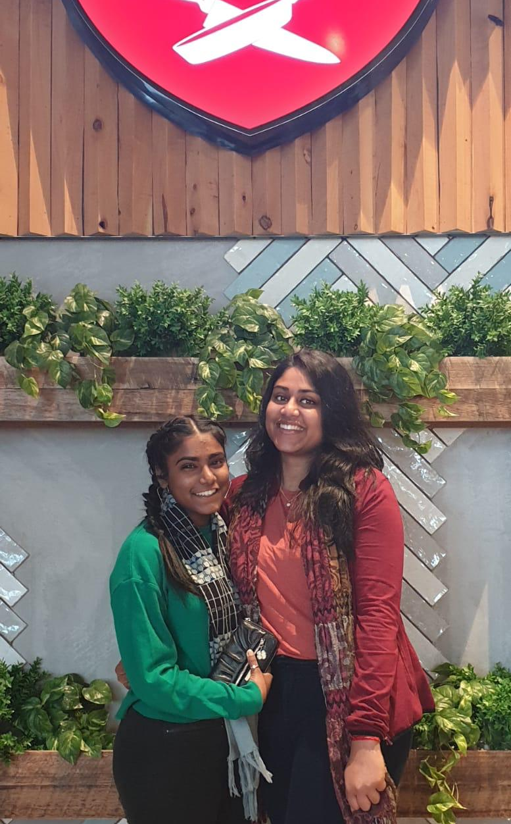
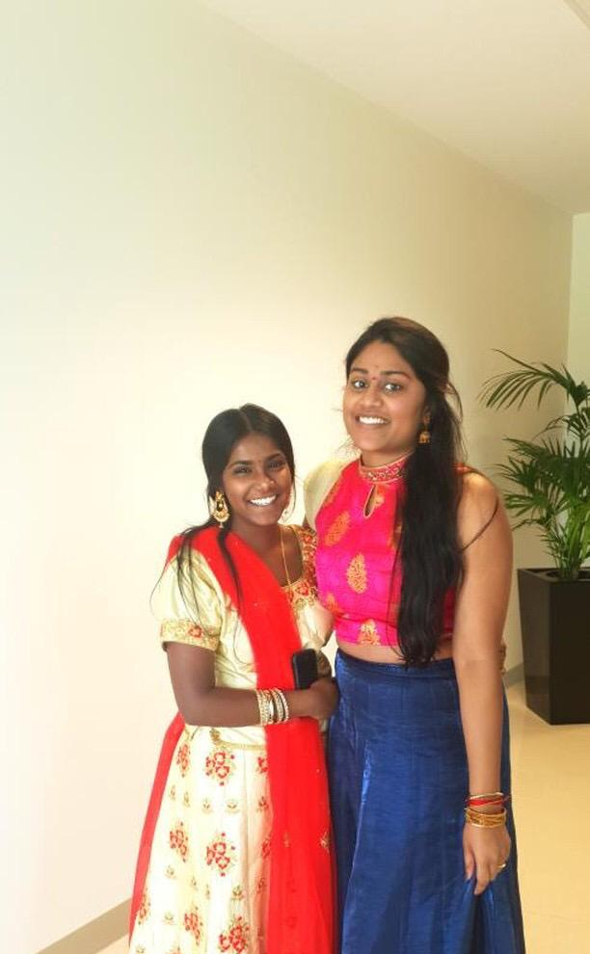
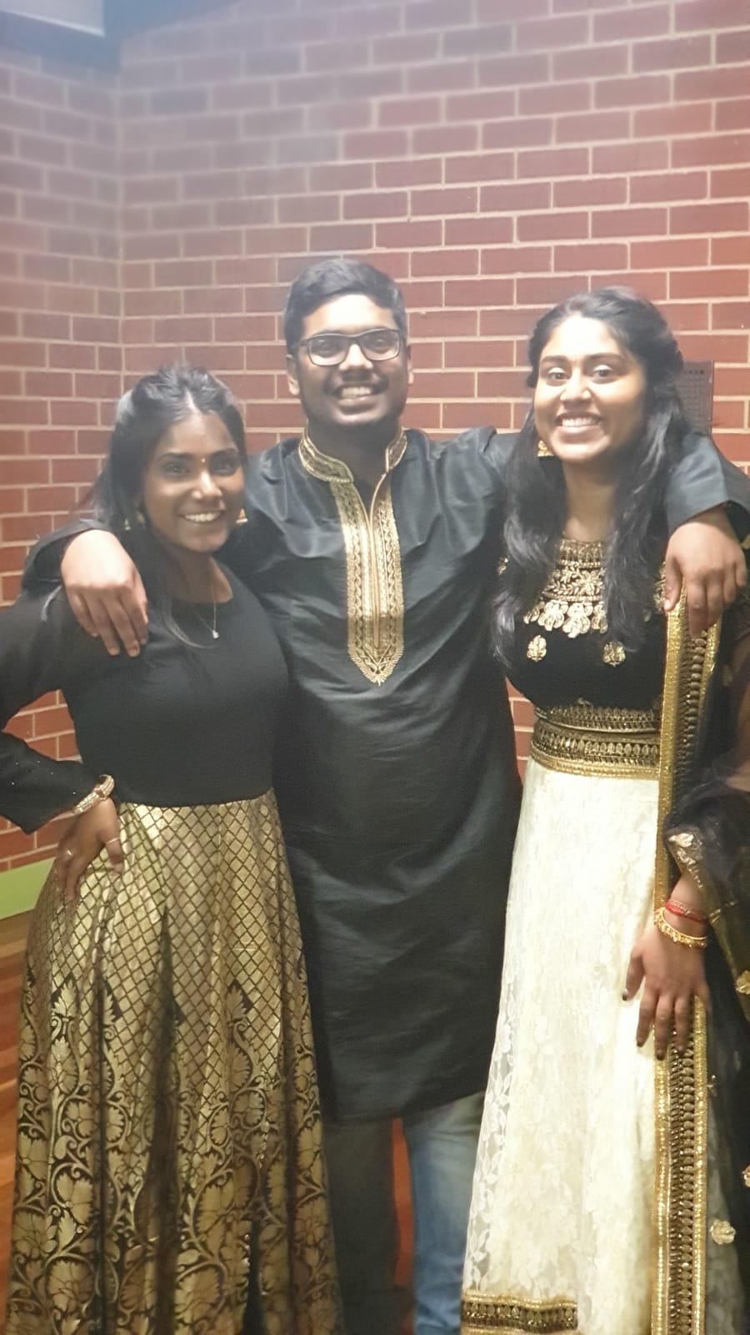
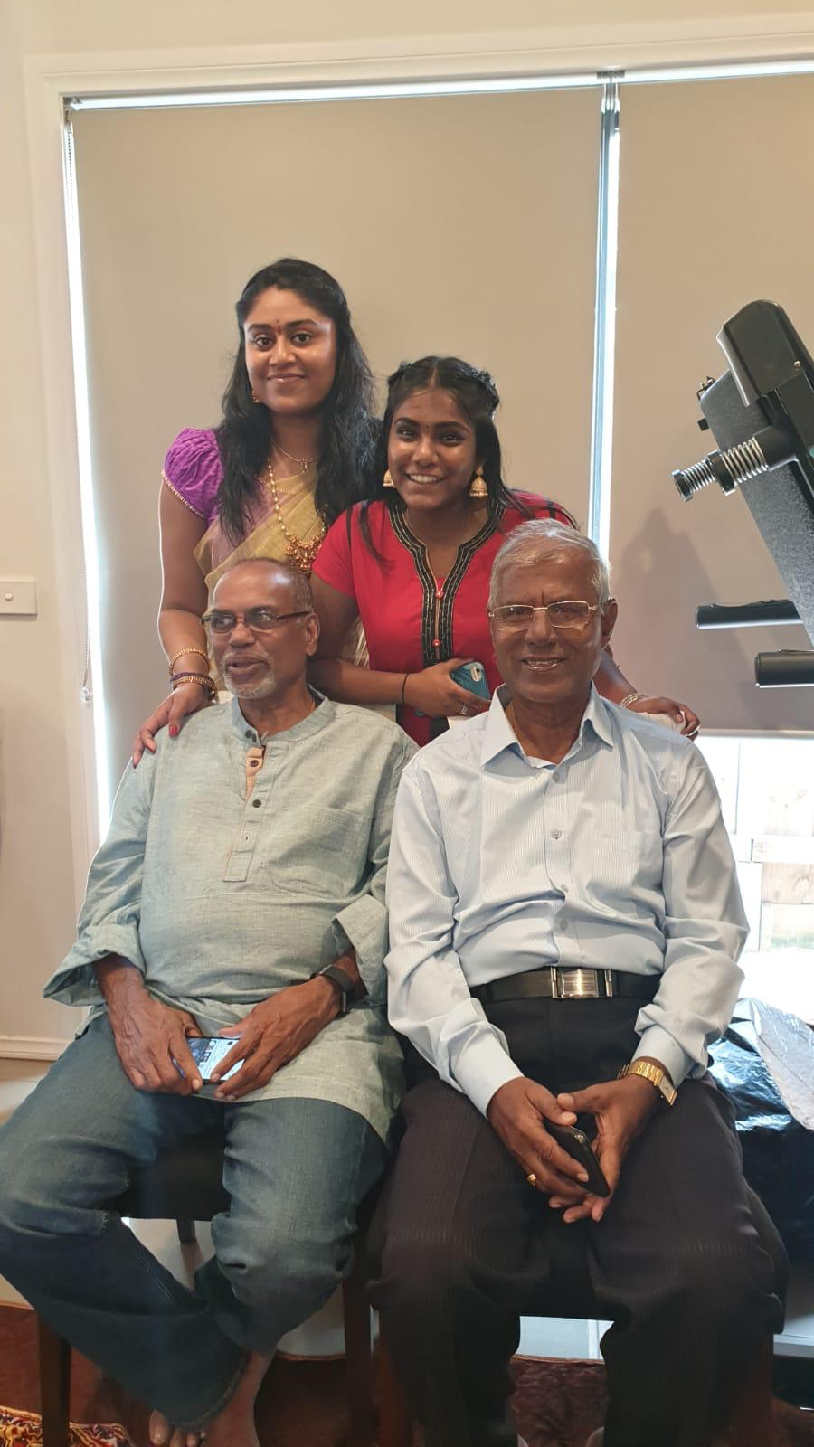

Slide 3
From amma
“Pooja is a very cute angel bestowed as a boon in our family, born with full of beauty bringing lots of happiness to us and her grandparents. She is bit sensitive and emotional at times. She cares for her parents and her sibling as well. I would say Vishnu is very lucky to have her as an elder sister in all aspects. She has made me feel very proud in many instances. Pooja is not only my daughter but also a mother, father and a good friend for me. My whole hearted wishes and blessings that God give her all the happiness and good health. May all her wishes and dream come true.”

Slide 4
From appa
Pooja 'an angle ' whom i always wish to see her with smile, residing in my heart forever. I am blessed since the day born and today she being with us as a pillar of four, filled with joy and noble thoughts from every side. Once again pooja, health is wealth and knowledge is power.
Good luck
Best wishes from lovely dad

Slide 5

From Pruthvic
Pooja, you are truly incredible! Happy 21st Birthday to one of the most sincere, genuine and caring people I've come across in a long time. You know very well how our friendship has evolved from uni days to now and I think this is a testimony of how genuine you really are. I only wish the best for you on this auspicious day until forever. May you excel in all your endeavours (studies, music, dance etc.) and continue to hit new feats every single time.
Many happy returns of the day you amazing hooman

Slide 6
From Aditi
Dear Pooja,
In the short period of time that I’ve known you, you’ve come to become one of my close friends, a strong support system whom I know I can call out to or rely on for anything. You have blossomed into a wonderful woman (almost paati now) who displays her love camouflaged under a lot of strength and tenacity; providing an ever-helping hand. I hope love and happiness are your constant companions in life. I pray the future only holds the best for you and God gives you the strength to deal with every hurdle and promotion in life with the same beautiful smile on your face! Wishing you a wonderfully happy birthday!
Love,
Aditi

Slide 7
From Agam and Manu and Gobi
Happy birthday Pooja. You are doing so well just keep it going and stay bubbly and happy.
- Manu
Hey Pooja just wanted to wish you a very happy 21st birthday I hope you have the best day and your coming year is flourished with happiness and success in all your endeavours.
- Agam
Hey pooja hope you have an amazing birthday and the best day ever tomorrow. When you held my hand cos I was scared on that ride I really felt like you were family, and cos I really don't have much of one it made me feel so much better.
- Gobi

Slide 8
From Rajan
Dear Pooja,
When I was younger, I always looked for that friend who will be my partner in crime and needless to say, you are that person. Each and every moment that I spend with you, I forget all my worries as you are full of wonder and nothing less of a bundle of joy. You always give me hope that we one day will stand together and achieve great things together whenever I lose confidence in myself. I promise you that we will face life head on, cherish the little things and always remain by each others side always. I am happy that you are in my life. Happy 21st birthday and hope we will annoy each other for another 80 birthdays.
Your best friend,
Rajan

Slide 9
Happy Birthday!

