Slide 1


Slide 2

ACTIVITY
Think outside the box
Using a pencil and paper, please write down as many different uses you can think of for a cardboard box. Try to be as creative as possible! Keep your list for later on in the awards ceremony.
Notes:
PRE-EVENT ACTIVITY
Announcement: Students, before we start the ceremony, please write down as many different possible uses that you can imagine for a cardboard box. They can be as imaginative as you like. There are no right or wrong answers. How long can you make your list?!
Note regarding pre-activity: some Instructors may like to consider turning this into a more involved activity. You could prepare some cardboard boxes on the table and ask student to create things with the resources provide on the table. Cardboard, glue, string etc. Then, later in the presentation you could ask individual students to tell you what they have created.

Slide 3
Notes:
VIDEO
[If you would like to make use of the short video available on the Instructors’ Portal, this can be played prior to the ceremony commencing. If you are not playing the video, please ignore this slide.]
Good morning/afternoon. We will soon commence our ceremony. Before we commence we have a short video to play, with comments from students about their learning at Kumon.

Slide 4
Notes:
Welcome ladies and gentlemen, boys and girls, parents and students, to the Kumon _______ Education Centre Awards Ceremony.

Slide 5

Kumon ________ Education
Centre Awards Ceremony
Notes:
I would like to say a special thank you to all families for taking the time to attend our ceremony today.
2018 has been a great year of learning at the Kumon _________ Education Centre. Today, we are proud to recognise the progress that all students have made this year.

Slide 6

Notes:
Students, as well as celebrating the progress you have made, today is also about recognizing the effort and perseverance you have put in to your Kumon this year. I’m sure you would agree, that Kumon is about more than maths and English …

Slide 7

Notes:
It’s also about learning how to face challenges, and discovering how good it feels when you put in the effort to overcome them. It gets students ready for the future challenges to come, whether they be in Kumon or not.

Slide 8

TRAIN YOUR BRAIN
Notes:
5.1 Training Your Brain
Today, I’d also like to ask you to think about how you can use the skills you have gained in Kumon to train your brain even further!
Now, has anyone heard of the term ‘brain plasticity’? (As for a show of hands). Also known as ‘neuroplasticity’, this is a term that refers to the brain's ability to change and adapt as a result of experience.

Slide 9
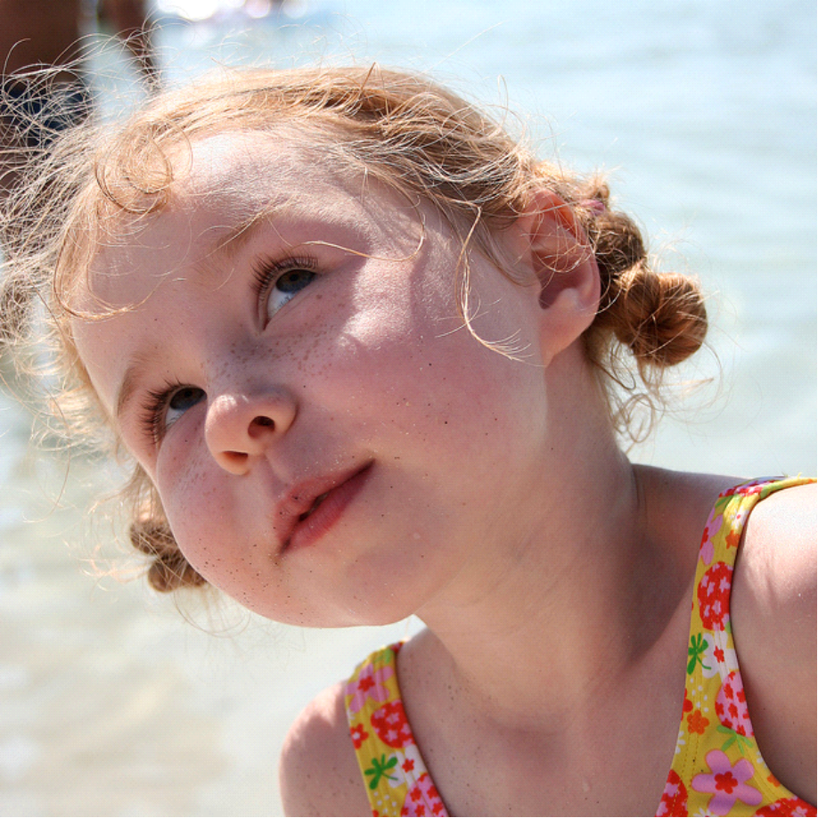
Notes:
Up until the 1960s, researchers believed that changes in the brain could only take place during in babies and in childhood. Modern research has shown that the brain continues to create new neural connections and pathways, even in adults.
So, how can we ensure that our brains continue to learn and grow?

Slide 12

Kumon International Standard
Notes:
Let’s start by handing out the awards for Kumon International Standard.
Kumon International Standard (or KIS), is an internal international benchmark set by Kumon. It is approximate to school grade level.
The KIS award recipients are:

Slide 13
ASHR
Notes:
We will now present the awards for students receiving an award for reaching the Advanced Student Honour Roll, or ASHR.
Students achieve ASHR when they reach a level at least six months ahead of Kumon International Standard.
The ASHR award recipients are:

Slide 14
ASHR 2 YEARS AHEAD
Notes:
I’m proud to now present the awards for the students receiving an award for ASHR 2 Years Ahead.
Students achieve 2 Years Ahead when they reach a level in the worksheets at least two years ahead of Kumon International Standard.
The award recipients are:

Slide 15
ASHR 3 YEARS AND ABOVE
Notes:
I’m proud to now present the awards for the students receiving an award for ASHR 3 Years Ahead.
Students achieve 3 Years Ahead when they reach a level in the worksheets that is at least three years ahead of Kumon International Standard.
The award recipients are:

Slide 16
COMPLETION OF PROGRAMME
Notes:
I’m proud to now present the awards for the students receiving an award for Completion of a Kumon Programme.
Kumon recognises students who complete a whole Kumon programme, up to the end of Level O in Mathematics, and Level L in English.

Slide 17

Notes:
Please join me in congratulating all students!

Slide 18
THANK YOU!
Notes:
We have talked a lot about student achievement, but I’d like to take a moment to recognise the efforts and dedication of parents in the support you have provided to your children’s Kumon this year. [CLICK] Let’s give a round of applause and a special THANK YOU to all parents.

Slide 19

Notes:
For most children, the long summer holiday is a time to play, read, dream, and discover. For Kumon students, it can also be a time to consolidate learning at a time when the daily routine is less busy. Families, if you’re going away on holiday, I’d be happy to discuss some options that would best suit you and your children’s learning, in order to achieve the goals that we have set for 2019.

Slide 20

CENTRE HOURS - DECEMBER
CENTRE HOURS - JANUARY
Notes:
The Centre will be [open during the holidays] / [closed over these dates] so, students, please tell me what challenge you want to overcome this school holidays and we’ll plan for you to go back to school with that feeling that you can achieve anything!
[Note: Instructors, for this slide you may prefer to include your last centre day for 2018 and first day for 2019]

Slide 21

GREAT SUMMER READS
Notes:
Speaking of summer, I encourage you all to participate in Kumon’s Great Summer Reads competition. To enter, children need to complete the following steps:

Slide 22

What’s your favourite book?
Take a photo
‘Why is this your favourite book?’
Share the photo and answer on Facebook
Tag it with #kumonreads
Notes:
Identify your favourite book
Take a photo of yourself with your favourite book, and answer the question ‘Why is this your favourite book?’
Share the photo on Facebook, and tag it with #kumonreads
Include your answer to the question in the comments area.
Winners will be announced on the Kumon Australia New Zealand Facebook page in February.
We hope you have a wonderful time reading, dreaming and learning over summer

Slide 23

It’s how far you have come and what’s still possible that counts.
Notes:
So, parents and students, today we have celebrated the progress that children have made in the program this year. Before I conclude, one important point I would like to make is this: I believe it is not about where you are in the program now that matters, it is about the progress you have made. It’s how far you have come and what’s still possible that counts.

Slide 24
Notes:
That brings us to the end of our awards ceremony today. Parents, thank you for all your support to your children’s learning at Kumon this year. Students, thank you for all the effort you have put into your worksheets this year. We look forward to seeing you achieving your learning goals in 2019.

