Slide 1












Every child can shine!

Slide 2
Ceremony Guidelines
Registration in the reception is mandatory
Only one parent to accompany the child to give the award
The children will be taken to the photo booth after receiving the award.
The next group of parents/ children to move and get seated in the front row when the previous group is receiving the award.
Food should not be consumed within the event hall
Kindly remain seated throughout the ceremony
Mobiles in Silent Mode, Please
A BIG THANK YOU !!!
Every child can shine!

Slide 3

Let the Celebrations
begin!
Every child can shine!

Slide 4
Kumon AWARDS
Shining Star
Kinder and Pre-Kinder Students demonstrating excellent reading ability and numerical skills
Every child can shine!

Slide 5
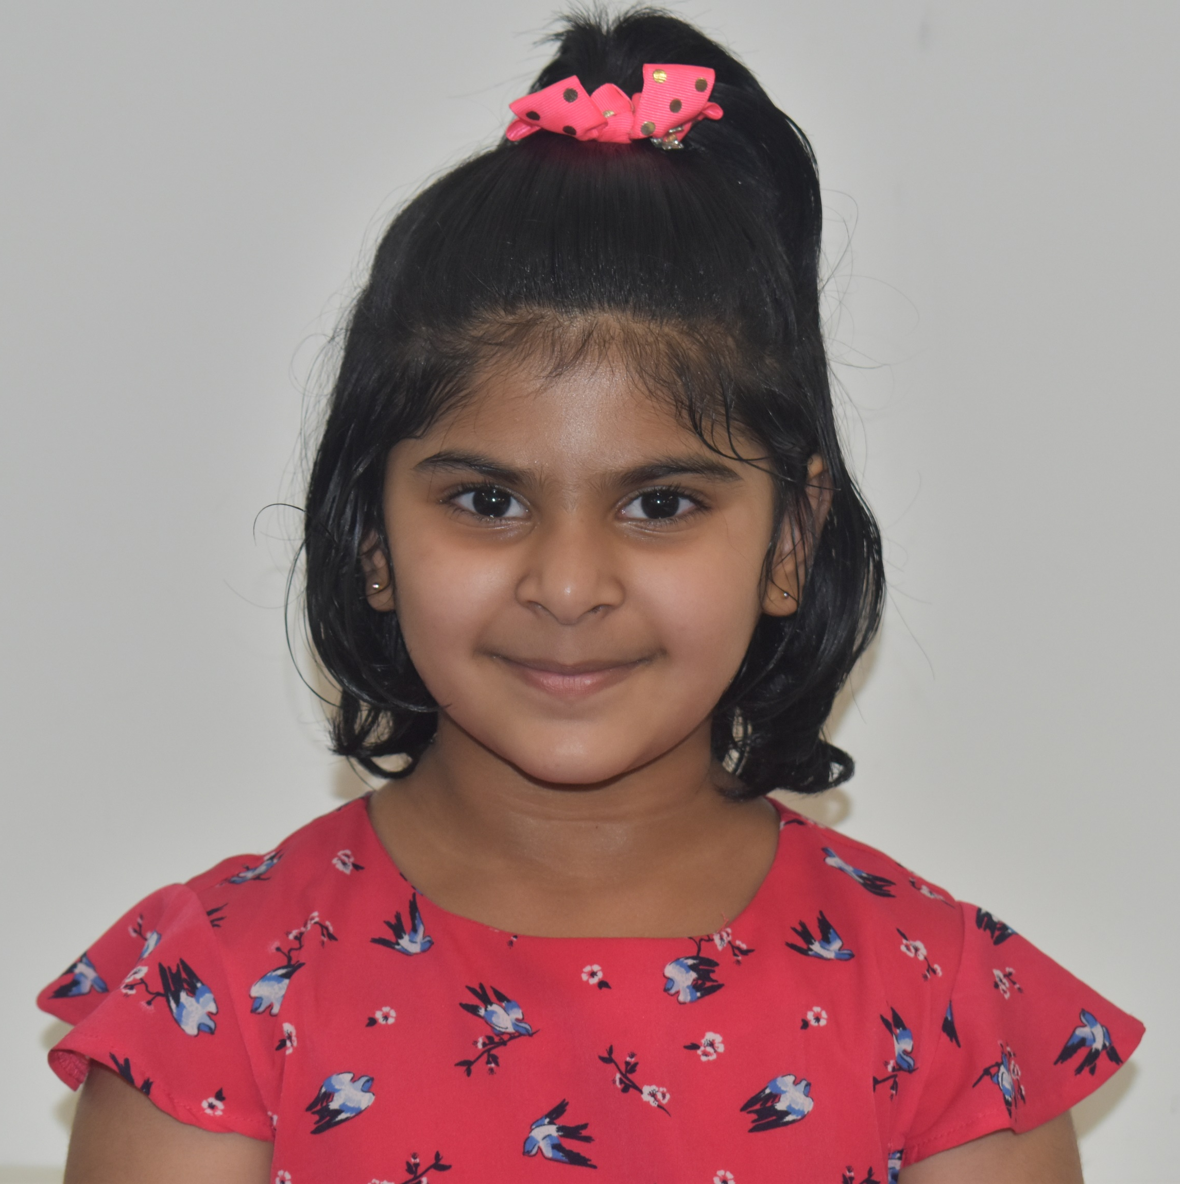
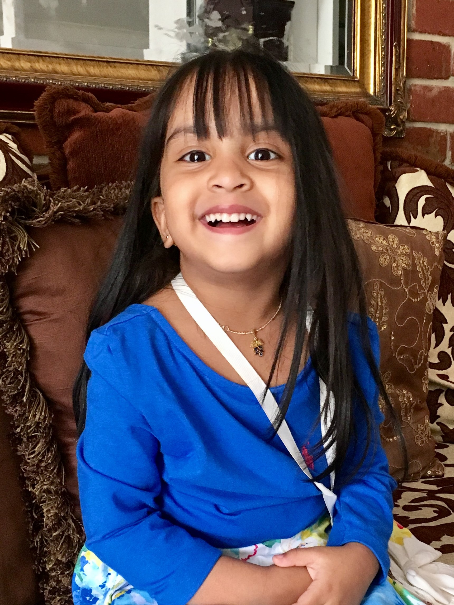
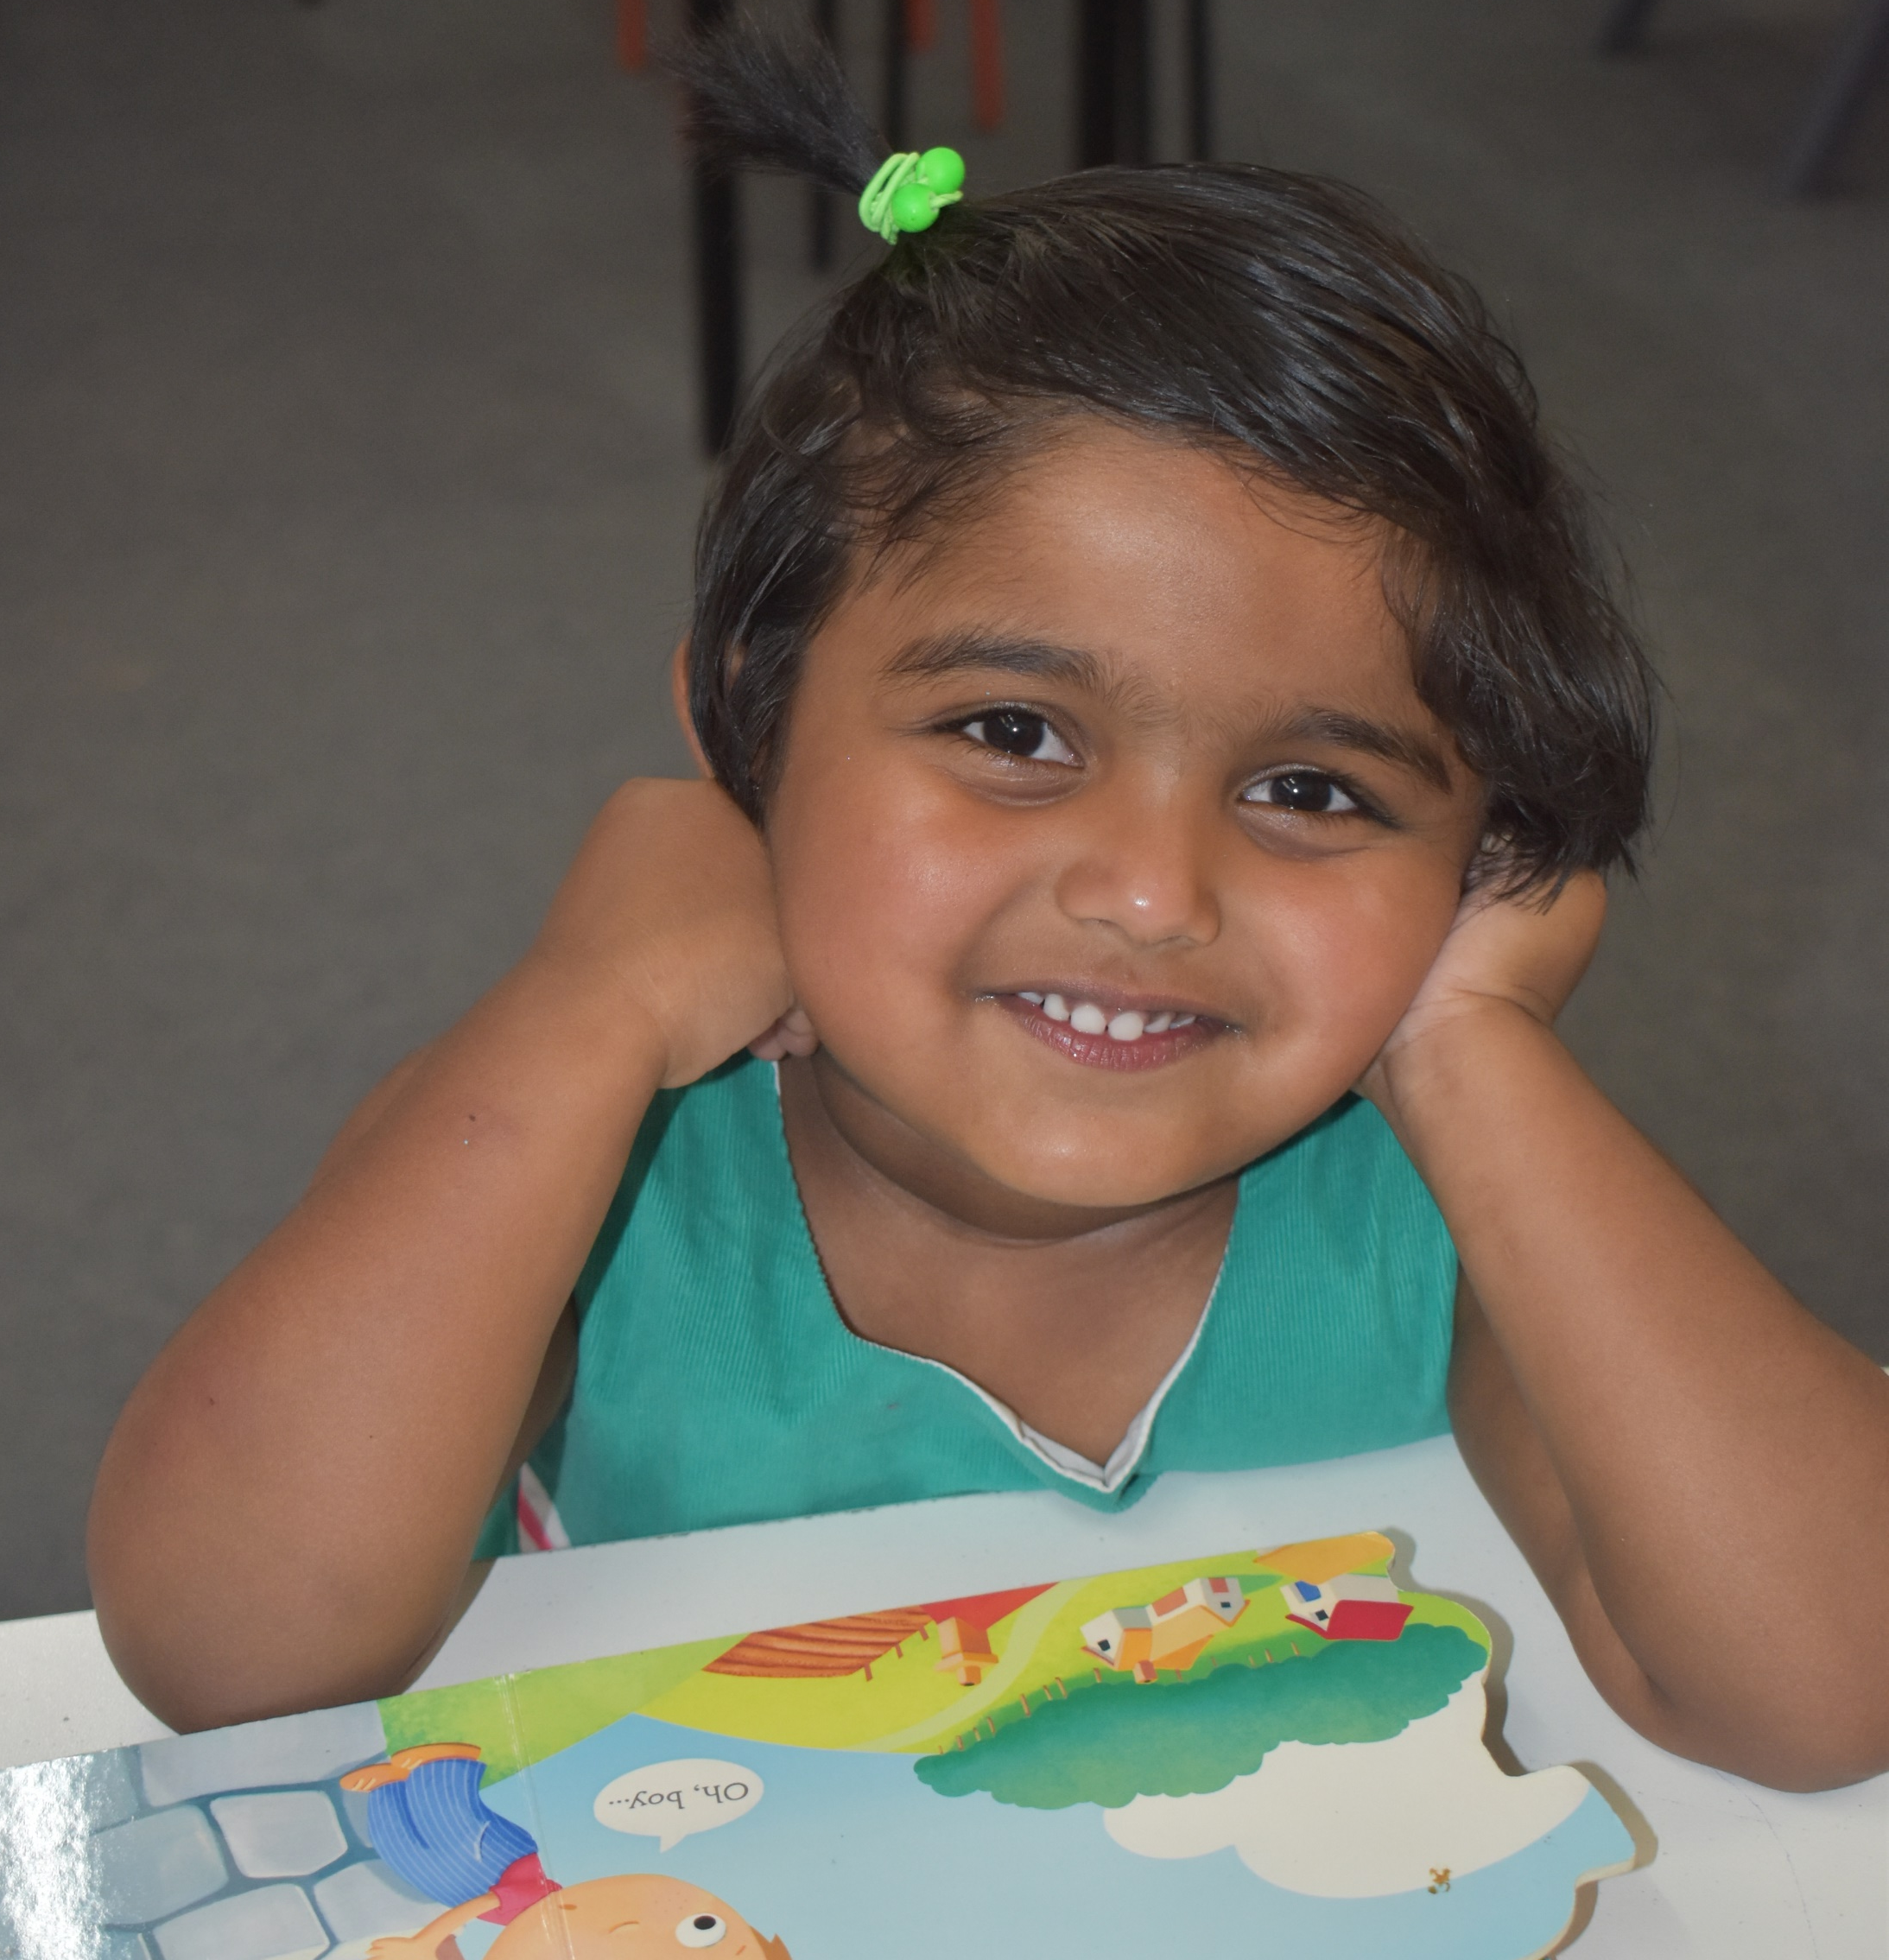
AADHYA AATHAVAN
ASHR / ASHR 2
MARCO MIRACOLA
KIS
ALEENA RINCE
SHINING STAR
HARSHA HARISH
KIS/ASHR 2
CURTIS BENZO
KIS/ ASHR 3
AADHYA AATHAVAN
ASHR / ASHR 2
MARCO MIRACOLA
KIS
Every child can shine!

Slide 6
AADHYA AATHAVAN
ASHR / ASHR 2
MARCO MIRACOLA
KIS
ALEENA RINCE
SHINING STAR
HARSHA HARISH
KIS/ASHR 2
CURTIS BENZO
KIS/ ASHR 3
AADHYA AATHAVAN
ASHR / ASHR 2
MARCO MIRACOLA
KIS
Every child can shine!

Slide 7
Building Focus & STAMINA
lEARNING HOW TO learn
Strong Foundation
Daily Study Practice MASTERY
Individualised for Every Child
Parents Involvement
Nurture Growth Mindset
Resilience to face challenges
Why Kumon?
A Parent’s Perspective
Every child can shine!

Slide 8
Kumon AWARDS
Self Learners
Students who are new to Kumon but learning faster and confident of reaching KIS (Kumon International Standard ) within the first year
Every child can shine!

Slide 9
AADHYA AATHAVAN
ASHR / ASHR 2
MARCO MIRACOLA
KIS
ALEENA RINCE
SHINING STAR
HARSHA HARISH
KIS/ASHR 2
CURTIS BENZO
KIS/ ASHR 3
AADHYA AATHAVAN
ASHR / ASHR 2
MARCO MIRACOLA
KIS
Every child can shine!

Slide 10
Kumon AWARDS
KIS (Kumon International Standard)
Students who studying 6 months ahead of their grade level - First milestone in Kumon
Every child can shine!

Slide 11
AADHYA AATHAVAN
ASHR / ASHR 2
MARCO MIRACOLA
KIS
ALEENA RINCE
SHINING STAR
HARSHA HARISH
KIS/ASHR 2
CURTIS BENZO
KIS/ ASHR 3
AADHYA AATHAVAN
ASHR / ASHR 2
MARCO MIRACOLA
KIS
Every child can shine!

