Slide 1
7A- A monthly meeting
25/05/2021

Slide 2
Goals of April and May
Focus on reading and handwriting
Start doing spelling for 3A and 2A students
Look through all the 3A and 2A maths worksheets and refer to the best practices when instructing
Actively pace the children to reach SCT and build stamina to complete 10 pages
Participate in group chats and end of day meetings to build a strong culture

Slide 3
Agenda
Review the goals of April and May
How to manage absences effectively?
Setting expectations for new students
7A- 5A process additions / changes
Feedback sheet
Worksheet training (Maths A- B & English 2A- AII)

Slide 4

Reflect on how this job has changed your perception, values and what are you gaining out of this?
Briefly note your answers….

Slide 5
Absences
Brainstorm how could we manage absences effectively?
- Note your ideas in the space below

Slide 6
Setting expectations for new students
Check all the homework
  Name, date and time
  Is the worksheet complete?
  Are there any missing pages or incomplete work?
Should complete full book in class
  (30 mins single subject, 45 mins to 1 hour if double subject)
Give 6 days of Homework with proper labels
Please show the CW to Pooja before sending the child

Slide 7
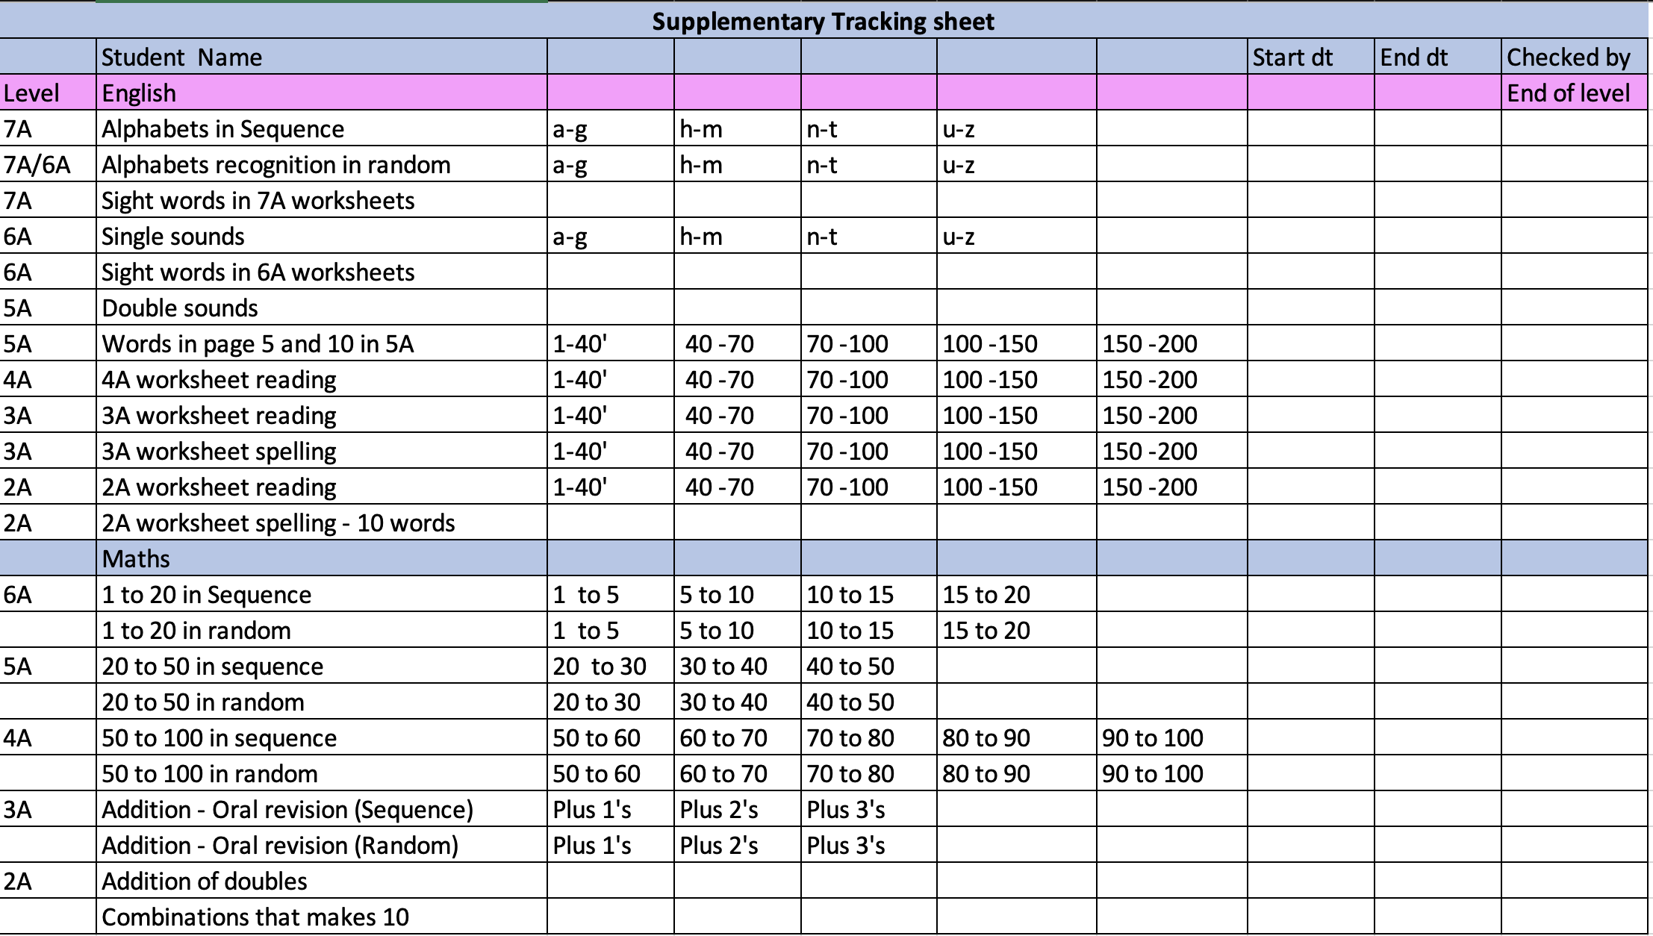
New changes in 7A-5A

Slide 8
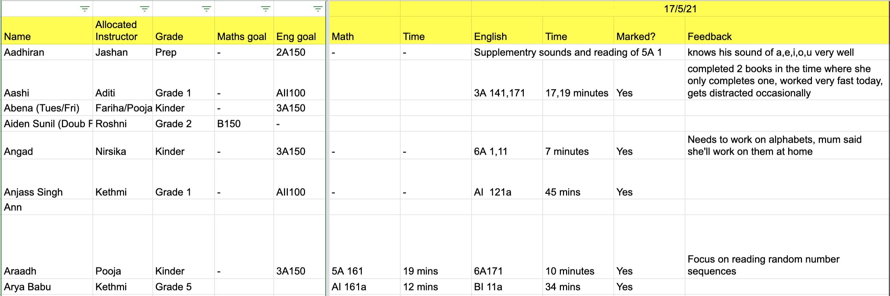
Feedback sheet

Slide 9

Goals for June 2021
1. Focus on reading and handwriting predominantly
2. Participate in group chats and end of day meetings to build a strong culture
3. Complete worksheet training
4. Regular monthly meetings
5. Up to date feedback sheet

Slide 10


