Slide 1
7A- A monthly meeting
24/03/2021

Slide 2

Agenda
Areas of development and potential solutions
Update on the new format of feedback sheet
New additions and changes with respect to 7A-5A students
Goals for the month

Slide 3

Area 1- Reading and handwriting
Solution :
First sheet of every new learning to be taken seriously, done as 1*1 and set new expectations with the child.
That classwork is sent as reference to the parents. Should be done along with assessment of previous level.
Staff to take turns to review CW and HW misses.
CW Miss - Staff training
HW miss - Parent Communication
Being very firm and strict on reading and handwriting.
Maintaining stroke order in 5A
Tracing on the words neatly in 4A / writing words completely in page b
Writing and re-reading in 3A
2A Writing should be written in 4 lines properly
Note: Levels AI and AII are too late to start building/ improving on handwriting.

Slide 4
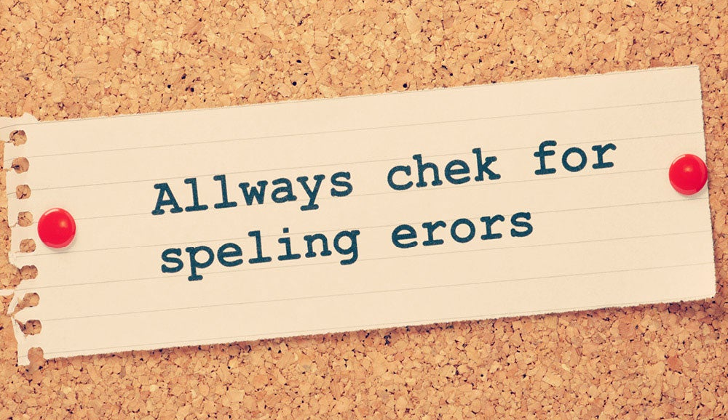
Area 2- Spelling
Solution :
Build attitude for remembering spelling in 3A itself by orally checking spelling or even writing 5 words from the worksheet done.
First page of 2A, Children should read the words 3 times and then write it. If they cannot write the words on page 'b'. Ask students to write 3 times in the first sheet itself. Try to address within the class, within the sheet.
Every 3 sheets, do block reading and spelling in class and move ahead only when satisfactory. Share the spelling sheet on that day with the parent as justification for the repeat.

Slide 5
Area 3- How to teach Levels 3A and 2A maths
Solution :
3A 71
Child should read the instruction and hints. Very important sheet. They should write next number by reading and following instruction and not by the teacher informing them.
3A 131
Start upward counting by touching the '+'and '2' and write answers
Oral revision of +2's before starting classwork
Encourage the child to write from memory without counting.
3A 161
Start upward counting by touching the '+', '3' and '=' and write answers
Oral revision of +3's before starting classwork
Ask the child to remember +2's and write the next number.
Encourage the child to write from memory without counting.
2A 1
Teach sum of doubles from 1+1 up to 9+9
Use printed material of doubles and numbers making up to 10
Move to 2A 11, only when the child is proficient with it
2A 11
Remember +3's and write next number
Oral revision of +4's

Slide 6

Area 4- Building on Stamina and pace
Solution :
Be energetic and enthusiastic so children catch up the energy.
7A-2A students are a complete reflection of their teachers and you need to be a great role model.
Instructor's body language and the tone should set pace and encourage to do it faster without compromising quality
Train children to turn pages by themselves.
Ask children not to wait for marking
Start praising for doing the worksheet within 15 minutes

Slide 7

Area 5 – Building a strong culture
Solution :
Understand misses do happen, but we need to take feedback positively and ensure that it does not recur
Point out misses for peers and improve team teaching quality
Build a culture that we are in it together and finding misses is not to find faults but to continuously improvise to provide the best.

Slide 8
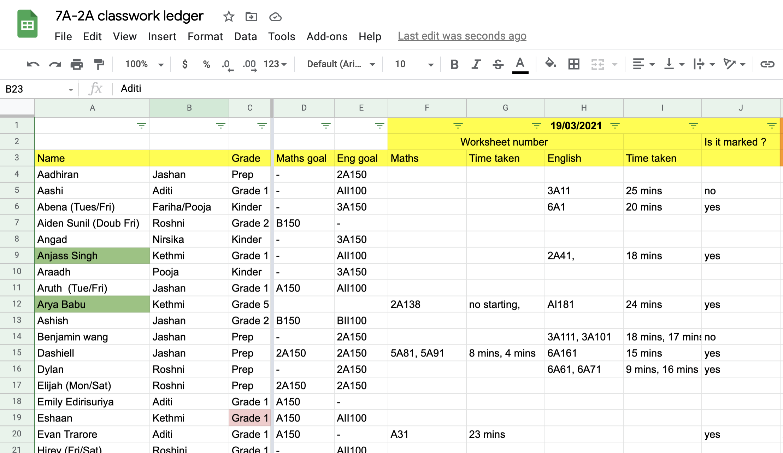
Format of Feedback sheet
Roster of updating the schedule
Check absences and inform
Identify your students and meaningfully take them to KIS
Highlight students who require extra attention

Slide 9

Goals for the month
Focus on reading and handwriting
Start doing spelling for 3A and 2A students
Look through all the 3A and 2A maths worksheets and refer to the best practices when instructing
Actively pace the children to reach SCT and build stamina to complete 10 pages
Participate in group chats and end of day meetings to build a strong culture

Slide 10


