Slide 1



What is your why?
Notes:
One fundamental question each and every person has to answer at some point of their life is “what is your why?”
Why could mean different things to different people, a why for someone could be why they wake up each day, a why for someone else may be why they work at job that is extremely tiring but still continue to do so, a why for someone else might be ….. And today in this presentation I am going to share what my why is

Slide 2


Notes:
My name is Pooja and I am a Monash University graduate, I have completed Bachelor in Commerce, with a double major in Management and accounting.
When I started my degree, I had dreams of becoming an Auditor
I was really entranced by the corporate job and the corporate world, hence I really wanted to join one of the big 4 companies
At the same time as I started my degree, I had an opportunity to do a Cadetship at DOXA.
At Doxa, I was given a glimpse into the corporate life and whilst it excited me initially, I soon lost interest.
WHY? I felt that the job did not align with what my reason for being is.

Slide 3

“The grand essentials to happiness in this life are something to do, something to love, and something to hope for”
-Washington Burnap
Notes:
So why is aligning the job we do to our purpose of being important?
Only if we recognize what our why is, we will do something we love, we will do something the society needs and do something that makes a difference at the end of the day. This concept has been covered by a Japanese philosophy called “IKIGAI”

Slide 4
IKIGAI
IKI (EE-KI)
means
“life”
GAI (GUY)
means
“purpose”
IKIGAI
roughly translates to
“purpose of life”
Notes:
So, today I am going to present about what my Ikigai is? But, before that what is Ikigai?
Ikigai is a Japanese word where “Iki” means Life and “Gai” means Purpose
Together, the word roughly translates to purpose of life
Everyone has Ikigai, but the greatest challenge is to discover it
Practicing Ikigai is proven to enrich an individual's personal life and the lives of others around them
Ikigai enables an individual to find contentment in life and the day-to-day tasks

Slide 5
IKIGAI
What you really love
What the world needs
What I can use to earn a livelihood
What you are good at
Notes:
In 2011, Andres Zuzunaga, a Spanish author, came up with this particular Venn Diagram which has now been widely adopted as a tool to find one's Ikigai.
This author believed that one's Ikigai is the intersection of four aspects of life which is
What you love
What you are good at
What you can use to earn a livelihood
What the world has a need for.
One of the best ways to learn a concept is through stories and I would like to share my journey of how I found my IKIGAI .
If all these four things happen and they come together, You have found your “IKIGAI”.

Slide 6


What you really love
Notes:
The first place you start at is what am I good at?
My strengths are:
1. High interpersonal skills
2. Technical knowledge in finances
3. Measuring and developing suggestions based on a business KPI
4. Taking complex concepts and distilling them into simple, understandable concepts

Slide 7
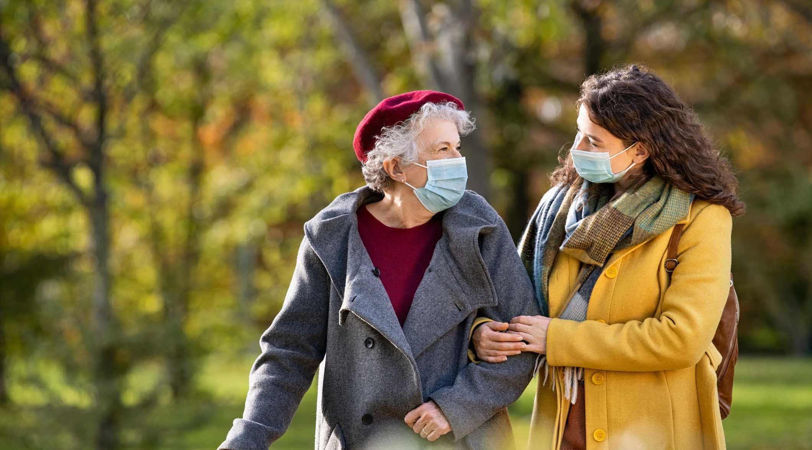

What you are good at
Notes:
From my story…..
What I love doing: is I like to help people. I gain happiness in helping people and that is what I have wanted to do. I have a passion for working with children and teaching.

Slide 8
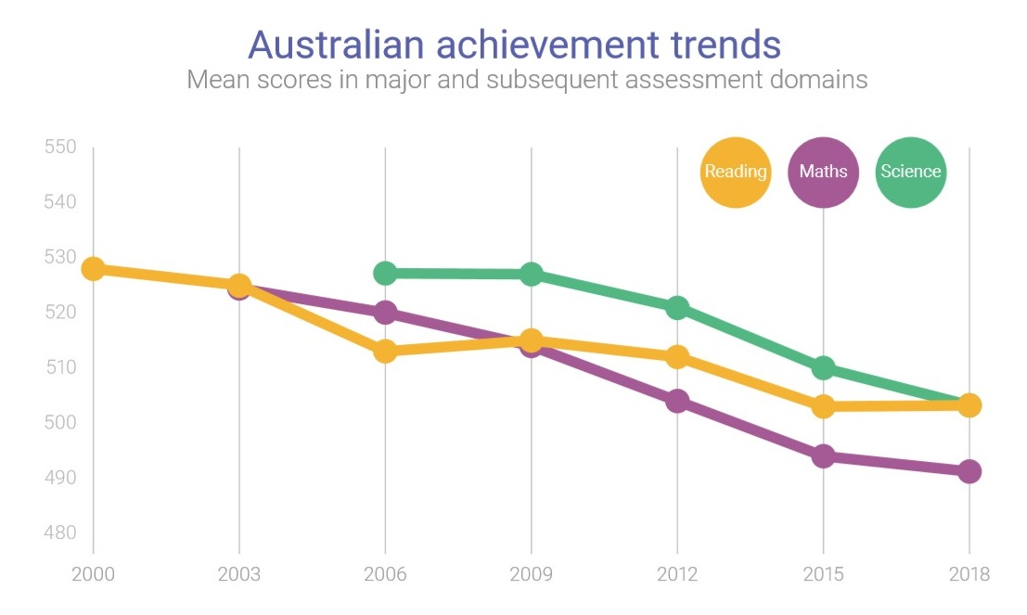

What the world needs
Notes:
The third step in the IKIGAI process is What the world needs?
So in my story, I found that as a recent graduate, I am recounting my experiences as a student. In many situations, I have seen students fear approaching an assignment or task that was deemed to be hard. They lacked the motivation and didn't know how to break down the task into smaller and manageable tasks and at the same time, literacy and numeracy levels are dropping in Australia and there is an urgent need to bridge this to reach international standards. As a person who started my education in India, I understand the value of practice and repetition.

Slide 9


What I can use to earn a livelihood
Notes:
In the fourth and final core component of IKIGAI, it is about the what can earn a decent livelihood. So in my journey, my possible career option is teaching and I believe Kumon is the right platform for me.

Slide 10
Lesson I learnt ….
The real joy in life comes from finding your true purpose and aligning it with what you do every single day.
And that is why I am here today!
Notes:
Only if we recognize what our purpose is, we will be able to attain real joy in life and do something that makes a difference in the world at the end of the day. This is why I think Kumon is the perfect fit for me

Slide 11


