Slide 1

Notes:
My name is Pooja and I am a Monash University graduate, I have completed Bachelor in Commerce, with a double major in Management and accounting.
When I started my degree, I had dreams of becoming an Auditor
I was really entranced by the corporate job and the corporate world, hence I really wanted to join one of the big 4 companies
At the same time as I started my degree, I had an opportunity to do a Cadetship at DOXA.
At Doxa, I was given a glimpse into the corporate life and whilst it excited me initially, I soon lost interest.
WHY? I felt that the job did not align with what my reason for being is.

Slide 2
IKIGAI
The purpose of life
“IKI” means life, “GAI” means purpose
Notes:
So, today I am going to present about what my Ikigai is? But, before that what is Ikigai?
Ikigai is a Japanese word where “Iki” means Life and “Gai” means Purpose
Together, the word roughly translates to purpose of life and I am going to share with you what my Ikigai is.

Slide 3
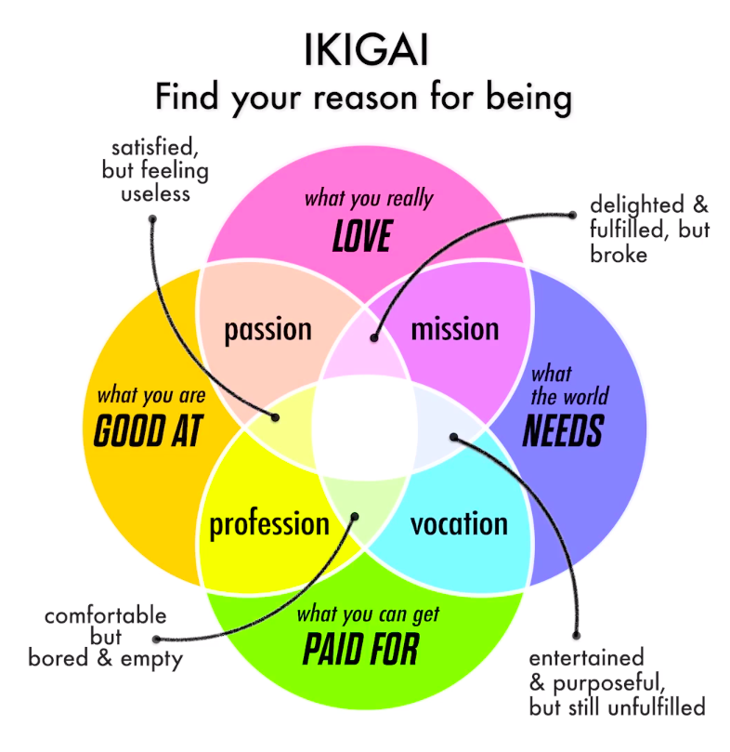
Notes:
In 2011, Andres Zuzunaga, a Spanish author, came up with this particular Venn Diagram which has now been widely adopted as a tool to find one's Ikigai.
This author believed that one's Ikigai is the intersection of four aspects of life which is
What you love
What you are good at
What you can use to earn a livelihood
What the world has a need for.

Slide 4
I have a passion for teaching children
I enjoy spending time refining and introducing new concepts to children
WHAT I LOVE DOING?

Slide 5
I have been taking classes for the students of various ages from the past 4 years
I am reasonably good in managing a section of
WHAT I AM GOOD AT?

Slide 6
WHAT CAN I EARN A LIVELIHOOD FROM ?

Slide 7
WHAT THE WORLD NEEDS ?

Slide 8
“The real joy in life comes from finding your true purpose and aligning it with what you do every single day.”
LESSON I LEARNT…..
And that is why I am here today!
Notes:
This is why I think Kumon is the perfect fit for me

