Slide 1
Kinematics
Exercise 22C
Constant Acceleration

Slide 2
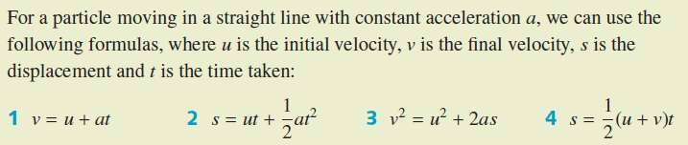
Constant acceleration
If an object is moving due to a constant force (for example, gravity), then its acceleration is constant. There are several useful formulas that apply in this situation.
These four formulas are very useful, but it must be remembered that they only apply when the acceleration is constant.
When approaching problems involving constant acceleration, it is a good idea to list the quantities you are given, establish which quantity or quantities you require, and then use the appropriate formula. Ensure that all quantities are converted to compatible units.

Slide 3
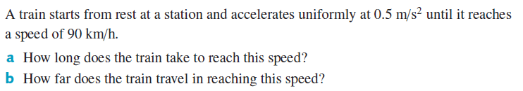
Example 1

Slide 4
Example 1 (continued)

Slide 5
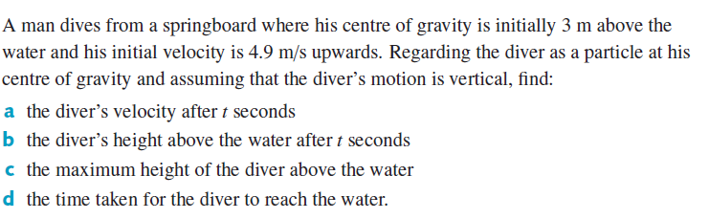
Example 2

Slide 6
Example 2 (continued)

