Slide 1
Kinematics
Exercise 22B
Applications of antidifferentiation to kinematics

Slide 2
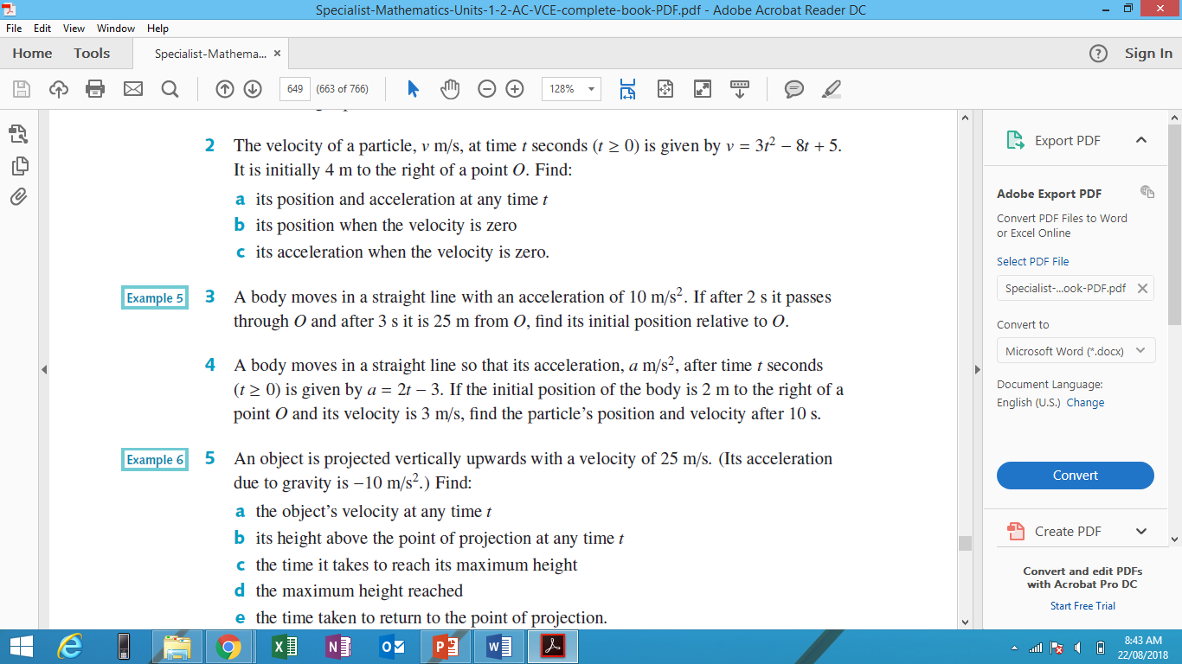
Example 1

Slide 3
Example 2

