Slide 1
Kinematics
Exercise 22A
Position, velocity and time

Slide 2

Kinematics
Position
Displacement

Slide 3



Kinematics
Velocity
Speed

Slide 4
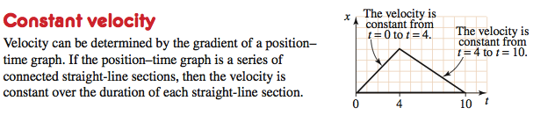

Kinematics
Constant velocity
Position expressed as a function of time

Slide 5
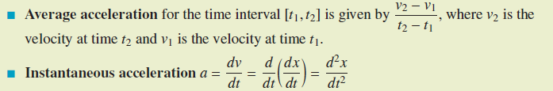
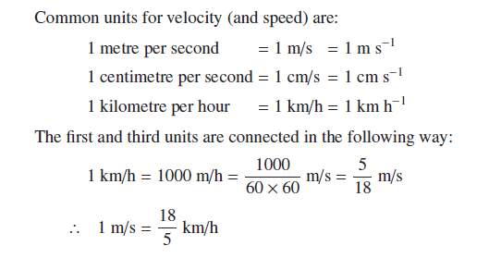
Kinematics
Acceleration
Units of measurement

Slide 6
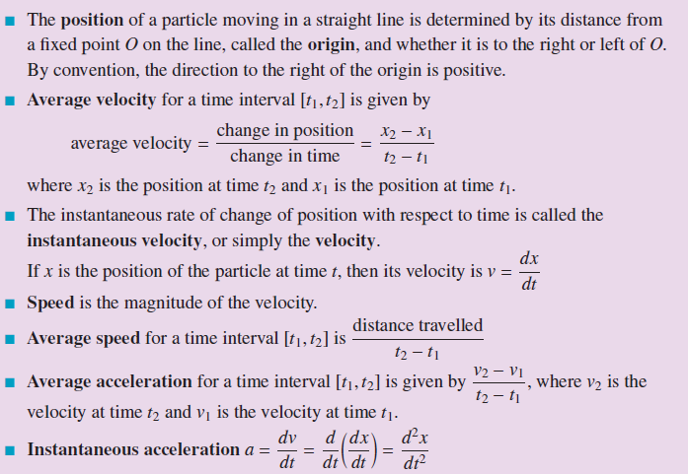
Terminology

Slide 7


Example 1
The following position-time line shows a particle which moves from S to A in 2 seconds, then from A to F in 3 seconds. Find:

Slide 8
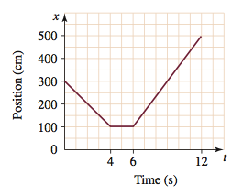

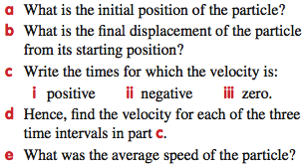
Example 2

Slide 9
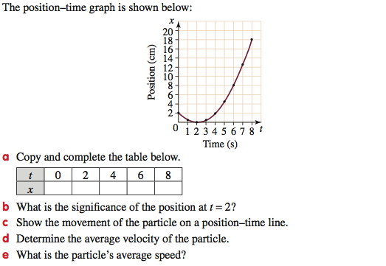
Example 3

Slide 10
Example 3 (continued)

Slide 11
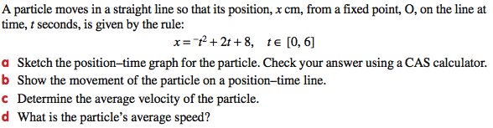
Example 4

Slide 12
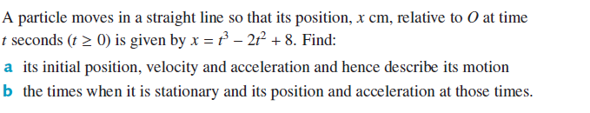
Example 5

