Slide 1
Specialist Mathematics
Antidifferentiation
Reference:
Williams, R., Nolan, J., Karanikolas, N., et al. (2013). Maths Quest 11, Mathematical Methods CAS (3rd ed.). Qld, Australia: Jacaranda.

Slide 2
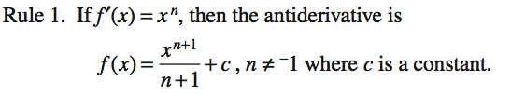
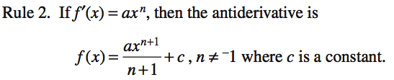

Rules of Antidifferentiation

Slide 3

Antidifferentiation notation

Slide 4
Example 1
Find the antiderivative for each of the following.
a) 8x + 5 b) 1 + x + x² + x³

Slide 5

Example 2

Slide 6
Example 3
a) x(3x – 4) b) (x + 2)(x² – 2x + 4)

Slide 7


Example 4
Find the following.
a) b)

Slide 8
Example 5
Find the antiderivative of (3x – 5)³.

