Slide 1
Exercise 9A
Points, lines and angles
Specialist Mathematics 11

Slide 2
Points, lines and angles
Point:
In geometry, a point is used to indicate position.
Line:
In the physical world, we may illustrate the idea of a line as a tightly stretched wire or a fold in a piece of paper. A line has no width and is infinite in length.
Plane:
A plane has no thickness and it extends infinitely in all directions. We make the following assumptions about points and lines:
Given a point and a line, the point may or may not lie on the line.
Two distinct points are contained in exactly one line.
Two distinct lines do not have more than one point in common.

Slide 3
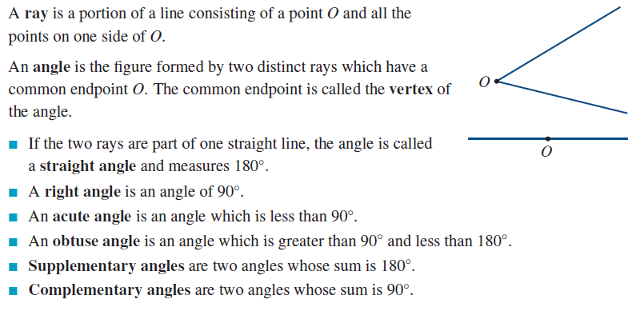
Angles

Slide 4
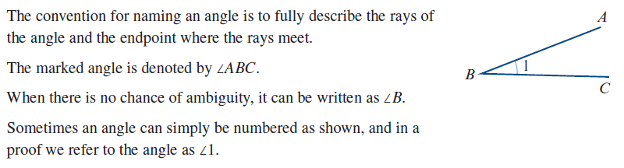
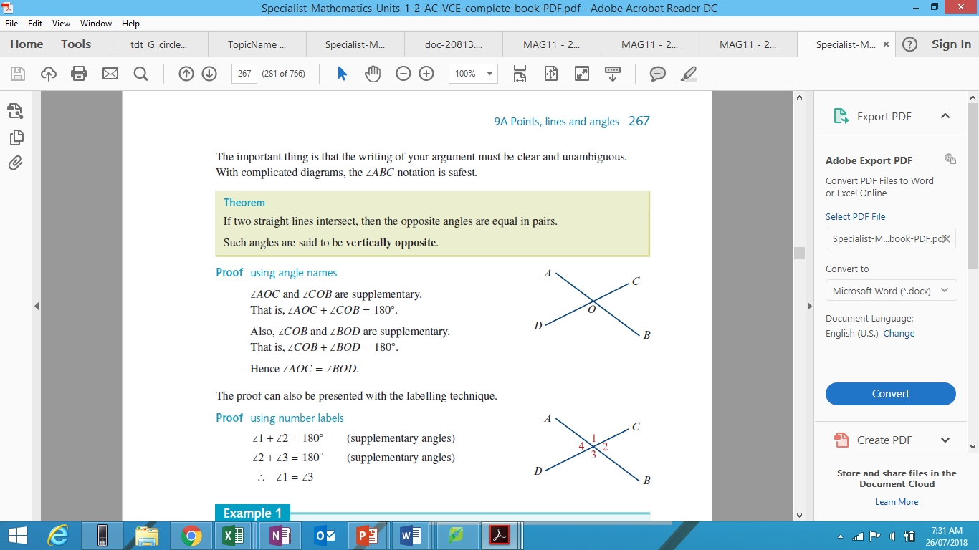
Naming angles

Slide 5
Vertically opposite angles

Slide 6
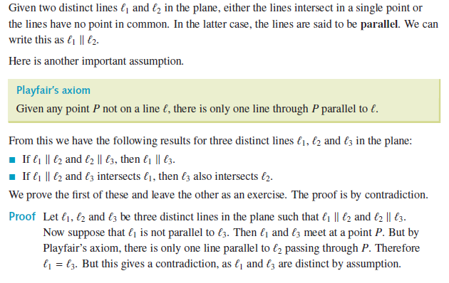
Parallel lines

Slide 7
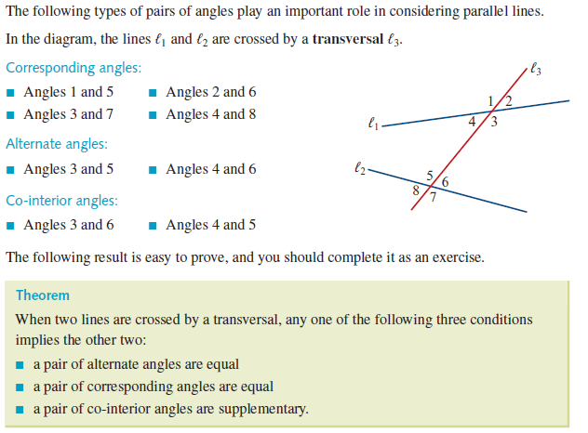
Corresponding, alternate and co-interior angles

Slide 8
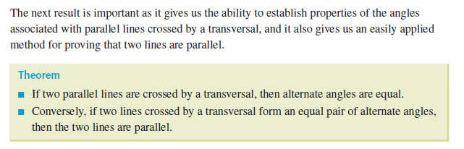
Corresponding, alternate and co-interior angles

Slide 9
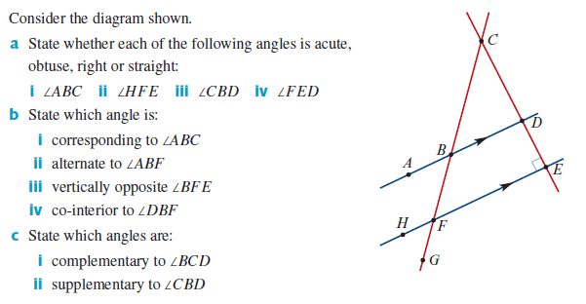
Example 1

Slide 10
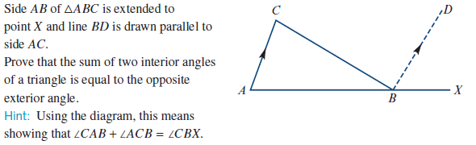
Example 2

Slide 11
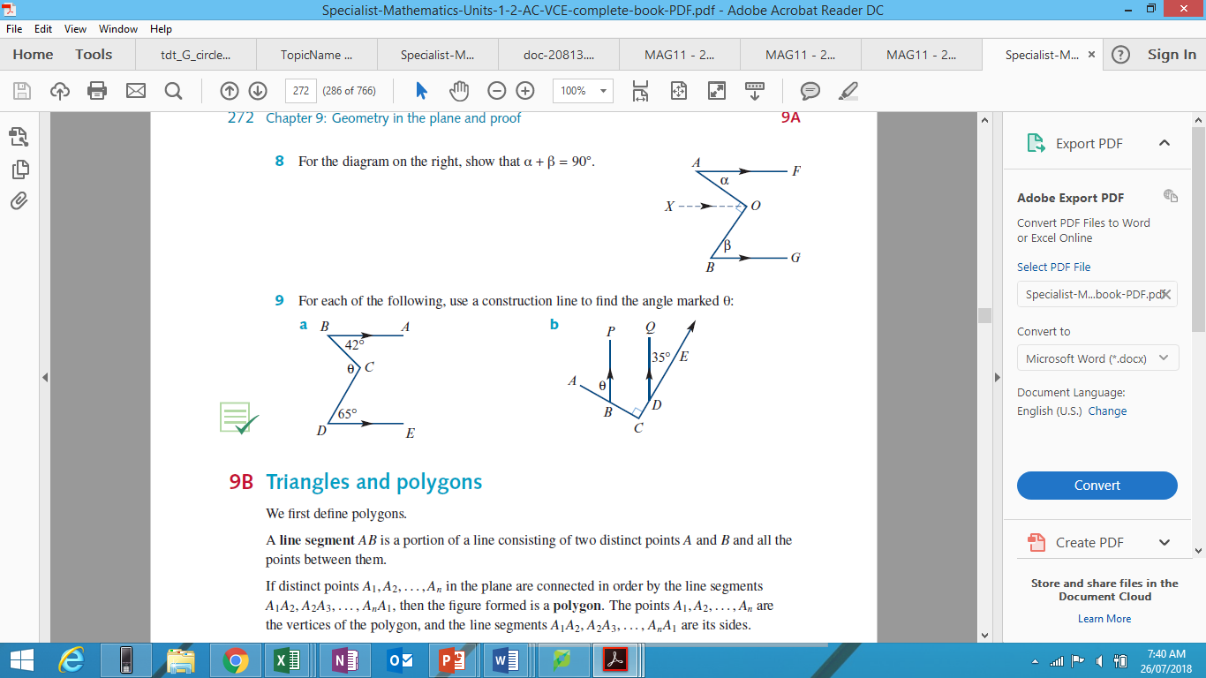
Example 3
For the following, use a construction line to find the angle marked:
a) b)

Slide 12
Example 3
For the following, use a construction line to find the angle marked:
a) b)

