Slide 1
Cystic Fibrosis
By - Vishnu Sivakumar

Slide 2
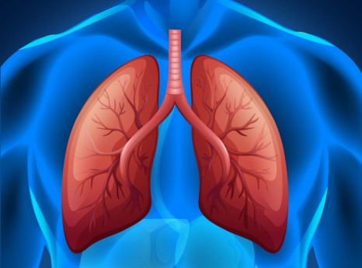
Information on Cystic Fibrosis
The birth of the Cystic Fibrosis disorder.
Affected population.

Slide 3
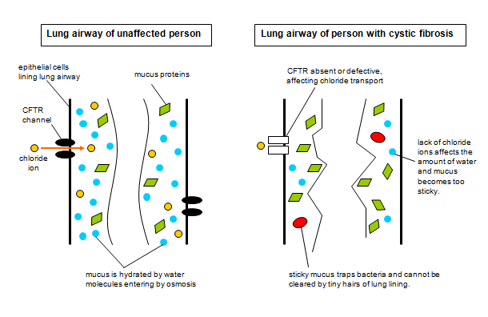
Effects and Symptoms
Persistent Coughing
Salty tasting skin
Shortness of breath
Wheezing
Poor weight gain
Difficulty in Bowel Movements
Lung infections
Inability to conceive

Slide 4
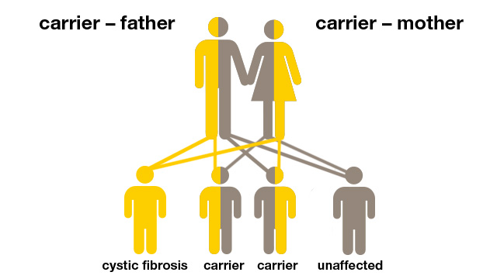
Cause of the Disorder
Passed down from ancestors.
Chromosomal abnormality on the 7th chromosome.

Slide 5
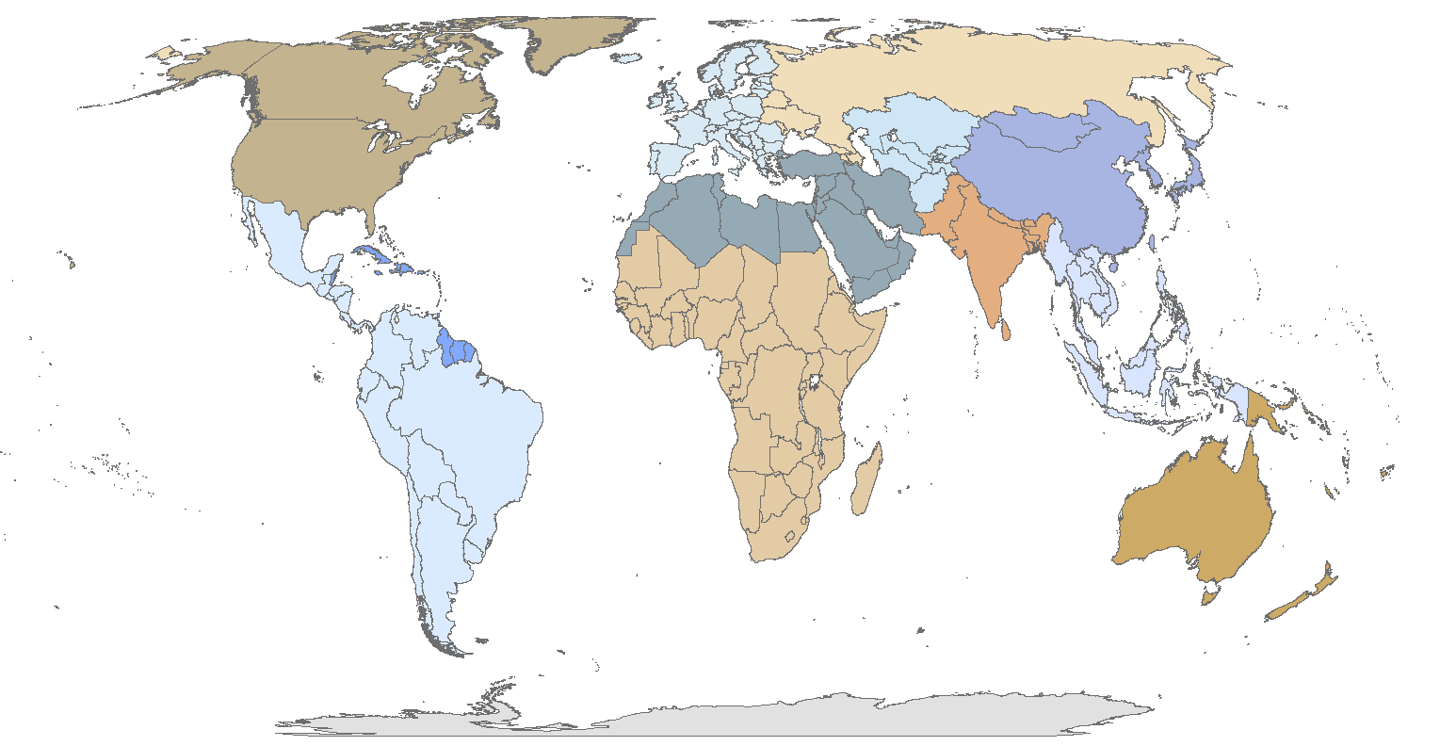
Affected Regions/people
Caucasians
Europeans
Ashkenazi Jewish race /ethnicity

Slide 6

THANK YOU
By – Vishnu Sivakumar

