Slide 1
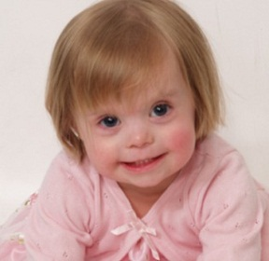
DOWN SYNDROME
By: Pooja Sivakumar

Slide 2
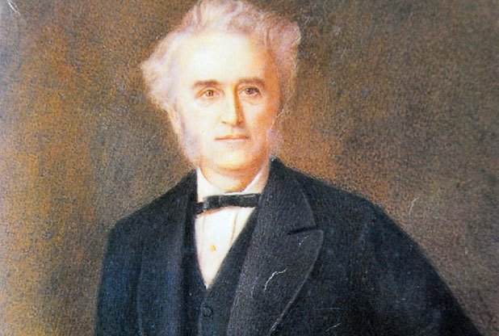
What is the name of the Genetic Disorder and where did the name originally come from or does it have another name?
The genetic disorder is Down Syndrome. It was named after Dr Langdon Down, the doctor who first described its features in 1866. There are 3 types of Down Syndrome, Trisomy 21, Mosaic and Translocation Down Syndrome but the hereditary one is the latter.

Slide 3
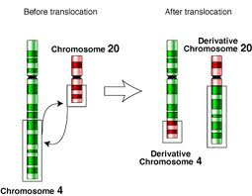
Where is the chromosomal abnormality found within the 23 pairs of chromosomes?
Babies with Translocation down Syndrome also have an extra part of a chromosome number 21, attached to another chromosome, which usually is chromosome number 14.

Slide 4
What are the effects of this Genetic Disorder physically and/or mentally?
Children with Down syndrome always go forward with their development but at a slower rate and your child in adulthood would need more help than the average person. Children with Down Syndrome will also have a longer period of Cognitive development. Eyes that slant upwards. Tiny folds covering the inner corners of the eyes (epicanthic folds).
Small white flecks on the iris (Bushfield spots).
A small nose with a broad, flat bridge.
A small mouth which makes the tongue appear large.
Small low set ears.
A single crease on the palm of the hand.
Short hands and fingers. Inclining pinkie.
Wider gap between the big toe and second toe.
A slightly flattened appearance of the back of the head.

Slide 5
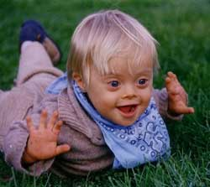
What percentage of the population are affected (or incidence rate) by this Genetic Disorder?
About 1 in every 600 babies are born in developing countries and 1 in every 1000 born in developed countries has Down syndrome.
4% of Down Syndrome are of translocation with the symptoms being the same as Trisomy 21.
Despite a growing trend towards women having children later in life, the annual rate of Down syndrome births in Australia is remaining fairly constant due to advances in prenatal screening.

Slide 6

How is this Disorder passed down from one generation to the next (is it autosomal/sex-linked, etc.)?
Translocation Down Syndrome an Autosomal Disorder. It is the only type of Down Syndrome that is hereditary.
If an egg or sperm cell may gain an extra copy of chromosome 21. If one of these atypical reproductive cells contributes to the genetic makeup of a child, the child will have an extra chromosome 21 in each of the body's cells.

Slide 7
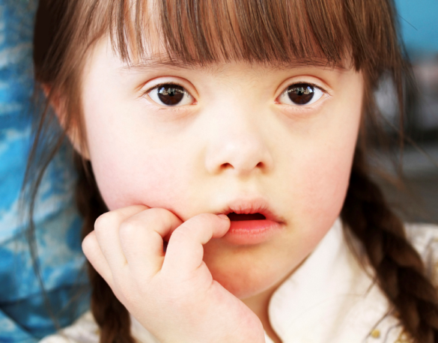
Can this Disorder be treated? If so, how? Is there any treatment available for the Disorder? Explain.
Down syndrome itself cannot be prevented by special medicine or medical prevention since it is caused by a change in the chromosomes. Neither can this change be reversed in an individual with the disorder. Down syndrome cannot be cured.

Slide 8
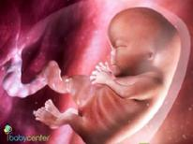
Can this Disorder be diagnosed prenatally (before birth) or after birth? Explain how either or both can be done.
A routine maternal blood screening to determine the risk of the baby of having Down syndrome can be performed at 15 - 20 weeks of pregnancy but detects only about 60% of all cases. Another prenatal test is called an amniocentesis and is 98% accurate. This test is usually performed at the 15th or 16th week of pregnancy, but in certain cases it is done as early as 13 weeks or as late as 22 weeks.

Slide 9

Bibliography
Website 1
http://www.downsyndrome.org.za/
Website 2
https://www.genome.gov/19517824#4
Website 3
Down Syndrome the facts Book

Slide 10
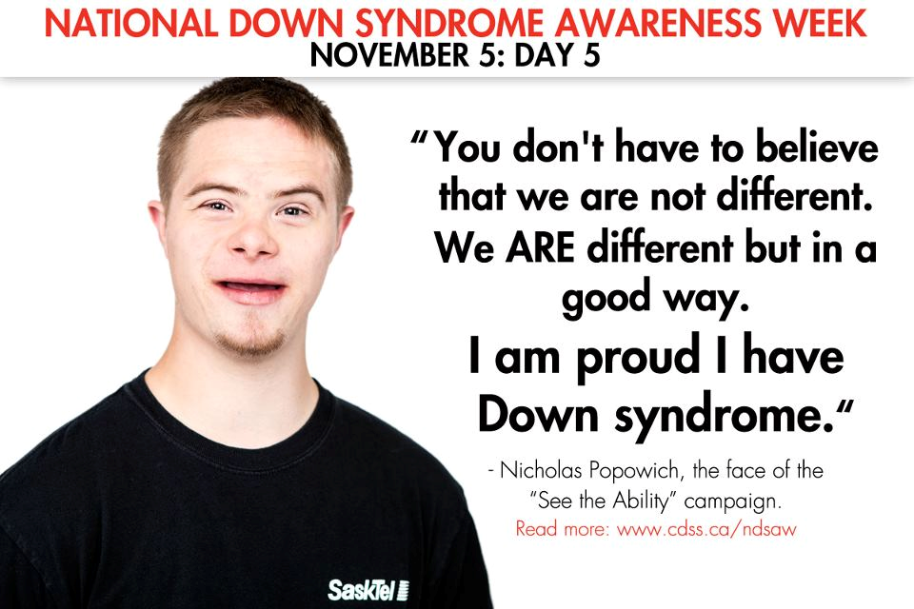
Thank You
By: Pooja Sivakumar

