Slide 1

Color blindness
Pooja Sivakumar

Slide 2

What is the name of the genetic disorder and where did it originally come from or does it have another name?
Color blindness is the name of the genetic disorder. Colour blindness (colour vision deficiency, or CVD) affects approximately 1 in 12 men (8%) and 1 in 200 women in the world. In Britain this means that there are approximately 2.7 million colour blind people (about 4.5% of the entire population), most of whom are male.
There are different causes of colour blindness. For the vast majority of people with deficient colour vision the condition is genetic and has been inherited from their mother, although some people become colour blind as a result of other diseases such as diabetes and multiple sclerosis or they acquire the condition over time due to the aging process, medication etc.

Slide 3

Where is the chromosomal abnormality found within the 23 pairs chromosomes?
Human beings have 23 pairs of chromosomes. Out of these 23 pairs 22 are autosomal chromosomes which are equal in both sexes and encode body functions. Only one pair consists of two sex-chromosomes which are different for men and women. The 22 pairs of equal chromosomes are numbered from 1 through to 22. The sex-chromosomes are labelled with X and Y, whereas women carry the combination XX and men the combination XY. This all sums up in a total of 46 chromosomes which make the human genome.
Human Karyotype
Colour blindness was actually the trigger to start mapping the human genome. It all began in 1911, when red-green colour blindness was assigned to the X chromosome. This was based upon the observation that colour blindness is passed from mothers to their sons. Thereby the women are usually not affected because of the normal copy, the second X chromosome. Men in contrary can not oversteer the defective chromosome, because they are carrying just one X chromosome.

Slide 4
Chromosomal Abnormality
Type | Chromosome
Deuteranomaly | X Chromosome
Deuteranopia | X Chromosome
Protanomaly | X Chromosome
Protanopia | X Chromosome
Tritanomaly | Chromosome 7
Tritanopia | Chromosome 7
Blue Cone Monochromacy | X Chromosome
Rod Monochromacy | Chromosome 2/8

Slide 5

How is this disorder passed down from one generation to the next (is it autosomal or sex-linked, etc)?
Colour blindness is a common hereditary (inherited) condition which means it is usually passed down from your parents.
The 23rd chromosome is made up of two parts – either two X chromosomes if you are female or an X and a Y chromosome if you are male. The faulty gene for colour blindness is found only on the X chromosome. So, for a male to be colour blind the faulty colour blindness gene only has to appear on his X chromosome. For a female to be colour blind it must be present on both of her X chromosomes.
If a woman has only one colour blind gene she is known as a ‘carrier’ but she won’t be colour blind. When she has a child she will give one of her X chromosomes to the child. If she gives the X chromosome with the faulty gene to her son he will be colour blind, but if he receives the ‘good’ chromosome he won’t be colour blind.
A colour blind boy can’t receive a colour blind gene from his father, even if his father is colour blind, because his father can only pass an X chromosome to his daughters.

Slide 6
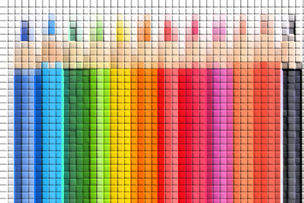
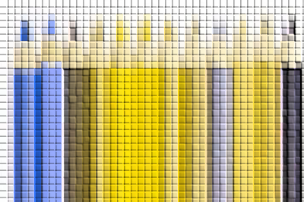
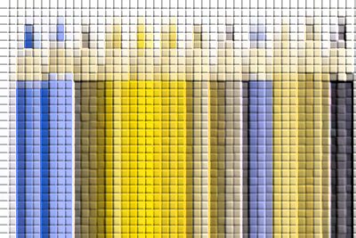

Types of color blindness:-
NORMAL VISION
DEUTERANOPIA
PROTANOPIA
TRITANOPIA

Slide 7
Bibliography
Sources:
1.colour Blindness
http://www.uic.edu/com/eye/LearningAboutVision/EyeFacts/ColorBlindness.shtml
2. Living with colour Blindness
http://www.colour-blindness.com/solutions/living-with-colour-blindness/
3.colour Blindness Limitations
http://www.colour-blindness.com/general/dangers/
4.colour Blindness and Testing in Children
http://www.laurenscharff.com/courseinfo/SL2000/color_blindness.html
5.colour Blindness
http://www.bbc.co.uk/dna/h2g2/A883523
6. Living with colour Blindness
http://www.eyedoctorguide.com/eye_problems/living_with_color_blindness.html
http://www.colourblindawareness.org/colour-blindness/
http://www.colorblindness.com/2006/06/02/chromosomes-involved-in-color-blindness/

Slide 8

Thank-you

